Slide 1
Welding Skills
  Flexible Manufacturing

Slide 3
Welding
  The term welding means joining two or more pieces of metal together along an edge or surface. This is done by heating the metal to a melting point and letting the metal fuse together to form one piece.

Slide 4
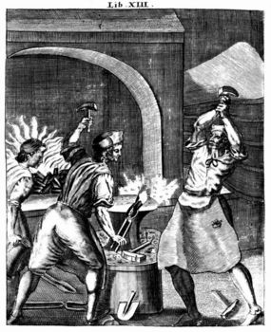
Blacksmith Welding
  Blacksmiths would heat two pieces of metal to a white hot, then use a hammer to forge them together.

Slide 5
Theory of Shielded Metal Arc-Welding
  Shielded Metal Arc-Welding is the process of arc welding. The American Welding Society has changed the term used. This is also called stick welding or arc welding.
  This is the use of an electric arc for heating the base metal and a fluxed rod for the filler.

Slide 6

Shielded Metal Arc-Welding
  When the electricity passes through the fluxed rod or electrode an arc is struck between the metal to be welded and the electrode.
  This arc heats the metal and electrode causing the pieces to melt and fuse together.

Slide 7
Shielded Metal Arc-Welding Equipment
  Welding equipment is sized by current type and duty cycle.
  The welder can be both direct current (DC) or alternating current (AC).
  DC welding equipment can be powered with a gas engine to be able to use it in the field.
  DC welding equipment produces a wider range of amperages for welding thicker materials.

Slide 8
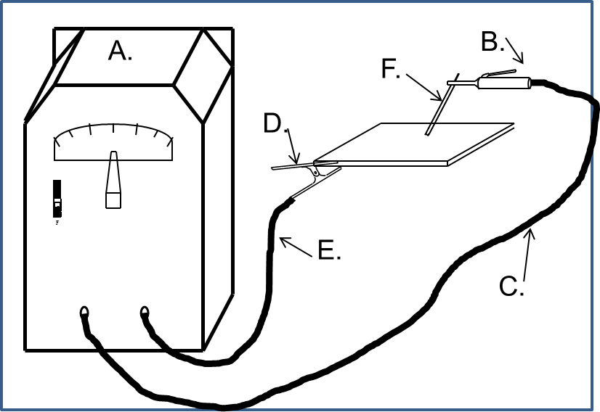
Shielded Metal Arc-Welding Parts
Power source and control
Electrode holder
Electrode cable
Ground clamp
Ground cable
Electrode

Slide 9
Welding Duty Cycle
  The duty cycle is the time the welder can be used at a specific current level in a 10 minute period.
  For example: 60% at 150 amps is the continuous use for 6 minutes of welding at 150 amps of power. Then the machine needs 4 minutes to cool down to protect it from overheating.

Slide 10
Electrode
  An electrode is a metal rod covered with a coating to shield the molten puddle from impurities in the air. This is known as flux.
  Electrodes are classified by diameter, tensile strength, welding current, type of coating and position for use.

Slide 11
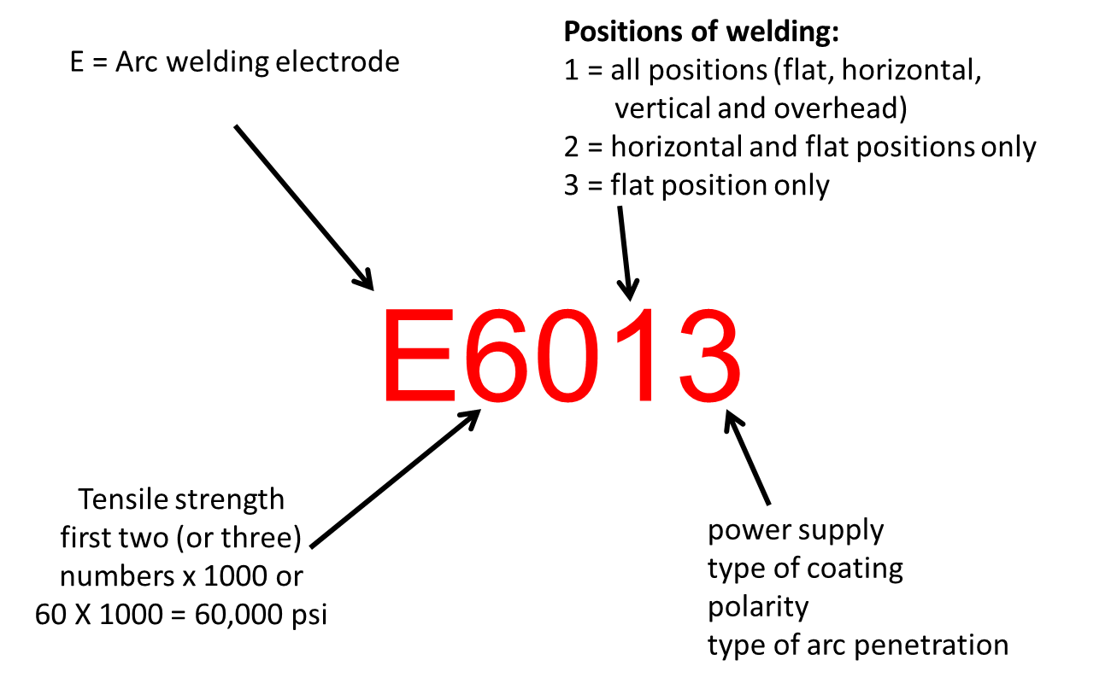
Electrode Classifications

Slide 12
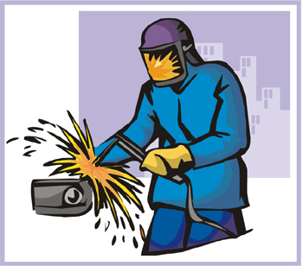
Example of Electrode Classification
  E6013 = 60,000 tensile strength, all position and a coating of titania potassium.

Slide 13
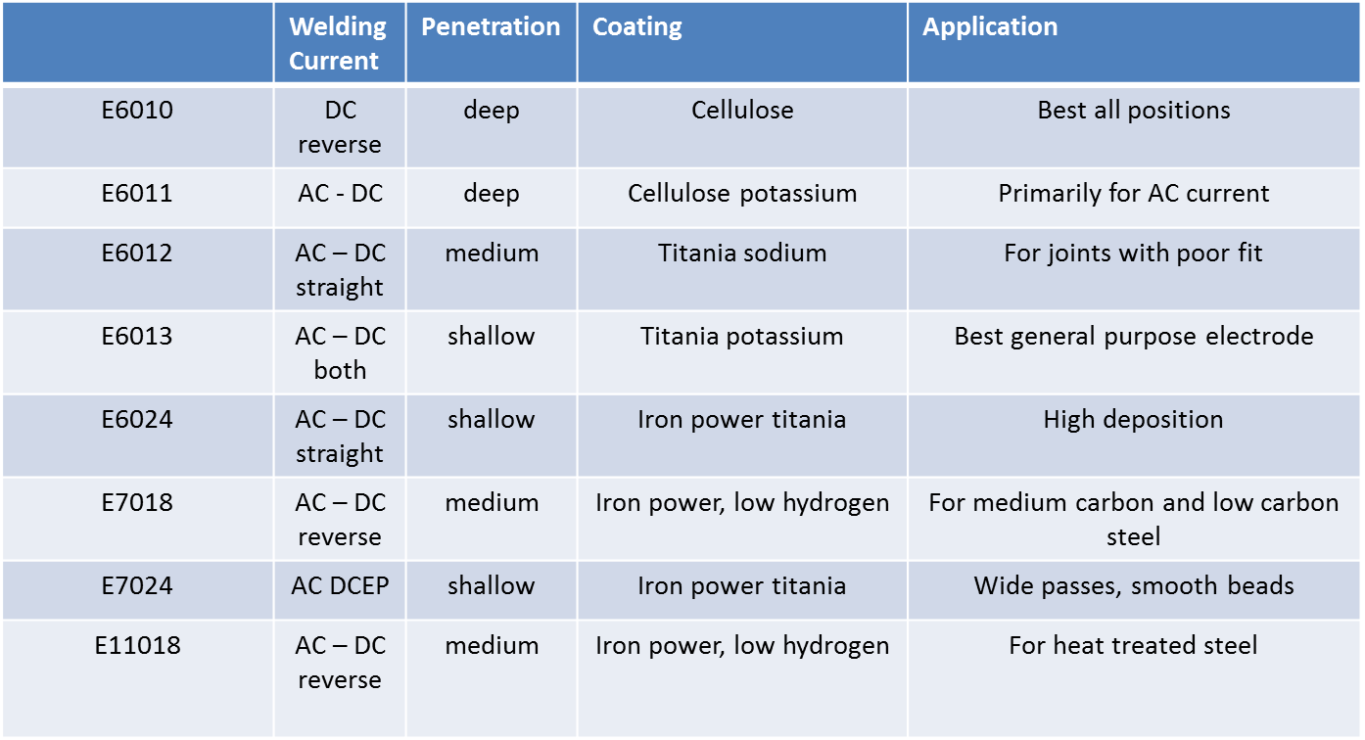
Electrode Classification Chart

Slide 14
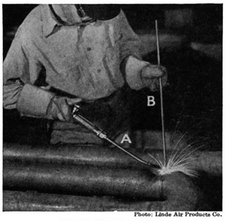
Oxygen-Fuel Welding
  This type uses a torch fueled by acetylene, propane, natural gas, hydrogen or MAPP gas.
  Acetylene is the most popular fuel to use for the welding and cutting because of the amount of heat produced.

Slide 15
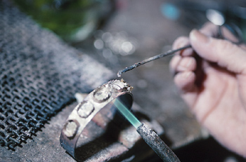
Oxygen-Fuel Welding Rods and Fluxes
  Mild carbon steel rod 1/16 to ¼ inch diameter.
  Bronze rod for brazing with flux.
  Cast iron filler rods with flux.
Notes:
A wire coat hanger can be used as a filler rod for gas welding.

Slide 16
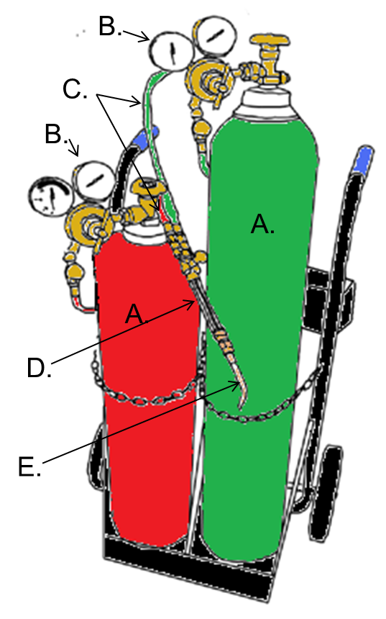
Oxy-Fuel Welding Equipment
Tanks
Regulators
Hoses
Torch handle
Torch tip

Slide 17
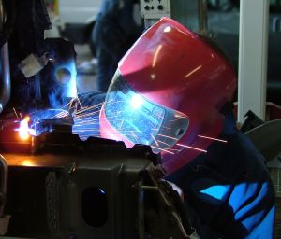
Plasma Cutting Processes
  Plasma is an ionized gas that will conduct electricity.
  The gas is compressed air, and electricity is added through an electrode. The more electricity, the hotter the plasma arc becomes.
  The plasma rushes from the torch forcing the molted metal from the cut.

Slide 18
Plasma Cutting Processes
  The arc is concentrated in the torch tip and this heats the metal and forces the molten metal from the cut.
  The plasma cutter will cut any material that conducts electricity.
  The plasma cutter will cut metal up to 2” in thickness or down to sheet metal thickness.
  The cuts are clean with little or no material stuck to the back of the cut.

Slide 19
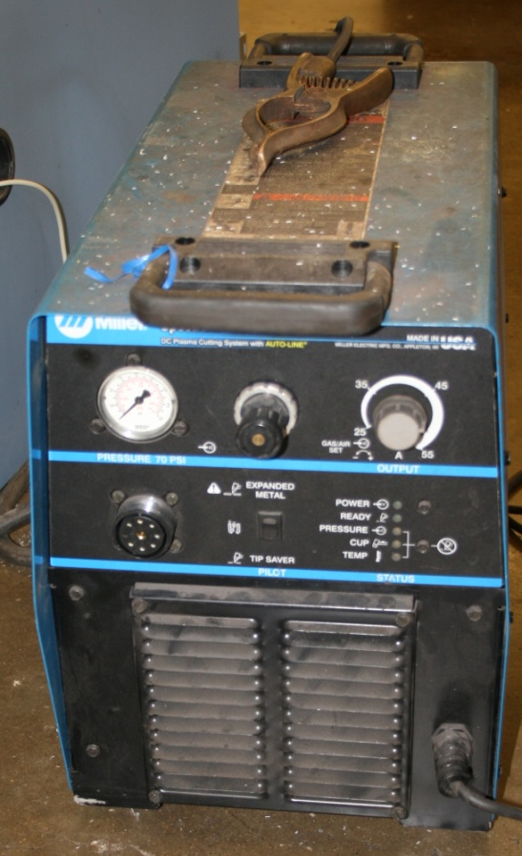
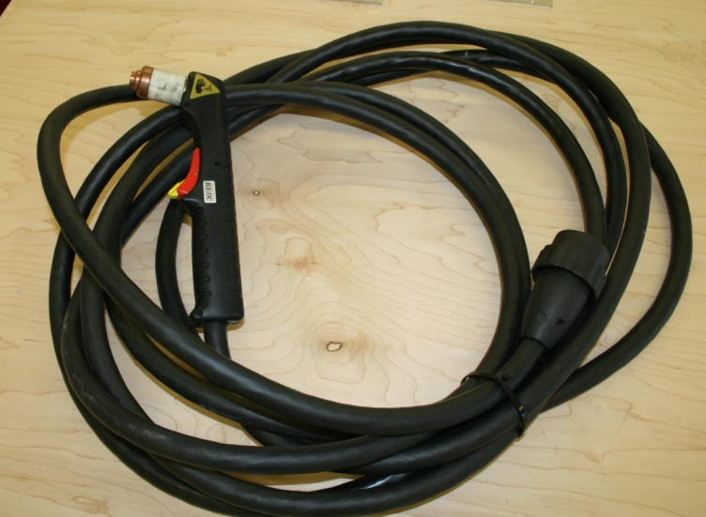
Plasma Cutter Parts
  Power Supply
  Torch
  Lines

Slide 20
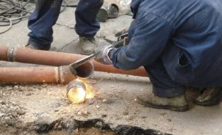
Oxygen-Acetylene Cutting Processes
  The flame heats the metal to a molten state with an oxygen blast forcing the molten metal from the cut.

Slide 21
Welding Assignment Criteria
  Beads should be smooth and even; no splatter or slag left on material.
  Welds can be made with the arc welder or oxy-fuel welder. The only difference will be the thickness of metal used.
  Grades will be determined by appearance and penetration of weld as determined by a welding projects rubrics.

Slide 22
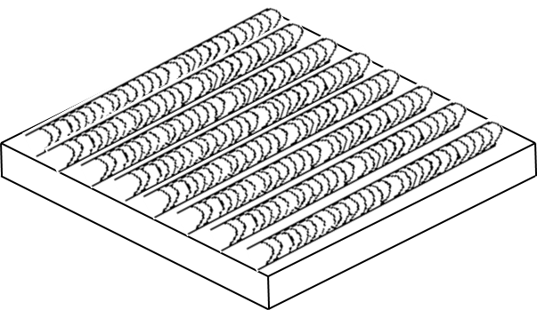
Welding Assignment: Beads Across a
Metal Plate
  The metal for arc welding should be a 3” x 3” x ¼” metal plate.
  The metal for oxy-fuel welding should be a 3” x 3” x 1/8 metal plate.

Slide 23
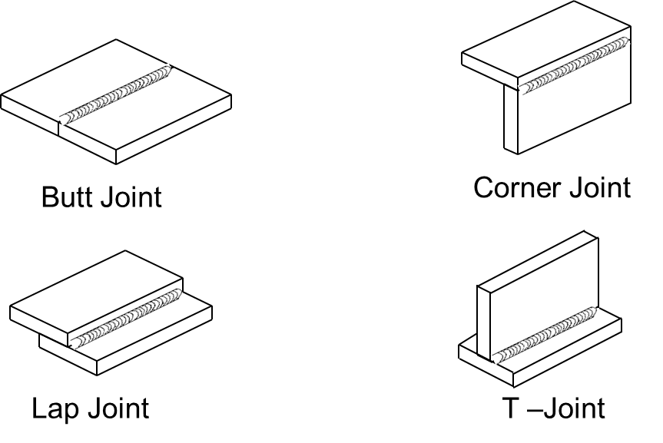
Welding Assignment: Making Joints
  Use the cutting torch and cut (8) 1 ½” x 4” strips of metal to weld the following joints:

Slide 24
Resources
  http://www.aws.org/ - American Welding Society

