Slide 1
Welding Trades
  Oxy Fuel Welding

Slide 3
Objectives
Objectives
Objectives
  Explain oxyfuel cutting safety.
  Identify and explain oxyfuel cutting equipment & flames
  Identify and explain backfire and flashbacks
  Set up & shut down oxyfuel equipment
  Light and adjust an oxyfuel torch.
  Change empty cylinders
  Perform oxyfuel cutting – straight line

Slide 4
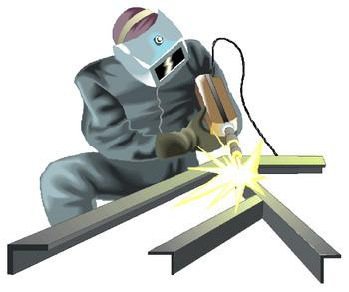
Safety First
  Review the safety sheet

Slide 5

Material You Need
  Oxygen Gas and Cylinders
  Acetylene and Cylinders
  Regulators
  Hoses
  Torches
  Cutting Tips

Slide 6
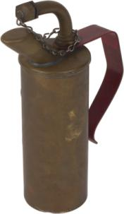
Work Activities
  Lab 1
    Turning off the oxy fuel rig
  Lab 2
    Turning on the oxy fuel rig

Slide 7

Clean Up & Review
  Check and Re-Check Your Work
  Review Terminology
  Keep Safety in Mind
  Take Test

