Slide 1
Welding Trades
  Mild Steel Welding

Slide 3
Objectives
  Mild steel is the easiest metal to gas weld
  Mig weld using mixed gas
  Weld flat, vertically, and horizontally with mild steel
Notes:
Safety rules protect you and those around you from injury.
Whose responsibility is safety and health in the classroom laboratory? (Students’, teachers’, everyone’s)

Slide 4
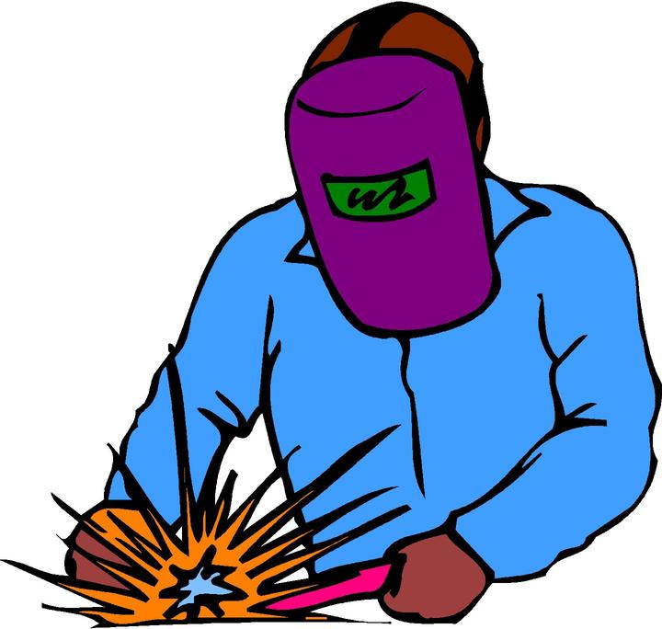
Material You Need
  3 x 6 3/8” steel plate
  .035 mig wire
  Gas 75%-25% (argon, carbon dioxide)

Slide 5
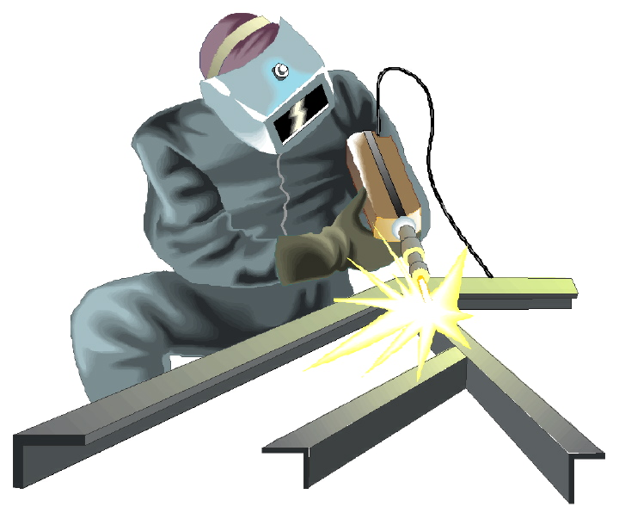
Equipment Needed
  Personal safety equipment
  Mig machine
  Mig gun

Slide 6
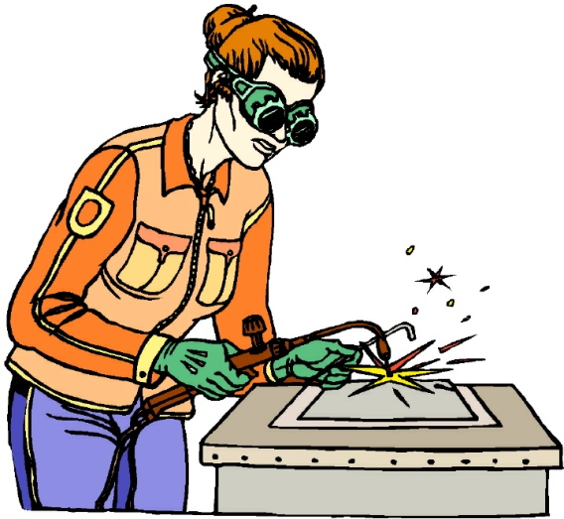
LABS
Students will rotate through four labs to complete mild steel welding:
  Lab 1: Flat Welding
  Lab 2: Vertical Welding
  Lab 3: Horizontal Welding
  Lab 4: Lap Welding

Slide 7
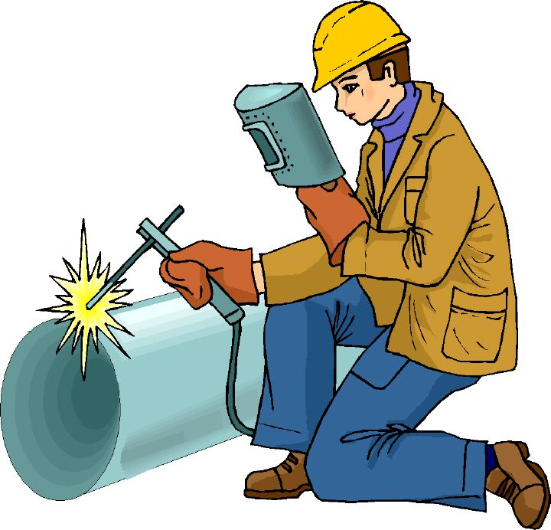
Steps:
Set - up
Weld
Clean-up and inspection
Keep Safety in Mind

