Slide 1
Welding
  Candle Holder Project

Slide 3
Safety Review
  Safety comes first!
  Follow procedures
  If unsure, ASK!

Slide 4
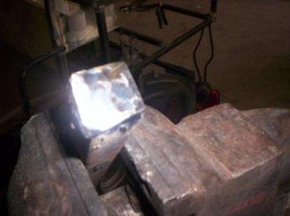
The Candle Holder Project
  It helps you practice your welding skills
  It’s a great gift or outdoor item

Slide 5
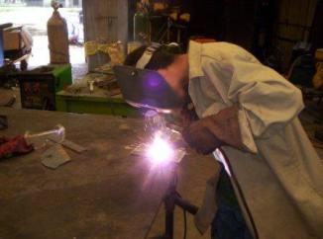
Steps
  Place a can on the cutting or welding table
  Find a starting point in the middle of the can
  Lower the welding tip down towards the can
  The neutral blue flame should slight penetrate through the can

Slide 6
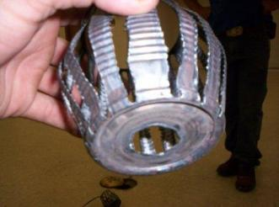
Steps
  Cut a straight line through the ribs of the can stopping where the ribs stop
  Pick the tip up
  Move about a 1/8 inch over and cut another line
  Repeat this process until the can has been completely cut through all the way around

Slide 7
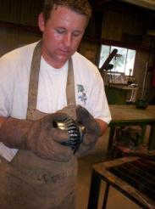
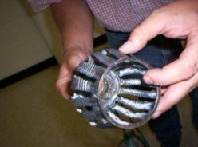
Steps
  After the can has cooled, place one hand on the inside of the can and begin bending and prior outward so that a slight bulge begins to form in the middle of the can

Slide 8
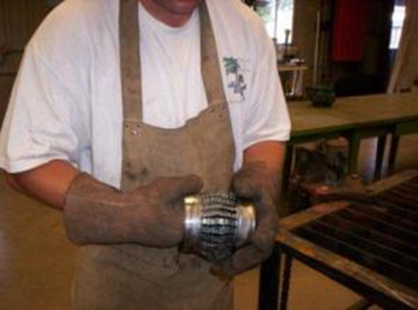
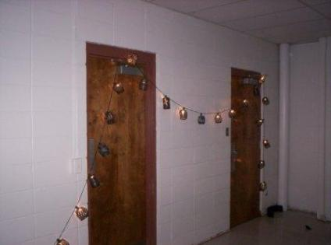
Steps
  When you can no longer use your hands, apply slight pressure to both ends of the can until the desired bulge has been achieved
  If the bulge seems “lopsided” use your hands once more and bend to even the bulge back out
  Finally apply paint using the spray paint if deemed necessary

