Slide 1
45° or Graduated Layers Haircut
  Cosmetology I
Notes:
Let’s take a deeper look at one of the most sought after hairstyles in every salon.
Today’s modern bob was redesigned and inspired by the architectural influences seen in every downtown skyline.
In 1963, Vidal Sassoon was busy changing modern hairdressing by creating geometric shapes on clients never before seen in the history of the industry.
These low-maintenance styles made the pages of every hairdressing magazine from the UK across the Atlantic to the U. S.

Slide 3
  “Hair brings one's self-image into focus.”
  -Shana alexander, American journalist

Slide 4
The 45° Haircut
  Made popular by Vidal Sassoon
  Graduated shape or wedge
  Sometimes called a “bob”
  Can be used with a center or side part or with bangs
Notes:
The ends of the hair appear to be stacked in this haircut.
Many variations and effects can be created with this haircut by adjusting the degree of elevation, the amount of over direction or the cutting line.

Slide 5
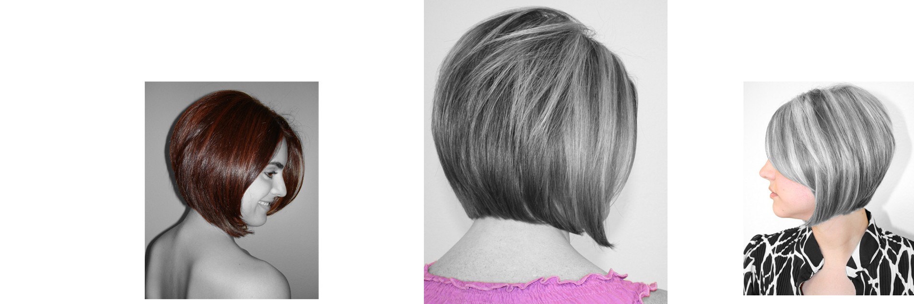
Styles
Notes:
Each graduated bob has a uniqueness of its own. This depends on hair density and texture.

Slide 6
Vidal Sassoon
  Introduced revolutionary geometric cuts in the 60’s
  Rejected traditional haircutting styles
  Drew inspiration from modern architecture
  Founded a multi-million dollar hair product business
  Motto:
  “If you don't look good, we don't look good."
Notes:
He popularized the angular and easy-to-wear haircuts.

Slide 7
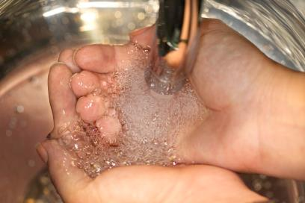

Reminder
  Safety and Sanitation Precautions -
  Cosmetology Administrative Rules
Notes:
Remind students of the safety and sanitation procedures before they begin working on a client.
Click on the photo to view Texas Department of Licensing and Regulation’s 10 most common violations. Use this as an eye opener for students to understand how important it is to practice state law.
Cosmetology Administrative Rules
These standards include:
clean and disinfect equipment, tools, implements and supplies before use on each client
use clean towels for each client
use clean cutting and shampoo capes for each client
use a sanitary neck strip or towel
employ good hygiene habits while providing cosmetology service
Demonstrate:
draping for wet styling (explain purpose)
sanitation - hand sanitizer and hospital grade Environmental Protection Agency registered disinfectant
safety - shielding the client’s face from the spray bottle with cupped hands
how to keep hair and setting lotion out of the client’s eyes
Explain the importance of keeping pointed implements away from the client’s face.

Slide 8
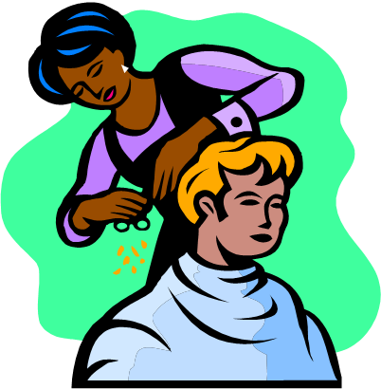
Body Positioning and Posture
  Position your client
  Center your weight
  Work in front of your section
Notes:
As a working cosmetologist, you will be spending many hours on your feet.
Good posture and body positioning will help you avoid back problems in the future and ensure better haircutting results.
Position your client – make sure your client is sitting up straight and legs are not crossed
Center your weight – keep body weight centered and firm
Work in front of your section – stand or sit directly in front of the area you are cutting
Demonstrate the correct way to stand.
Correct body positioning - rolling your shoulders back and standing directly (parallel) in front of the section on which you are working
Allow students to stand and demonstrate the correct way to position themselves in front of a client.

Slide 9
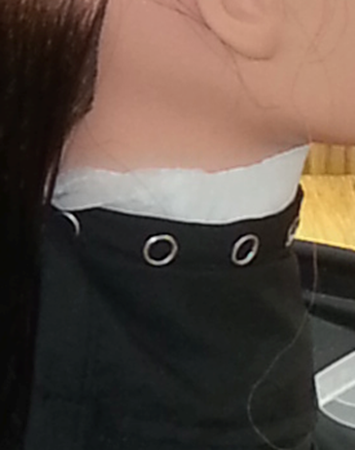

Draping
  Neck strip
  Cutting cape
Notes:
Demonstrate a proper draping on a volunteer student.
Emphasize the importance of the cape staying on throughout the haircut and how the cape is your client’s first line of defense from loose hair.
Failing to secure the neck strip will result in an uncomfortable experience for your client.
Neck strip - secure a neck strip around the client’s neck
Cutting cape - place a cape over the neck strip and fasten in the back
Be sure to fold the neck strip down over the cape so that no part of the cape touches the client’s skin.

Slide 10
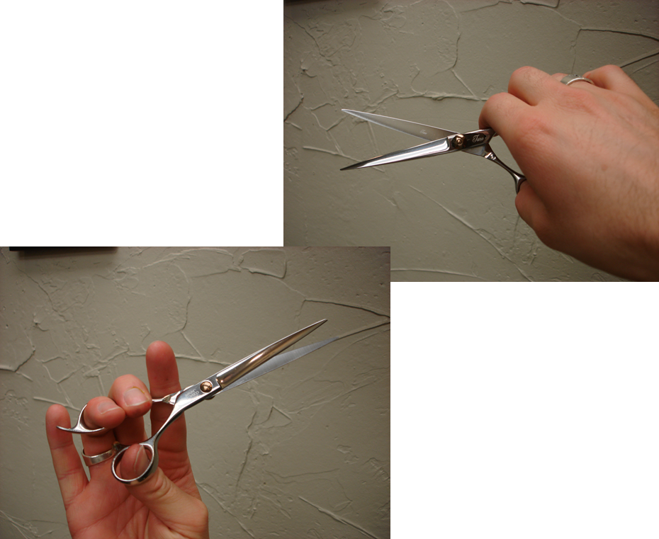
Handling Scissors
  Haircutting shears
  Place thumb in moving blade (bottom)
  Place ring finger on top blade
  Rest index and middle finger on the shank
  Practice opening and closing blade
Notes:
Demonstrate the appropriate way to handle your haircutting shears.
Haircutting shears - used mainly for removing length and detailing the haircut

Slide 11
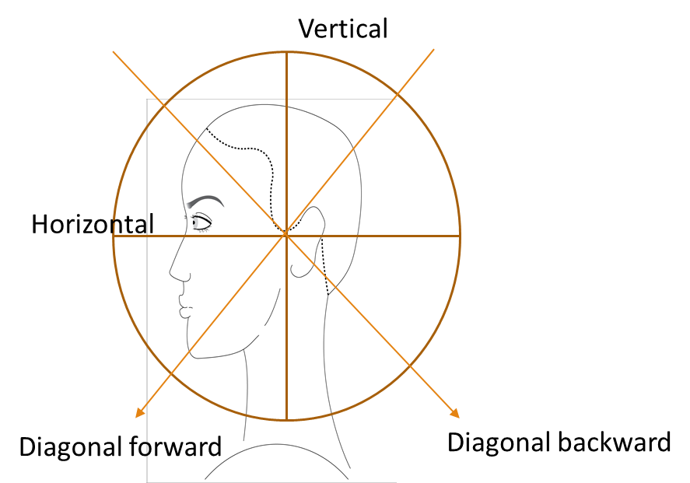
Graduated Layers
  A haircut with a heavy weight line along the perimeter
  It’s movement falls diagonal from back to front
  Builds weight at a 45° angle
  Gradually adds length with over direction
  Moves toward both sides of head
Notes:
Demonstrate proper parting and explain why it matters to have an accurate diagonal forward section.
Explain the importance of understanding each cutting direction of the cutting wheel.
Key Point
For a smooth buildup of weight, keep a consistent elevation throughout each section.

Slide 12
Proper Sectioning and Guidelines
  Reminder:
  Clean and consistent sectioning is a must
  Will keep haircut smooth and balanced
  Keep cutting lines parallel to your hand and body positioning
Notes:
Explain how clean partings go hand in hand with your guideline and cutting angles.
Remember - slow and steady wins the race.

Slide 13
Phases of a Haircut
  Phase 1 – Wet cut
  Phase 2 – blow dry
  Phase 3 - Refinement
Notes:
There are 3 phases of a haircut.
Phase 1 - Wet Cut
Phase 2 - Blow Dry
Phase 3 – Refinement
All are important, but none more than the structure-building step of phase 1.

Slide 14
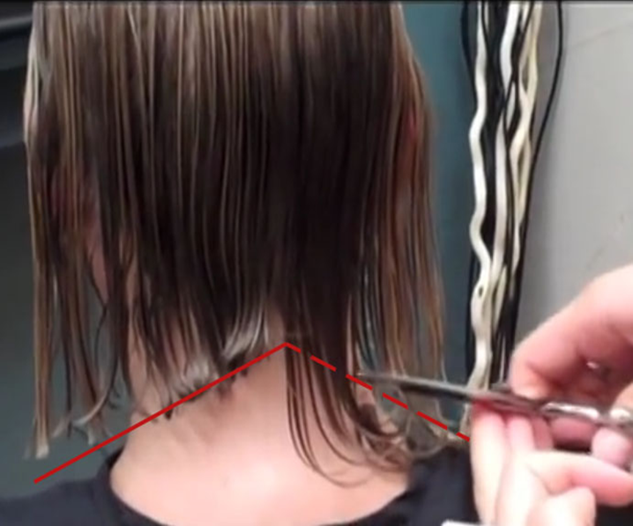
Phase 1: The Wet Cut
  Focus on:
  Creating foundation and structure (most important)
  Building rest of the design on top
Notes:
Key Points
position the head down
place fingers under steady blade to prevent cutting neck and cape
visually identify shortest and longest piece
start your short guideline and work down

Slide 15
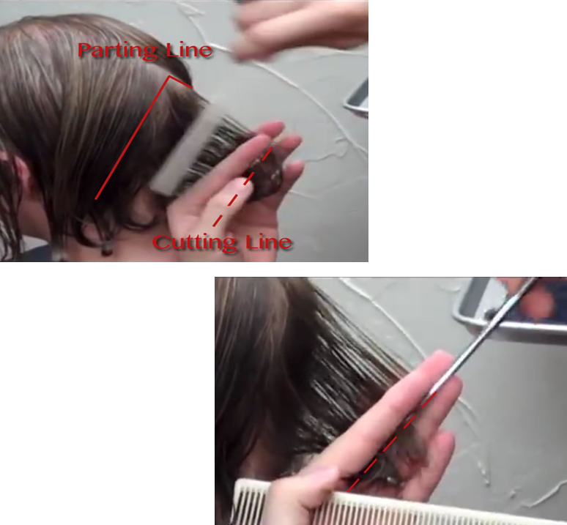
Starting the Graduation
  Cut the perimeter to your client’s liking
  Move toward the interior
  Create the diagonal forward line
  This will define the:
    Overall weight
    Appearance
Notes:
Focus in on your diagonal forward line. Determine your length by visually measuring where your line will end up.
Once the perimeter is cut to you and your clients liking, you will move toward the interior of the haircut. The diagonal at which you create your graduation will define the overall weight line and appearance of your haircut.

Slide 16
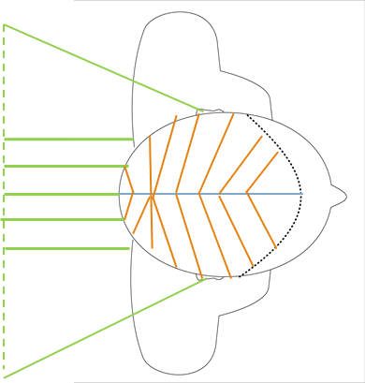
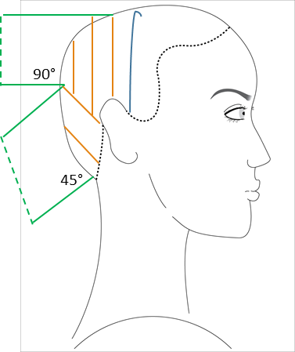
Proper Sectioning and Guidelines
  Decide the steepness of your angle
  Start at the stationary guideline
  Over direct every section back to the same point of elevation
  Change to 90° when creating the layering
  Move slightly from each section to the next
  Grab half of previous section when moving around the head
Notes:
Follow through with your sectioning by pulling everything back to your stationary guideline.
Explain the importance of staying consistent with your elevation.
When creating your graduation, decide on the steepness of your angle and start your stationary guideline. Over direct every section back to the same point of elevation.
When creating your layering, be sure to change your elevation to 90° and move slightly from each section into the next grabbing half of your pervious section as you are moving around the head.

Slide 17
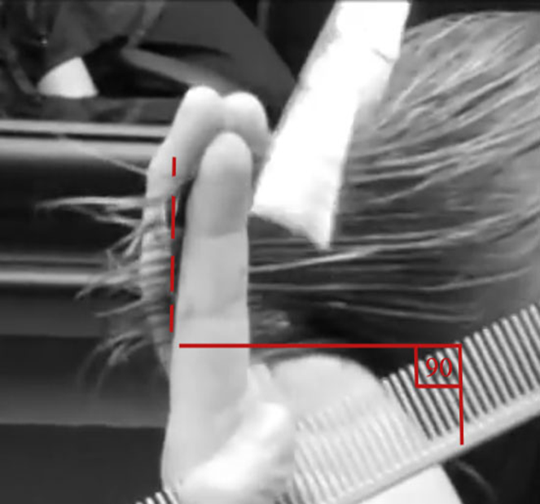
Layering
  Removes weight
  Creates movement
  Produces a softer graduation
  Optional, but adds shape and style
Notes:
Adding a section of layering will give the traditional bob a softer graduation.
Layering within the interior of the haircut will create movement by removing weight.
This step is optional when creating a bob, but adds shape and style to this traditionally heavy perimeter.
Key Points
remove weight from interior
use guide from previous section
over direct behind the ears

Slide 18
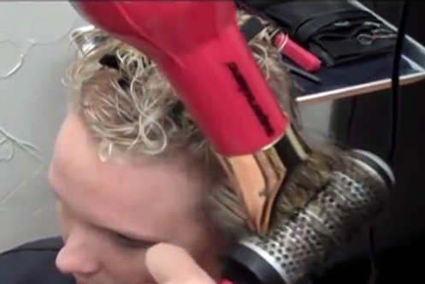
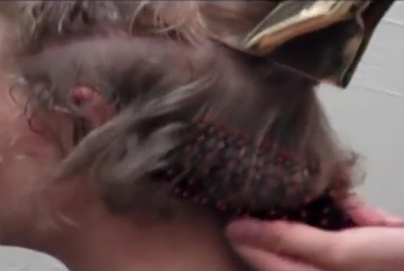
Phase 2: The Blow Dry
  Sections should be no wider than the diameter of your round brush
  Create a tension from the pull of the brush and the heat of the blow dryer
  Point the concentrator down the hair shaft
  The slightly damp hair will dry silky smooth eliminating the use of a flat iron
Notes:
Demonstrate a traditional round brush blow dry on a student model.
Stress the importance of tension in the final equation of a perfect style out.

Slide 19
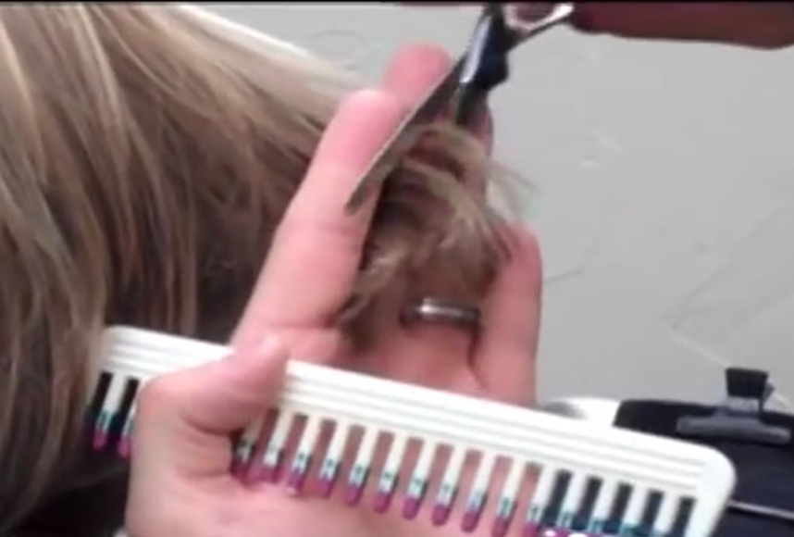
Phase 3: Refinement
  Remove excess bulk to desired look
  Make three distinct cuts ½ inch apart
  Do not cut in the same place
  Blend a smooth transition from the layers
Notes:
During this phase, we will work on detailing and finishing our look.
Handling thinning shears is no different than handling haircutting shears.
Be sure to remind the students on how these scissors work so they can best understand when to use them, and more importantly, when not to use them.
Using thinning shears, remove excess bulk to create the desired look.
Avoid cutting length by making 3 distinct cuts ½ apart, down the ends of the hair.
Work your way down the last 2-3 inches of ends.
Do not cut in the same place!
This will not only cut bulk - but length.
Work on blending a smooth transition from the layers, down to the perimeter.

Slide 20
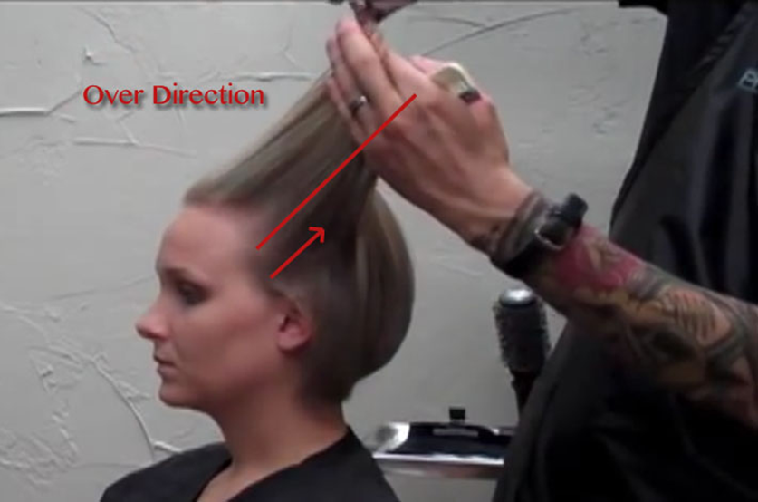
Detailing and Finishing
  Follow original cutting line and elevation angles
  Trim each section with thinning shears
  Hair will grow neat and clean without split ends
Notes:
Re-establish the three phases of the haircut that lead up to this point by going ever the details of each one.
Your effort to pay attention to every detail this far will start to pay off when you reach the final stage of the haircut.
With straight blades, follow the original cutting line and elevation of angles and trim each section texturized with thinning shears.
Doing this will allow your client’s hair to grow out neat and clean without split ends.
Your work in the finishing stages will make all the difference 4-6 weeks from now.
These extra five minutes will guarantee a client for life.

Slide 21
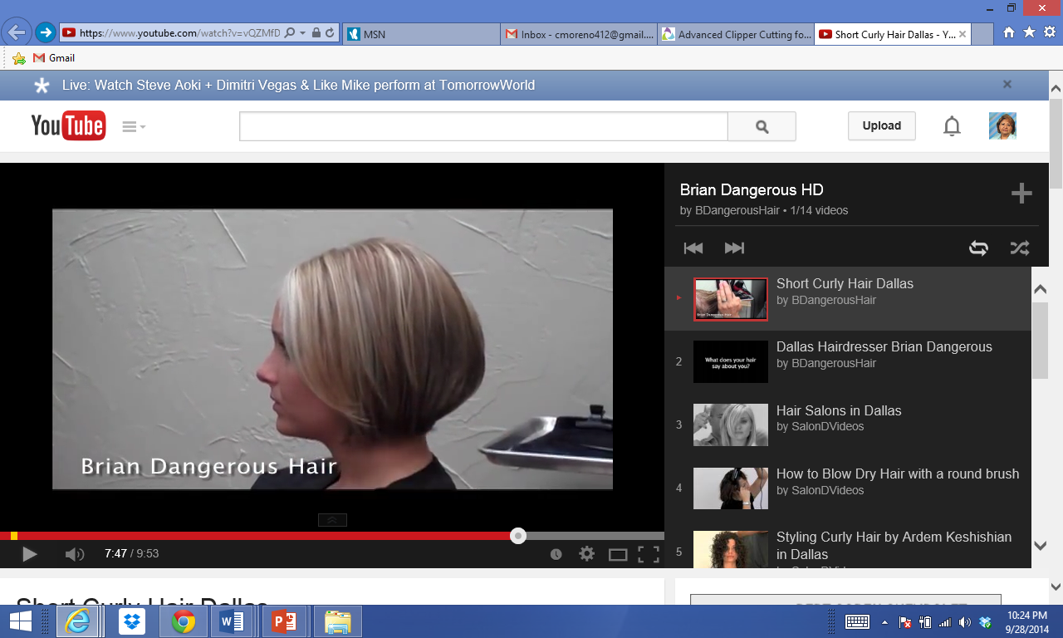

Short Curly Hair Dallas
  Graduated Layers – Brian Dangerous Hair
  Brian is a Hairdresser and Licensed Cosmetology Educator, who helps his clients achieve the look they want, without compromising the texture or fabric of the hair. Brian offers a wide range of services and treatments to enhance the quality of the hair and bring out its natural shape
Notes:
Short Curly Hair Dallas
Brian is a Hairdresser and Licensed Cosmetology Educator, who helps his clients achieve the look they want, without compromising the texture or fabric of the hair. Brian offers a wide range of services and treatments to enhance the quality of the hair and bring out its natural shape.
http://youtu.be/vQZMfDNC4a4?list=PLA206B691631CD771
Play video of the haircut before students practice on their own independently.

Slide 22

Questions?

Slide 23
Resources and References
  Images:
    B. Rodriguez, Licensed Cosmetology Instructor: Used with permission from Brian Dangerous Hair.
    Microsoft Office Clip Art: Used with permission from Microsoft.
  Textbook:
    Milady standard cosmetology: Situational problems.(2012). Clifton Park, NY: Cengage Learning.
  YouTube™:
    Short Curly Hair Dallas
    Brian is a Hairdresser and Licensed Cosmetology Educator, who helps his clients achieve the look they want, without compromising the texture or fabric of the hair. Brian offers a wide range of services and treatments to enhance the quality of the hair and bring out its natural shape.
    https://www.youtube.com/watch?v=vQZMfDNC4a4&index=1&list=PLA206B691631CD771

