Slide 1
A Business Plan for Salon Ownership
  Cosmetology II

Slide 3

The Salon Business
Notes:
After working and perfecting your techniques, you may decide to be a salon owner.
This lesson will touch on the options to consider.

Slide 4
Rent or Manage
Notes:
Two options to consider when you feel ready to become your own boss.

Slide 5
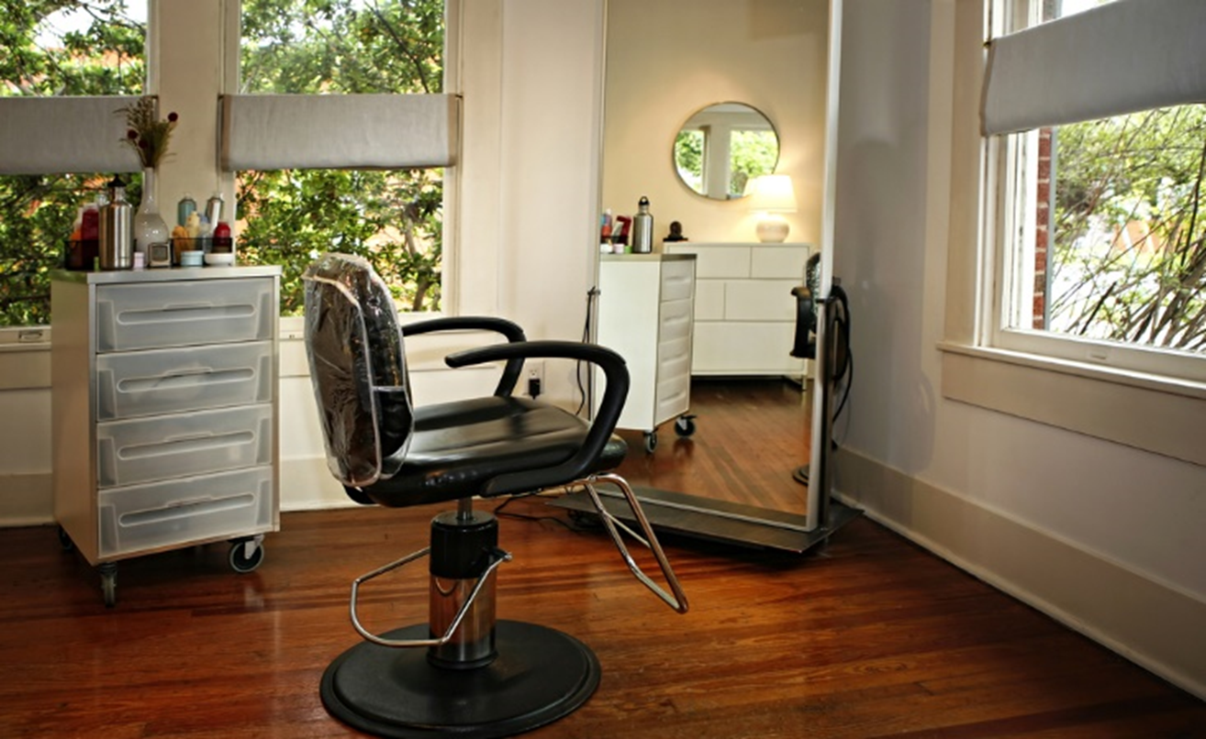
Booth/Chair Rental
Notes:
Booth rental is also known as a chair rental.
It means that a cosmetologist can rent a booth or a station at a salon without the stresses of owning a business.
It is an opportunity for the cosmetologist who has a steady clientele and is busy.

Slide 6

Renting a booth - Advantages
  A cosmetologist:
  Becomes his or her own boss
  Is responsible for his or her own
    Accounting
    Clientele
    Record keeping
    Supplies
  Pays a weekly fee to salon owner
  Rents a work station in a salon from a salon owner
Notes:
This is a popular practice and may be more desirable than owning a salon.
Fees would vary depending on the salon.

Slide 7
Renting a Booth - Facts
  A cosmetologist must:
  Budget for advertising
  Carry adequate insurance
    Health
    Malpractice
  Collect all service fees
  Comply with all IRS obligations for independent contractors
  Create professional materials
      Business cards
      Service menu
  Keep records for tax purposes
  Pay for continuing education courses
  Pay taxes, including Social Security
  Purchase all supplies
  Track and maintain inventory
  Use personal phone for bookings
Notes:
Renting a booth does not allow for benefits such as:
paid days off
vacation time
If you do not work, you do not get paid.

Slide 8

Managing a Salon
  Management opportunities:
    Assistant manager
    Department head
    Educator
    General manager
    Inventory manager
    Special events manager
Notes:
Becoming a salon manager is career path that a cosmetologist may choose to take.

Slide 9

Business Skills Needed
  Accounting
    Math
    Profit and loss statements
  Marketing
    Advertising
    Promotions
    Public relations
Notes:
To manage a salon, a different set of skills is needed.
A business education is recommended.
Many salon managers are not cosmetologists due to business of making a profit.

Slide 10
Factors to Consider
Notes:
Opening a salon involves making many decisions

Slide 11

Decisions
  Business Name
  Location
    Easy access
    Good visibility
    Handicap access
    High traffic
    Sufficient parking
  Timeline
  Written agreements
  Employee and vendor contracts
  Lease
Notes:
These are just a few of the many decisions that will need to be made before opening a salon.
Business name – select a name that explains what it is and can set it apart from competitors.
Location – should be based on the clientele and their needs.
Timeline – a time period to grow, expand the business, become a full-time manager and plan for retirement.

Slide 12
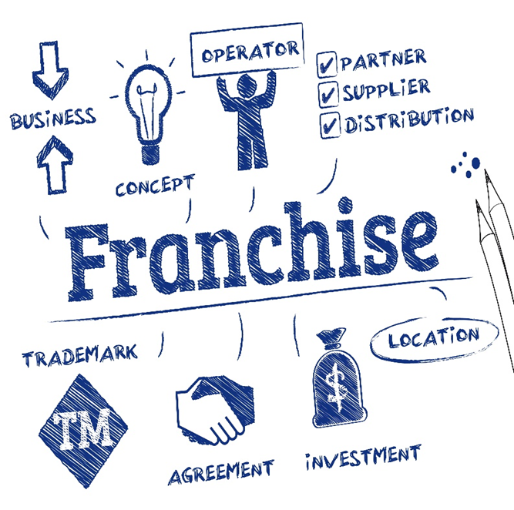
Types of Ownership
Notes:
Before deciding on the type of ownership you would like, be sure to research each option to find out which one is best for you.

Slide 13

Salon Ownerships
  Individual
    Sole proprietor
  Partnership
  Corporation
  Franchise
Notes:
1. Sole proprietor – a self-employed person; sole owner of a business.
2. Partnership - a type of business organization in which two or more individuals pool money, skills and other resources and share profit and loss in accordance with terms of the partnership agreement.
3. Corporation - an ownership structure controlled by one of more stockholders.
4. Franchise - arrangement where one party (the franchiser) grants another party (the franchisee) the right to use its trademark or trade-name as well as certain business systems and processes, to produce and market a good or service according to certain specifications.

Slide 14

Owning a Salon
  Brand identity
  Lease or rental agreement
  Insurance
    Fire
    Lawsuits
    Theft
  Operations
Notes:
Many decisions will need to be made before you open a salon, such as:
creating a culture and identity
hiring additional staff, if needed
method and philosophy for running the business
products to use and carry
types of marketing and promotions
A rental or lease agreement is essential since more than likely, you will not own the building you open your salon in.
Insurance should be purchased while you are in business to protect you from fire, lawsuits or theft.
Day-to-day operations of the salon require a strong business sense and sound practices to be successful.

Slide 15
Business Records
Notes:
Business records may include all legal documents required to meet rules and regulations.

Slide 16

Business Plan
  Include:
    Executive summary
    Vision statement
    Mission statement
    Organizational plan
    Marketing plan
    Financial documents
    Supporting documents
    Salon policies
Notes:
There are several variations of business plans.
Contact your local Small Business Administration office for a business plan that will suit your needs.

Slide 17


  How to Write a Business Plan
Notes:
Click on hyperlink to view video:
How to Write a Business Plan
Interested in starting a business plan? Developing and maintaining your business plan is like your roadmap to entrepreneurial success.
https://youtu.be/SMr_uLZV-eM

Slide 18

Record Keeping
  Bookkeeping
    Income and expenses
  Business taxes
    Local
    State
    Federal
  Inventory
  Service
Notes:
It is important that good business records are kept to meet local, state and federal laws.
A professional bookkeeper may be needed to handle all of the documents.

Slide 19

Notes:
What does this quote mean to you?

Slide 20
Time for Review
  Why study the business of salon ownership?
  What are the advantages and disadvantages of a booth rental?
  Does a management position interest you?
  Why are business skills needed to operate a salon?
  Name three decisions to consider before opening a salon.
  Which type of salon ownership is the best one?
  What other factors do you need to consider before you open a salon?
  Is a business plan necessary?
Notes:
Answers to the questions are found within the slide presentation or may vary with class discussion.

Slide 21


Slide 22
References and Resources
  Images:
    Shutterstock™ images. Photos obtained with subscription. (Slides 1, 3, 4, 5, 6, 8, 9, 10, 11, 12, 13, 14, 15, 16, 18, 19, 20, 21)
  Textbook(s):
    Frangie, C. M. (2012). Milady standard cosmetology. Clifton Park, NY: Cengage Learning.
    Backe, J. (2016). Milady standard cosmetology. Clifton Park, NY: Cengage Learning.
  Websites:
    Texas Department of Licensing and Regulations
    The leader in public service, customer satisfaction, and innovation
    http://www.tdlr.texas.gov/index.htm
  YouTube™:
    How to Write a Business Plan
    Interested in starting a business plan? Developing and maintaining your business plan is like your roadmap to entrepreneurial success.
    https://youtu.be/SMr_uLZV-eM

