Slide 1
A Caregiver’s Responsibilities
Child Development

Slide 3
Roles and Responsibilities of Caregivers
  A caregiver spends most of his or her time interacting with the children or observing them.
  Understands the different stages of child development and helps the children progress from one stage to another successfully.
  Develops the children’s physical, intellectual, social and emotional needs.
Notes:
They have many roles and responsibilities. Caregivers must have excellent training and experience to provide the most adequate child care to children. A caregiver is also responsible for the safety and security of the children and the facility. They are also responsible for following the state’s laws and regulations pertaining to the operation of the child care center; provide an adequate educational program to develop the children’s physical, intellectual, social, and emotional needs. Discipline is appropriate and not causing harm to the children, provide a clean facility, and the physical setting is inviting and homelike. The teachers and staff attend to the children and there is a good adult-child ratio. The parents feel welcomed and there is open communication between the parents and the caregivers.

Slide 4
Responsibilities of a Daycare Worker
What are the Duties of a Daycare Worker?
Click on text above
Notes:
How to Own a Daycare: What are the Duties of a Daycare Teacher?
The duties of a daycare teacher include teaching simple academics, forming lesson plans and other basic child care tasks, such as changing diapers, providing nourishment and dealing with any emergencies that may arise. Discover the main duties of a daycare teacher, which vary depending on their experience and job title, with teaching advice from the owner of a daycare center in this free video on child care.
http://youtu.be/Ugz3A5NMQSU

Slide 5

A Caregiver
Must understand and recognize the roles and responsibilities of caregivers and how they have an impact on the development of all children including those with special needs
Notes:
If you were a caregiver at a child care center, what kinds of activities would you implement to development the needs of all children?

Slide 6

What is Physical Development?
Involves changes in a person’s thinking, intelligence, and language
Ways that a caregiver can encourage physical development in children:
  Infants
    Move arms and legs together
  Toddlers
    Building small towers of blocks
  Pre-school age children
    Play kick ball
Notes:
An effective parent and caregiver need to understand how children grow and develop. Development refers to progress in skills and abilities. Development is measured in stages, because it occurs in an orderly sequence.
Please give me additional examples to encourage physical development in infants, toddlers and pre-school age children.
Some of these changes occur in the entire body such as bones and muscles, internal organs and the brain. Other physical development changes include hormones and motor skills.
What are gross motor skills? Give me an example of gross motor skills.
What are fine motor skills? Give me an example of fine motor skills.

Slide 7
Intellectual Development
Ways that a caregiver can encourage intellectual development in children:
  Reading books
  Playing board games
  Helping in the kitchen
Notes:
Intellectual development includes all of the brain’s activities and functions such as memory, perception, problem solving, decision-making and imagining.
How can you develop an infant’s intellectual development? A toddler? A pre-school age child?

Slide 8

What is Emotional Development?
Involves recognizing feelings or emotions
Ways that a caregiver can encourage emotional development in children:
  Gaining a sense of independence
  Using positive guidance and discipline
  Encouraging self confidence
Notes:
What are some emotions that infants, toddlers and pre-school age children exhibit? Emotional feelings can be love, hate, happiness, anger, jealousy, and fear. Another part of emotional development is understanding how to express their emotions while learning how to control their responses to certain emotions. Emotions play a vital role in personality development.
Children can learn how to express their emotions in a healthy manner through interactions with parents, siblings, caregivers and others.
What are some other ways caregivers can encourage emotional development in infants? In toddlers? In pre-school age children?

Slide 9

What is Social Development?
Involves the changes which occur in a person’s relationships with other people
Ways a caregiver can encourage social development in children:
  Encourage playing with other children
  Set up centers that encourage role playing
  Allow child to observe and explore
Notes:
Children first learn about interacting and relating with other people by observing their parents. A child’s social development is greatly influenced by how much or how little contact they have with other people.
Do you agree with this statement “Being a parent is the hardest job you are ever going to have?”
Why or why not?
How can a caregiver encourage emotional development in an infant? In a toddler? In a pre-school age child?

Slide 10
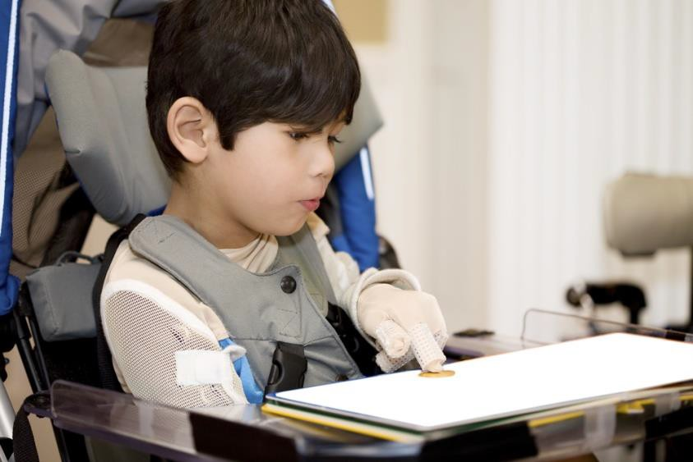
Development in Children with Special Needs
A caregiver must understand the growth and development of children with special needs
Notes:
What kind of attention would a child with cognitive or mental disabilities require? What is the difference between a physical disability and a mental disability? What is a learning disability? How does a learning disability differ from a mental disability? What is dyslexia? What is dyscalculla? What is dysgraphia? Are attention deficit disorders learning disabilities? No, they are not. Each has a separate diagnosis and treatment. In some cases, the same child may have both problems. What kind of training and education would a caregiver need in order to help a child with special needs?

Slide 11
Writing and Speaking Standard
English in Child Guidance Careers
Correct the following passage:
caregivers should plan teeching strategies which offers a variety of diffirent learning activities sit up to acheive specific goals and objectives in the physiical, emotionel, socail, and intellectul developmment of children. The process children usie in playing and discoviring in learning centers is more importents than the end product. Indoore learning centers might inclide activities areas for art, bloks, computer, sceince, dramatic play, langauge arts, manipilative play, math, music, and queit time.
Notes:
Writing and speaking standard English is an important responsibility of child guidance providers. It is necessary to be able to write directions, letters and notes. Have the students read the above passage. In pairs, the students will grammatically correct the passage. Review and discuss the corrections.
Correct passage: Caregivers should plan teaching strategies which offer a variety of different learning activities set up to achieve specific goals and objectives in the physical, emotional, social, and intellectual development of children. The process children use in playing and discovering in learning centers is more important than the end product. Indoor learning centers might include activity areas for art, blocks, computer, science, dramatic play, language arts, manipulative play, math, music, and quiet time.
Why is it vital to write and speak correct standard English in Child Guidance careers?
As a Child Guidance profession, have students brainstorm what problems might occur due to inadequate writing and speaking skills.

Slide 12

Work Ethics
  Influences
  Work ethics qualities
  Code of ethic
  Decisions to keep in mind
Notes:
A work ethic is a personal commitment to doing your very best as part of the team. Employees who have a good work ethic are often successful in their careers.

Slide 13
References and Resources
  Textbook:
    Stephens, K., & Hammonds-Smith, M. (2004). Child & adult care professional. (pp. 449-472). Peoria: McGraw Hill Glencoe. Websites:
  National Early Childhood Technical Association Center
    Promoting Social-emotional Well being in Early Intervention Services http://www.nectac.org
  Texas Department of Health
    Information for Children with Special Health Care Needs Services Program http://www.dshs.state.tx.us
  Zero to Three
    ZERO TO THREE is a national, nonprofit organization that informs, trains, and supports professionals, policymakers, and parents in their efforts to improve the lives of infants and toddlers.
    http://www.zerotothree.org
  YouTube™:
    Working with Special Needs Children College students interacting with special needs children
    https://www.youtube.com/watch?v=VLTaV6fBqX8

