Slide 1
A Look at Qualities of Effective Schools
Instructional Practices in Education and Training

Slide 3
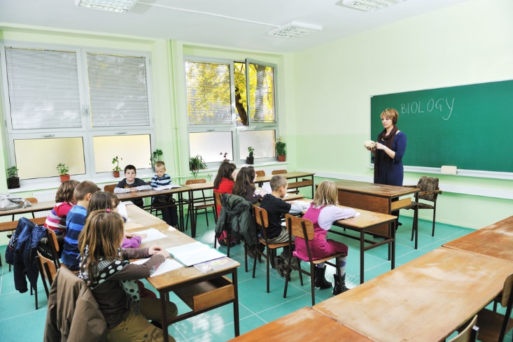
Notes:
What is an Effective School? Allow students to share their ideas of what effective schools are.

Slide 4
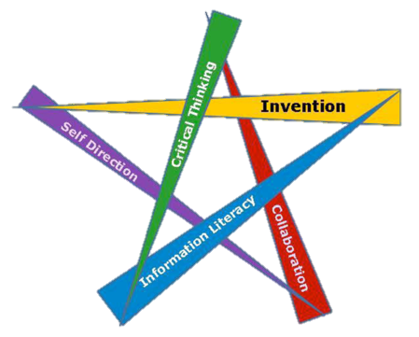
What do you think are the QUALITIES of an effective school?
Notes:
Allow students to share.
What are the characteristics or qualities of an effective school?
Does our school display those characteristics and qualities?

Slide 5
How do you identify an effective school?
Notes:
Allow students to share.
How would you identify an effective school?
How do you know that our school is an effective school?

Slide 6
What are the outcomes of an effective school?
Notes:
Allow students to share.
What is the outcome of having an effective school?
Why do we care as educators?
Why do you care as a future educator?

Slide 7
Notes:
Is this an Effective School? This is an image of an old school building established in 1916.
Ask the students if they think this is an effective school.

Slide 8
Notes:
This image is of a modern school.
Does this make it an effective school?

Slide 9
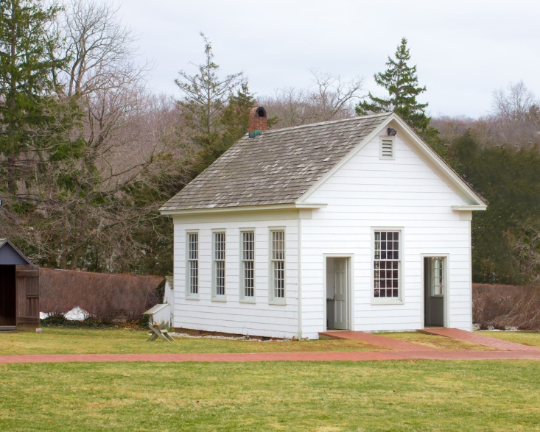
Notes:
This is an image of a one-room school house.
Is this an effective school?

Slide 10
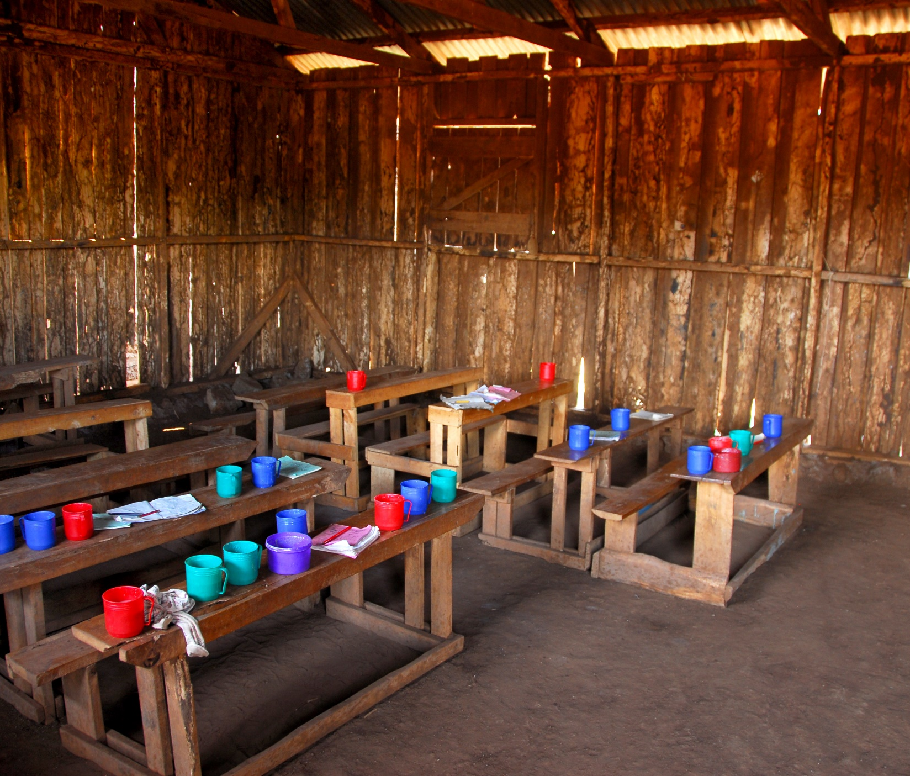
Notes:
This is an image of a classroom in a poor country.
Is this an effective school?

Slide 11
Notes:
This image is a digital classroom.
Does access to technology automatically make a school effective?

Slide 12
What Makes a School Effective?
Notes:
Answers will vary.

Slide 13
How have your personal experiences shaped your views of education?
Notes:
Think about your personal experiences as a student and the qualities of an effective school that we discussed.
How have your personal experiences shaped your views of education and your view points of what an effective school should look like?

Slide 14
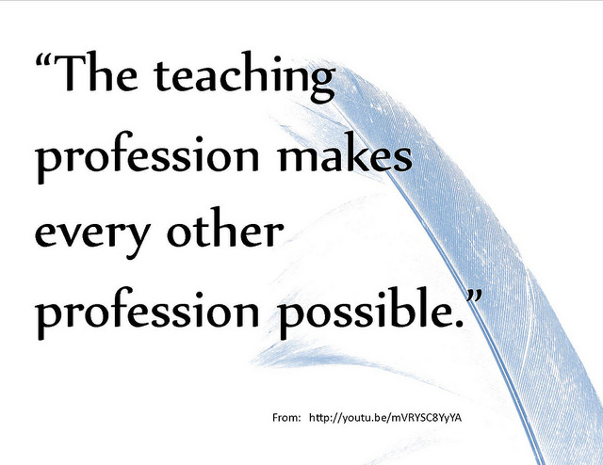
Notes:
What does this quote mean? How does it relate to the qualities of effective schools?

Slide 15
Questions?

Slide 16
References and Resources
Images:
Microsoft Office Clip Art: Used with permission from Microsoft™. (Slides 4, 13, 14)
Shutterstock™ images. Photos obtained with subscription. (Slides 1, 3, 5, 6, 7, 8, 9, 10, 11, 12, 15)
Websites:
About Education Top ten characteristics of a quality school. http://712educators.about.com/od/teacherresources/tp/quality-school.htm
Association for Effective Schools, INC. Correlates of Effective Schools http://www.mes.org/correlates.html
Characteristics of Effective Teachers This collection of characteristics of teachers was collected from various research studies. This site has other useful resources and links. http://ctl.stanford.edu/handbook/characteristics-of-effective-teachers.html

Slide 17
References and Resources
Websites:
Code of Ethics This website sponsored by the National Educators Association provides an overview of ethics for educators. http://www.nea.org/home/30442.htm
Websites:
Code of Ethics for Educators This website sponsored by the American Association of Educators provides an overview of ethics for teachers. http://www.aaeteachers.org/index.php/about-us/aae-code-of-ethics
College of Continuing Education at the University of Oklahoma Seven Correlates of Effectiveness http://ces.ou.edu/7_correlates_effectiveness.html
Texas Education Agency—-Code of Ethics This site has the Code of Ethics and the Texas Administrative Code for Texas teachers. http://ritter.tea.state.tx.us/rules/tac/index.html

