Slide 1
A Safe and Welcoming Environment for All
Practicum in Human Services

Slide 3

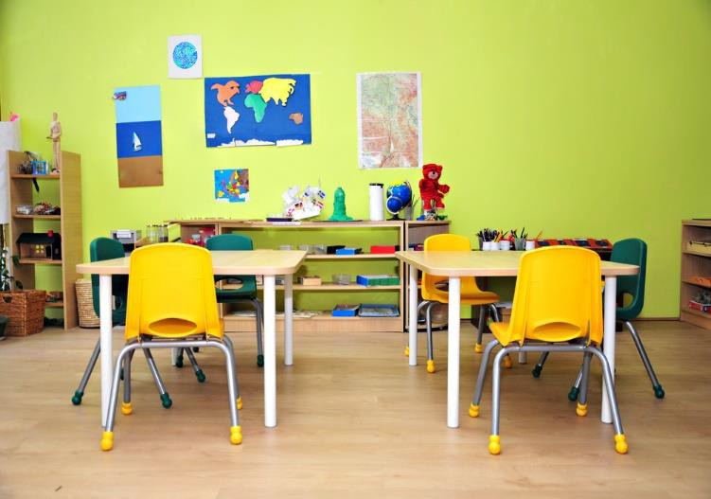


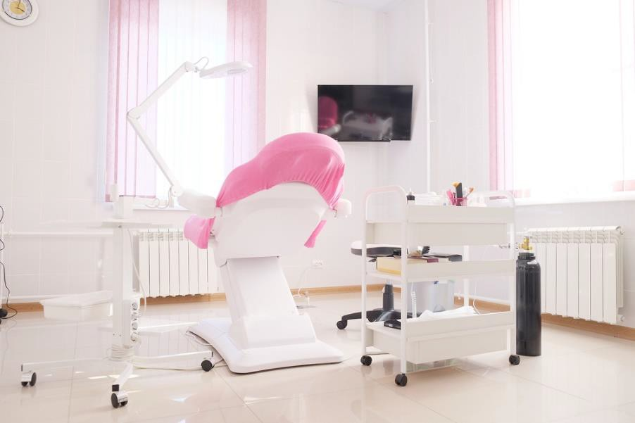
Human Services Career Pathways

Slide 4

Evaluating the Work Environment

Slide 5
Evaluating the Work Environment
Why should we evaluate the workplace environment?
What work environment factors should be assessed?
Who is responsible for assessing the work environment?

Slide 6

Evaluating, Identifying and Assessing the Work Environment
If a hazard is determined to be a risk (based on likelihood of occurrence and severity of consequences), it is advisable to provide time, money and personnel resources to help prevent or minimize the risks.

Slide 7

Environmental Hazards
The following environmental hazards may require consideration in a workplace:
Lighting
Noise
Radiation
Ventilation, air quality and thermal comfort
Vibration

Slide 8

Controlling the Risks
The risk associated with each hazard can be controlled by implementing the following hierarchy of controls:
Administration adjustments
Eliminating hazardous equipment
Isolating hazards
Providing protective gear
Redesigning the workplace
Substituting materials

Slide 9

Functional Work Environment
The four main categories of physical characteristics that need to be considered in the work environment are:
Arm reach, which has a bearing on storage of materials
Clearance such as headroom, legroom, elbow-room, access
Posture, which has a bearing on the location of materials/equipment, heights of working surfaces
Strength

Slide 10

Flow of Work Stations
Components of the computer workstation may include:
a chair
a desk
anti-glare screen
document holder
printer
other equipment essential to working with computers

Slide 11

Arrangement of Equipment
Basic guidelines to follow in the design of the work area to enable the efficient management of tasks include:
Frequency of use
Function
Importance
Optimal positioning
Sequence of use
Work/rest schedules

Slide 12

Ergonomics
For each task, the following should be considered:
frequency and flow of work
materials and equipment required
the priority of different tasks

Slide 13

Emotionally Safe Work Environment
Ideally, an individual’s work environment is one in which the employee is comfortable and one that fosters high levels of creativity and productivity.

Slide 14

Discrimination
Age
Disability
Equal pay/compensation
Genetic information
Harassment
National origin
Pregnancy
Race/color
Religion
Retaliation
Sex
Sexual harassment

Slide 15


Diversity
Workplace diversity refers to the variety of differences between people in an organization.

Slide 16

Non-threatening Environment
Employees have the right to feel safe and work in a non-threatening environment.

Slide 17

Sexual Harassment
It is unlawful to harass a person (an applicant or employee) because of that person’s sex.

Slide 18

Safety at the Workplace
It is the responsibility of both the employer and employee to impose and comply with safety precautions. Workplace safety can include:
Chemical safety
Construction safety
Electrical safety
Eye safety
Fall injury prevention

Slide 19

Procedures Necessary to Provide Emergency Aid
Prepare for emergencies by:
Accounting for all employees
Brainstorming the worse-case scenarios
Establishing an emergency action plan
Establishing evacuation routes and exits
Providing medical assistance
Training all employees
Ways to alert employees

Slide 20

NIOSH YOUTH @Work Video
(click on image)

Slide 21

Are You a Teen Worker?
(click on image)

Slide 22

Safety is NOT a Priority
(click on image)

Slide 23
Review
Why should we evaluate the workplace environment?
What work environment factors should be assessed?
Who is responsible for assessing the work environment?
What are ergonomics?
Describe a non-threatening work environment.

Slide 24


Slide 25
Resources and References
Images:
All photos obtained through a license with Shutterstock.com™.
Websites:
Are You a Teen Worker?
This guide gives the facts an individual needs to stay safe and healthy at work, what you can (and can’t) do, and it teaches you about your rights and responsibilities as a young worker.
http://www.cdc.gov/niosh/docs/2011-184/pdfs/2011-184.pdf
Centers for Disease Control and Prevention Personal Protective Equipment (PPE). http://www.cdc.gov/niosh/ppe/
The Place for Ergonomics
A resource for office ergonomic solutions
http://www.ergoweb.com
United States Department of Labor Health and safety topics.
https://www.osha.gov/SLTC/ergonomics/identifyprobs.html
U.S. Equal Employment Opportunity Commission Types of discrimination. http://www.eeoc.gov/laws/types/index.cfm

Slide 26
Resources and References
YouTube™:
NIOSH YOUTH @Work Video Teen Workers: Real Jobs, Real Risks
http://www.cdc.gov/niosh/talkingsafety/video.html
Safety is NOT a Priority
Safety Training Video – Preventing Workplace Accidents and Injuries. Workplace Ergonomics
https://www.youtube.com/watch?v=fcv1BxCL3Z8&feature=youtu.be
Ergonomic basics that apply to virtually any workplace. https://www.youtube.com/watch?v=QeDUCXfzl6U&feature=youtu.bezl6U&feature=youtu.be

