Slide 1
A New Kind of “Flour Baby”
How to create a more life-like flour baby

Slide 2
Copyright
Copyright © Texas Education Agency, 2015. These Materials are copyrighted © and trademarked ™ as the property of the Texas Education Agency (TEA) and may not be reproduced without the express written permission of TEA, except under the following conditions:
1) Texas public school districts, charter schools, and Education Service Centers may reproduce and use copies of the Materials and Related Materials for the districts’ and schools’ educational use without obtaining permission from TEA.
2) Residents of the state of Texas may reproduce and use copies of the Materials and Related Materials for individual personal use only, without obtaining written permission of TEA.
3) Any portion reproduced must be reproduced in its entirety and remain unedited, unaltered and unchanged in any way.
4) No monetary charge can be made for the reproduced materials or any document containing them; however, a reasonable charge to cover only the cost of reproduction and distribution may be charged.
Private entities or persons located in Texas that are not Texas public school districts, Texas Education Service Centers, or Texas charter schools or any entity, whether public or private, educational or non-educational, located outside the state of Texas MUST obtain written approval from TEA and will be required to enter into a license agreement that may involve the payment of a licensing fee or a royalty.
For information contact: Office of Copyrights, Trademarks, License Agreements, and Royalties, Texas Education Agency, 1701 N. Congress Ave., Austin, TX 78701-1494; phone 512-463-7004; email: copyrights@tea.state.tx.us.

Slide 3
Necessary Equipment
Supplies per baby:
One five pound sack of flour
Polyester fiberfill
Two pairs of full-size large pantyhose
Two rubber bands
Scissors

Slide 4
Large pantyhose work best.

Slide 5
Making the head
Take a handful of polyester fiberfill and place it in one foot of panty hose. This will be the head so you want to fill it enough to make it appear proportional to the body size.

Slide 6
Here is a sample of the baby’s head. Be sure to round out the shape.

Slide 7
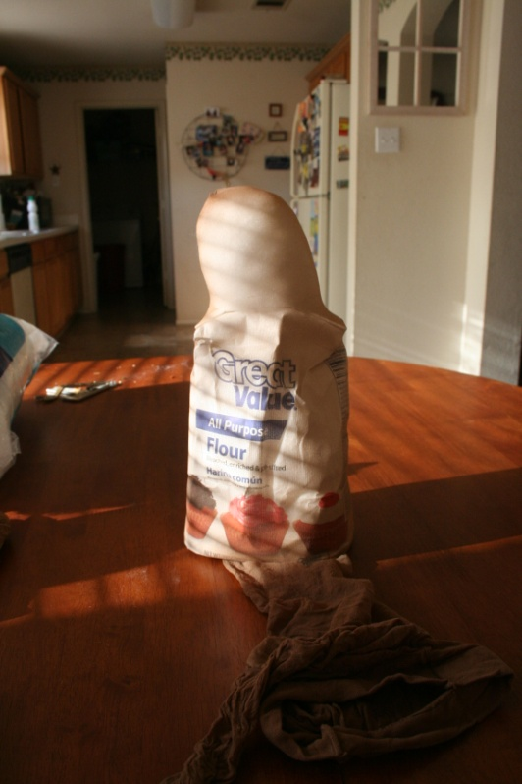
Next, place the entire bag of flour into the same pantyhose leg used to created the head. Push the flour all the way through until it is touching the polyester fiberfill.

Slide 8
Twist the pantyhose three times then turn the pantyhose inside out and place the flour sack back into the hose for another layer of protection.

Slide 9
You can see the twist at the bottom of the bag.

Slide 10
Pull the hose up so that it looks like your baby is wearing a scarf. Twist the panty hose again, turning the body twice to create a neck. Do not twist too much or the neck will not hold the head up.

Slide 11
After you have twisted and created the neck, pull the pantyhose down one last time to create the last layer of protection. (Keeping the flour contained, rather than in the classroom or hallway.)

Slide 12
Pull the hose all the way down and use the first rubber band to hold it. Be sure the crotch area of the pantyhose is below the rubber band.

Slide 13
Cut off the empty leg of the panty hose. This will become the “legs” of the baby.

Slide 14
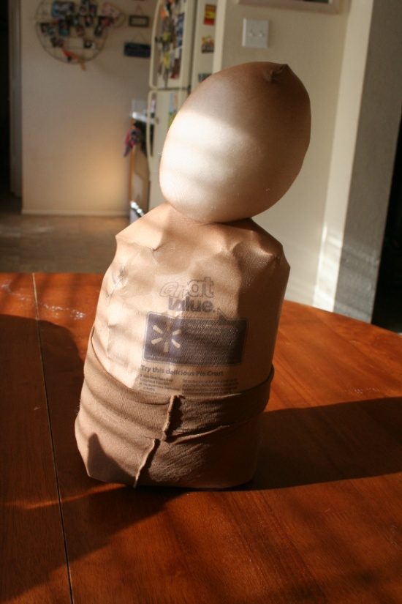
Pull the leftover part up on the baby to create what looks like a diaper.

Slide 15
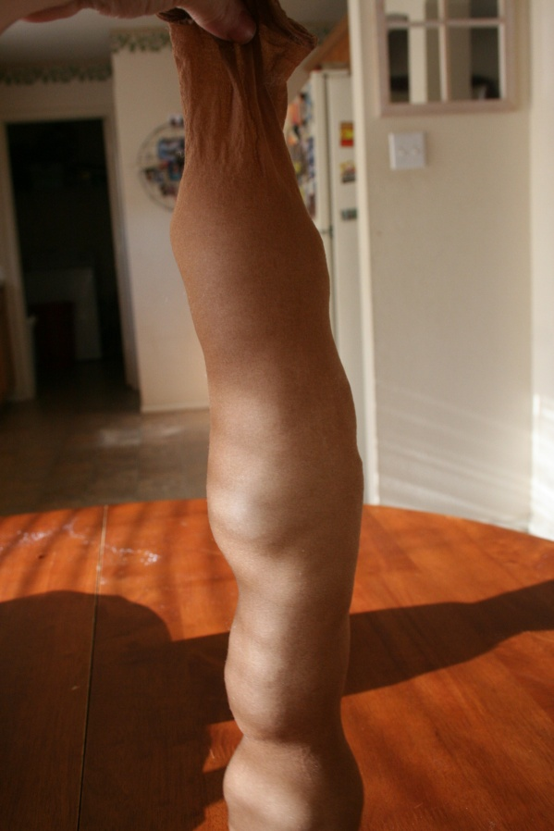
Stuff the cut pantyhose leg with polyester fiberfill.

Slide 16
Tie off the leg with the second rubber band.

Slide 17
The finished piece will be shaped like a long balloon. Don’t worry if the ends are uneven. They will be covered with socks.

Slide 18
Place a natural break in the finished piece, creating two smaller, more proportional looking “legs” for the baby.

Slide 19
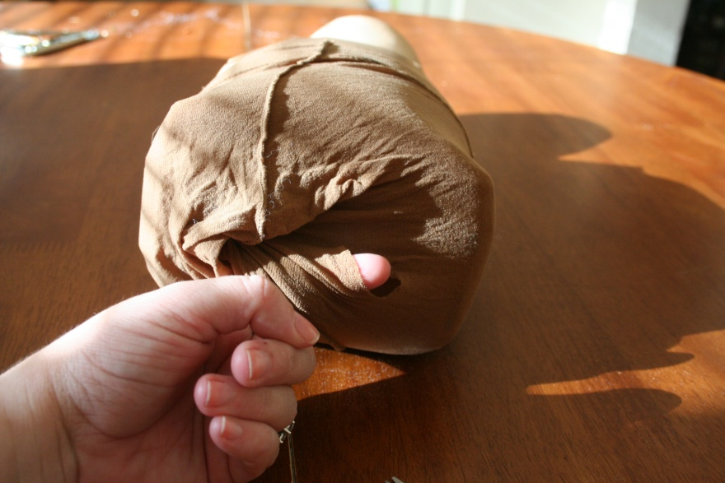
You should have a hole from where you cut the leg off the first pair of panty hose.
Cut another hole into the bottom as a place to put the baby legs.

Slide 20
The baby now has legs.

Slide 21
Place a small amount of polyester fiberfill into each foot of the second pair of panty hose.

Slide 22
This part is VERY important. Cut off the top of the panty hose. DO NOT cut below the crotch area. The two pair of legs need to be connected.

Slide 23
Use this part of the panty hose to create a “shirt” to hold the arms in place. Cut a hole where the finger and scissors are pointing. If the holes are too far apart, the arms will hang backwards.

Slide 24
Take the legs of the pantyhose and wrap them around the body until the arms are in place. Once the baby is dressed, the arms and legs will stay in place.

Slide 25
The body of the flour baby is now complete!
Decorate by adding eyes, hair and clothing.

Slide 27
References and Resources
Photos provided by Susan Sumpter
Flour Babies book
http://www.amazon.com/Flour-Babies-Anne-Fine/dp/0440219418
Decker, Celia. (2011). Child development; early stages through age 12. 7th. Tinley Park, IL: Goodheart-Willcox.

