Slide 1
Accepted!
College Selection and Admission
Practicum in
Education and
Training

Slide 3

Forecasts for Educators
Notes:
The Bureau of Labor Statistics forecasts the need for elementary school teachers to increase at an average of 12% through 2022, and the need for high school teachers to grow at a slower than average rate of 6%. A career as a professional teacher in public and most private schools requires at least a bachelor’s degree, with advancement and pay increases generally tied to either an advanced degree or teaching experience.
Why is it important to know the job forecast in education before pursuing a college education?

Slide 4

Education Program
Notes:
The majority of your college experience will be within the walls of the education building, so it only makes sense to start researching the college with the education program in mind.
First, look at the program requirements to see if the school meets your needs. What does the degree plan look like? How many hours are required of the program? Does the program offer internships, externships or options to study aboard? If so, what are the requirements for participating in each?

Slide 5

Educator Certification
  Programs of study should be:
    Standards-focused
    Learner-centered
    Field-based
Notes:
Educator Certification
Educator preparation programs should be standards-focused, learner-centered and field-based. A college should prepare you, as a potential educator, in a collaborative, proficiency-driven, learner-centered program to meet needs of a diverse society.
Typical degree programs for candidates who wish to obtain certification include coursework in general education (core curriculum), an academic major, the teaching field(s) and professional education. Individuals must meet admission requirements to educator certification. Teacher certification is available at both the undergraduate and graduate level for most areas. Verify the educator preparation programs are accredited by the state before applying for a particular college.
The State Board of Educator Certification (SBEC) issues educator certificates. Candidates must apply for their certificates through SBEC. The college will make a recommendation for certification to SBEC when an individual has met degree requirements; the degree has been conferred; all certification requirements have been met, including coursework, successful completion of the Texas Examinations of Educator Standards™ (TExES™) and field experience (student teaching at the undergraduate and graduate-level or one-year teaching internship at the graduate level); and the online application has been submitted.
Stephen F. Austin State University
The James I. Perkins College of Education includes the Departments of Elementary Education, Human Services, Kinesiology and Health Science, and Secondary Education and Educational Leadership, and the School of Human Sciences.
http://www.sfasu.edu/documents/05-education.pdf

Slide 6

Supplemental Certification
  Bilingual
  English as a Second Language (ESL)
  Special Education
  Visual Impairments
Notes:
Supplemental Certification
If you are interested in working with Bilingual, ESL or Special Education students, you may wish to add a supplemental certification. Supplemental certificates must be added to a valid Texas certificate based on a bachelor’s degree and will match the grade level of the base certificate.
The Teacher of Students with Visual Impairments (TVI) Certificate allows credentialed TVI’s to teach students who are blind or visually impaired and between ages 0-22 years. A valid Texas teaching certificate is required from another certification program, such as elementary education, secondary education or special education.
If you are interested in working with Bilingual, ESL or Special Education students, check your college of choice for supplemental certification programs.
Stephen F. Austin State University
The James I. Perkins College of Education includes the Departments of Elementary Education, Human Services, Kinesiology and Health Science, and Secondary Education and Educational Leadership, and the School of Human Sciences.
http://www.sfasu.edu/documents/05-education.pdf

Slide 7

Selecting a College
  How do I select a college?

Slide 8

Six Steps Texas Students Should Take
Notes:
According to AchieveTexas, there are many free resources available for Texas college-bound students. To help you get started with the college search process, here are six steps you should take:
Making school your job – What do I mean by that? One of the first things admissions officers look for on your application is your grade point average. You have to be making the grades in high school to earn your spot in a college. If you start thinking of high school as a job, remember to:
Always be on time to class
Have a good attitude with peers, teachers and administrators
Complete your assignments on time
Practice teamwork, problem-solving and communication skills
2. Getting involved in activities – What are colleges looking for in a college student? They want students that are possibly active in sport teams, performing on stage, volunteering for service projects and being in organizations such as CTSOs. Are you involved in clubs and teams? If so, this is an excellent opportunity to develop teamwork and leadership skills.
3. Building a résumé portfolio – As a CTE student, building a portfolio is a vital part of the curriculum. You probably started a career portfolio during your freshmen year. You can use some of the information in your career portfolio for your college portfolio. A college portfolio can include your participation in service learning projects, winning an award or honor, being a recipient of a scholarship or obtaining a new job or position. Remember, your portfolio is an ongoing, working document. Teacher note: You may opt to pair students in order to discuss and consider the work they’ve done in this course and other courses with respect to the college major they are interested in.
4. Prepping for the tests – Most colleges use scores from the SAT, SAT II or ACT tests in making their admissions decisions. Check which tests the schools you are interested in require and sign up to take them in time to include the scores in your application. College for Texans (www.collegefortexans.com) also has a free ACT, SAT, and GRE prep course. Being prepared for the tests will result in good scores. Remember, if you don’t do well on a test the first time, you usually can take it again and try to improve your score.
5. Making a list of colleges – Are you interested in staying in Texas for college? Maybe out-of-state? Make a list and compare programs of study.
6. Submitting a polished application. What does a polished application look like?
AchieveTexas
AchieveTexas College and Career Initiative is an education initiative designed to prepare students for a lifetime of success. It allows students to achieve excellence by preparing them for secondary and postsecondary opportunities, career preparation and advancement, meaningful work, and active citizenship.
http://www.achievetexas.org/

Slide 9

College for All Texans
Notes:
A good resource to start your college/university search is College for All Texans. The website provides a connection and clarification for the steps you will need on the path to college and career education, career education, from taking the right classes and tests, to applying to colleges, and then finding the money to pay for school.
Teacher note: You may opt to take the time to explore the three components of the website.
College for All Texans
Students can be inspired, explore colleges and apply for college at this one-stop shop.
http://www.collegeforalltexans.com/

Slide 10

Factors to Consider
  Location
  Programs of interest
  Scholarships
  Tuition and fees
Notes:
The decision of which college to attend takes careful consideration of many different factors. It is one of the hardest decisions to make because it can profoundly affect the rest of your life. When you are comparing colleges, be sure to look at the program you are interested in and actually speak to the program coordinator to find out more information about the program. Also, consider the location of the college, the price of tuition and scholarship opportunities.
Also look at the clubs and organizations that are connected to the education program. Some organizations are academic professional organizations that can provide scholarship opportunities and networking. Others are more focused on volunteering, or giving back to the community. Both type so of organizations can lead to worthwhile experiences and look great on a job application for your first teaching position.
Most importantly, TALK to someone from the education program such as the program coordinator or a student ambassador. You can only learn so much from a website about the college and the education program. Therefore, make sure you talk to the program coordinator and student ambassadors to get a better understanding of the program. Some colleges will even allow you to sit in on a class so you can get a feel for the professors, course load and expectations.

Slide 11


Location
Near home versus long distance
Rural versus urban
Notes:
If you are the type of student who will be making frequent visits home to see friends and family members, then you may want a college that is closer to home. This will cut down on travel time and expenses.
If you like to rustle and bustle of city life, then a college nestled in the country might not be the best fit for you.

Slide 12

Scholarships
Notes:
Scholarships are essentially free money that does not have to be repaid back to the lender. Ask the college admissions counselor and program coordinator about possible scholarships you qualify for. The more scholarships you apply for, the greater your chances are of being accepted for a scholarship. Scholarships can go towards any college expense needed, such as tuition and fees, books and supplies.

Slide 13

Tuition and Fees
  In-state versus out-of-state
  Private versus public schools
  Credit hours
Notes:
The price of a college education can vary depending on whether or not you attend college in your home state or out-of-state, and if the college is private or public.
In order to qualify for in-state tuition, most colleges say you must have lived in the state for which you are applying for the previous year. Also, public tuition is usually lower than private tuition.
Another factor to consider is the number of hours you will be taking. Since tuition is based per credit hour, the more credit hours you will be taking, the higher the tuition cost will be.
What are the latest figures for the cost of college education?

Slide 14

Paying for College
(click on picture)
Notes:
Sal Khan's story: College admissions
Information on navigating the college applications, admissions and paying for college.
http://youtu.be/cGg1j1ZCCOs

Slide 15

College Tour
  Visit the college and the town
Notes:
After you have researched the college and spoke to the admissions counselor, make a visit to the school. Once again, the website can only tell you so much about the school and the town. You must visit the college yourself to determine if the college is a right fit for you and your needs. Tour the campus, visit the school student center, have lunch in town. Get the full experience of the college and the town – you will be spending at least the next four years of your life there!

Slide 16

Comparisons
  Compare at least three post-secondary options
Notes:
You cannot make an informed decision about where to spend the next four years of your life without investigating and exploring other colleges. Therefore, research, call and visit at least three colleges before making an informed decision about where you will attend college to become a teacher. Never pick a college based on the fact that your high school best friends or significant other will be attending the same college! It must be your decision to attend the college of your choice based on what is best for you, your interests and needs.

Slide 17
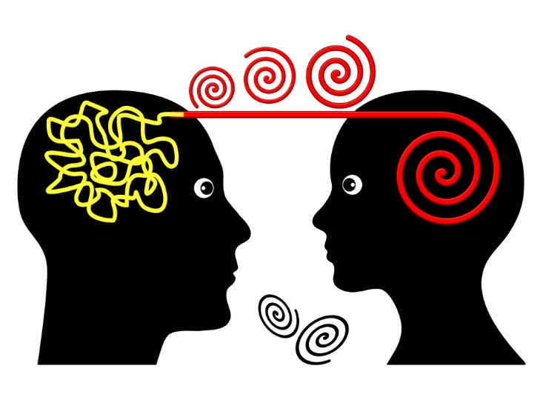
College Options
(click on picture)
Notes:
Sal Khan's story: Exploring college options
Hear how Sal determined where to apply for college.
http://youtu.be/3fEIvVnGUcI

Slide 18

Discussions
  Friends
  Family
  Guidance counselor
  Teachers
Notes:
Discuss your options with those key influential people in your life who you can trust with major decisions. Weight your options with those whom you know have your best interests at heart and can give sound advice.

Slide 19

The End Result
  Jobs
  Career
Notes:
Select a college that will be able to help you in obtaining a degree and potential position as an educator. Most colleges will host career fairs with several school districts to help you get your first teaching job prior to graduation. It is a wonderful feeling to have your job lined up before walking across the graduation stage when many students are still applying for the perfect job.

Slide 20
Review
  According to the Bureau of Labor Statistics forecasts, what is the need for elementary school teachers?
  Educator preparation programs should be _________-focused, ________-centered and _______-based.
  Describe a typical degree program for candidates who wish to obtain certification to include coursework in general education.
  What are two examples of supplemental certifications which may be added to a degree?
  What are three factors to consider when deciding on a college?

Slide 21

Questions

Slide 22
References and Resources
  Images:
    Photos obtained through a license with Shutterstock.com™
  Textbooks:
    Diaz, C., Pelletier, C. & Provenzo, Jr., E. (2006). Touch the future: teaching! Boston, MA: Pearson Education, Inc.
    Kauchak, D. & Eggen, P. (2014). Introduction to teaching: becoming a professional. (Fifth ed.). Saddle River, NJ: Pearson Education, Inc.
    Morrison, G. (2012). Early childhood education today. (Twelfth ed.). Upper Saddle River, NJ: Pearson Education, Inc.
  Websites:
    AchieveTexas:
      AchieveTexas College and Career Initiative is an education initiative designed to prepare students for a lifetime of success. It allows students to achieve excellence by preparing them for secondary and postsecondary opportunities, career preparation and advancement, meaningful work, and active citizenship.
      www.txcte.org

Slide 23
References and Resources
  Websites:
    College for All Texans:
      Students can be inspired, explore colleges and apply for college at this one-stop shop.
      http://www.collegeforalltexans.com/
    National Council for Accreditation of Teacher Education (NCATE)
      What makes a teacher effective?
      http://www.ncate.org/public/researchreports/teacherpreparationresearch/whatmakesateachereffective/tabid/361/default.aspx
    Stephen F. Austin State University
      The James I. Perkins College of Education includes the Departments of Elementary Education, Human Services, Kinesiology and Health Science, and Secondary Education and Educational Leadership, and the School of Human Sciences.
      http://www.sfasu.edu/documents/05-education.pdf

Slide 24
References and Resources
  YouTube::
    Sal Khan's story: College admission
      Information on navigating the college applications, admissions and paying for college
      http://youtu.be/cGg1j1ZCCOs
    Sal Khan's story: Exploring college options
      Hear how Sal determined where to apply for college.
      http://youtu.be/3fEIvVnGUcI

