Slide 1
Advanced Clipper Cutting for Men

Slide 3
Evelyn Lauder, American businesswoman, socialite and philanthropist
“One of the most important things about looking youthful is to have a modern haircut.”

Slide 4







Men’s Haircuts
Business opportunities are endless
Men cut their hair every 3 to 5 weeks
Loyal clientele

Slide 5
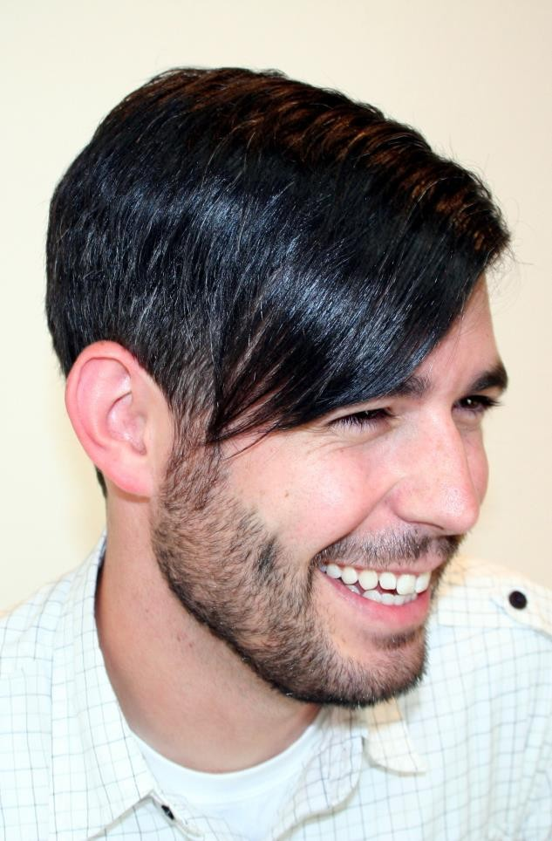
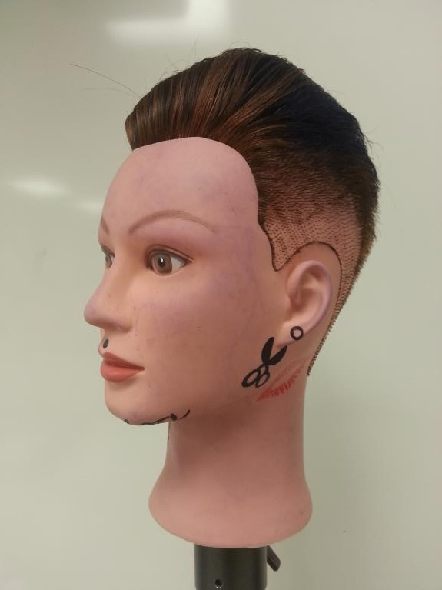

Trends in Men’s Styling

Slide 6
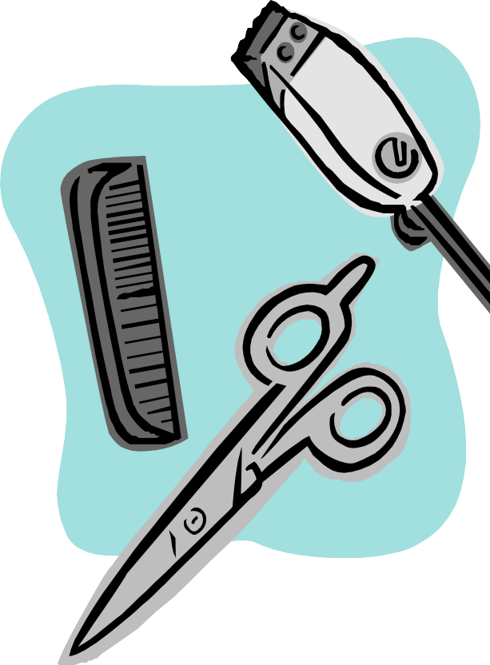
Clipper Cuts and Trimmers
Clipper-over-comb
Clipper cutting with attachments
Men’s clipper cut
Trimmers

Slide 7
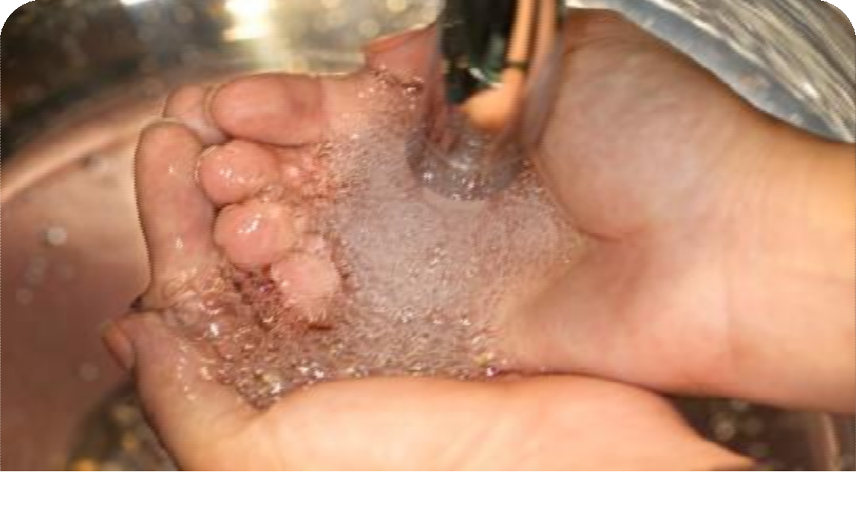
Reminder
Safety and Sanitation Precautions - Cosmetology Administrative Rules

Slide 8
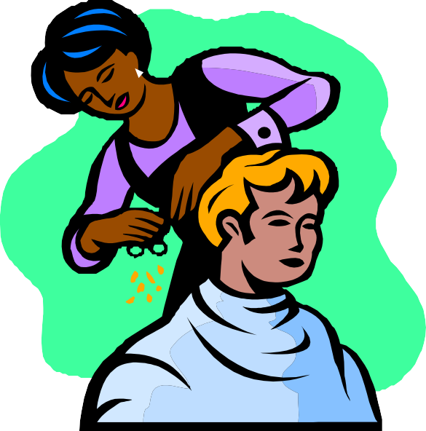
Body Positioning and Posture
Position your client
Center your weight
Work in front of your section

Slide 9
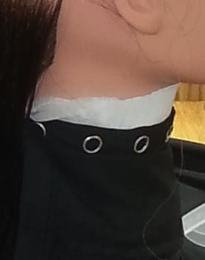
Draping
Neck strip
Cutting cape

Slide 10
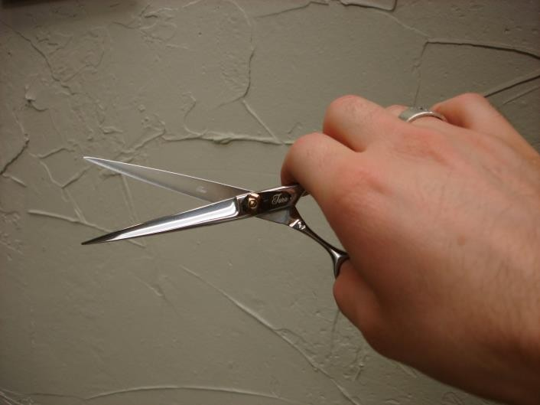
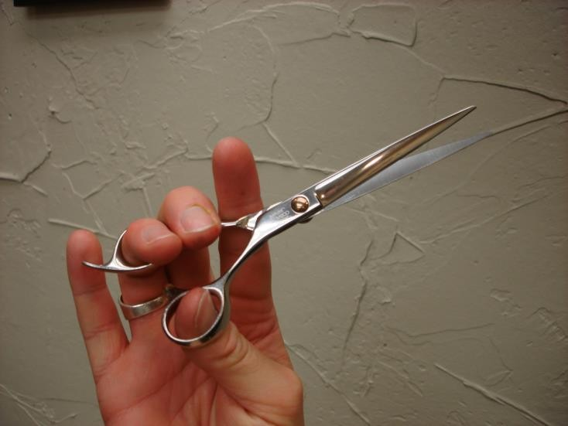
Handling Scissors
Haircutting shears
  Place thumb in moving blade (bottom)
  Place ring finger on top blade
  Rest index and middle finger on the shank
  Practice opening and closing blade

Slide 11
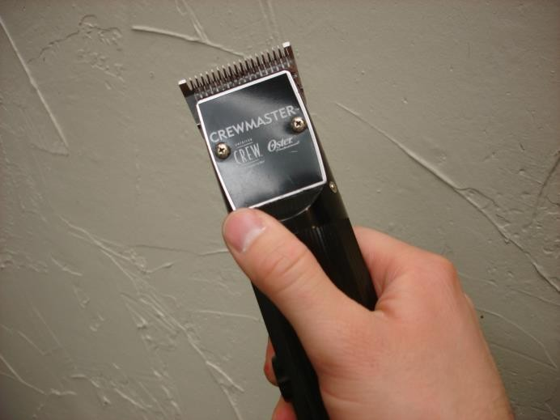
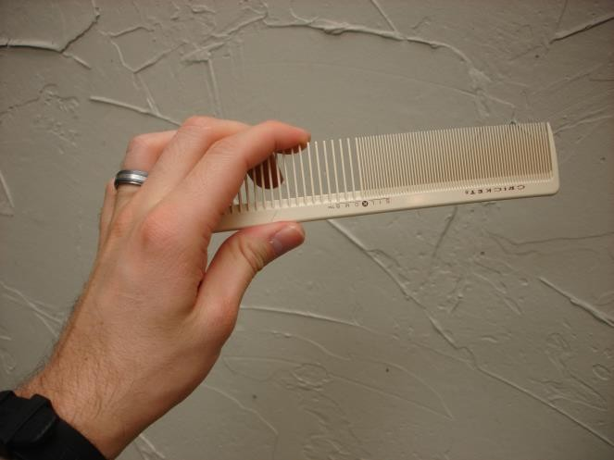
Handling Equipment
Clippers
Classic Barbering Comb
  Proper hold give you the most control and best results
  Helps avoid muscle strain on hands, arms, neck and back

Slide 12
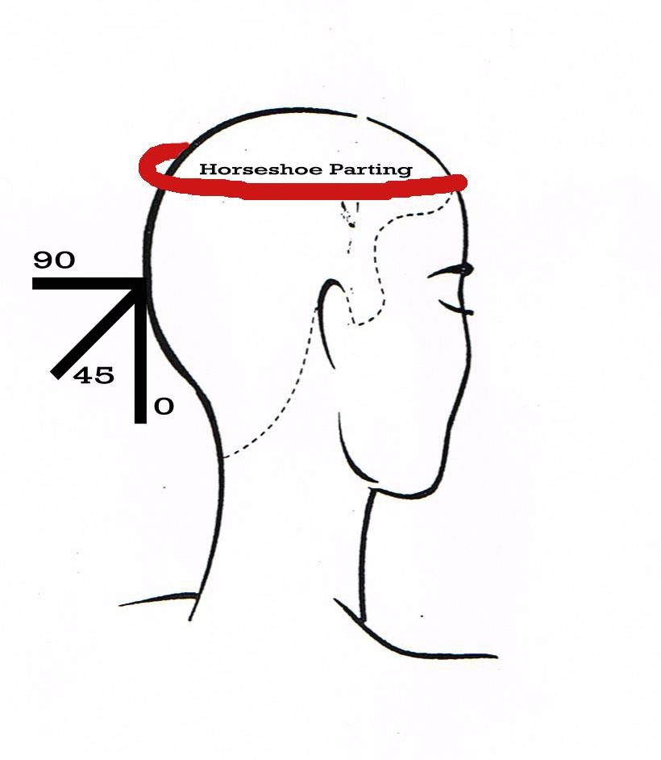
Proper Sectioning and Guidelines
Horseshoe Parting
Moving Guideline

Slide 13
Starting the Guideline
Start at the nape area
Place the haircutting comb against the scalp, teeth up
Angle the comb 45 degrees
Cut the hair that extends through the comb
Hands On Hair Cutting Classes - Part 1 of 3
(click on link)

Slide 14
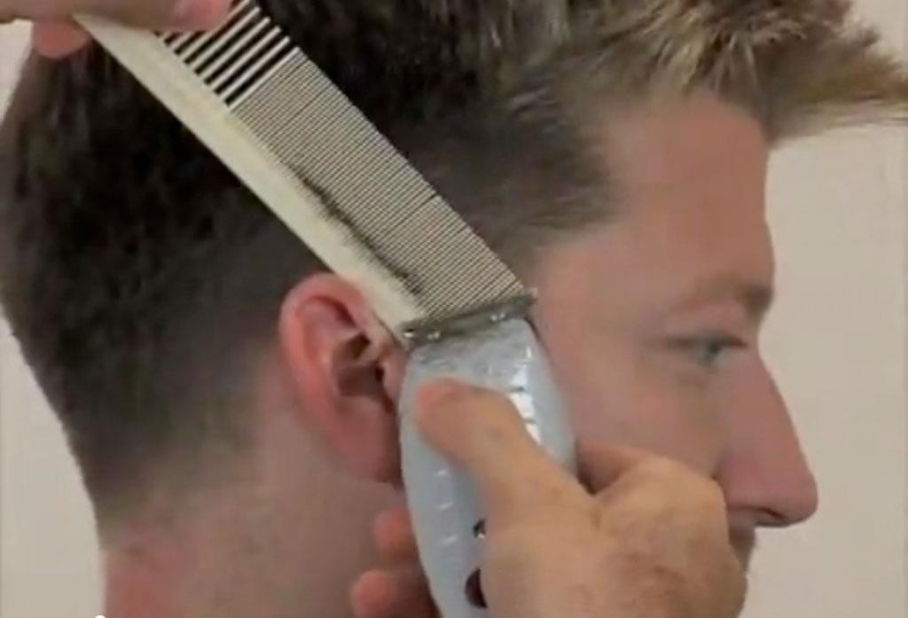
Tapering
Blended haircut
Done with clipper guard attachments
Use caution along the front hairline
Men's Hair Cut by Ardem Keshishian - Part 2 of 3
(click on link)

Slide 15
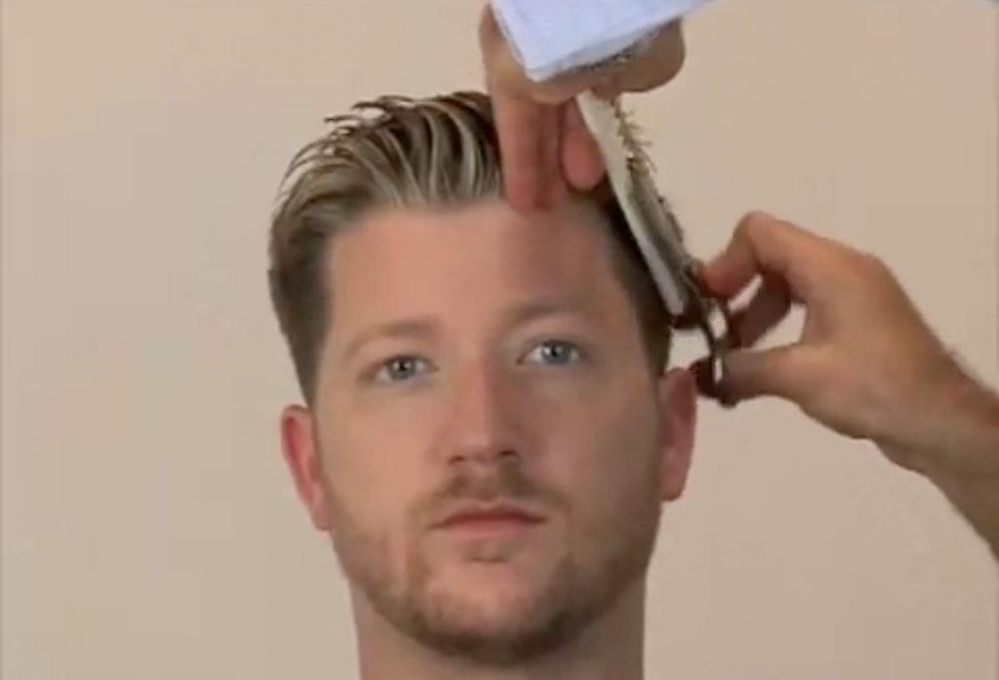
Blending
A smooth transition from the sides to the top
Tools
  Thinning shears
  Wide tooth comb
Hands on Men's Hair Cutting Classes - Part 3 of 3
(click on link)

Slide 16
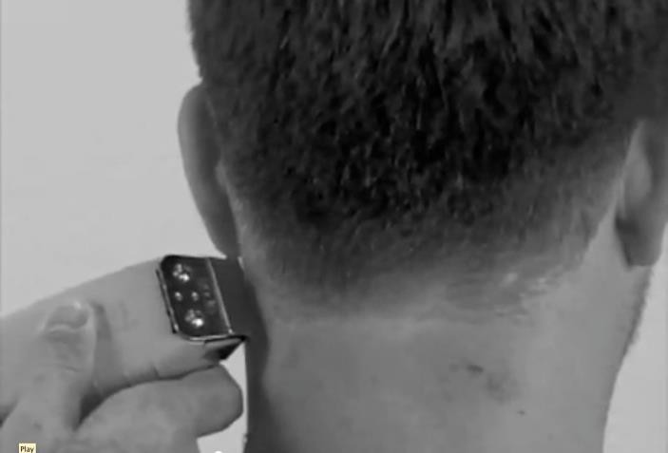
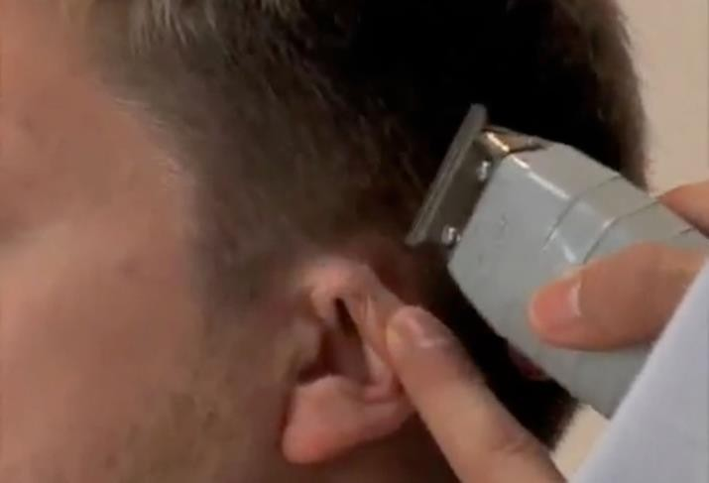
Trimmers
Create detail
Cleans necklines and around ears

Slide 17
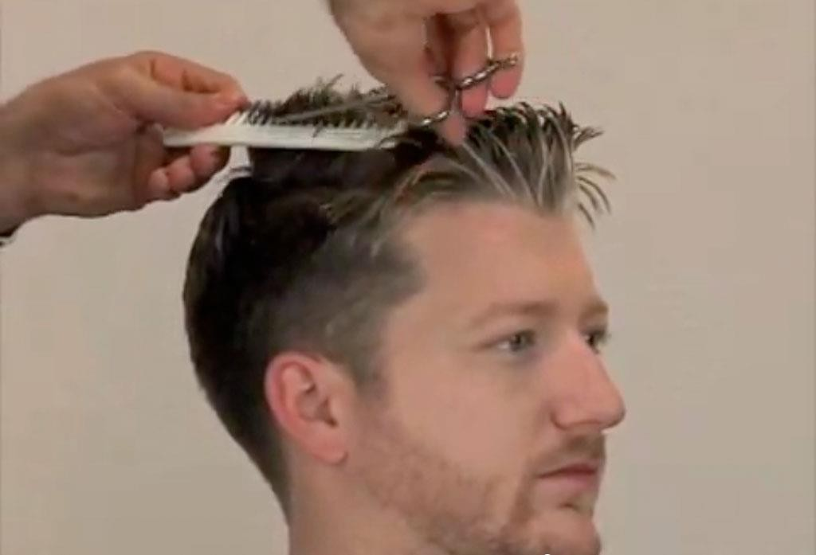
Cross-Checking
Check for consistency
Clean sections that are not accurate

Slide 18
Review
What cutting angles previously learned helped us create the basic shape of today’s cut?
What is a taper and how does it affect the outcome of your haircut?
How do you appropriately drape a client for a men’s haircut?
Why is it important to follow all safety and sanitation procedures?
How will these techniques help you build a steady men’s clientele?

Slide 19
References
Images:
Ardem Keshishian, Master Stylist and Salon Owner: Used with permission from Salon D, Dallas, Texas.
B. Rodriguez, Licensed Cosmetology Instructor: Used with permission from Brian Dangerous Hair.
Microsoft Office Clip Art: Used with permission from Microsoft.
Textbook:
Milady standard cosmetology: Situational problems. (2012). Clifton Park, NY: Cengage Learning. YouTube™: Hands on Men's Hair Cutting Classes by Ardem Keshishian in North Dallas Men's Cut Part 1 of 3. Salon D Dallas, Texas http://youtu.be/RWb2ahezTnY
Men's Hair Cut by Ardem Keshishian in Dallas Men's Cut Part 2 of 3. Salon D Dallas, Texas http://youtu.be/y2keTaFBSg4
Hands on Men's Hair Cutting Classes by Ardem Keshishian in Dallas Men's Cut Part 3 of 3. Salon D Dallas, Texas http://youtu.be/7e9rErcv-14

