Slide 1
Adventures in Travel
Planning a Texas Vacation

Slide 3
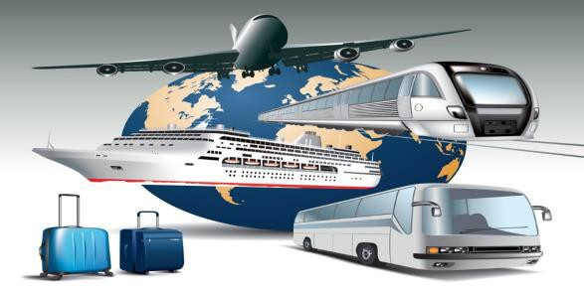
What is a Vacation?
  A period of time during which a person rests and is free from daily obligations, such as work and school
Notes:
Most people travel away from home on their vacations.
A travel decision is a conclusion or resolution reached after consideration of several factors that could affect vacations.
What are some of the places you have been on vacation?

Slide 4

Travel Decisions
  Budget
  Destination
  Lodging
  Meals
  Recreation
  Time
  Transportation
Notes:
Lots of decisions need to be made when planning a vacation.
Begin by trying to answer the following questions:
How much money can you spend?
Where will you go?
Where will you stay? With family? In a hotel, motel or inn?
Where will you eat? How many meals can you afford to eat out?
What will you do for entertainment?
How long will you stay?
Will you travel by car, plane, train, boat or recreational vehicle (R.V.)?

Slide 5

FCCLA Planning Process
  Identify concerns
  Set a goal
  Form a plan
  Act
  Follow up
Notes:
Utilizing the FCCLA Planning Process may help in making decisions.
The Planning Process is a decision-making tool that supports the organization’s overall philosophy about youth- centered leadership and personal growth. It can be used to determine group action in a chapter or class or to plan
individual projects.
IDENTIFY CONCERNS
Brainstorm to generate ideas, or state the activity or problem you want to address if already determined.
Evaluate your list and narrow it down to a workable idea or project that interests and concerns the majority or all of your members.
SET A GOAL
Get a clear mental picture of what you want to accomplish, and write your ideas down as your goal.
Make sure your goal is one that can be achieved and evaluated.
Consider resources available to you.
FORM A PLAN
Decide what needs to be done to reach your goal.
Figure out the who, what, where, when, and how.
List the abilities, skills, and knowledge required on your part.
List other available resources, such as people, places, publications, and funds.
Make a workable timetable to keep track of your progress.
List possible barriers you might face, and develop plans if necessary.
Decide ways to recognize your accomplishments along the way.
ACT
Carry out your group or individual plan.
Use family and community members, advisers, committees, task forces, and advisory groups when needed.
FOLLOW UP
Determine if your goal was met.
List ways you would improve your project or plan for future reference.
Share and publicize your efforts with others, including the media if appropriate.
Recognize members and thank people involved with your project.

Slide 6

Budget
Money to spend on:
  Entertainment
  Food
  Gifts
  Lodging
  Transportation
Notes:
How much money will be needed for all the items listed above?
A budget should include enough money to cover the items and any emergencies that may occur.
A budget plan may also include unexpected emergencies just in case.

Slide 7

Destination
  Beach
  Camping
  Festival
  Historical sites
  Natural wonders
  Sporting events
  Theme and Amusement parks
  Other
Notes:
There are so many places to go on vacation to:
enjoy
explore
rest
relax
Can you think of other destinations to vacation?

Slide 8



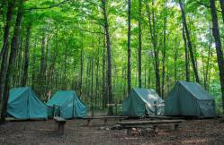
Lodging
  Bed and Breakfast
  Campgrounds
  Hotel
  Inn
  Motel
  Resort
Notes:
Lodging means a place to sleep for one or more nights.
The lodging industry consists of businesses that provide overnight accommodations. They vary from expensive to budget motels and camping.

Slide 9
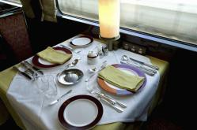
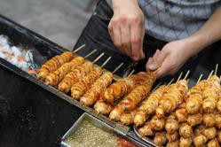
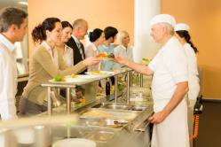
Meals
  Cafeterias
  Carryout
  Full-service restaurants
  Quick-service restaurants
  Street vendors
Notes:
Meals can range from casual to fancy and can range from inexpensive, moderate, to very expensive.

Slide 10
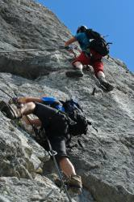


Recreation
  Attractions
  Entertainment
  Participatory sports
  Spectator sports
Notes:
Recreation is any activity that people do for rest, relaxation and enjoyment.
Attractions – are places of special interest to visit, such as:
historical sites
natural scenery
museums
zoos
Entertainment – provide a show for you to watch, such as:
concerts
live theater
movies
Participatory sports – are sports that you take part in yourself, such as:
mountain climbing
skiing
snowboarding
Spectator sports – are sports that you watch others play, such as:
baseball
basketball
football

Slide 11

Time
Number of nights and days on vacation
  Holiday weekend
  Long weekend
  Month
  Overnight
  Seven day cruise
  Two weeks
Notes:
Travel for pleasure has changed in recent years with people taking shorter vacations more often.
It includes trips of varying lengths, from short to long.

Slide 12
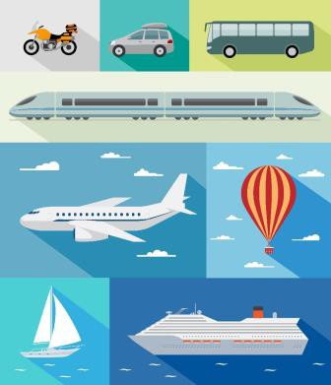
Transportation
  Boat
  Bus
  Car
  Motorcycle
  Plane
  Recreational vehicle (R.V.)
  Train
Notes:
The travel industry consists of businesses that physically move people from one place to another.
Some destinations are so far away, they require a boat or a plane to get there. Others may be closer, so travelers can transport themselves, take a bus or a train.

Slide 13
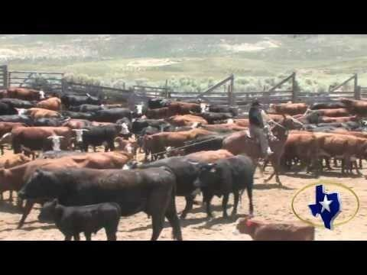
Let’s Plan a Texas Vacation!
Let’s Plan a Texas Vacation
Deep in The Heart of Texas Song
Click on text above
Notes:
Click on image and allow students to sing along:
Deep In The Heart Of Texas Texas Chamber Of Commerce http://youtu.be/VGF4ibgcHQE

Slide 14
Resources and References
Images:
  Family, Career, and Community Leaders of America (FCCLA). FCCLA Logo with Tagline http://www.fcclainc.org/ (Slide 6)
  Shutterstock™ images. Photos obtained with subscription. (Slides 1,3,4,5,7,8,9,10,11,12,13,15)
  Textbook:
  Reynolds, Johnny Sue. (2010) Hospitality Services. Tinley-Park, Illinois: The Goodheart-Willcox Company.
Website:
  Texas It's Like a Whole Other Country http://www.traveltex.com/
YouTube™:
  Deep In The Heart Of Texas
    Texas Chamber Of Commerce http://youtu.be/VGF4ibgcHQE

