Slide 1
Assisting in the Development of Children with Special Needs
Child Guidance

Slide 3
Children with Special Needs
Developmental disabilities
Physical disabilities
Emotional problems
Giftedness
Notes:
Children with conditions such as developmental disabilities, physical disabilities, emotional problems or giftedness are children with special needs. Understanding these needs helps in caring for these children. A variety of professionals can help these children with special needs. Caregivers should know the child care facility’s policy for referring children to professionals. Caregivers must also know how to create a positive environment for children with special needs in their care.

Slide 4
Understanding Special Needs
Heredity and environment:
Hereditary factors include the genetic history and make-up of a person
Environmental factors affect the fetus after conception or after child birth
Notes:
Heredity and environment influence the special needs in individuals. Hereditary factors include the genetic history and make-up of a person. Environmental factors affect the fetus after conception or the child after birth.
Many environmental factors can create special needs in children. These factors may include:
Accidents
Alcohol
Child abuse
Drugs
Illness
Poor nutrition
How can an illness create a special need? For example, repeated middle ear infections, if untreated, can cause hearing loss. Such hearing loss can result in slow language development. Poor nutrition, especially a lack of protein, can cause permanent brain damage. Accidents with cars, poisonous substances and unsafe surroundings often cause disabilities in children. Child abuse can lead to physical and emotional disabilities.
Often the exact cause of a child’s disability is unknown. Experts are learning more about the development of children with special needs. Some disabilities can provide helpful information with parents and others about the prevention of disabling conditions in children.

Slide 5
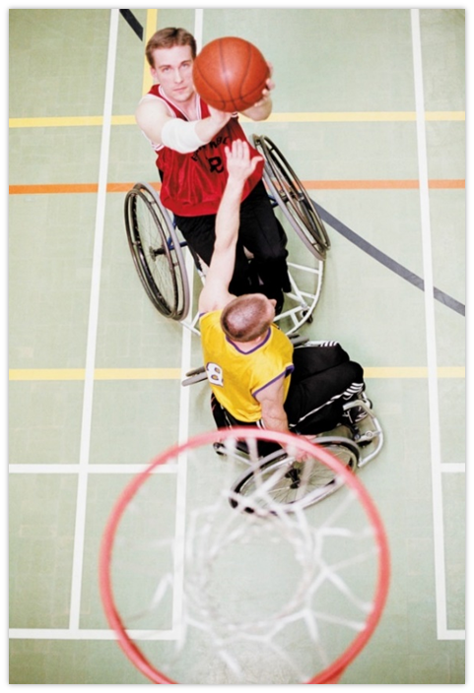
The Nature of Special Needs
A disability is any condition that prevents, delays or interferes with a child’s normal achievement and development.
Developmental
Learning
Physical
Sensory
Notes:
A disability is any condition that prevents, delays or interferes with a child’s normal achievement and development. Developmental disabilities impair a child’s cognitive functioning. Learning disabilities result in reasoning and perceptual problems. Physical disabilities include deformities and diseases of the spine, bone, muscles and joints, as well as other health problems. Sensory disabilities include hearing and vision problems.
Other disabilities may be related to speech and language disorders. Behavioral problems include social and emotional adjustments. Giftedness refers to children with a greater than average ability to learn, reason and create. Often this category is called “gifted and talented.” Children with special needs are classified on the basis of the area of greater need. Each child has unique needs and cannot be described by these categories except in general terms.

Slide 6
Developmental Disabilities
Some goals for the care and education of children with developmental disabilities are as follows:
Expanding language skills
Increasing attention span
Learning self-help skills
Mastering basic concepts
Notes:
Developmental disabilities involve cognitive functions which are much lower than average. Poor cognitive development usually prevents a person from functioning well in everyday life. Such deficiencies are obvious during a child’s life.
Developmental disabilities are some of the most common causes of special needs in children. In the past, children with developmental disabilities were referred to as children with mental retardation. Today the disability is called intellectual disability (ID). Children identified with developmental disabilities are grouped into four categories: mild, moderate, severe and profound. Child care programs are most likely to include children with mild or moderate developmental disabilities. These children may be slower than average in some areas of their development. They learn to use the toilet, feed themselves or talk several months later than most children their age. In the classroom, the child with a developmental disability needs more time and more repetition to learn new tasks. Tasks should be broken down and presented in a step-by-step manner. Some goals for the care and education of children with developmental disabilities are as follows:
Expanding language skills
Increasing attention span
Learning self-help skills
Mastering basic concepts

Slide 7
Learning Disabilities
A learning disability involves a disorder in understanding or using spoken or written language.
A child with a learning disability may be unable to listen, think, speak, spell or calculate mathematical problems.
Notes:
A learning disability involves a disorder in understanding or using spoken or written language. A child with a learning disability may be unable to listen, think, speak, spell or do mathematical problems.
Learning disabilities are most obvious in the academic classroom settings. Therefore, children with learning disabilities may not be diagnosed until the elementary school years. Traits of learning disabilities in young children may include hyperactivity, impulsiveness, perception (recognition) problems or poor memory. Each of these characteristics in some way makes learning difficult for children with learning disabilities.
There are many theories about what causes learning disabilities. Causes may range from genetic defects to diet. Knowing the exact nature of each child’s needs helps in caring for children.
Why are learning disabilities frequently not diagnosed until a child is in school?
What symptoms of learning disabilities can caregivers look for in preschool children?

Slide 8
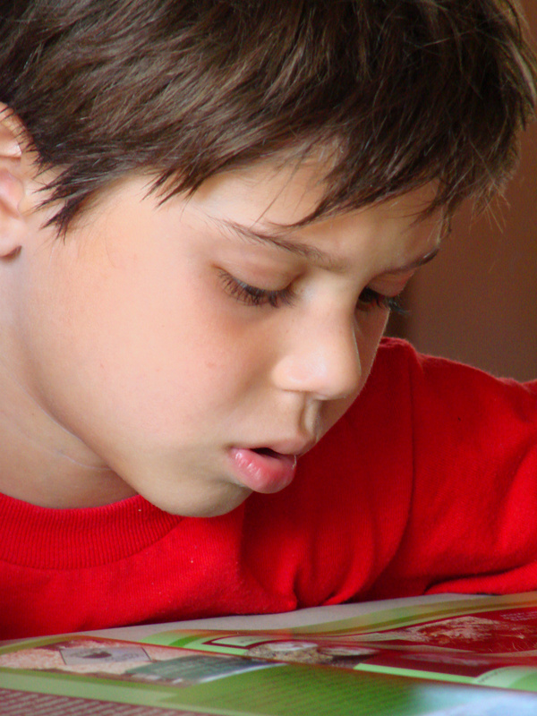
Dyslexia – A Learning Disability
Notes:
What is it like to have dyslexia? Animations and Illustrations
This is a series of animations taken from a project aimed at helping people to find out what it is like to have dyslexia.
http://youtu.be/gwZLFTW4OGY

Slide 9
Strategies for Working with Learning Disabled Children
The following strategies are suggestions for working with learning-disabled children:
Behavior modification
Multi-sensory training
Task analysis
Notes:
The following strategies are suggestions for working with learning-disabled children:
behavior modification
multi-sensory training
task analysis
Task analysis involves breaking down a job into small steps. For example, teaching how to brush teeth may be broken down into holding a tube of toothpaste, unscrewing the cap, putting toothpaste on the brush, and other small steps involved.
Multi-sensory training helps children learn through use of several senses at one time. An example might be guiding children outdoors to watch, listen, look and hunt for various items which are described by the caregiver.
Behavior modification is a method of changing a person’s behavior through carefully planned consequences for specific behaviors. For example, behavior modification is often used to teach self-help skills such as learning to use the restroom or cleaning up after oneself. For each appropriate behavior of the child, the caregiver responds with praise, a reward or some type of positive reinforcement.

Slide 10
Physical Disabilities
Physical disabilities limit physical movement or result in chronic health problems.
Since children learn through physical activity, physical limitations may affect other areas of development.
Notes:
Physical disabilities limit physical movement or result in chronic health problems. These conditions include deformities in the spine, muscles, joints or bones. Missing or paralyzed limbs (arms and legs) also limit movement. Allergies, diabetes, epilepsy or congenital heart defects are examples of chronic health problems that may affect children.
Since children learn through physical activity, physical limitations may affect other areas of development. The effect of the condition depends on the type of disability. A child with cerebral palsy, for example, may be unable to control muscle movement. This may make speech and small muscle coordination difficult.

Slide 11
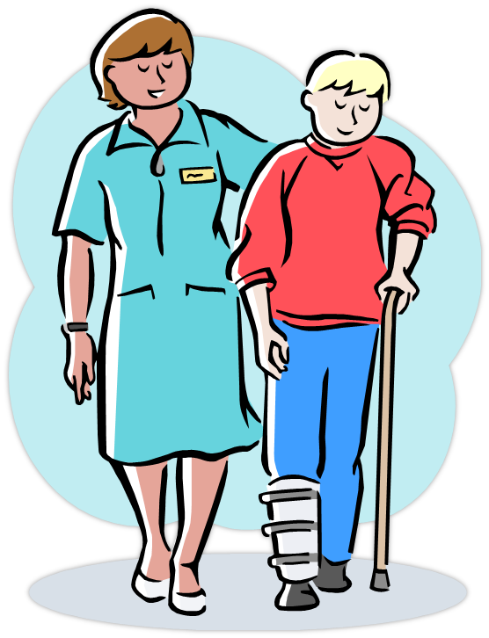
Physical Disabilities
Learn as much as you can about each child’s special issues.
Notes:
Caregivers who care for children with physical disabilities need to learn about each child’s special needs. Some of the following guidelines may apply:
Arrange the environment to allow freedom of movement for the child. Remove the barriers.
Check the child’s equipment frequently to be sure it is working and fitting properly.
Help the child learn self-help skills.
Encourage the child to be actively involved with the group.
Know first aid procedures for the child with epilepsy or other chronic health problems.
Know how to help the child with braces, a prosthesis (an artificial body part, such as an artificial arm or leg) or other equipment.
Learn from the child’s therapists how to properly position the child.
Work with dietitians or specialists to follow the child’s nutritional program.

Slide 12
Sensory Disabilities
Vision and hearing problems fall into the category of sensory disabilities.
Loss or impaired use of a sense greatly affects a child’s life and learning abilities.
With good support and education, children can overcome their disabilities and live normal lives.
Notes:
Vision and hearing problems fall into the category of sensory disabilities. Loss or impaired use of a sense greatly affects a child’s life and learning abilities. However, most of these children are intelligent. With good support and education, they can overcome their disabilities and live normal lives. Children with visual impairments have vision problems even after corrective measures have been taken. They may be partially sighted (have lost most or all vision) or may be blind. Some children who are legally blind tend to have a small amount of vision.
Children who are blind from birth or early infancy tend to progress slower in some areas. For example, poor vision makes it more difficult to understand object permanence and gain locomotor skills. Children with visual impairments cannot gather as much information from their surroundings as sighted children. Therefore, their experiences are limited. Their development of concepts about the world may be slower. Professionals can teach children such skills as mobility, Braille reading or use of visual aids.

Slide 13
Sensory Disabilities
Caregivers who work with visually impaired children can aid their development in the following ways:
Encourage children to make full use of any remaining vision.
Help children develop other senses fully.
Organize an environment so that it is easy to move around.
Translate what others learn through vision into one of their other senses.
Notes:
Caregivers who work with visually impaired children can aid their development in the following ways:
Encourage children to make full use of any remaining vision.
Help children develop other senses fully.
Organize an environment so that it is easy to move around.
Translate what others learn through vision into one of their other senses.

Slide 14
Sensory Disabilities
Caregivers who work with children who have hearing impairments need to be aware of each child’s individual needs. In general, caregivers may use strategies such as:
Cooperate with each child’s speech therapist. Learn how to speak for lip reading or master sign language. Be able to communicate with the child in his or her own way.
Encourage children to use as much of their remaining hearing as possible.
Face the children when speaking to them.
Use a natural tone of voice and avoid exaggerated lip movements.
Notes:
Children with hearing impairments may be classified according to degree of hearing loss. Children who are hard of hearing will not be able to hear soft sounds, such as a whisper. They may need to use a hearing aid. Children who are classified as deaf are not easily able to hear spoken language, but they may be able to hear sounds like thunder. These children need special training to learn communication skills.
Children who have hearing impairments have trouble with listening and speaking skills. Their needs differ depending on when the hearing loss occurred. During the first three or four years, children with normal hearing learn many language skills. Children who lose their hearing before learning to talk need special training to learn to speak.
Caregivers who work with children who have hearing impairments need to be aware of each child’s individual needs. In general, caregivers may use strategies such as:
Cooperate with each child’s speech therapist. Learn how to speak for lip reading or master sign language. Be able to communicate with the child in his or her own way.
Encourage children to use as much of their remaining hearing as possible.
Face the children when speaking to them.
Use a natural tone of voice and avoid exaggerated lip movements.

Slide 15
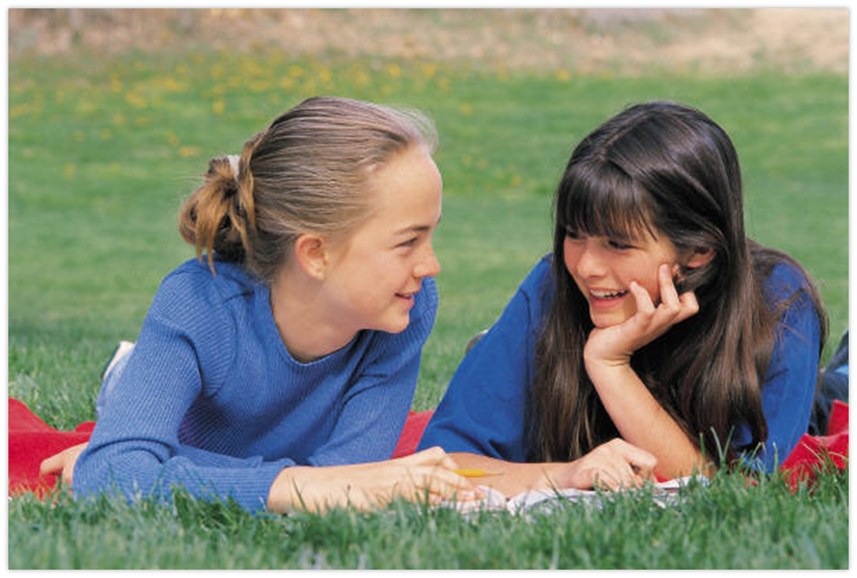
Communication Disorders
A child has a communication disorder when he or she is unable to speak or understand spoken language. Four categories of speech impairments are identified:
Articulation disorders
Fluency disorders
Language disorders
Voice disorders

Slide 16
Communication Disorders
Caregivers of children with communication disorders need to learn about each child’s special needs. The following guidelines apply to children with speech impairments:
Accept and reinforce all attempts by the child to use speech
Be a good speech model
Be patient when listening. Give the child your full attention and plenty of time to speak
Know where the child is in regard to learning language, and help the child move to the next level
Provide activities and objects to increase the child’s vocabulary.
Notes:
Caregivers who care for children with communication disorders need to learn about each child’s special needs. The following guidelines apply to children with speech impairments:
Accept and reinforce all attempts by the child to use speech.
Be a good speech model.
Be patient when listening. Give the child your full attention and plenty of time to speak.
Know where the child is in regard to learning language, and help the child move to the next level.
Provide activities and objects to increase the child’s vocabulary.

Slide 17
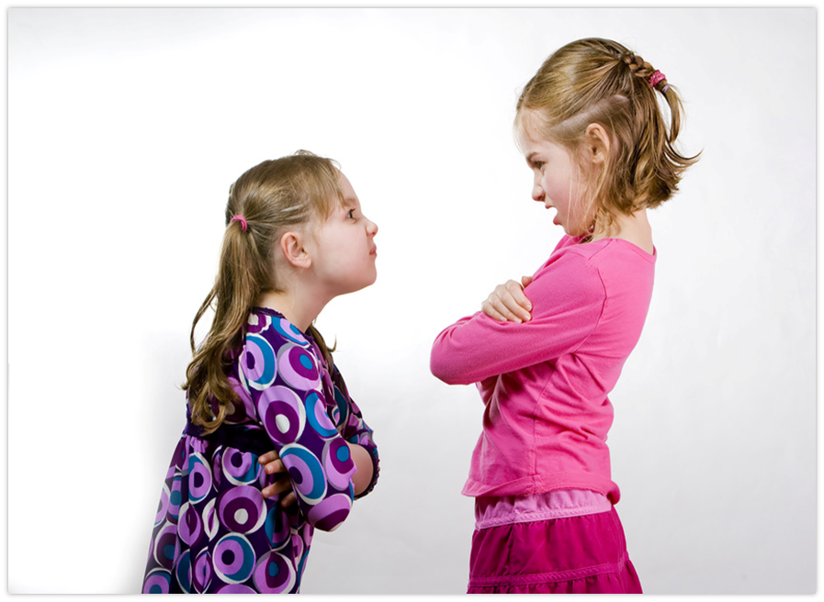
Emotional/Behavioral Disorders
Two major categories:
Hyperactive-aggressive
Anxious-withdrawn
Notes:
Children who have unusual behavior regularly over a long period of time may have an emotional/behavioral disorder. Unusual behaviors are behaviors that are not appropriate for the child’s age or cultural group. Experts have named many categories for behavioral disorders in children. The two major categories are hyperactive-aggressive and anxious-withdrawn.

Slide 18
Emotional/Behavioral Disorders
Hyperactive-aggressive
Defiant toward adults
Destruction of property
Inability to stay with a task or wait to be rewarded
Inappropriate attention-seeking behavior
Need for frequent intervention from adults
Solitary, disordered and agitated play style
Anxious-withdrawn
Ability to be easily frustrated
Excessive dependence on adults and peer leaders
Fearfulness
Lack of self-confidence
Shyness or watching from a distance
Tendency to be depressed
Notes:
The child who is hyperactive-aggressive may demonstrate the following characteristics:
Defiant toward adults
Destruction of property
Inability to stay with a task or wait to be rewarded
Inappropriate attention-seeking behavior
Need for frequent intervention from adults
Solitary, disordered and agitated play style
The child who is anxious-withdrawn may demonstrate the following characteristics:
Ability to be easily frustrated
Excessive dependence on adults and peer leaders
Fearfulness
Lack of self-confidence
Shyness or watching from a distance
Tendency to be depressed
Any behavior of children who are hyperactive-aggressive or anxious-withdrawn may be seen in normally developing children. However, such behaviors or emotional states occur more frequently among children with these disorders.
Patience, self-confidence and good child guidance techniques are very important for caregivers of children with emotional/behavioral disorders. Some of the following guidelines may be used:
Establish and consistently apply classroom or group rules.
Learn as much as possible about the child’s strengths, needs and responses.
Learn to use effective guidance techniques for group management and for teaching appropriate behavior.
Plan and adjust surroundings to avoid encouraging inappropriate behavior.
What characteristics might be displayed by a child who is hyperactive-aggressive?
What characteristics might be displayed by a child who is anxious-withdrawn?

Slide 19
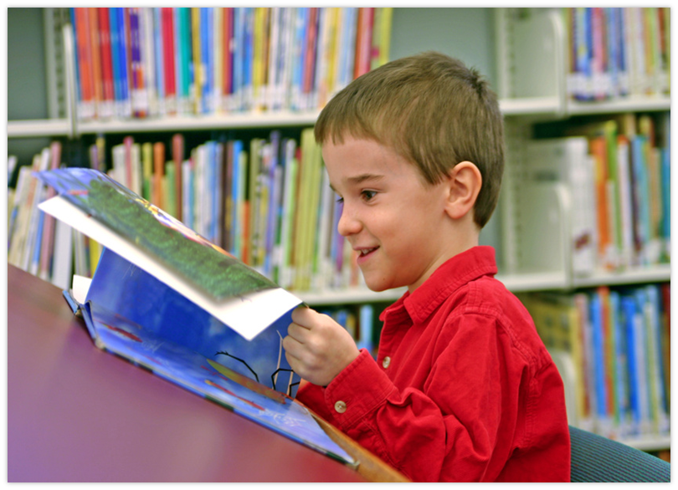
Gifted/Talented Children
Need a stimulating environment. Some of the following guidelines may be useful:
Encourage interest the child shows in different areas. Serve as a resource person.
Help children develop observations skills and reasoning abilities.
Provide a rich and stimulating learning environment.
Provide opportunities for the children to take leadership roles within the group.

Slide 20
Special Needs, But No Diagnosis
Notes:
Special Needs, But No Diagnosis - The Azima Family - Our Special Life -- Episode 7
Kingston is a 4-and-a-half year old boy with special needs that have not yet been diagnosed. He presents some symptoms of Angelman Syndrome but has so far tested negative for that diagnosis. His mother and nanny work with him full-time, along with his Special Education Itinerant Teacher (SEIT), to develop the Activities of Daily Life (ADL) many parents take for granted.
http://youtu.be/LPzNjX_8NFQ

Slide 21
Detecting Children Who Have Special Needs
Notes:
Caregivers play an important role in identifying and caring for children with special needs. Through training and experience, caregivers understand normal patterns of child growth and development. They understand the sequence and age level for developing skills. When a caregiver sees a major delay or problem in a child’s development, the child is referred to a specialist, teacher or other professional for assessment.
Remember that children develop at different rates and that the range of “normal” development is broad. However, early detection of developmental problems is important. The sooner a child is referred, the sooner he or she can begin receiving help.

Slide 22
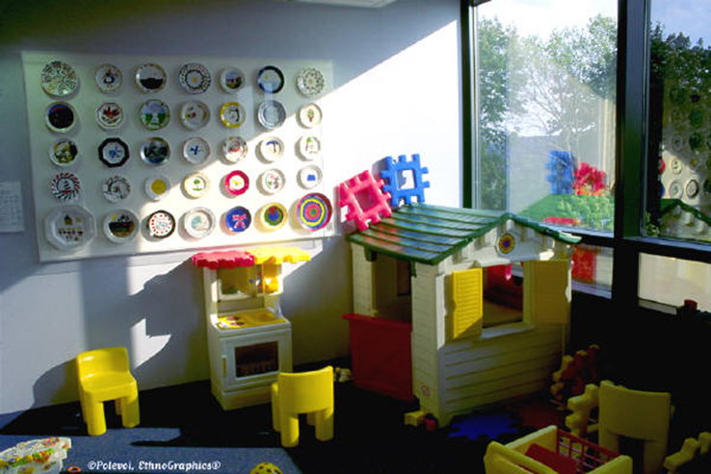
Role of Professionals
Appreciation of individual differences
Arranging the environment
Assessment
Encouraging cooperation
Encouraging independence
Encouraging positive interactions
Mainstreaming/Inclusion
Schedule planning
Notes:
As a professional of special needs children, you have many important roles to fulfill such as:
Appreciation of individual differences – Each child has special qualities which make him or her different from every other child. Caregivers should develop positive attitudes about individual differences in children. Such attitudes help caregivers serve as role models for children in their care. Caregivers should be aware of their own biases and feelings about children with disabilities or gifted children.
Arranging the environment – Rooms should be arranged so that children can move around freely and have easy access to all areas used. There should be a large open area for group activities and large muscle play. Several small areas should be planned for learning centers, small group activities or private, quiet activities. Avoid rearranging rooms, especially when children have physical or visual disabilities.
Assessment – Assessment involves a detailed evaluation of a child’s growth and development. Professionals determine the child’s areas of strengths and weaknesses and may be able to diagnose certain disabilities. Several professionals may participate in the assessment depending on the child’s needs. Caregivers can assist children with special needs by giving them individualized care. Such care should be based on a professional assessment and recommendation.
Encouraging cooperation – Promote positive interactions by providing materials and learning experiences which encourage cooperation. Such materials as blocks, dramatic play props and table games encourage children to play together. Plan learning experiences that give children a chance to interact positively.
Encouraging independence – Independent living is a major lifetime goal of children with disabilities. Caregivers may be tempted to perform tasks for children with disabilities but should avoid these temptations. Children with disabilities should be allowed to perform everyday tasks that they can do for themselves. This accomplishment builds self-confidence and gives a sense of independence to these children. Children can learn to care for their own needs through new and repeated experiences.
Encouraging positive interactions – There are many benefits when all children, with and without special needs, are educated and cared for together. Positive group interactions do not happen automatically. Caregivers must work to encourage positive group interactions. Plan and follow a well-balanced daily schedule to allow time to for positive interactions.
Mainstreaming/Inclusion – Mainstreaming is the process of placing individuals with disabilities into the general education or community environment. The term is now not recommended because of its association with the perceived “dumping” of students into general educational classes without the support they need (Kasser & Lytle, 2004).
Mainstreaming and Inclusion, the two terms are related, but are quite different. In mainstreaming, as in partial inclusion, an individual with a disability’s home classroom is a special education classroom. However, students who are mainstreamed will spend most of their day learning side by side with their general education peers. In mainstreaming the students are usually expected to keep up with the rest of their peers without significant supplementary aids and support services. This supports and values having individuals with disabilities interact with student without any disabilities. Inclusion is a philosophy that states all individuals, regardless of ability, should participate within the same environment with necessary support and individualized attention. Inclusion is more than simply placing individuals together, it’s a belief that all individuals belong and are valued (Kasser & Lytle, 2005). Children need caring adults to provide love security, safety and a positive environment. They need good surroundings to stimulate and support their development.
Schedule planning – The daily schedule may need to be more structured than usual for children with special needs. Much unstructured playtime may be difficult for such children. During a scheduled free choice time, limit the number of choices given. Spend a few minutes directing the child in a specific activity.
A well-balanced schedule should include carefully planned transition activities. Check on the child’s status in terms of task completion. If needed, delay the transition or remind the child in advance that an activity period is ending.
What is mainstreaming? Why is the term inclusion often used?
What strategies may a caregiver use for creating a positive mainstreamed environment?
What are four guidelines for caregivers working with children with disabilities?

Slide 23
Legal Responsibilities and Laws Regarding Individuals With Special Needs
Notes:
There are many disability rights laws such as:
Air Carrier Access Act
Americans with Disabilities Act
Architectural Barriers Act
Civil Rights of Institutionalized Person Act
Fair Housing Act
Individuals with Disabilities Education Act
National Voter Registration Act
Rehabilitation Act
Telecommunications Act
Voting Accessibility for the Elderly and Handicapped Act
Today we are going to focus on the Americans with Disabilities Act and the Individuals with Disabilities Education Act.
Teacher note: You may opt to assign the students one of the disability rights laws to research as an enrichment activity. You may refer the students to “A Guide to Disability Right Laws” at http://www.ada.gov/cguide.pdf.

Slide 24
What do federal laws require of a public school to meet the communication needs of students with hearing, vision or speech disabilities?
Notes:
What do federal laws require of a public school to meet the communication needs of students with hearing, vision or speech disabilities?
Under the Individuals with Disabilities Education Act (IDEA), schools must provide a student with a disability a free appropriate public education (FAPE) designed to provide meaningful educational benefit through an Individualized Education Program (IEP).
Under Title II of the Americans with Disabilities Act, schools must, without charge, ensure that communication with students with disabilities is as effective as communication with students without disabilities, giving primary consideration to students and parents in determining which auxiliary aids and services are necessary to provide such effective communication.

Slide 25
The Individuals With Disabilities Education Act (IDEA)
Notes:
The Individuals with Disabilities Education Act (IDEA) is a law ensuring services to children with disabilities throughout the nation. IDEA governs how states and public agencies provide early intervention, special education and related services to more than 6.5 million eligible infants, toddlers, children and youth with disabilities.
Infants and toddlers with disabilities (birth-2) and their families receive early intervention services under IDEA Part C. Children and youth (ages 3-21) receive special education and related services under IDEA Part B.
Building the Legacy: IDEA 2004
The Individuals with Disabilities Education Act (IDEA) is a law ensuring services to children with disabilities throughout the nation. IDEA governs how states and public agencies provide early intervention, special education and related services to more than 6.5 million eligible infants, toddlers, children and youth with disabilities.
http://idea.ed.gov

Slide 26
Americans With Disabilities Act Of 1990 (ADA)
The Americans with Disabilities Act of 1990 (ADA) prohibits discrimination and ensures equal opportunity for persons with disabilities in employment.
Notes:
The Americans with Disabilities Act of 1990 (ADA) prohibits discrimination and ensures equal opportunity for persons with disabilities in employment, state and local government services, public accommodations, commercial facilities and transportation. It also mandates the establishment of TDD/telephone relay services. The current text of the ADA includes changes made by the ADA Amendments Act of 2008 (P.L. 110-325), which became effective on January 1, 2009. The ADA was originally enacted in public law format and later rearranged and published in the United States Code.
On July 23, 2010, Attorney General Eric Holder signed final regulations revising the Department's ADA regulations, including its ADA Standards for Accessible Design.
U.S. Equal Employment Opportunity Commission
The law requires an employer to post a notice describing the federal laws prohibiting job discrimination based on race, color, sex, national origin, religion, age, equal pay, disability or genetic information.
http://www.eeoc.gov/employers/upload/poster_screen_reader_optimized.pdf

Slide 27
Child Care Centers and Americans with Disabilities Act (ADA)
Notes:
Privately-run child care centers - like other public accommodations such as private schools, recreation centers, restaurants, hotels, movie theaters, and banks -- must comply with title III of the ADA.
The ADA requires that child care providers not discriminate against persons with disabilities on the basis of disability, that is, that they provide children with disabilities and parents with an equal opportunity to participate in the child care center's programs and services.
Teacher note: There are thirty questions regarding child care centers and the ADA. You may opt to read the questions as a class or assign it for research.
U.S. Department of Justice
Commonly asked questions concerning child care centers and the Americans with Disabilities Act.
http://www.ada.gov/childqanda.htm

Slide 28
A Brother’s Devotion
Notes:
A Brother's Devotion to His Special Needs Sister Will Break You Down Into Tears
This brother's devotion to his sister, who has spinal muscular atrophy, is one of the sweetest things we have ever seen. Let his pure devotion wash over you, it's incredible.
http://youtu.be/P-PgdePJI94

Slide 30
References and Resources
Images:
Microsoft Clip Art: Used with permission from Microsoft™. (Slides 4, 5, 6, 7, 8, 9, 10, 11, 12, 13, 14, 15, 17, 19, 22 and 29)
Photos obtained through a license with Shutterstock.com™. (Slide 27)
Textbooks:
Decker, C. (2011). Child development early stages through age 12. (7th ed.). Tinley Park: Goodheart-Willcox Company, Inc.
Decker, C. (2004). Children: the early years. (5th ed.). Tinley Park: Goodheart-Willcox Company, Inc.
Websites:
Building the Legacy: IDEA 2004 The Individuals with Disabilities Education Act (IDEA) is a law ensuring services to children with disabilities throughout the nation. IDEA governs how states and public agencies provide early intervention, special education and related services to more than 6.5 million eligible infants, toddlers, children and youth with disabilities.

Slide 31
References and Resources
http://idea.ed.gov
Texas Department of Family and Protective Services Child Care Minimum Standards—Texas Licensing Law, Rules & Minimum Standards http://www.dfps.state.tx.us/documents/Child_Care/Child_Care_Standards_and_Regulations/Chp42_09-11.pdf
Texas Education Agency Special education: About one of every eight Texas public school students needs special education services. A wide array of services and support are available for these students and families. http://tea.texas.gov/Curriculum_and_Instructional_Programs/Special_Education
Texas Woman’s University Least Restrictive Environment (LRE), Inclusion and Mainstreaming. http://www.twu.edu/inspire/least-restrictive.asp

