Slide 1
Bankruptcy and Personal Financial Records
Dollars and Sense

Slide 3
What is Bankruptcy?
Notes:
Bankruptcy: A legal declaration of the inability to pay debt
Who should consider bankruptcy and what is involved?

Slide 4

When Should Bankruptcy be Considered?
  Heavily in debt
  Threats of foreclosure
  Drop in income
  Difficulty paying bills
  Insufficient income
  Loss of income due to a disability or divorce
Notes:
Bankruptcy is a legal declaration of the inability to pay one’s debts. There is a lot to consider, and one should not enter into bankruptcy without giving it careful thought. If the conditions listed on the slide describe you, then you might want to consider bankruptcy.
You are heavily in debt with little prospect of resolving it in the next five years
Creditors are threatening foreclosure on your home
You have experienced a drop in income
You pay bills late and have difficulty making the minimum payment on credit cards
You are paying more on monthly payments than you earn
You have recently become disabled or are going through a divorce resulting in the loss of income

Slide 5

Disadvantages of Bankruptcy
  Loss of privacy
  Loss of assets
  Closed accounts
  Forfeited luxury possessions
  A recent bankruptcy makes it nearly impossible to get a mortgage
Notes:
Disadvantages of bankruptcy:
You will lose all your credit cards (unless you pay them off before filing).
You may also have to forfeit some luxury possessions.
A recent bankruptcy makes it nearly impossible to get a mortgage (although you should be able to do so within about five years).
A bankruptcy stays on your credit report for 10 years, making it difficult to acquire credit, buy a home or car, get life insurance, or sometimes get a job.
Not all debts may be "discharged" in a bankruptcy. Student loans and back taxes (within 3 years) are prime examples.
Bankruptcy is an admission of defeat, an embarrassment.
Being sued for bad debts or having your car repossessed or your home foreclosed on is also an admission of defeat.
If you declare bankruptcy, your name will be in court records and may appear in the newspaper.
If your creditors sue you, your name will be in court records and may appear in the newspaper.
You will have to explain to a judge or trustee how you got into a financial mess.
Usually you can keep your home, but you might lose inheritance or insurance settlements if you own a business.

Slide 6
Advantages of Bankruptcy
  Fresh financial start
  You may be able to keep assets
  Collection efforts stop
  You can start rebuilding your credit and life sooner
Notes:
Advantages of bankruptcy:
When you file bankruptcy, it stops all collection actions by creditors, including foreclosures, repossessions and garnishments.
If you have filed with an attorney, he or she shields you by handling all inquiries from creditors.
Most states allow you to exempt your home, car and other essentials, so you will not wind up homeless and unable to get around.
Declaring bankruptcy now can get you started rebuilding your credit and life sooner. If there is another disaster, you may be able to amend your existing Chapter 13 plan to accommodate it.
While nothing will get rid of student loan debt, at least bankruptcy will prevent your lenders from aggressive collection action.
The biggest advantage is a fresh financial start.

Slide 7

Common Mistakes People Make
  Add additional charges on credit cards
  Transfer property out of their names
  Cash in retirement accounts unnecessarily
  Ignore pending lawsuits
  Treat some creditors better than others
Notes:
Some people think that since they are filing bankruptcy and their debts will be discharged, they might as well make additional charges. Debts incurred within 90 days of filing bankruptcy will not be discharged. You still have to pay them.
Some people think they can transfer their property into the names of family members and get it back after the bankruptcy proceedings. A bankruptcy trustee may be able to reverse the transfer made in an attempt to hide assets from creditors.
Most funds in tax-qualified retirement accounts are protected, so you can discharge your debts and keep your retirement account.
Any pending lawsuit will move forward until the bankruptcy is final.
In bankruptcy, you cannot choose to treat one creditor better than another. All creditors get a proportionate share of whatever funds are available to pay back your debt.

Slide 8

Debts Usually Discharged
  Credit card bills
  Medical bills
  Personal loans
  Judgments resulting from car accidents
  Payday loans
Notes:
List of debts usually discharged:
Typical bills such as credit card bills
Medical bills
Personal loans
Judgments resulting from car accidents as long as they do not involve alcohol or drugs
Payday loans

Slide 9

Procedure for Filing
  Complete forms and petition with a bankruptcy court
  Before filing, the law requires that you receive financial education from a certified financial counselor
Notes:
To file bankruptcy, you must file a petition with a local bankruptcy court. After reviewing the petition, the court assigns a bankruptcy trustee to review your file. Your creditors cannot collect any debts owed them until the court contacts them. A federal code decides what assets are exempt and which ones are turned over to the court trustee to sell and apply toward your debts. You must go through credit counseling before your case is considered.

Slide 10
Personal Financial Records

Slide 11

Keeping Organized
  Maintaining a healthy financial life takes organization.
  There are many documents, statements and records that are generated as a consumer goes about his or her business.
  Keeping good records is key!
Notes:
Why should I keep records?
For tax purposes. It will make your life easier when tax season rolls around if you have all of your financial information neatly organized.
To save time. When something comes up that requires an old receipt or document, you’ll know where to find it.
In case of an emergency. In the event of a disaster, your documents will be safe.
As documentation in case of disputes. You never know when you will need detailed records of all your important transactions.
As proof of ownership. In order to sell property or a car, you have to have proof of ownership; if there is ever a dispute of ownership, you have proof.

Slide 12

What to Keep
  Legal evidence of ownership
  Legal evidence of debt and its cancellation
  Income and expense records
  Income tax records
Notes:
Here is a list of common records you should keep. In addition, you should keep any unique documents you may have such as investment portfolios, adoption papers, marriage certificates and divorce decrees. Everyone is an individual and has different documents of importance.
Important family records include:
Legal evidence of ownership
Certificates of deposit
Stocks and bonds
Deeds
Property titles
Legal evidence of debt and its cancellation includes:
Notes
Receipts for payment of debts
Finance contracts
Income and expense records include:
Pay records
Canceled checks and other receipts
Bank statements
Income tax records
Income tax returns
All tax forms (such as W-2s and 1099s)

Slide 13

What to Keep
  Insurance records
  Other family records
  Tax records
  Reference:
    Warranties, insurance documents and passwords
Notes:
Here is a list of common records you should keep. In addition, you should keep any unique documents you may have such as investment portfolios, adoption papers, marriage certificates and divorce decrees. Everyone is an individual and has different documents of importance.
Insurance records:
All insurance policies
Records of premium payments
Records of claims
Other family records:
Birth certificates
Marriage certificates
Divorce and support papers
Immunization records
Immigration/naturalization papers
Diplomas
Social security cards
Wills
Licenses
Vehicle titles
Passports
Tax records including investment statements, mortgage interest statements and settlement statements from home purchases
References including warranties, insurance documents and passwords

Slide 14
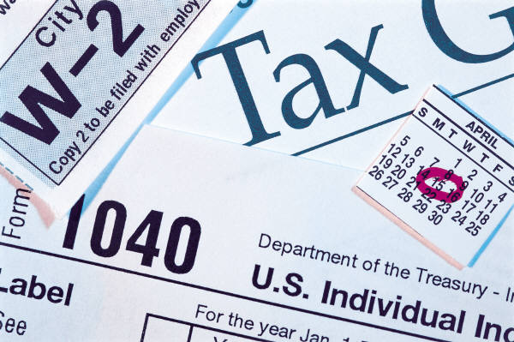
Internal Revenue Service (IRS) Guidelines
  See the link to read the following:
    Why Keep Records?
    Kinds of Records to Keep
    How Long to Keep Records
    How to Get Tax Help
    IRS Guidelines
  Internal Revenue Service Guidelines
  (Click on link)
Notes:
See the link to read the following:
Why Keep Records?
Kinds of Records to Keep
How Long to Keep Records
How to Get Tax Help
IRS Guidelines
http://www.irs.gov/publications/p552/ar02.html
There are many reasons to keep records. In addition to tax purposes, you may need to keep records for insurance purposes or for getting a loan. Note to teacher: You may have the students retrieve the handout Keeping Family / Household Records (see All Lesson Attachments tab) on where to store various personal records. Use Keeping Family / Household Records (Key) (see All Lesson Attachments tab) to have students correct their handouts with the right answers.

Slide 15
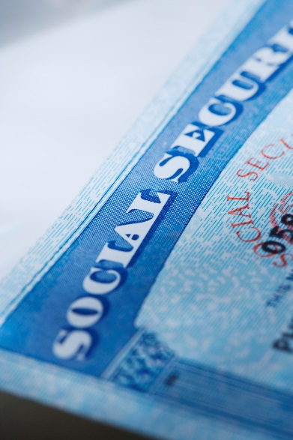
How Long to Keep Financial Records
  Records such as birth certificates and social security cards need to be kept permanently
  Tax records should be kept for varying lengths of time
  Use common sense regarding credit card statements, receipts for bills or car maintenance records
Notes:
Records such as birth certificates and social security cards need to be kept permanently in a safe deposit box. Tax records should be kept for varying lengths of time. Marriage and adoption certificates are also documents you should save.
marriage certificate
adoption certificates
There are some records, such as property deeds or automobile titles, that you should keep until you no longer own the item with which they are associated. At that time, the records are transferred to the new owner.
How long you should keep tax records varies. It is always a good idea to ask your accountant for advice.
There are some records you want to keep for a period of time such as pay check stubs, paid receipts, car maintenance records, but there will come a time when you can discard these items. You need to use your good judgment about this.

Slide 16

How to Keep Financial Records
  Documents need to be protected from theft, fire and disorganization!
    Safe deposit box
    Home safe or lock box
    Filing cabinet
    Electronic storage
Notes:
There are various ways to store documents.
Safe deposit box – locked storage area located in a bank. Store difficult to replace items such as birth certificates, car titles or property deeds.
Home safe or lock box – less secure, but more convenient. Try to get a fireproof system.
Filing cabinet – a home filing system for bank statements, paid bills, insurance policies and tax records
Electronic storage is a great way to store items. Just make sure you have a backup copy and that the file is encrypted. Copying records to a portable storage device such as a CD or flash drive and storing it in a safe deposit box is a great idea. You should also password protect electronic data so someone who borrows your computer does not have access to your personal information.

Slide 17

Electronic Storage
  With increased development of technology, many methods of organizing paperless financial records exist today.
  Many financial institutions offer online banking and access to accounts and statements, as well as electronic payment methods.
  Records can be stored on a remote server (the “cloud”) or on a local computer. Always back up data!
Notes:
In addition to electronic storage, there are records on the web that you can print to have a hard copy available. Storing data in the cloud has its own risks because you aren’t in control of the physical servers that contain your data. Make sure you encrypt the files and hide the encryption key.

Slide 18

More on Electronic Management
  Electronic spreadsheets and financial management software programs are readily available.
  Electronic methods can simplify financial record keeping, but it is important to protect passwords and understand security!
Notes:
You can use a special program, web tool or spreadsheet for electronic storage.
Teacher note: Discuss record keeping and have students retrieve the handout “Keeping Family / Household Records” (see All Lesson Attachments tab) on where to store various personal records. Use “Keeping Family / Household Records (Key)” (see All Lesson Attachments tab) to have students correct their handout with the answers.

Slide 19

Questions?

Slide 20
References and Resources
  Images:
    Microsoft Clip Art: Used with permission from Microsoft.
  Textbook:
    Ross Lowe, 2006. Consumer education & economics, student edition. 6 Edition. Glencoe/McGraw-Hill
    Madura, Jeff, Mike Casey, and Sherry J. Roberts. Personal financial literacy. Boston: Pearson, 2010. 23-29. Print.
  Websites:
    All Insurance Information Organization. Great site for general insurance information.
    http://allinsuranceinfo.org/
    Federal Trade Commission
    Filing for Bankruptcy: What you should know.
    http://www.consumer.ftc.gov/articles/0224-filing-bankruptcy-what-know

Slide 21
References and Resources
  Websites:
    Insurance 411 Organization
  Web tool to make a credit card size insurance information card to carry in your wallet.
    http://insurance-411.org/
    Money Matters
    Financial Education Curriculum produced by First Command Educational Foundation, 2010.
    http://www.fcef.com
    NEFE High School Financial Planning
    National Endowment for Financial Education.
    http://www.hsfpp.org/
    Privacy Rights Clearing House
    Information on record Keeping.
    https://www.privacyrights.org/fs12a-personal-data-retention-and-destruction-plan#whykeep

Slide 22
References and Resources
  Websites:
    Record Keeping and Personal Care Guide
    Create personal records for the family.
    http://ddc.ohio.gov/Pub/RecordGuide.pdf
    Texas Department of Insurance
    Consumer information guide for purchasing insurance.
    http://www.tdi.texas.gov/pubs/consumer/cb088.html
    Texas Financial Responsibility Report
    Information on Texas law concerning auto insurance.
    http://www.tdi.texas.gov/pubs/consumer/cb088.html
    United States Courts
    Information on bankruptcy.
    http://www.uscourts.gov/FederalCourts/Bankruptcy/BankruptcyBasics.aspx

