Slide 1
Be Our Guest!
Customer Service Skills
  Culinary Arts

Slide 3
Customer Service
  The total customer experience with that business
  If you work just for money, you'll never make it, but if you love what you're doing and you always put the customer first, success will be yours.
  -Ray Kroc
Notes:
Ray Kroc has been called "fast food's founding father."
A traveling salesman, inspired by a California restaurant, launched the McDonald’s fast food empire that spread worldwide. It succeeded by making uniformity, simplicity, and value cardinal virtues.
Have students discuss what they believe Ray Kroc meant by this statement.

Slide 4

Quality Service
  Appearance
  Benefits
  Attitude
  Goals
Notes:
Service is what foodservice industry employees provide.
This lesson will review the appearance, attitude, benefits and goals of quality service.

Slide 5

Appearance
  Hygiene
    Hair
    Hands and nails
  Jewelry
  Uniform
Notes:
The appearance of foodservice employees impacts the business.
Employees should:
practice good personal hygiene
hair should be pulled back or put up
hands should be clean and nails short
jewelry should be minimal
wear a clean uniform to work

Slide 6

Attitude
  Be someone who is:
    Friendly and cheerful
    Positive
    Shows courtesy to customers
    Takes pride in their work
    Willing to please the customer
Notes:
A positive attitude is critical to the foodservice business.

Slide 7

Benefits
  Enhanced business reputation
  Improved customer satisfaction
  Increased profits
  Greater customer loyalty
  Positive work environment
  Reduced marketing costs
Notes:
Many benefits are gained when providing quality customer service.
Do you agree with these?

Slide 8
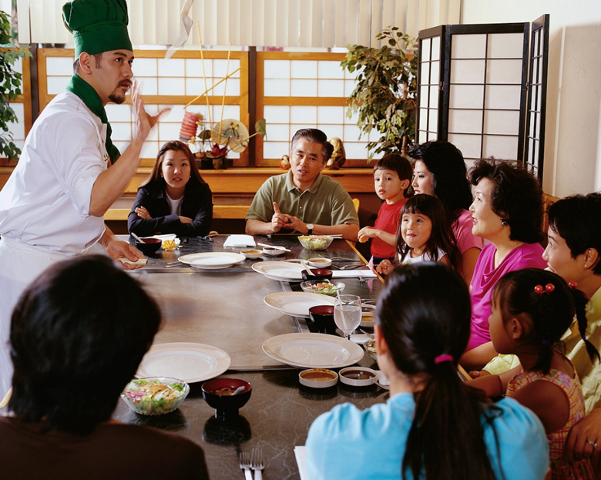
Goals
  Display courtesy, respect and friendliness
  Greet customers immediately upon arrival
  Make the customer feel welcome
  Set the stage for a pleasant dining experience
Notes:
The primary goal of a quality foodservice industry is to always make the customer feel special.
How do you feel when you dine out?

Slide 9
Beauty and the Beast
Be Our Guest!
  Click on image to view video:
  Beauty and the Beast - Be Our Guest
  Be Our Guest song from Beauty and the Beast
  http://youtu.be/afzmwAKUppU

Slide 10

Questions?

Slide 11
References and Resources
  Book:
    Remarkable service: a guide to winning and keeping customers for servers, managers and restaurant owners. (2009). Hoboken, NJ: John Wiley & Sons.
  Images:
    Microsoft Office Clip Art: Used with permission from Microsoft
  Textbooks:
    Culinary essentials. (2010). Woodland Hills, CA: Glencoe/McGraw Hill.
    Foundations of restaurant management & culinary arts: Level one. (2011). Boston, MA: Prentice Hall.
    Reynolds, J. S. (2010). Hospitality services: Food & lodging. Tinley Park, IL: Goodheart-Wilcox Company.

Slide 12
References and Resources
  Website:
    Ray Kroc
    Restaurant Chains
    http://www.pbs.org/wgbh/theymadeamerica/whomade/kroc_hi.html
    Texas A & M Agrilife Extension
    Online courses and programs
    For everyday people interested in learning more about a variety of topics
    https://extensiononline.tamu.edu/secure_index.php
  YouTube(tm) video:
    Beauty and the Beast - Be Our Guest
    Be Our Guest song from Beauty and the Beast
    http://youtu.be/afzmwAKUppU

