Slide 1
Be Visually Aware
Nail Diseases and Disorders

Slide 3
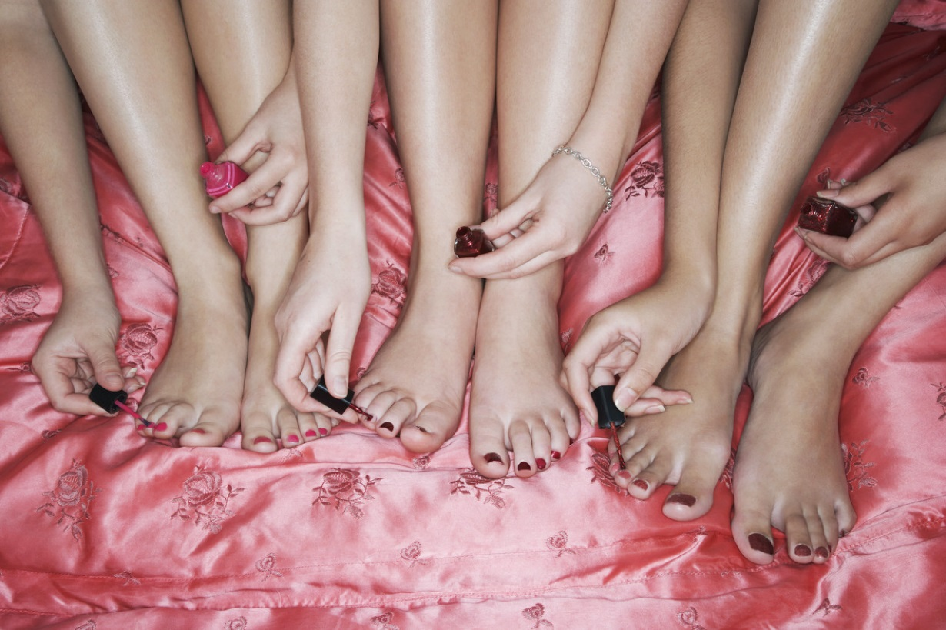
Nails
  Diseases
  Disorders

Slide 4
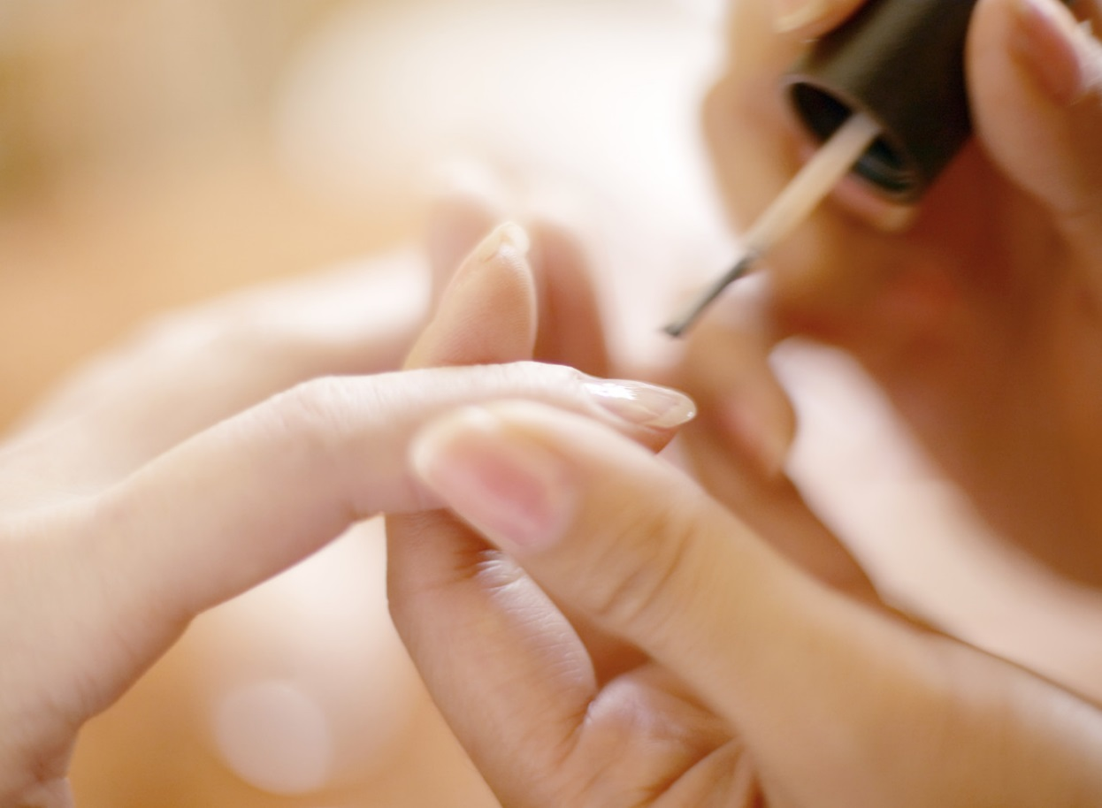
Healthy nails
  A normal healthy nail is firm but flexible
  The surface is shiny, smooth, and unspotted
  A healthy nail is whitish and translucent in appearance
Notes:
Nails are small mirrors of the general health of the entire body.
Certain health conditions may first be revealed by a change in the nails, a visible disorder, or poor nail growth.

Slide 5
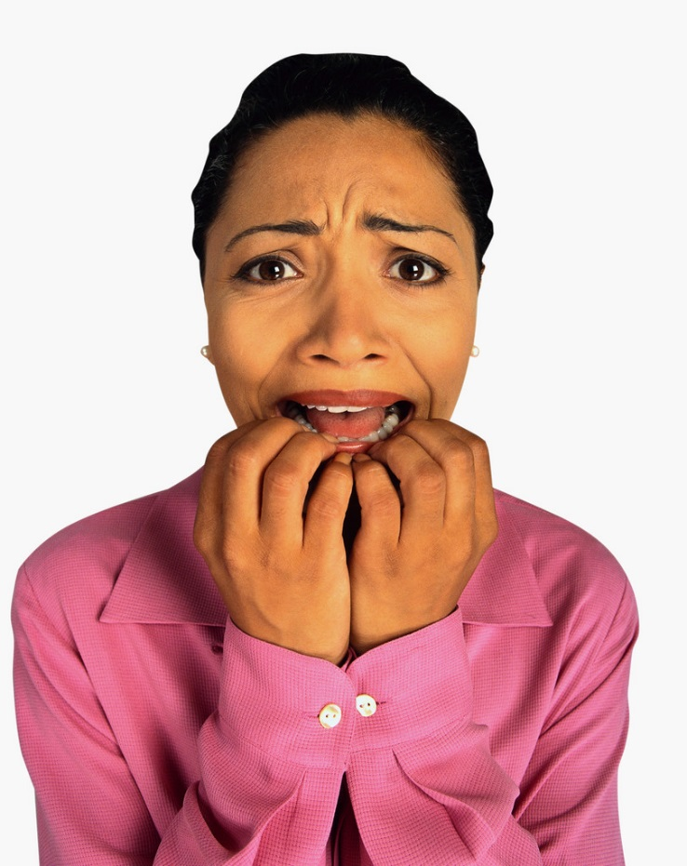
Disorder
  A condition caused by injury or disease of the nail unit
  A cosmetologist should:
    recognize normal and abnormal nail conditions
    understand what to do
    be able to help a client with a nail disorder
  Nail Disorders
(click on link)
Notes:
If a client has a nail disorder:
Tell the client that they have a disorder and suggest they see their physician for treatment.
You may cosmetically improve certain nail plate conditions if the problem is cosmetic and not a medical condition or disorder.
YouTube™ video:
Nail Disorders
Dr. Scott Robertson shows examples of common finger and toe nail disorders.
http://youtu.be/LEPizQQuI_Y
Note: video is only 3.50 minutes but repeats itself without voices. Be sure to stop it after the 3.5 minutes.

Slide 6
Nail Disorders
  Blue nail
  Bruised nail
  Eggshell nails
  Corrugations
  Furrows
  Hangnail
  Leukonychia
  Melanonychia
  Onychatrophia
  Onychauxis
  Onychophagy
  Onychorrhexis
Notes:
Causes:
Blue nail - caused by poor circulation, heart disorder, or medications
Bruised Nails - caused by an injury to the nail
Corrugations - caused by uneven growth of nails usually by illness or injury
Eggshell nails - may be caused by diet, illness, or medication
Furrows or Beaus Lines - usually a result of illness, injury or cancer. Seek a physician’s diagnosis
Hangnail - caused by cutting off too much cuticle or carelessly removing tissue
Leukonychia - caused by an injury at the base of the nail
Melanonychia - caused by a localized area of increased pigment cells in the matrix bed
Onychatrophia - caused by an injury or disease
Onychauxis - caused by a local infection or imbalance
Onychophagy - a nervous habit of biting the nails
Onychorrhexis - caused by many things; careless filing, vitamin deficiency, illness, exposure to strong soaps

Slide 7
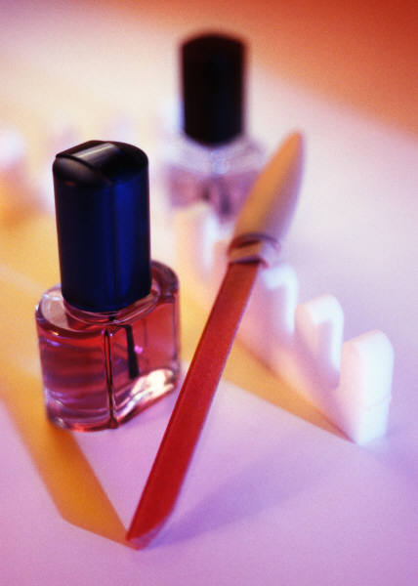
Diseases
  Should not be diagnosed or treated in the salon
  A medical examination is required
  Refer client to a physician
Notes:
Any nail disease that shows signs of infection or inflammation (redness, pain, swelling, or pus) should not be diagnosed or treated in the salon.
Medical examination is required for all nail diseases and any treatments will be determined by the physician.

Slide 8
Nail Diseases
  Onychia
  Onycholysis
  Onychomadesis
  Nail psoriasis
  Onychomycosis
  Paronychia
  Pyogenic granuloma
  Tinea pedis
Notes:
Symptoms:
Onychia - inflammation of the nail matrix, followed by shedding of the nail
Onycholysis – lifting of the nail plate from the nail bed, without shedding
Onychomadesis – separation and falling off of a nail plate from the nail bed
Nail psoriasis – tiny pits or severe roughness on the surface of the nail plate
Onychomycosis – fungal infection of the natural nail plate
Paronychia – bacterial inflammation of the tissues around the nail plate causing pus, swelling, and redness
Pyogenic granuloma – severe inflammation of the nail in which a lump of red tissue grows up from the nail bed to the nail plate
Tinea pedis – red, itchy rash on the skin on the bottom of feet and/or between the toes

Slide 9
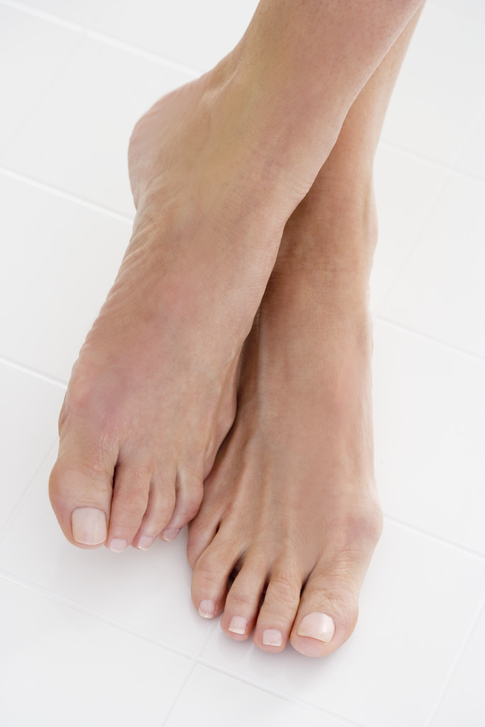
Nail Knowledge
  Know the structure and physiology of the nails
  Be creative
  Working on good healthy nails is a pleasure
  Working on unhealthy nails can be a danger to you, your client, and to the general public
  Begin with knowledge and grow from there

Slide 10
Questions

Slide 11
Resources and Reference
  Textbooks:
    (2004). Milady standard cosmetology. Clifton Park, New York: Thompson Delmar Learning
    Frangie, C.M. (2012). Milady Standard Cosmetology. Clifton Park, NY: Cengage Learning
  YouTube™ video:
    Nail Disorders: Dr. Scott Robertson shows examples of common finger and toe nail disorders - http://youtu.be/LEPizQQuI_Y

