Slide 1
Brain Power
Counseling and Mental Health
Notes:
It is all in your head!! The brain is the center of what we think, feel, and do. Along with the nervous system, it plays a vital role in being mentally healthy.

Slide 3
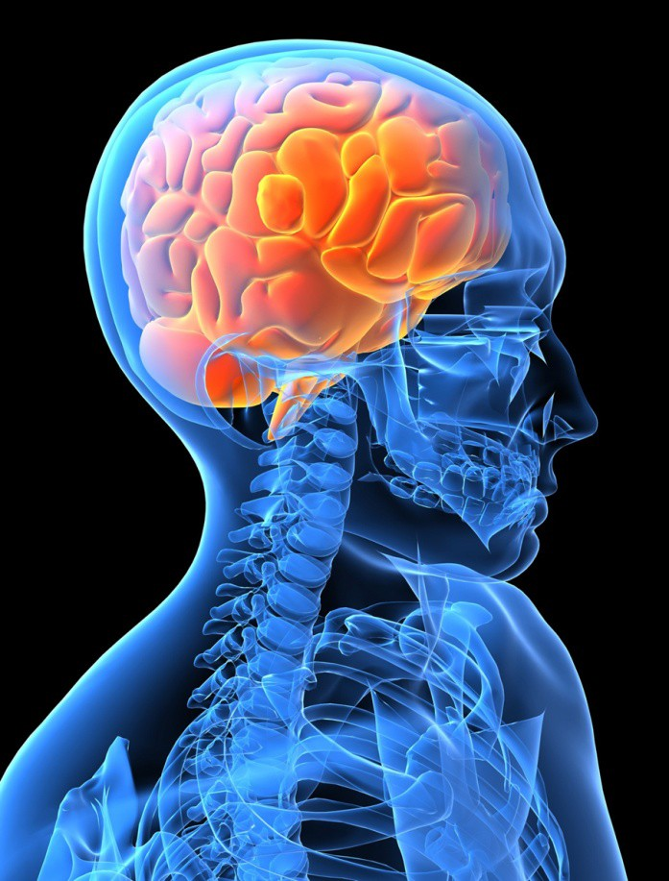
Did You Know…
  There over a billion nerve cells in the human body.
  Nerves can carry signals at 100 meters per second.
  If all your neurons were lined up, they would form a 600 mile long line.
  Neurons are the largest cell in the body; they do not undergo the process of mitosis.
Notes:
Here are some interesting facts about the nervous system. There are many others at various websites. There are over a billion nerve cells in the human body— the number is more than the stars in the Milky Way.

Slide 4
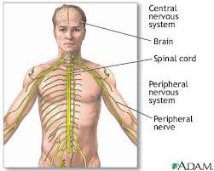
Nervous System
The nervous system controls:
  Emotions
  Movements
  Thinking
  Behavior
Notes:
The Central Nervous System controls reflex functions and is a path to the brain.

Slide 5
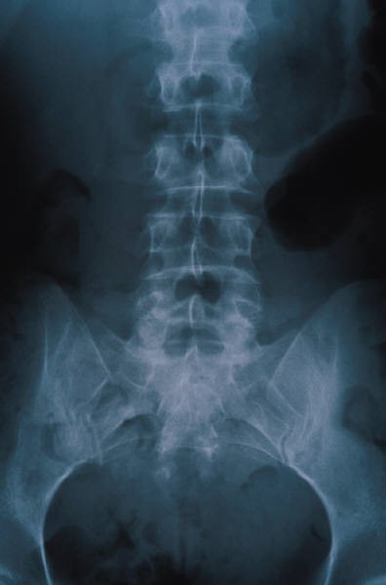
Nervous System
Is divided into 2 parts:
  Central Nervous System (CNS)
    Brain and spinal cord
  Peripheral Nervous System (PNS)
    Smaller branches of the nerves
    Skull and membranes protect the brain
    Vertebrae and membranes protect the spinal cord
Notes:
The Central Nervous System controls reflex functions and is a path to the brain.
The Peripheral Nervous System controls most voluntary movements. Examples would be raising your arm, scratching, etc.

Slide 6
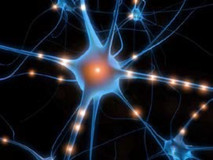
Neurons
Messages travel through these cells to and from the brain.
  Cell Body: contains the nucleus and produces energy
  Dendrites: receives impulses from other neurons
  Axon: carries impulses away from the body toward the dendrites of the next neuron
Notes:
Students could draw and label parts of neurons.

Slide 7
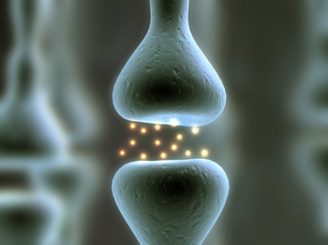
Neurons
  Myelin sheath: axons and speeds transmissions of impulses
  Synapse: is the space between the nerve cells
  Neurotransmitters: chemicals released by the neurons
Examples-
    Dopamine: motivation/positive stress
    Glutamate: learning/memory Serotonin: regulates sleep, mood
Notes:
This is the medium by which nerve signals travel.

Slide 8
The Brain
Did You Know…
  The brain weighs about 3 pounds.
  The right side of the brain controls the left side of the body and the left side controls the right side of the body.
Did You Know…
  The brain is made up of 75% water.
  There are no pain receptors in the brain, therefore it can not feel pain.
  The human brain is the fattest organ in the body. It is about 60% fat.
Notes:
Here are some interesting facts about the brain.

Slide 9
Brain Anatomy
The human brain is comprised of 3 parts:
  Hindbrain
  Midbrain
  Forebrain
Notes:
Students could make a diagram of the brain and label as the various slides are presented.
Students could use the Personal Word Wall for vocabulary words.

Slide 10
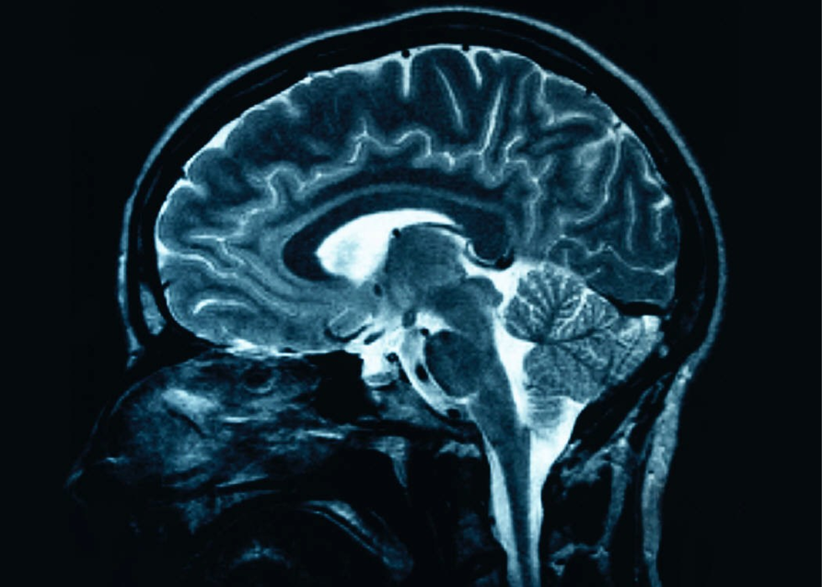
Brain Anatomy - Hindbrain
The Hindbrain is located at base of skull and consists of:
  Cerebellum: posture, balance, voluntary movement
  Medulla: breathing, heart rate, reflexes
  Pons: bridge between the spinal cord and the brain
Notes:
Students could make a diagram of the brain and label as the various slides are presented.
Students could use the Personal Word Wall for vocabulary words.

Slide 11
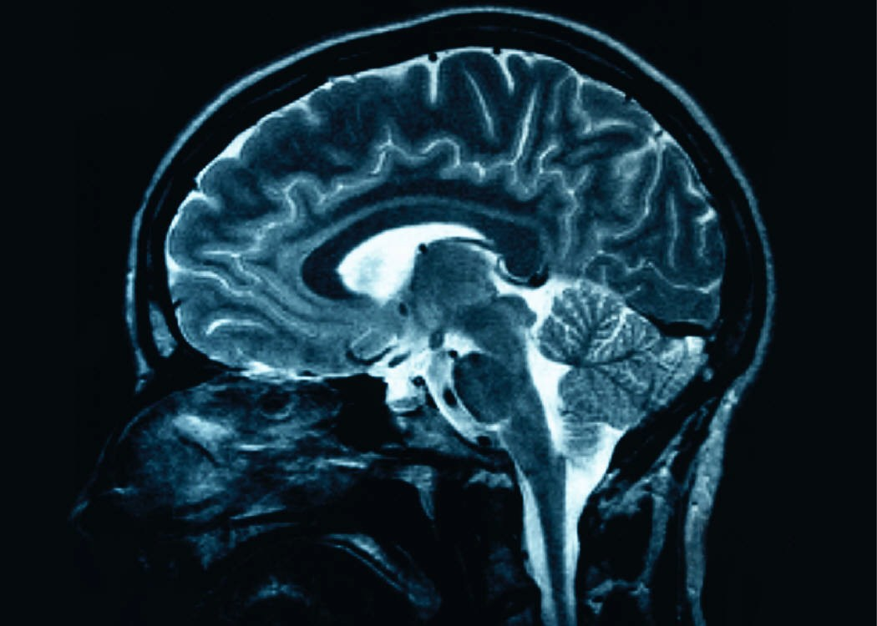
Brain Anatomy - Midbrain
The Midbrain integrates sensory information. Examples:
  Handles all sensory information that passes between the spinal cord and the forebrain.
  It is also involved in body movement in relation to auditory and visual signals.
  Located just above the hind brain.
Notes:
The forebrain covers the brain’s central core.

Slide 12
Brain Anatomy - Forebrain
The Forebrain contains-
  Thalamus: relay station for all sensory information except smell.
  Hypothalamus: controls hunger, thirst, sexual behavior
  Hippocampus: important in forming memories
  Amygdala: involved in memory and emotions
Notes:
The forebrain covers the brain’s central core.

Slide 13
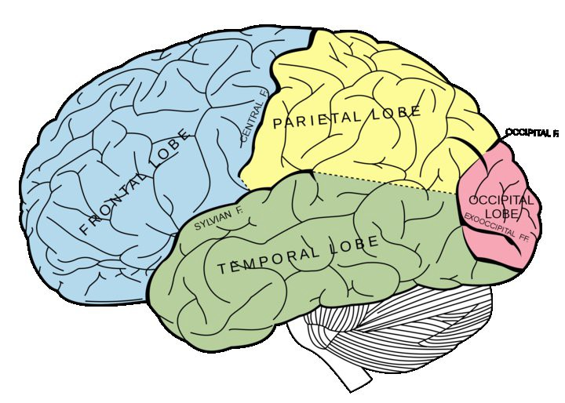
Brain Anatomy - Forebrain
  Cerebrum: the largest and most developed part of brain.
    Responsible for intelligence, personality, thinking The cerebral cortex is a gray tissue that covers the cerebrum
http://en.wikipedia.org/wiki/Intraparietal_sulcus
Notes:
The cerebral cortex is the top layer of the cerebrum.
Share with students that they will have an opportunity to make a brain and label it similar to this one.

Slide 14
Brain Anatomy - Forebrain
The cerebral is divided into two hemispheres which contain the…
  Occipital lobe: for vision
  Parietal lobe: handles information from the senses
  Temporal lobe: hearing, memory, emotion, speaking
  Frontal lobe: organization, planning, creative thinking

Slide 15
Famous Head Injury Case: Phineas Gage
  People described him as a nice man.
  In 1848 he worked for the railroad and an explosion occurred that propelled a metal rod through his cheek and into his skull.
  He survived, but his personality changed. He was angry and belligerent.
  This was the first brain injury case to suggest a link between brain trauma and personality change.
Notes:
Doctors were able to study his personality change and contributed the change to his brain injury.
Students could do further research into this case.

Slide 16
References and Resources
Images
  Nervous System. Digital image. Life in Spite of MS. N.p., n.d.Web. 21 Oct. 2012. http://www.life-in- spite-of-ms.com/multiplesclerosispictures.html
  "Intraparietal Sulcus." Wikipedia.org. N.p., n.d.Web. 21 Oct. 2012. http://en.wikipedia.org/wiki/Intraparietal_sulcus
  "Various Images." Microsoft Office on Line. N.p., n.d.Web. 21 Oct. 2012. http://office.microsoft.com/en- us/images/??Origin=EC790014051033&CTT=6&ver=12&app=powerpnt.exe
Textbooks
  Kasschau, R.A. (2002) Understanding Psychology. NewYork: Glencoe/McGraw-Hill School Pub. Co.
Websites
  KidsHealth
    #1 most-trusted source for physician-reviewed information and advice on children's health and parenting issues. For parents, kids, teens www.kidshealth.org
  Brain Facts
    Learn the basics of how the brain’s 100 billion nerve cells are born, grow, connect, and function. Neuroanatomy; Cell Communication; Brain Development. www.brainfacts.org

