Slide 1
Branding Cattle

Slide 3
Today we will…
Describe the history of branding and how it came about
Identify other methods of identification
Explain what branding is and why it is important in beef cattle management
Construct their own brand
Demonstrate how to brand their own cattle using the proper steps

Slide 4
Branding Methods
Freeze Brands
Hot brands
Why do we brand?
Identification
Ownership

Slide 5
Freeze Brands
A freeze brand consists of a super-cold or chilled branding iron
They are applied to the hide of the animal, where the pigment producing cells are destroyed or altered
When the hair grows back, it is white

Slide 6
Advantages of Freeze Branding
The brand is more legible throughout most of the year than a hot-iron brand.
Freeze branding causes less damage to the hide than a hot brand

Slide 7
Hot Branding
Burns the hide off the skin
Can be electric
Can be heated by fire

Slide 8
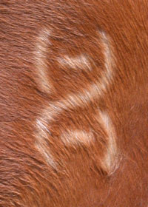
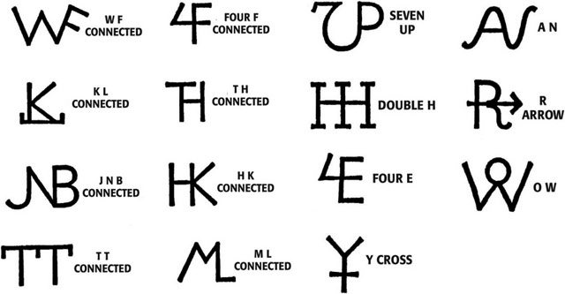
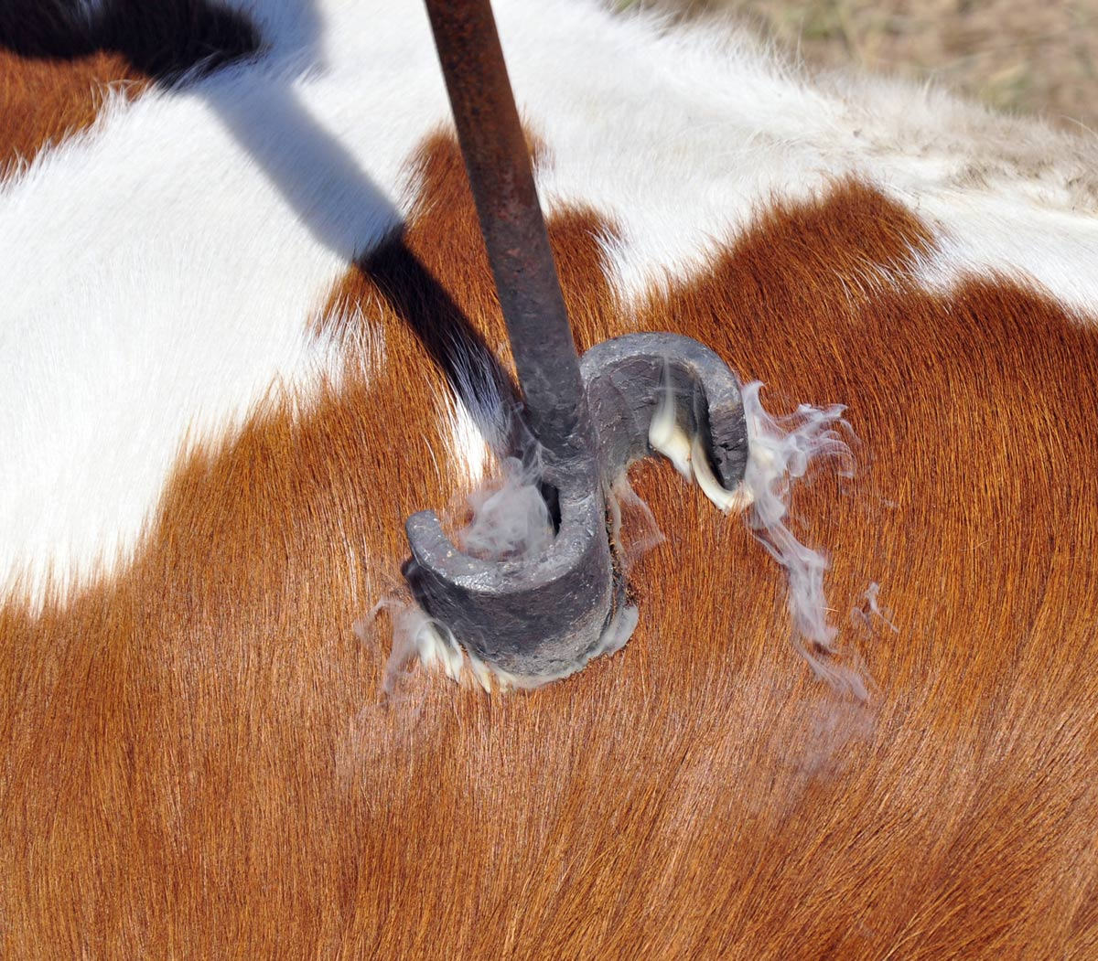
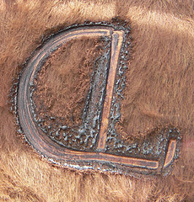

Slide 9
Let’s look at some common designs
http://www.tscrabrands.com/design-brand.html

Slide 10
Time to make your own!!

