Slide 1
Building Healthy Family Relationships

Slide 3
What Does a Healthy Relationship Look Like?
Notes:
Ask the students where and what kind of relationships they have had or currently have in their lives.

Slide 4
How Do Families Build Healthy Relationships?
Notes:
Families can build healthy relationships by:
sharing a lasting commitment
sharing goals and priorities
sharing resources
sharing time together
showing affection
showing appreciation to one another
using communication effectively
using creative problem solving
How are these components going to help you build and sustain future relationships?

Slide 5
Sharing Goals and Priorities
Notes:
What are goals?
What are priorities?
Do you share your goals with your family?
What priorities does your family share?

Slide 6

Sharing Goals and Priorities
  Celebrate together when a goal is accomplished
  Establish realistic expectations and set priorities
Notes:
Celebrate together when a goal is accomplished. Establish realistic expectations and set priorities.
Families help members develop personal priorities by:
Supporting each other
Listening to each other
Showing each other respect and understanding
If a family shares goals, they are more likely to work together with enthusiasm.

Slide 7
Sharing Resources
Notes:
What resources do families possess?
Resources can include:
Automotive maintenance
Bookkeeping skills
Budgeting
Child rearing skills
Cooking
Emotional support
Home improvement / maintenance
Housekeeping skills
Lawn and garden care
Pet care
Sewing / mending
Technological skills

Slide 8

Sharing Resources
  Time, energy, interest, knowledge and skills
  Use resources for home management
Notes:
Time, energy, interest, knowledge and skills -
If a particular family member is better at doing something than other members, they should help the others who might struggle with that task.
For example: A big brother might be better at pouring milk for his little brother’s cereal.
What are some other resources one family member might possess that he or she could help other members with?
Use resources for home management.
Example: Prepare a work schedule and assign responsibilities to each member.
Why? It provides a sense of belonging and individuals will learn responsibility.
Helping around the house
Chores
Cleaning
Cooking
Doing the laundry
Shopping for groceries
Taking care of the pets, yard or vehicles
Financially
Do chores without expecting an allowance
Do not waste resources such as water, electricity or food
Find time to get a job
Restrain from asking for extras (wants)
Other
Assist your family members wherever help is needed
Do things for others to help alleviate stress
Take the initiative when it comes to helping around the house. How does this component relate to the workplace?
Think of others before you think of yourself

Slide 9
Sharing a Lasting Commitment
Notes:
How many years have your parents been married? Grandparents? What are the secrets to a lasting commitment?

Slide 10

Family Bonds
  All families go through difficult and trying times
  When pressures of life, finances or work affect a family member, other family members can help out
Notes:
All families go through difficult and trying times. That is why it is so important to love and support each other at all times.
When pressures of life, finances or work affect a family member, other family members can help out.
Students can brainstorm ways to support family members.

Slide 11
Sharing a Lasting Commitment
  Adding to a person’s sense of security
  Providing individualized attention to the needs of each person
  Showing people they are not alone
Notes:
Sharing a lasting commitment:
Adding to a person’s sense of security
An expression of love
Participating in each other's activities
Providing individualized attention to the needs of each person
Sharing about each other's day
Showing people they are not alone
The tie that binds family members
A family can make a commitment in writing – a mission statement. Decide what you want your family to stand for. Start with one sentence. Mission statements change as the family changes.

Slide 12
Ways to Show Commitment
  Ask about each other’s day
  Be involved in each other’s activities
  Create a family mission statement
Notes:
Be involved in each other's activities. How are you involved with your family?
Genuinely ask about each other's day. It is important to converse with your family on a daily basis.

Slide 13

Building Relationships
  Building Relationships for a Happy, Healthy and Balanced Life
  (click on link)
Notes:
How can you plan to spend more time with the people you care most about?
If you only had six months to live, how would your relationships with family and friends change?
Why do relationships require high quantities of time?
Why is it important to a build high quality of relationships?
Building Relationships for a Happy, Healthy and Balanced Life
The most important ingredient for a long, happy, healthy life is a sense of balance between your work and your relationships with your family and the people you care about.
http://youtu.be/H97Gug4Q230

Slide 14
Showing Appreciation to One Another
Notes:
How do you show appreciation to your family members? How do your family members show you appreciation?

Slide 15
Showing Appreciation
  Show appreciation frequently
  Be appreciative of invisible work
  Behavior is contagious
Notes:
Showing your appreciation to other family members should be frequent and short. A simple “thank you” can go a long way.
Be appreciative of invisible work. Invisible work consists of tasks that get done for you when you don’t ask, such as your laundry that your mom might do. Another example is realizing that groceries don’t just show up in your refrigerator and that someone goes to the grocery store and buys them. Show your family members that you appreciate the things they do for you by saying, “Thank you.”
Behavior is contagious. When you show others that you appreciate them, they will do the same for you.

Slide 16
Showing Affection
Notes:
Why is showing affection to family members so important?

Slide 17

Showing Affection
  Affection is showing other family members that you care about them
  Expressing love – Understand what affection means to the other person and offer your love unconditionally
Notes:
Affection is showing other family members that you care about them. This can be accomplished in a variety of ways.
Expressing love – Understand what affection means to the other person and offer your love unconditionally.
It is important to realize that each family member sees affection differently. Your little brother might not go for a hug, but to him a high five means a great deal.
Your mother, on the other hand, might understand that you care for her or appreciate her when you give her a hug or tell her that you love her.
Offer a hug.
Listening to a family member can be a form of affection. Why?
Offer positive verbal praise and support. Can you give me some examples of positive verbal praise and support?

Slide 18
Sharing Time Together

Slide 19

Sharing Time Together
  Quality time is more important than quantity time
    Camping
    Completing chores
    Doing homework
    Eating together
    Vacationing
Notes:
The purpose of spending time together is to strengthen relationships with family members.
Quality time is more important than quantity time. Families can share time by:
Camping
Celebrating holidays
Gathering for celebrations
Going out to eat together
Going to a park
Going to the movies
Having a game night with board games
Participating in sports events
Shopping
Vacationing
Working out together
Continuous experiences where families can spend time together include:
Completing chores
Doing homework
Eating together

Slide 20
Using Creative Problem Solving

Slide 21

Creative Problem Solving
  Happy families have the same number of arguments as other families, but they have spaces filled with happy times
  It is okay to have problems, but the key is to solve them quickly
Notes:
Strong families can solve problems in creative ways. What are some creative ways your family solves problems?
Happy families have the same number of arguments, but they have spaces filled with happy times.
It is okay to have problems, but the key is to solve the problems quickly.
The longer you are in an argument, the harder it is to get out of it. Why?

Slide 22
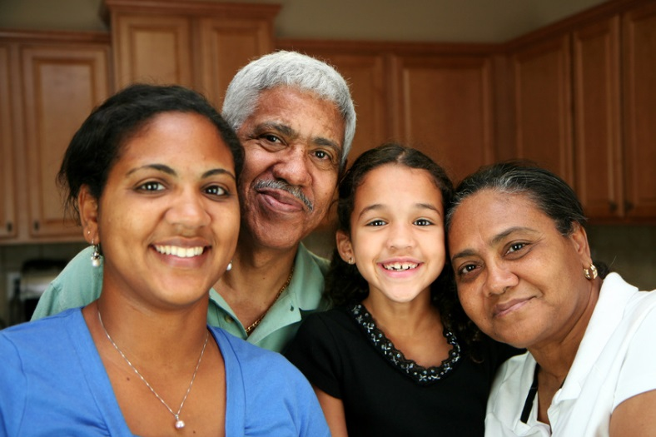
Maintaining a Great Relationship
  Family Relationships
  (click on link)
Notes:
What are the little things that might cause problems in a family?
How do you handle misunderstandings in your family? In a friendship? At school? At work?
Family Relationships
One of the important ways to establish and maintain a great relationship is the ability to forgive and forget the little things. We are all human so there can be many little things that occur. In reality though, true big issues or problems happen very rarely.
http://youtu.be/9i2lLck7UgI

Slide 23
Using Communication Skills Effectively

Slide 24

Using Communication
  Families should encourage open discussion and good communication
  Open communication encourages families to share goals
Notes:
As we communicate, we need to be aware of our communication goals. If we have good goals, our communication will go well.
Families should encourage open discussion and good communication. Open communication encourages families to share goals.

Slide 25
Traits of a Healthy Family
  Affirms and supports
  Communicates
  Listens
  Respects
  Trusts and forgives
Notes:
Discuss how each one of these items is important to the family. Ask students if there are other traits to add to the list.

Slide 26

Additional Traits to Consider
  Admits and/or seeks help for problems
  Has a sense of humor
  Has family rituals and traditions
  Shares responsibilities
  Teaches right from wrong
  Values service to each other
Notes:
Review how traditions build family bonds and creates memories.

Slide 27
Discussion Questions
  “In a united family, happiness springs of itself.” – Chinese Proverb
    Why are these components important?
    How will these components help you in future relationships?
Notes:
We have discussed how these components can build healthy family relationships:
Sharing a lasting commitment
Sharing goals and priorities
Sharing resources
Sharing time together
Showing affection
Showing appreciation to one another
Using communication effectively
Using creative problem solving
Have students list different types of relationships they will experience throughout their lives and how each of the components might be beneficial in that relationship.

Slide 28
How Can We Transfer These Skills to Further Develop Relationships?
Notes:
What are some other examples of relationships?

Slide 29

Relationships Can Be With…
  Associates
  A dating partner
  A family member
  Friends
  A marriage partner
  Neighbors
  Place of Worship
  Work colleagues
Notes:
Relationships can be with:
Associates
A dating partner
Family member(s)
Friends
Marriage partner
Neighbors
Place of worship
Work colleagues
Relationships are the basis of social groups and society as a whole.

Slide 30

Questions?

Slide 31
References and Resources
  Images:
    Microsoft Clip Art: Used with permission from Microsoft.
  Textbook:
    Johnson, L. (2010). Strengthening family & self. (6th ed.). Tinley Park, Illinois: The Goodheart-Willcox Company. Inc.
  Websites:
    Advocates for Youth
    Strengthening Family Relationships
    http://www.advocatesforyouth.org/publications/1229?task=view
    American Psychological Association
    Family and Relationships.
    http://www.apa.org/helpcenter/family/index.aspx
    University of Minnesota
    Why Personal Relationships are Important.
    http://www.takingcharge.csh.umn.edu/enhance-your-wellbeing/relationships/why-personal-relationships-are-important

Slide 32
References and Resources
  YouTube ™:
    Building Relationships for a Happy, Healthy and Balanced Life
    The most important ingredient for a long, happy, healthy life is a sense of balance between your work and your relationships with your family and the people you care about.
    http://youtu.be/H97Gug4Q230
    Family Relationships
    One of the important ways to establish and maintain a great relationship is the ability to forgive and forget the little things. We are all human so there can be many little things that occur. In reality though, true big issues or problems happen very rarely.
    http://youtu.be/9i2lLck7UgI

