Slide 1
Business Economics in the Human Services Industry

Slide 3





Human Services Career Pathways
Notes:
Practicum in Human Services provides occupational specific training and focuses on the development of:
Consumer Services
Early Childhood Development and Services
Counseling and Mental Health Services
Family and Community Services
Personal Care Services
The importance of business economics can be applied to all Human Services Career Pathways.

Slide 4
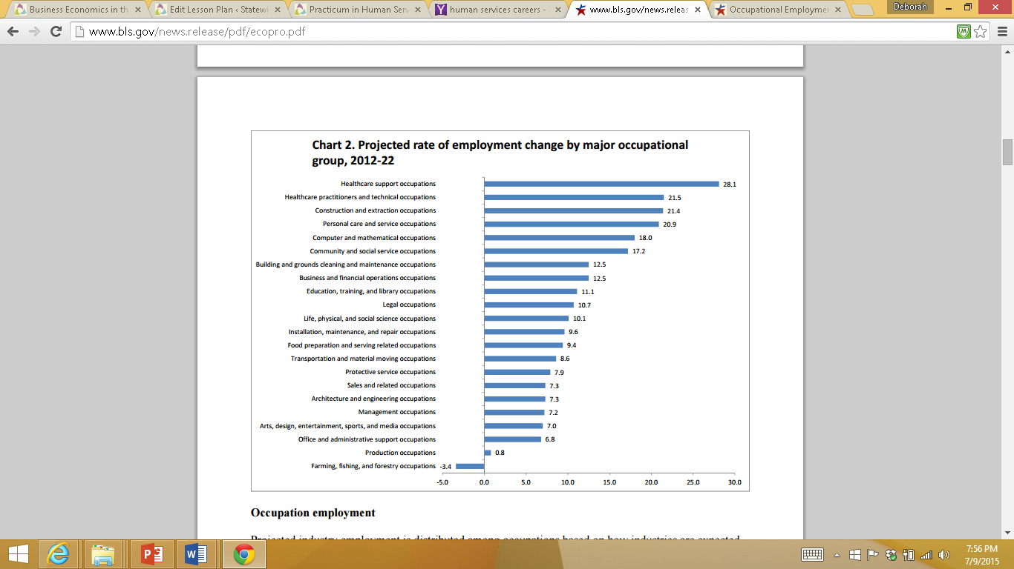
Aspects of Industries and Careers
Notes:
According to the Bureau of Labor Statistics, the occupational employment and wages for careers in Human Services were as follows:
The occupations with the largest employment in May 2014 were retail salespersons and cashiers (Consumer Services), the U.S. Bureau of Labor Statistics reported today. These two occupations combined made up nearly 6 percent of total U.S. employment, with employment levels of 4.6 million and 3.4 million, respectively.
Of the ten largest occupations, only registered nurses (Counseling and Mental Health Services), with an annual mean wage of $69,790, had an average wage above the U.S. all- occupations mean of $47,230. The highest paying occupations overall included several physician and dentist occupations, chief executives, nurse anesthetists, and petroleum engineers.
The ten largest occupations accounted for 21 percent of total employment in May 2014. In addition to retail salespersons and cashiers, the largest occupations included combined food preparation and serving workers, including fast food; general office clerks; registered nurses; customer service representatives (Consumer Services); and waiters and waitresses.
Office and administrative support was the largest occupational group, making up about 16 percent of total U.S. employment. The next largest groups were sales and related occupations (Consumer Services) and food preparation and serving related occupations, which made up about 11 percent and 9 percent of U.S. employment, respectively.
The highest paying occupational groups were management, legal, and computer and mathematical occupations. The lowest paying occupational groups included food preparation and serving related; personal care and service (Personal Care Services); and farming, fishing, and forestry occupations, each with an annual mean wage of about $25,000 or less.
Five of the ten largest occupations in the public sector were related to education, including elementary school teachers, except special education (Early Childhood Development and Services), with public sector employment of over 1.2 million; teacher assistants (933,500); and secondary school teachers, except special and career/technical education (845,480). These occupations were found primarily in local government.
Occupations found only in the public sector included tax examiners and collectors, and revenue agents; judges, magistrate judges, and magistrates (Family and Community Services); and fish and game wardens. Although found in both the public and private sectors, conservation scientists, emergency management directors, zoologists and wildlife biologists, and many types of postsecondary teachers also had above-average shares of their employment in the public sector.
What do the projections on the table show in area of Human Services? Consumer Services? Counseling and Mental Health Services? Early Childhood Development and Services, Family and Community Services, Personal Care Services?
How are these projections related to the state of the economy in your community? State? At the national level? Globally?

Slide 5

The Economic System
The economic system involves:
distribution of economic outputs
financial institutions
government policies
households investments
land availability
production
the allocation of economic inputs
Notes:
An economic system is loosely defined as a country’s plan for its services, goods produced, and the exact way in which its economic plan is carried out. An economic system is a system for producing, distributing and consuming goods and services, including the combination of the various institutions, agencies, consumers, entities (or even sectors as described by some authors) that comprise the economic structure of a given society or community. It also includes how these various agencies and institutions are linked to one another, how information flows between them, and the social relations within the system (including property rights and the structure of management). A related concept is the mode of production.
The economic system involves:
distribution of economic outputs
financial institutions
government policies
households (earnings and expenditure consumption of goods and services in an economy)
investments
land availability
production
the allocation of economic inputs

Slide 6

General Economic Systems
The economic systems include:
Barter economy
Command economic systems
Gift economy
Market economy
Participatory economics
Planned economy
Traditional economy
Notes:
The basic and general economic systems are:
Barter economy (where goods and services are directly exchanged for other goods or services)
Command (Centrally planned) economic systems: (a generic term for older economic systems)
Gift economy (where an exchange is made without any explicit agreement for immediate or future rewards)
Market economy (“hands off” systems, such as Laissez-faire capitalism)
Mixed economy (a hybrid that blends some aspects of both market and planned economies)
Participatory economics (a system where the production and distribution of goods is guided by public participation)
Planned economy (“hands on” systems, such as state socialism or state capitalism)
Traditional economy (a generic term for older economic systems)
What determines what type of economy a country has?
The type of economy is determined by the extent of government involvement in economic decision making.

Slide 7

Common Economic Systems
Command
Free market
Mixed
Traditional
Notes:
The four most common economic systems are:
Command Economy
central ownership of property/resource
centrally planned economy
lack of consumer choice
examples: Cuba and Former Soviet Union
Free Market Economy
consumers have many choices
business decisions are driven by the desire to earn a profit
private ownership of property/resources
there is a great deal of competition
Examples: United States, Japan, Colombia and South Korea
Mixed Economy
a greater government role than in a free market economy
government as decision maker for the public sector
individuals and businesses as decision makers for the private sector
most common economic system today
examples: England, Germany and Russia
Traditional Economy
allocation of resources is based on rituals, habits or customs
little individual choice
people work together for the common good
roles are defined by family
Example: Country of Madagascar

Slide 8

Types of Economic Systems
(click on image)
Notes:
Click on image to view video:
UniversityNow: Types of Economic Systems
Nearly every society in the world bases same fundamental problem how to distribute limited resources to people in a way that will be fair.
https://youtu.be/5xgwYRX19VU

Slide 9
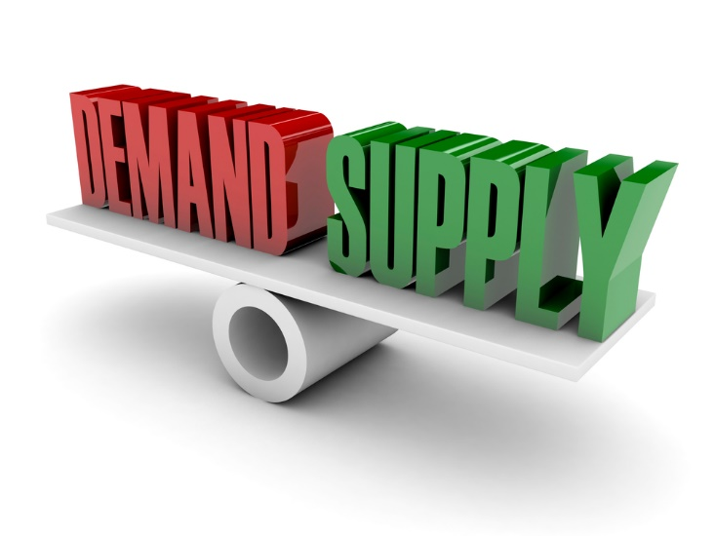
Supply and Demand
Notes:
In microeconomics, supply and demand is an economic model of price determination in a market. It concludes that in a competitive market, the unit price for a particular good will vary until it settles at a point where the quantity demanded by consumers (at current price) will equal the quantity supplied by producers (at current price), resulting in an economic equilibrium for price and quantity.
The four basic laws of supply and demand are:
If demand increases and supply remains unchanged, a shortage occurs, leading to a higher equilibrium price.
If demand decreases and supply remains unchanged, a surplus occurs, leading to a lower equilibrium price.
If demand remains unchanged and supply increases, a surplus occurs, leading to a lower equilibrium price.
If demand remains unchanged and supply decreases, a shortage occurs, leading to a higher equilibrium price.
What are some examples of the four basic laws of supply and demand?

Slide 10

Supply and Demand
(click on image)
Notes:
Click on image to view video:
Supply and Demand
If you’ve only heard of one economics concept, it’s probably supply and demand. The video contains the 2-minute version of what supply and demand consist of.
https://youtu.be/8-yWKgZv9JY

Slide 11

Determinants of Supply and Demand
Notes:
The determinants of supply are:
a good’s own price
firms’ expectations about future prices
number of suppliers
production costs, how much a good costs to be produced
the technology used in production and/or technological advances
The determinants of demand are:
consumers’ expectations about future prices and incomes that can be checked
income
number of potential consumers
prices of related goods and services
tastes and preferences

Slide 12
The Business Cycle
Peak
Contraction (recession)
Trough
Expansion (boom)
Notes:
There are two phases of business cycle: the expansion or boom stage and the contraction or recession stage.
The business cycle is a useful tool for understanding how economic activity cycles. Although the business cycle depicted on the slide is a neat, circular cycle of activity, the cycle could more accurately be reflected in a series of ups and downs, twists and turns. More like a roller coaster as the economy proceeds through the phases. Economists and government analysts track economic indicators to determine the state of the economy in order to predict ups and downs and apply economic policies to try to smooth out the peaks and troughs.
Teacher note: As an enrichment activity, you may have the students use Economics textbooks, the Internet or other resources to research the business cycle, which reflects the ups and downs in the U.S. economy.

Slide 13
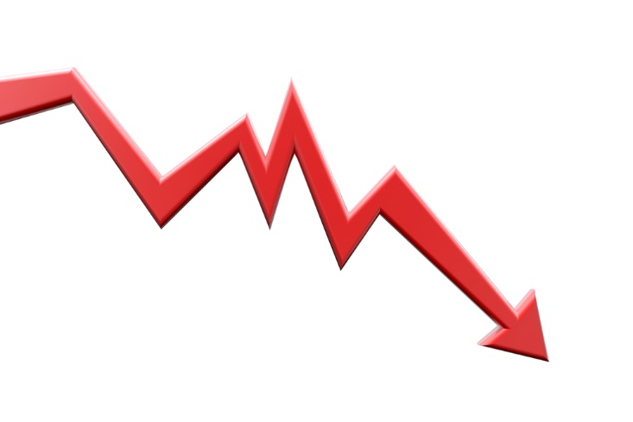
Recession Stage
Notes:
Recession is a period of decline gauged by changes in real Gross Domestic Product (GDP). A recession occurs when the real GDP declines over two quarters or six months. It begins when the GDP reaches its highest point prior to a steady decline over at least six months. Recession is characterized by failing incomes, high unemployment and decreased demand for goods and services. A recession continues until the GDP reaches a low point, the trough. If the trough is very severe, it may be a depression. In a depression, unemployment soars, prices fall severely and may businesses fail.

Slide 14

Expansion Stage
Notes:
The second phase of a business cycle, expansion, starts when the GDP rebounds after hitting a trough. During the expansion stage, the economy slowly recovers. Income increases, employment rises and people begin spending money again. This cycle continues until the peak or boom is achieved, and the cycle starts over again.

Slide 15
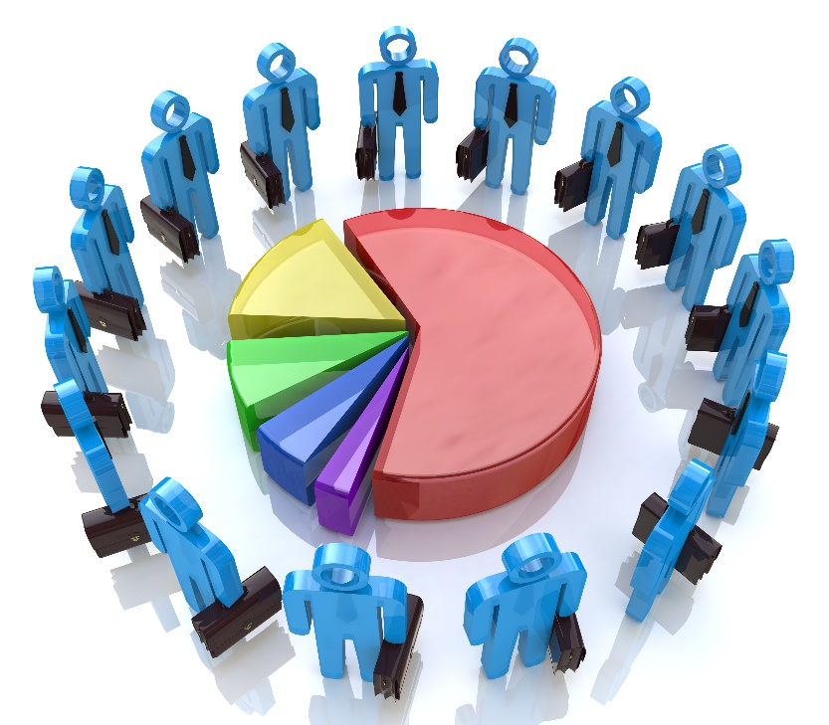
Types of Business Organizations
Corporation
Limited liability company (LLC)
Partnership
S corporation
Sole proprietorship
Notes:
The most common forms of business are corporation, partnership, S corporation and sole proprietorship. A more recent development to these forms of business is the limited liability company (LLC) and the limited liability partnership (LLP). Because each business form comes with different tax consequences, individuals will want to make a wise selection and select the structure that most closely matches the business’s needs.
Corporation
The corporate structure is more complex and expensive than most other business structures. A corporation is an independent legal entity, separate from its owners, and as such, it requires complying with more regulations and tax requirements.
The biggest benefit for a business owner who decides to incorporate is the liability protection he or she receives. A corporation’s debt is not considered that of its owners, so if you organize your business as a corporation, you are not putting your personal assets at risk. A corporation also can retain some of its profits without the owner paying tax on them.
Limited Liability Company (LLC)
Limited liability companies, often referred to as “Lacs,” have been around since 1977, but their popularity among entrepreneurs is a relatively recent phenomenon. An LLC is a hybrid entity, bringing together some of the best features of partnerships and corporations.
LLCs were created to provide business owners with the liability protection that corporations enjoy without the double taxation. Earnings and losses pass through to the owners and are included on their personal tax returns.
Partnership
If your business will be owned and operated by several individuals, you’ll want to take a look at structuring your business as a partnership. Partnerships come in two varieties: general partnerships and limited partnerships. In a general partnership, the partners manage the company and assume responsibility for the partnership’s debts and other obligations. A limited partnership has both general and limited partners. The general partners own and operate the business and assume liability for the partnership, while the limited partners serve as investors only; they have no control over the company and are not subject to the same liabilities as the general partners.
S Corporation
The S corporation is more attractive to small-business owners than a regular (or C) corporation. That’s because an S corporation has some appealing tax benefits and still provides business owners with the liability protection of a corporation. With an S corporation, income and losses are passed through to shareholders and included on their individual tax returns. As a result, there’s just one level of federal tax to pay.
In addition, owners of S corporations who don’t have inventory can use the cash method of accounting, which is simpler than the accrual method. Under this method, income is taxable when received and expenses are deductible when paid.
Sound similar to a LLC corporation? It is, except that an LLC offers business owners even more attractions than an S corporation. For example, there is no limitation on the number of shareholders an LLC can have, unlike an S corporation, which has a limit of 100 shareholders. In addition, any member or owner of the LLC is allowed a full participatory role in the business’s operation; in a limited partnership, on the other hand, partners are not permitted any say in the operation.
Sole Proprietorship
The simplest structure is the sole proprietorship, which usually involves just one individual who owns and operates the enterprise. If you intend to work alone, this structure may be the way to go.

Slide 16

Structures within Each Business
Notes:
Every organization should have a defined organizational structure. A well thought out and strategic structure helps support good processes for communication and clarifies lines of authority and reporting relationships to assure that work processes flow in a defined process. An organizational structure would show lines of authority and reporting relationships. Having this mapped out helps to ensure efficient work flow and project management as well as elimination of duplicate systems and processes.

Slide 17

Management of Products and Services
Notes:
When an economist considers the cost of an item, he or she considers more than the price tag. Economists also consider the opportunity cost or the cost of the next best alternative use of money, time or resources when one choice is made over another. For instance, a student with twenty-five dollars to spend can choose between several options – a new CD, a new shirt, movie tickets or restringing a tennis racket. The student decides that restringing the racket is the most important need at the time. The opportunity cost includes items and activities the student gave up deciding not to buy tickets to the movies, a favorite CD or new clothes.
Economists also consider the relationship of the scarcity of a good or service to its cost. In economics, scarcity is the condition of not being able to have all of the goods and services one wants. Resources do not exist in sufficient quantities to satisfy all to use them. Scarce items may have a higher value and the value may fluctuate depending on availability. People recognize that scarce items carry a higher opportunity cost; they give up more alternatives to purchase produce off-season than they would during produce season.
Possible questions to ask:
What is meant by the opportunity costs of a choice you make?
What does the concept of scarcity have to do with opportunity costs?
What were the opportunity costs of a choice you made in the past month?
Why is it important for family members to consider opportunity cost, in addition to the face costs, when making a financial decisions?

Slide 18

Quality-Control Systems for Goods and Services
Notes:
The operational techniques and activities that sustain the product or service quality to specified requirements are called quality-control systems. Planned and systematic action is necessary to insure a product or service will satisfy requirements and customer satisfaction.
Why are quality-control systems necessary in the Human Services industry?

Slide 19

Government Involvement
Notes:
The U.S. Small Business Administration (SBA) helps Americans start, build and grow businesses through an extensive network of field offices and partnerships with public and private organizations. SBA’s mission is to aid, counsel, assist and protect the interests of small business concerns, to preserve free competitive enterprise and to maintain and strengthen the overall economy of our nation. SBA achieves this mission through loans, loan guarantees, contracts, counseling sessions and other forms of assistance to small businesses.
Business.USA.gov is the U.S. Government's official web portal to support business start-ups, growth, financing, and exporting. It is designed to provide access to online resources and services of Federal, state, and local Government as well as those of non-profit and educational organizations supporting businesses.

Slide 20

Competition
Notes:
Competitiveness can be defined as the degree to which a nation can, under free and fair market conditions, produce goods and services that meet the test of international markets while at the same time maintaining or expanding the real incomes of its citizens.
Possible questions to ask students:
What are examples of the various forms of competition?
What purposes does competition serve for consumers within the American marketplace?
What would happen if there were no competition?

Slide 21



Spending Decisions
What?
Where?
Which item
From what source
Planned purchase
When?
Unplanned or Impulsive
How?
Notes:
Ask students to brainstorm examples of spending decisions they or family members have made within the past few months. Using the slide, lead the class discussion on spending decisions made by individuals and families.
Possible questions to ask:
What factors influence the initial decision of whether or not to buy?
How can you go about determining from what source to purchase and which specific item to buy? (such as sale item, comparison shopping, supply and demand)
What are examples of large purchases? Small purchases?
What external factors impact individual and family spending decisions?

Slide 22


Slide 23
References and Resources
Images:
All photos obtained through a license with Shutterstock.com™.
Bureau of Labor Statistics
Websites:
Bureau of Labor Statistics
Employment Projections — 2012-2022
http://www.bls.gov/news.release/pdf/ecopro.pdf
Small Business Administration
Starting a small business
https://www.sba.gov
Small Business Administration
Strategic Planning for Small Businesses online course.
https://www.sba.gov/tools/learning-center-view-course/1387291
YouTube™:
Supply and Demand
If you’ve only heard of one economics concept, it’s probably supply and demand. The video contains the 2-minute version of what supply and demand consist of.
https://youtu.be/8-yWKgZv9JY
UniversityNow: Types of Economic Systems
Nearly every society in the world bases same fundamental problem how to distribute limited resources to people in a way that will be fair.
https://youtu.be/5xgwYRX19VU

