Slide 1
Business Finances in Hospitality and Tourism
  Practicum in Culinary Arts and Practicum in Hospitality Services

Slide 3
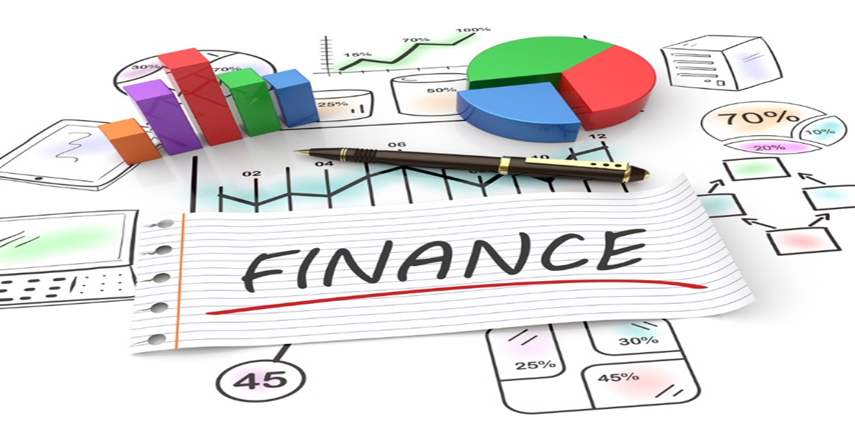
Finances
  The way in which money is used and handled; especially : the way in which large amounts of money are used and handled by governments and companies
Notes:
Business finance involves many activities that gather financial data to be analyzed to determine how well the business is doing.

Slide 4
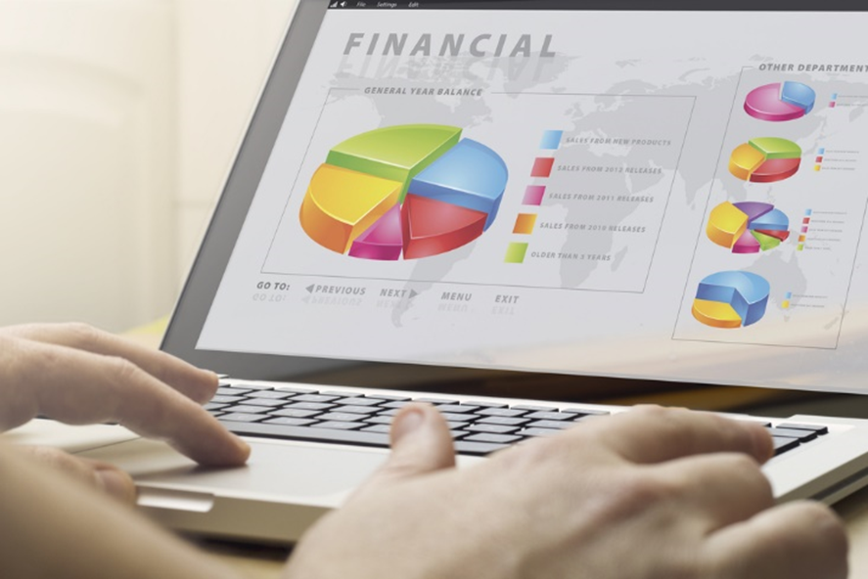
Financial Services
  Business Transactions
  Business Charts and Graphs
Notes:
Basic financial math skills are needed to run a foodservice and hospitality establishment effectively.
These skills include adding and subtracting, using fractions and decimals and percentages and ratios.

Slide 5
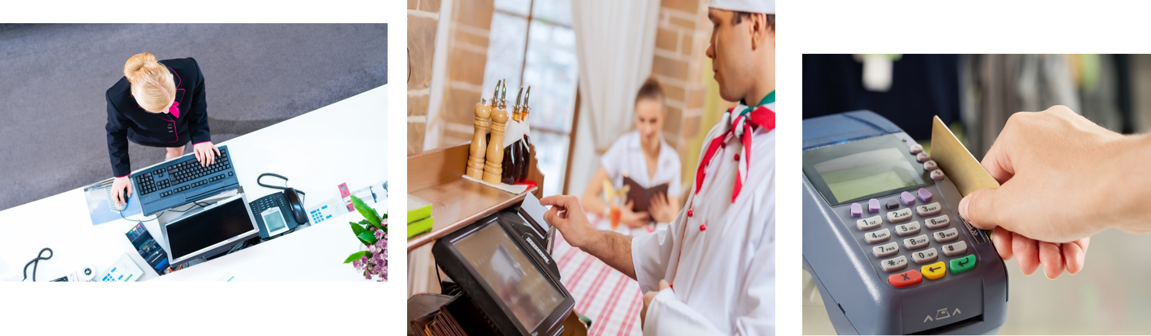
Business Transactions
  An economic event that initiates the accounting process of recording it in a company's accounting system
Notes:
Hotels use a property management system (PMS) to keep track of information for all of the departments.
Most foodservice establishments use a point-of-sale system to keep track of various activities in the restaurant.
Other industry businesses may use an accounting software system to keep track of their sales.

Slide 6
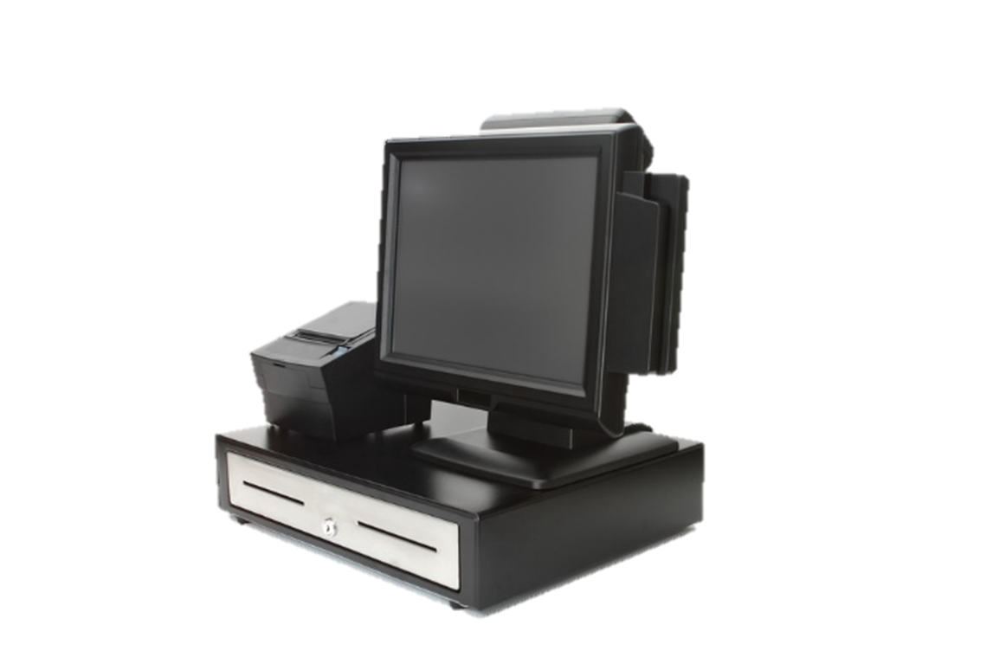
Point-of-Sale Systems
  A computerized system that can be used to:
    Communicate between staff members
    Create reports
    Generate bills
    Manage inventory
    Take orders
    Track revenue
Notes:
Point-of-sale systems can track:
expenses (marketing, advertising, and facility costs)
profits
purchases, price lists and inventory
reservations
recipes and food costs
work schedules, employee hours and wages
These systems will also allow you to see charts and graphs of items listed above.
Have you had an opportunity to use one of these?

Slide 7

Property Management Systems
  A computer software system that can be used for:
  Accounting records
  Electronic key systems
  Guest records
  Inventory
  Purchasing
  Receiving
Notes:
Property management systems can track:
employee time records
housekeeping
reservations
These systems will also allow you to see charts and graphs of items listed above.
Have you had an opportunity to use one of these?

Slide 8
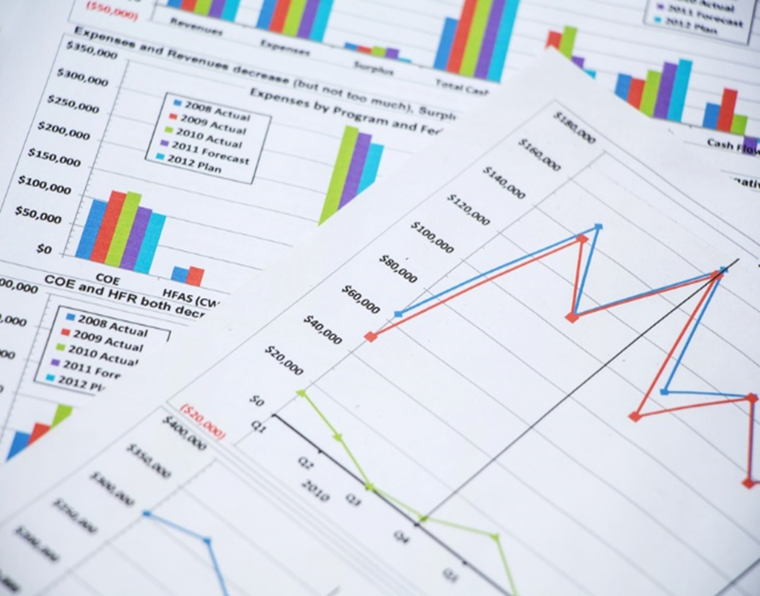
Business Charts and Graphs
  A visual representation to present data from evaluation activities
  Used to:
    Calculate expenses
    Estimate profits for the business
    Forecast future trends
Notes:
Business charts and graphs are an excellent way to illustrate program results.
These are also used in a business plan.

Slide 9
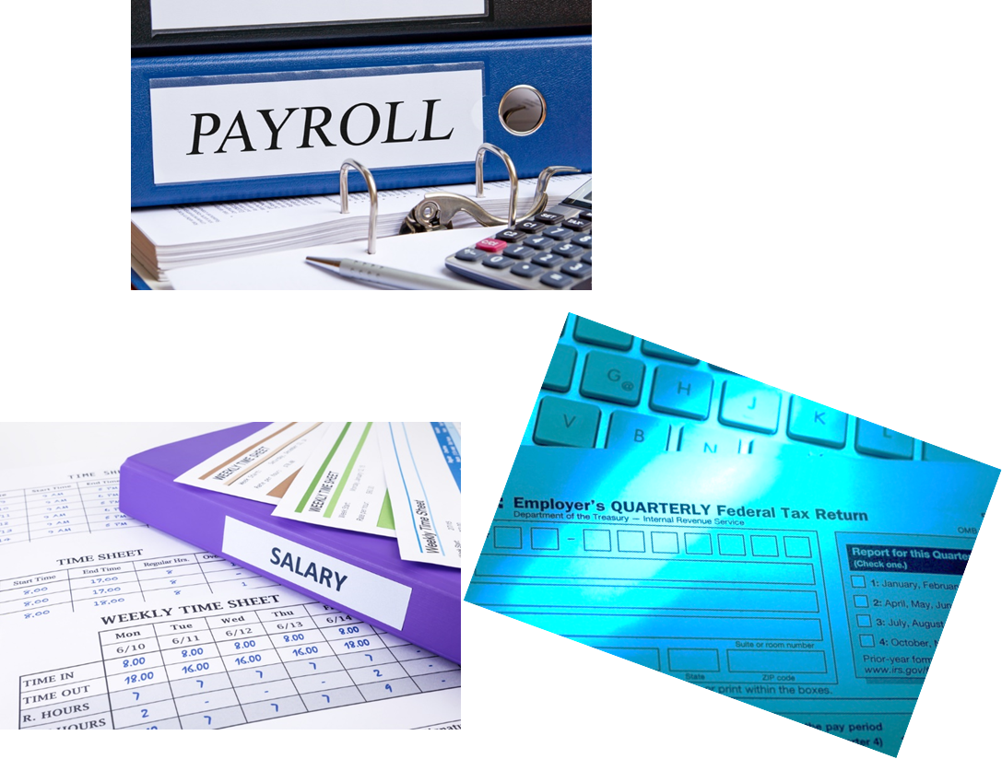
Workplace Documents
  Cash flow projections
  Inventory
  Purchase orders
  Tax forms
  Time sheets
  Work schedules
Notes:
Most businesses have individualized documents to be completed daily, weekly, monthly and yearly.

Slide 10


Property Management System
Notes:
Click on hyperlink to view video:
Property Management System
Patrick van der Wardt of iTesso explains the Property Management System for the hospitality industry.
https://youtu.be/f-1DNK__25o

Slide 11

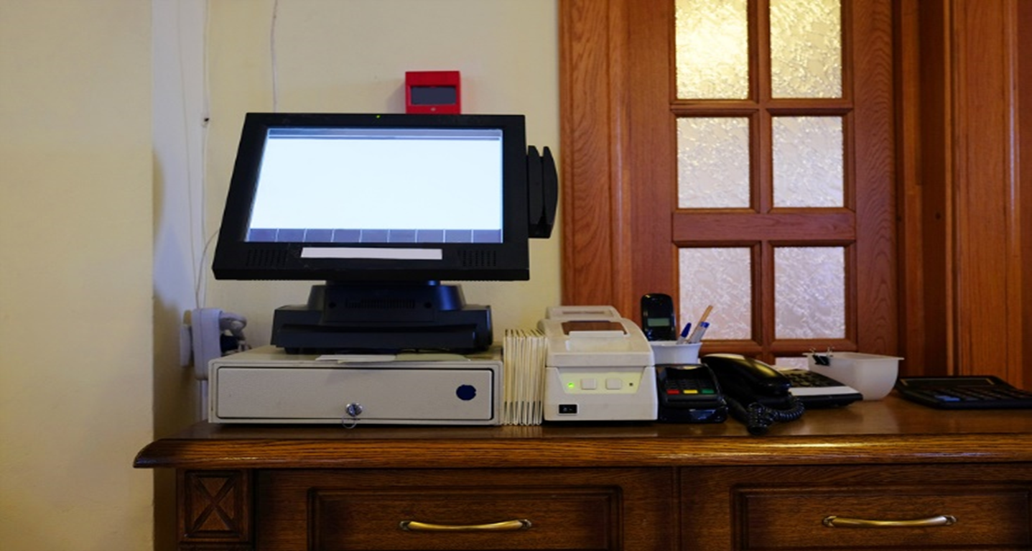
Using the POS (Point Of Sale) System
Notes:
Click on hyperlink to view video:
Using the POS (Point Of Sale) System
A brief tutorial of the basic functions of the POS system used in the food service department at Umpqua Community College. Topics include: clocking in/out, inputting a customer’s order, closing a ticket & printing a checkout (sales summary) report.
https://youtu.be/rISyrnykrEw

Slide 12
Let’s Review!
  What do finances involve?
  What type of software system do most foodservice operations use? What does it do?
  Why type of software system do most hotels use?
  What does it do?
  How are business charts and graphs used in foodservice industry?
Notes:
Answers to the questions are found within the slide presentation or may vary with class discussion.

Slide 13


Slide 14
References and Resources
  Images:
    Shutterstock™ images. Photos obtained with subscription. (Slides 3, 4, 5, 6, 7, 8, 9, 10, 11, 13)
  Textbooks:
    Culinary essentials. (2010). Woodland Hills, CA: Glencoe/McGraw-Hill.
    Draz, J., & Koetke, C. (2014). The culinary professional. Tinley Park, IL: Goodheart-Willcox Company.
    Foundations of restaurant management & culinary arts. (2011). Boston, MA: Prentice Hall.
    Reynolds, J. S. & Chase, D. M. (2014). Hospitality services. Tinley Park, IL: Goodheart-Willcox Company.

Slide 15
References and Resources
  Websites:
    Small Business Administration Learning Center Online Training
    Introduction to Accounting
    This course is designed to provide an overview of accounting.
    https://www.sba.gov/tools/sba-learning-center/training/introduction-accounting
  YouTube™:
    Property Management System
    Patrick van der Wardt of iTesso explains the Property Management System for the hospitality industry.
    https://www.youtube.com/watch?v=f-1DNK__25o&feature=youtu.be
    Using the POS (Point Of Sale) System
    A brief tutorial of the basic functions of the POS system used in the food service department at Umpqua Community College. Topics include: clocking in/out, inputting a customers order, closing a ticket & printing a checkout (sales summary) report.
    https://youtu.be/rISyrnykrEw

