Slide 1
Business Procedures, Equipment and Technology

Slide 3
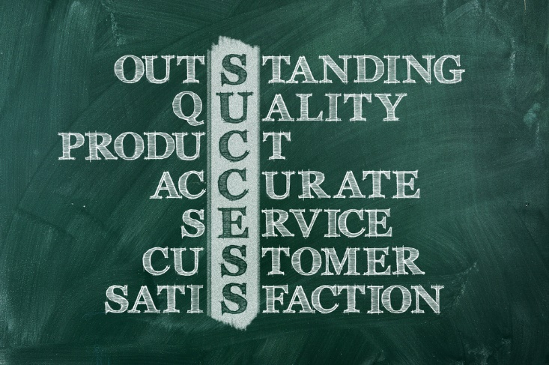
Customer Service
Quality customer service is the heart and soul of the human services industry.
Notes:
Customer service in a human services industry is the total customer experience with that business.
The total customer experience includes:
the cleanliness of the business
the courtesy of the staff/employees
the performance of the staff/employees
the way customers are treated during their visit
Quality customer service is the heart and soul of the human services industry. It is the reason why some businesses fail and others not only succeed, but thrive. With communication through technology at our finger tips, customers can spread the word when they have a positive experience; likewise, they can immediately post a negative one. Quality customer service will differ slightly from business to business, but there are some quality service elements that are universal to all businesses.
Quality Service Elements:
customers expect to be treated with respect and dignity
employees should be able to anticipate customer needs
facilities should be clean and attractive
information and requests should be dealt with in an honest manner
monetary transactions should be handled with honesty and accuracy
requests should be handled with efficiency and accuracy

Slide 4
Communication Skills
Listening and speaking are the most basic communication skills.
Notes:
Developing good communication skills can help you work through problems and improve relationships with family, friends, co-workers and customers. Listening is an active process. Communication involves nonverbal and verbal skills each day and both are equally important. Two types of communication are used in sending and receiving messages. The first type is nonverbal communication, which is a way of sending and receiving messages without using words. The second type is verbal communication, which is the use of words to send and receive messages.
You must:
focus on the speaker’s face and eyes
observe verbal as well as nonverbal communication
pay attention when you listen to someone
You will use listening skills when:
you interact with customers
your supervisor or co-workers give instructions or information

Slide 5
Verbal Communication
Verbal communication is being able to articulate your ideas and information in a clear and concise manner.
Notes:
Verbal communication is being able to articulate your ideas and information in a clear and concise manner. In the human services industry, having good verbal skills is a must!
As you communicate verbally:
ask questions for clarification
avoid slang or unfamiliar “jargon”- the vocabulary peculiar to a particular industry, profession, or work group
be respectful and speak in a professional tone of voice
know your audience
listen first, speak second
repeat the facts back to the person
stay focused on the topic being discussed

Slide 6
Nonverbal Communication
Nonverbal communication means without the use of words.
Notes:
The message you present with your body language includes:
facial expression
hand gestures
posture
eye contact
tone of voice
As an employee in the human services industry, make sure your nonverbal actions communicate warmth and concern for your customers.

Slide 7
Five Steps to Improve Customer Satisfaction
(click on image)
Notes:
Five Steps to Improve Customer Satisfaction
Steps to improve customer satisfaction.
https://youtu.be/XK3cNcuvuMs

Slide 8
Academic Skills
Notes:
Today’s business world requires a different set of writing skills than previous generations.
Advancements in technology have changed much of the way we communicate and transmit information from one party to another. However, all employees at every level should have good basic verbal and writing skills that include spelling and grammar. Beyond this, today’s corporate climates, including human services organizations, require their employees to be able to communicate effectively via the worldwide web.
Since the human services field is global, much business is conducted through computer websites. A person living in Indiana can log onto a business’s website in Paris, make purchase and request it to be mailed overnight. On the receiving end, employees need to know how to access necessary information and communicate effectively in return through e-mails.
Effective writing skills are a must to make:
booklets
brochures
business cards
flyers
reports
signage
Management positions need to be able to design:
employee evaluations
financial documents
presentations
proposals
year-end reports

Slide 9
Finances
Notes:
The way in which money is used and handled by governments and companies.
Business finance involves many activities that gather financial data to be analyzed to determine how well the business is doing.

Slide 10
Financial Services
Notes:
Basic financial math skills are needed to operate a human services establishment effectively.
These skills include adding and subtracting, using fractions and decimals and percentages and ratios.

Slide 11
Business Transactions
An economic event that initiates the accounting process of recording it in a company's accounting system.
Notes:
Many businesses use a property management system (PMS) to keep track of information for all of the departments.
Most consumer services establishments use a point-of-sale system to keep track of various activities in the business.
Other industry businesses may use an accounting software system to keep track of their sales.

Slide 12
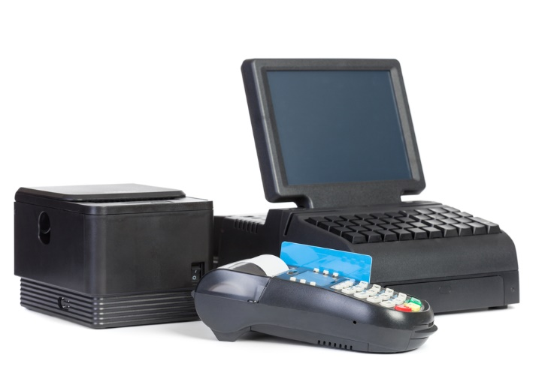
Point-of-Sales Systems
A computerized system that can be used to:
Communicate between staff members
Create reports
Generate bills
Manage inventory
Take orders
Track revenue
Notes:
Point-of-sale systems can track:
credits
daily, monthly, and annual tracking of sales
expenses (marketing, advertising and facility costs)
gift certificates
inventory tracking by department
layaway
profits
Purchases and price lists
refunds
vendor management
work schedules, employee hours and wages
Have you had an opportunity to use one of these?

Slide 13
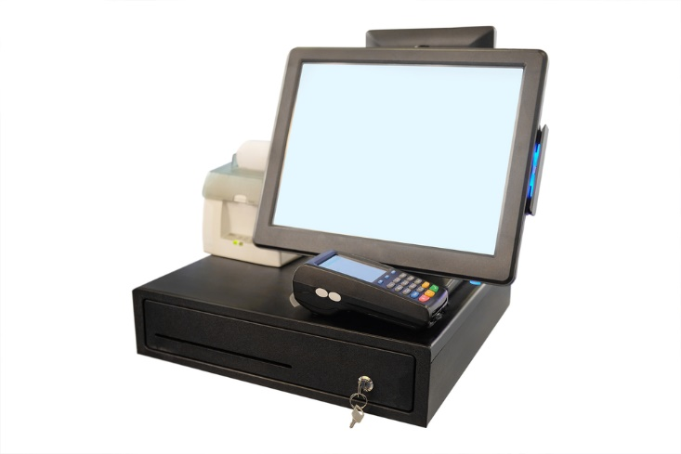
Using the Point-of-Sale (POS) System
(click on image)
Notes:
Using the POS (Point Of Sale) System
A brief tutorial of the basic functions of the POS system used in the food service department at Umpqua Community College. Topics include: clocking in/out, inputting a customer’s order, closing a ticket and printing a checkout (sales summary) report.
https://youtu.be/rISyrnykrEw
Teacher note: The video focuses on using a POS in a restaurant setting. The same principles can be applied to the fields of:
Consumer Services
Early Childhood Development and Services
Counseling and Mental Health Services
Family and Community Services
Personal Care Services

Slide 14
Workplace Documents
Cash flow projections
Customer orders
Inventory for equipment and supplies
Purchase orders
Notes:
Most businesses have individualized documents to be completed daily, weekly, monthly and yearly.

Slide 16
References and Resources
Images:
Shutterstock™ images. Photos obtained with subscription
Websites:
Small Business Administration Learning Center Online Training
Introduction to Accounting
This course is designed to provide an overview of accounting.
https://www.sba.gov/tools/sba-learning-center/training/introduction-accounting
YouTube™:
Five Steps To Improve Customer Satisfaction
Steps to improve customer satisfaction.
https://youtu.be/XK3cNcuvuMs
Using the POS (Point Of Sale) System
A brief tutorial of the basic functions of the POS system used in the food service department at Umpqua Community College. Topics include: clocking in/out, inputting a customer’s order, closing a ticket and printing a checkout (sales summary) report.
https://youtu.be/rISyrnykrEw

