Slide 1
Calculating the Cost of a Destination Vacation

Slide 3
Vacation
  Free from daily obligations
  Rest and relaxation
  Time to travel
  Decisions to be made:
    Destination
    Travel mode
    Cost

Slide 4
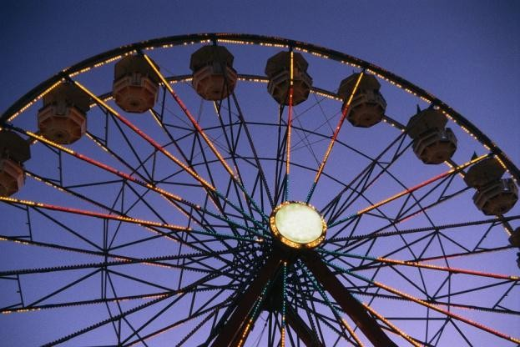
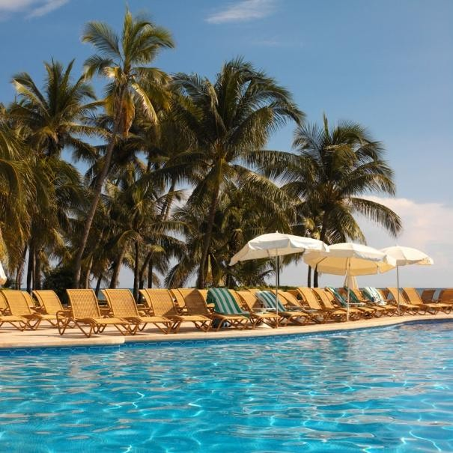
Destination
  Amusement
  Recreation
    Entertainment
    Attractions
    Spectator sports
    Participatory sports
  Resort

Slide 5
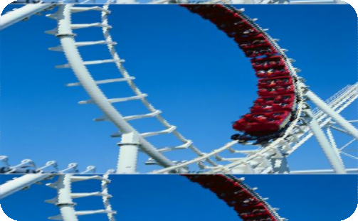
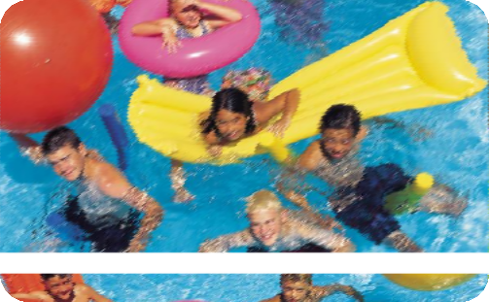
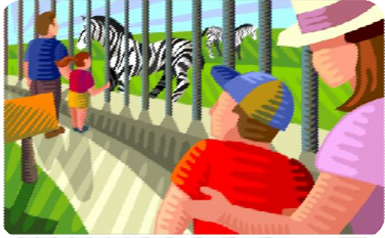
Amusement
Theme Parks
Water Parks
Zoos

Slide 6
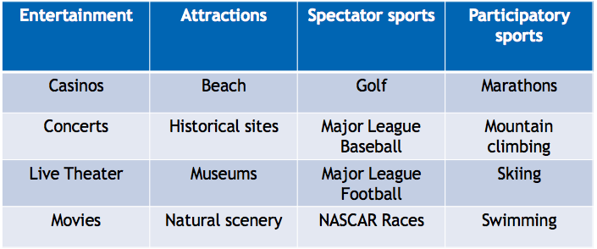
Recreation
What else can you add to the lists?

Slide 7
Resort
  All inclusive
    Entertainment
    Lodging
    Meals
    Recreational activities
    Shopping
    Sports
  May never have to leave premises

Slide 8
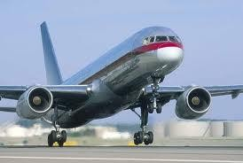
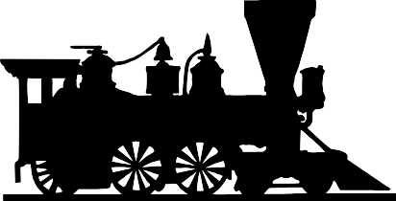
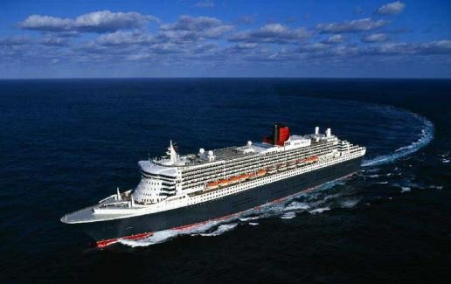
Travel Modes
  Airline
  Cruise line
  Rail

Slide 9
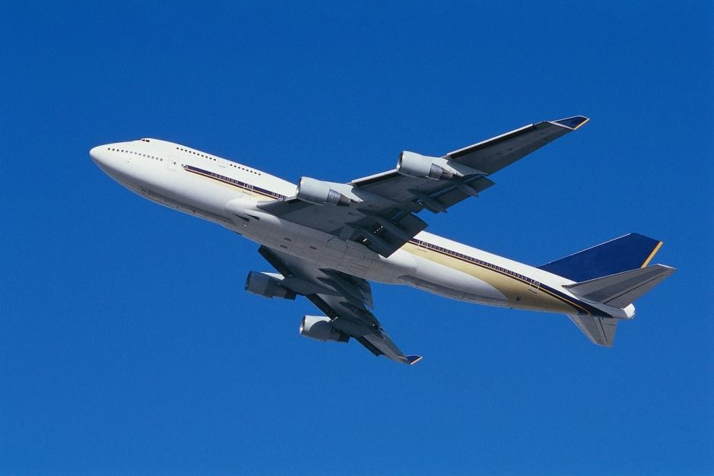
Airline
  Provide air transport services for traveling passengers
  Categorized as intercontinental, intra-continental, domestic, regional, international, or charter

Slide 10
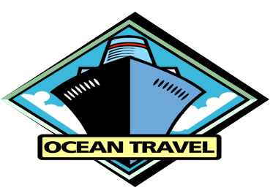
Cruise
  A cruise ship or cruise liner is a passenger ship used for pleasure voyages
  The voyage itself and the ship’s amenities are a part of the experience
    Example: My Disney Cruise

Slide 11
Rail
  Railways were the first form of mass transportation.
  By the 1930’s rail travel had become faster and more
  comfortable
  Amtrak was founded in 1971
  Efficient, economical, high speed trains provide an alternative to air travel
    Example: Amtrak

Slide 12
Other Travel Modes
  Bus
  Rental Car
  Recreation Vehicle

Slide 13
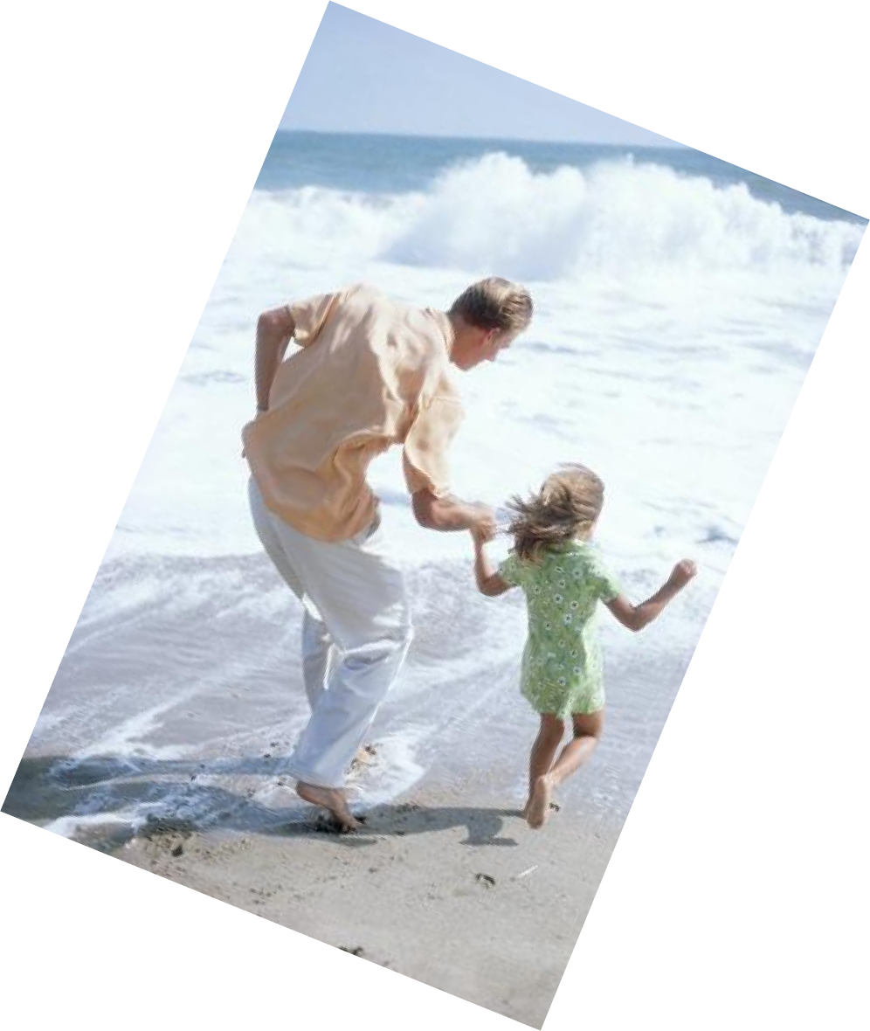
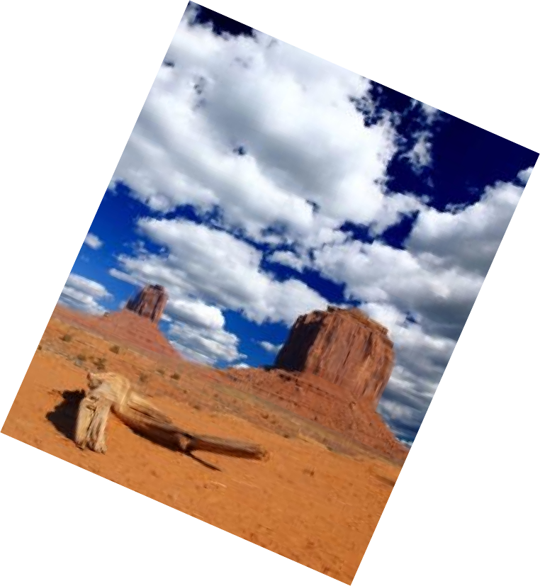

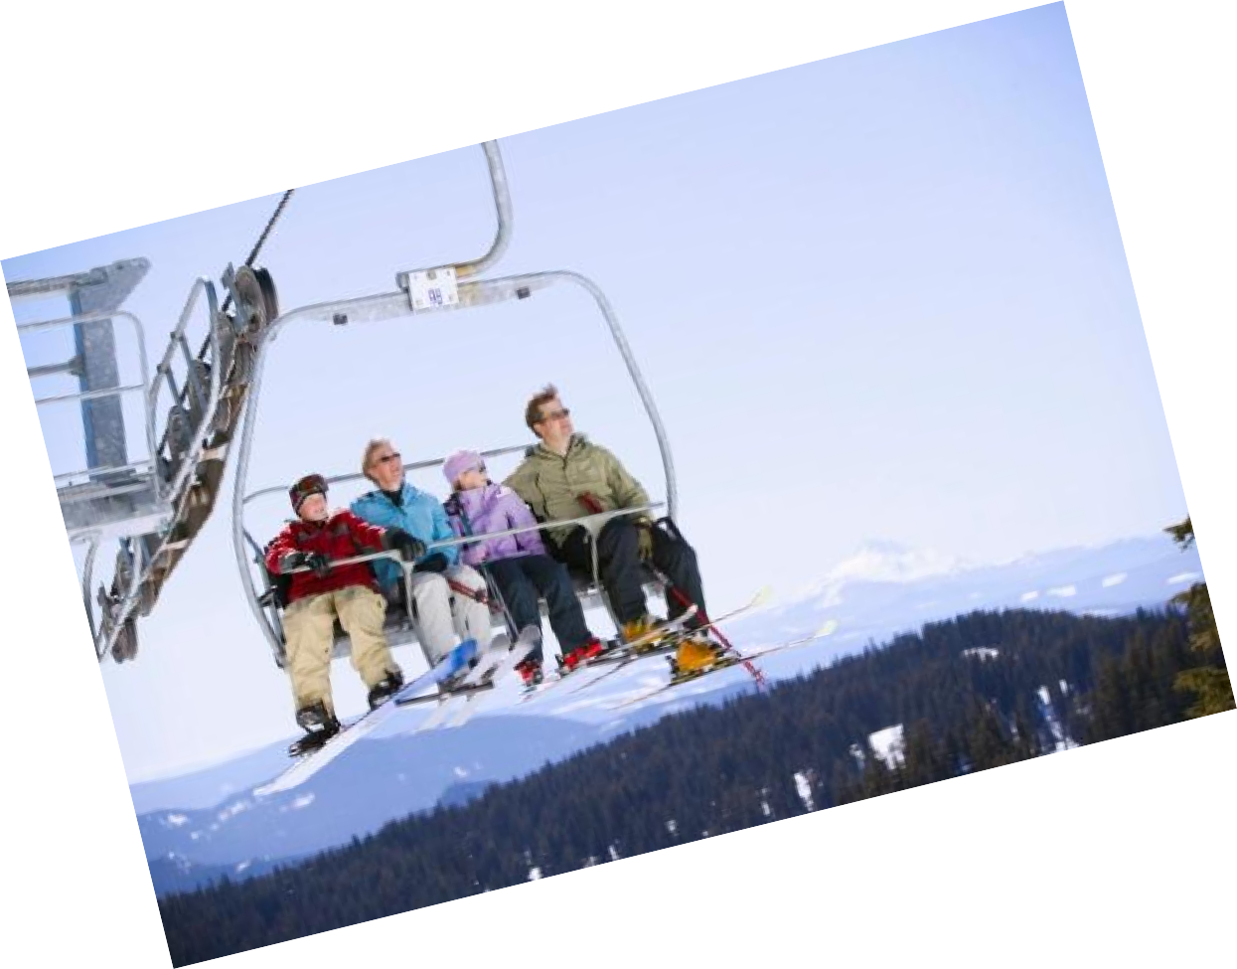
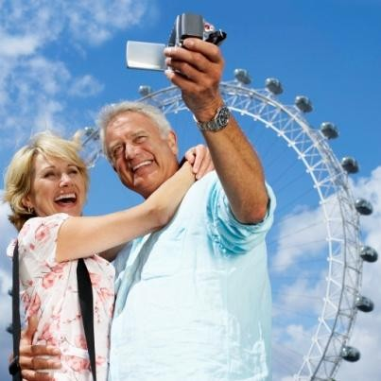
Let’s plan a vacation!

Slide 14
References/Resources
  Images:
    Microsoft Office Clip Art: Used with permission from Microsoft.
  Textbook:
    Reynolds, Johnny Sue. (2010) Hospitality Services. Tinley-Park, Illinois: The Goodheart-Wilcox Company, Inc.
  YouTube™:
    My Disney Cruise
      Explore a Disney Cruise through the eyes and imagination of one of its biggest (little) fans.
      http://www.youtube.com/watch?v=ZhLBKFMM9Tg&feature=share&list=PL304E723B FBDEF2E0
    National Train Day 2013
      The sixth annual National Train Day to show that trains matter to you, your town, and your community.
      http://youtu.be/O9YOZRMecWE

