Slide 1
Can’t We All Just Get Along? Conflict Resolution Strategies
  Interpersonal Studies
Notes:
This lesson will focus on listening skills, the art of compromise, mediation, controlling emotional responses and ethical professional reactions. Role playing scenarios are an excellent way to have you interact and practice appropriate responses to conflict. During these scenes, specific conflict resolution skills should be reinforced and reviewed. Let’s get started to learn about conflict resolution skills.

Slide 3
What are conflicts?
Notes:
There are many different types of conflicts we experience in our lives:
community conflict
economic conflict
emotional conflict
family conflict
group conflict
interpersonal conflict
intrastate conflict (for example: civil wars, election campaigns)
military conflict
racial conflict
relationship conflict
workplace conflict
Communication skills or the lack of – often contribute to various types of conflicts.

Slide 4
Who is responsible for effective communication?
Notes:
Ask the students this question and proceed with a discussion.
What does effective communication look like? Sound like?
How can effective communication help resolve conflicts?

Slide 5
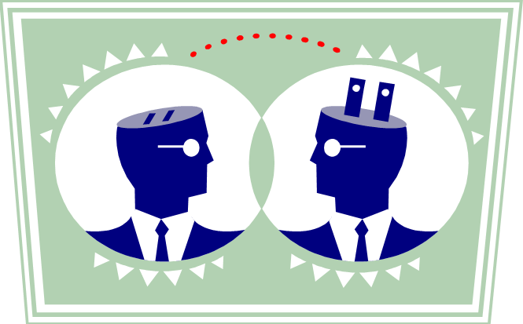
Responsible Effective Communication
  Both the sender and receiver share equal responsibility.
Notes:
Who is responsible for effective communication?
Both the sender and receiver share equal responsibility:
the sender sends a clear and understandable message
the communication loop is complete when the receiver understands, feels or behaves according to message of the sender
receivers must provide senders with enough feedback to ensure that an accurate message is passed through all the filters that might alter it

Slide 6

Interpersonal Communication
  Occurs when people involved talk and listen
  Message must be understood by both parties
  This type of communication takes more time than impersonal communication
Notes:
Interpersonal Communication
occurs when people involved talk and listen (dialogue)
for true communication to take place:
message must be understood by person receiving information in same way the sender intended
feedback is the way to make sure message has been understood
limitations of interpersonal communication:
takes more time than impersonal type
Are you able to convey your message(s) to the person receiving it? If not, has it resulted in a conflict?

Slide 7

Improving Personal Communication
  Develop listening skills
  Send clear messages
  Use appropriate timing
  Use repetition
  Use words carefully
Notes:
Improving Personal Communication
develop listening skills
people listen at a 25% efficiency rate in typical situations
discrepancy between rate of speaking and rate of hearing—
a) people speak approximately 150 words per minute
b) listening capacity is about 450 words per minute
c) because message is usually much slower than our capacity to listen, we have
plenty of time to let minds roam, think ahead and plan what to say next
send clear messages
don’t talk too fast
don’t be too verbose
be aware of communication filters
ask purposeful questions to make sure you were understood
use appropriate timing
not wise to communicate when receiver is extremely busy, angry and so forth
use repetition
studies show that repetition is an important element in ensuring communication accuracy
use parallel channels of communication: verbal instructions followed by memo
use words carefully
use simple and precise language
avoid words that might be vague
avoid technical language and trendy jargon

Slide 8

Develop Listening Skills
  The amount of time people spend on the different parts of communication process:
    Listening—45%
    Speaking—30%
    Reading—16%
    Writing—9%
Notes:
Research from Ohio State University shows the following information:
The amount of time people spend on different parts of communication process:
listening—45%, speaking—30%, reading—16%, writing—9%
How much time do you spend listening? Speaking? Reading? Writing?

Slide 9
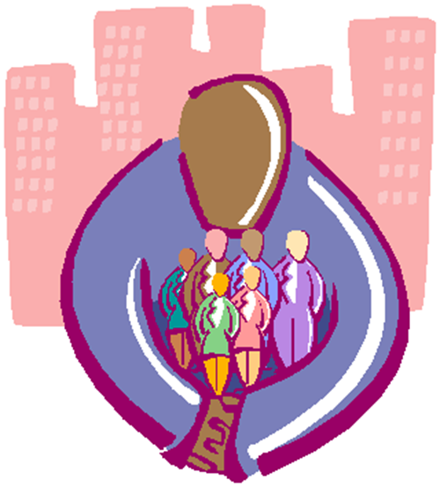
What is conflict resolution?
Notes:
There are many ways to resolve conflict. For conflict to be resolved, some form of change has to be accepted by both parties. This involves give and take. Conflict resolution can only occur if both parties are willing to work together.
Differences are sure to arise between people. When these differences are resolved in constructive ways, relationships can actually be made stronger. When destructive methods are used, relationships may be damaged or destroyed. The conflict either will not be resolved, or one party will definitely come out feeling bad. Learning to recognize constructive and destructive behaviors can help people focus on positive ways to resolve differences.
Can you recall the last conflict you had with an individual?
Did you resolve it? How was it resolved?

Slide 10
What are some positive constructive methods to resolve conflict?
Notes:
Ask the students this question and discuss their answers.

Slide 11
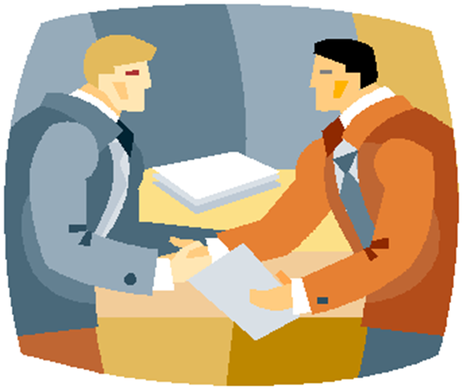
Constructive Conflict Resolutions
  Accommodation
  Compromise
  Concession
  Consensus
Notes:
The following list describes four constructive ways to resolve conflicts:
Accommodation – Both individuals “agree to disagree.” They accept differences and agree not to let these differences grow into major problems.
Compromise – Both individuals give in and find an agreement they can both live with. The result is based on a combination of their views.
Concession – One individual agrees to give in to the other.
Consensus - Both individuals are able to see each other’s point of view and choose a solution good for both of them.

Slide 12
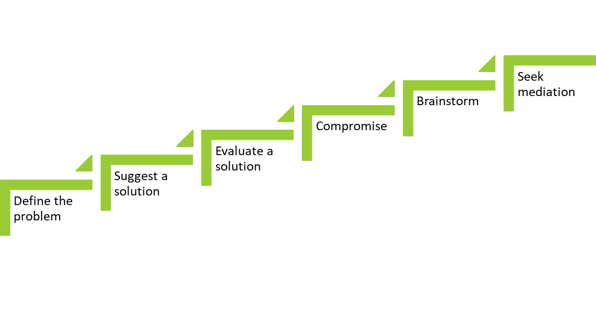
Steps in Conflict Resolution
Notes:
Define the problem - Each party takes a turn describing the problem from his or her point of view. Participants should show respect for each other.
Suggest a solution - Each party suggests a solution.
Evaluate a solution - The solutions are discussed. Each party explains the part of a suggestion that (1) they agree with, and (2) they cannot accept.
Compromise - If the parties are fairly close to agreeing, they may compromise or settle the dispute by each agreeing to give up something.
Brainstorm - If the parties cannot compromise, they brainstorm different ways to approach the problem and try again to reach a compromise.
Seek mediation - If no solution is reached, the parties invite a third party to listen and make suggestions.

Slide 13
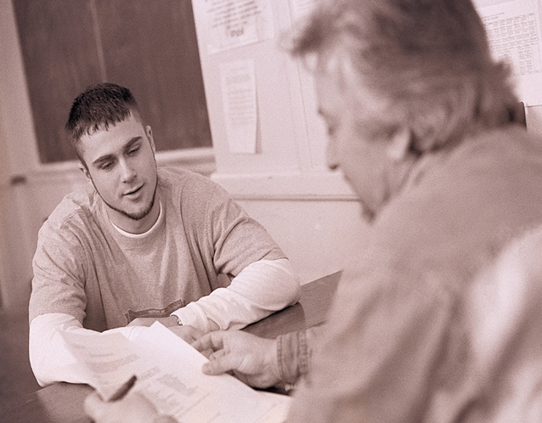
Conflict Resolutions
  Respect each other
  Listen to various points
  Work towards mutual decisions
Notes:
Conflict resolution or management requires that everyone involved respects each other, listens to various views, and works toward mutual decisions. Some steps to reach an agreement are:
Each person stating his or her side while others listen respectfully with no interruptions
Using I-messages to verify understanding. For example: “I hear you say ________________.
Trying to see the other’s opinions or side
Brainstorming to find solutions
Participants volunteering what they can do to solve the conflict or problem
Listening, negotiating and working toward a mutual agreement or decision

Slide 14

Practicing Constructive Conflict Resolution
  Be accepting of compromise
  Be flexible and willing to bend
  Be honest about your needs and wants
  Cooperate by working together toward a solution
  Do not change the subject
  Face the conflict without fear (Do not avoid it.)
  Put yourself in the other person’s shoes
Notes:
Be accepting of compromise
Be flexible and willing to bend
Be honest about your needs and wants
Cooperate by working together toward a solution
Do not change the subject
Face the conflict without fear (Do not avoid it.)
Put yourself in the other person’s shoes
What are some other ways to practice constructive conflict resolution?

Slide 15

Practicing Constructive Conflict Resolution
Notes:
10 Hot Tips - Managing Conflict
10 Hot Leadership Tips Series - Managing Conflict
http://youtu.be/mqkm788-Jk8

Slide 16
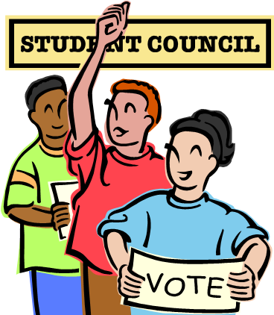
Conflict Resolution Strategies
  Altering the group structure
  Appealing to a higher belief or value
  Avoidance
  Communication
  Compromise
  Democratic vote
Notes:
Altering the Group Structure – In a classroom or group setting, altering the group structure may mean changing the physical space in order to separate two conflicting individuals, changing a student’s schedule or even changing a teacher’s job responsibilities. Like the strategy of avoidance, this strategy may sometimes just push the conflict out of sight temporarily, only to have it return with increased intensity.
Appealing to a Higher Belief or Value – When conflict seems irresolvable, sometimes focusing on an overarching goal or belief will help resolve conflict. For example, two siblings involved in a personal conflict may decide to put their differences aside in order to do what is best for the family. Developmental levels have a great deal to do with how effective this strategy may be with individuals. A very young child may not be able to use this strategy, whereas a parent may appeal to an older sibling for the greater good of all.
Avoidance – Avoidance is a conflict resolution strategy that is overused not only by students but by adults as well. It can be helpful, however, in some situations. For instance, if two students in a classroom are having real difficulties getting along, teaching them the technique of “just don’t go there” or helping them maintain a greater distance may help the overall classroom environment. Be aware that ignored conflict often mushrooms into deeper conflict, so this strategy should be used with caution when the situation seems to warrant it.
Communication – It may be obvious to say that communication is needed to prevent and resolve conflict. However, many conflicts occur because of poor communication. To be effective, a communicated message must be sent in a clear and concise manner. Individuals must determine the best way to communicate their intended messages, and then obtain feedback from the receivers to determine if it was received and interpreted in the manner intended.
Compromise – Compromise is a strategy that allows the conflicting individuals or group of individuals to meet halfway. In other words, each side gives up part of what he or she wants in order to resolve the issue. In a compromise, it is important that both parties give equally or resentment and further conflict will result.
Democratic vote – Imagine your CTSO is planning a fall festival, and each class is asked to host an activity in their classroom. In order to choose an activity, the teachers ask for suggestions and then allow the class to vote on its favorite. This is an example of resolving conflict through democratic vote. It is a “majority-rules” strategy, in which a vote is taken of all the students or members of the conflict. The vote can be written, hand-raised or verbal. The group with the most votes wins.

Slide 17

Conflict Resolution Strategies
  Direct order
  Expanding or developing new resources
  “I Need You and You Need Me”
  Outside intervention
  Seeking additional information
  Using conciliatory gestures
Notes:
Direct order – A direct order is a conflict resolution strategy that is often overused by parents, guardians, or teachers. With a direct order, there is no input sought from the conflicting individuals. Without input, most conflicts will not be completely resolved and will reappear. However, the direct order is useful when resolution is needed immediately, such as with a physical fight, and when the person making the order is accepted as an authority figure by conflicting individuals.
Expanding or developing new resources – Conflict often occurs when resources are scarce. When scarcity occurs, individuals begin to scramble to get their fair share. When they come up empty-handed, conflict occurs. This issue can be resolved by expanding the current resources or by developing new resources.
“I Need You and You Need Me” – This strategy helps individuals understand how two conflicting individuals or groups of individuals may have resources that, when shared, will help each side achieve its own goals and interests. This strategy helps individuals realize the value of others. For instance, a student who is strong in math can tutor a fellow classmate in return for help with English.
Outside intervention – Sometimes conflict becomes so intense that an outside perspective is needed. Outside intervention means involving a third party who can help negotiate, arbitrate or just offer wise counsel with regard to the conflict. When teachers are involved in conflict or conflict is occurring in the classroom, their school administrators or counselors may be good resources to contact. Teachers whom students trust may find themselves providing a third-party perspective.
Seeking additional information – Seeking additional information is a good way to keep from overreacting to misinformation. Misinformation and rumors are everywhere. Many individuals have become angry or upset over something that they thought was said or done. When the truth was known, the perceived event never occurred or occurred under conditions that were acceptable. Many individual conflicts can be resolved through this strategy. When individuals encounter the “He said, she said” conflict, they should immediately seek the facts.
Using conciliatory gestures – Often two conflicting students or student groups will come to an impasse. When communication ceases, conflict cannot be resolved. At this point in the conflict, a conciliatory gesture can be of tremendous value. A conciliatory gesture can be as simple as a smile or kind word, or it can be as complex as a concession. Conciliation is the process whereby one side of the conflict initiates a gesture of good faith in the hope that the other party will reciprocate with a similar type of gesture. The intent is to move both conflicting parties toward decreased tension and increased communication and, eventually, cooperation and conflict resolution.

Slide 18
What are some negative methods to resolve conflict?
Notes:
Ask the students this question and discuss their answers.

Slide 19

Destructive Conflict Resolution
  Attempting to prove who is right
  Bagging
  Blowing up
  Deceiving
  Lying
  Personal attacking
Notes:
When differences arise between people, negative reactions can damage or destroy relationships. The following list is a sample of some destructive behaviors that are often used in resolving conflicts.
Attempting to prove who is right makes the conflict worse. Personal feelings get involved and parties are unable to focus on resolving the issue.
Bagging occurs when a person saves up irritations, hurts and anger instead of confronting issues as they develop. Bagging causes anger and resentment to build. Individuals with “baggage” find it hard to focus on the immediate issue, which makes it hard to resolve.
Blowing up or getting angry damages the relationship. Blowing up may involve crying, screaming, shouting, stomping feet or other exhibitions of anger. Angry outbursts can result in hurt feelings and grudges. Often, thoughtless words are said that are not meant but are hard for the other person to forget.
Deceiving is much like lying. The person practicing deception tries to gain an advantage by misrepresenting the truth in his or her favor. Eventually, others begin to doubt that person’s honesty and the accuracy of any information.
Lying damages trust and causes relationships to suffer greatly. Lying sometimes seems like a quick way to get out of a conflict but conflicts can never really be resolved without honesty. Lying will eventually weaken and destroy the very foundation of relationships.
Personal attacking is another behavior that damages relationships. When a person ridicules or belittles someone else, the real issue is not addressed. Problem solving becomes difficult, and trust is destroyed.

Slide 20

Peer Mediation, Problem Solving and Negotiation
  Peer mediation is a process to resolve disputes between two people or small groups of people by a person or people of the same age group to facilitate the resolution.
Notes:
Peer Mediation, Problem Solving, and Negotiation
Peer mediation is a process to resolve disputes between two people or small groups by a person or people of the same age group of people to facilitate the resolution. This process has proven effective for years in all age groups, particularly in younger groups. Benefits of using peer mediation among the young have been used throughout the United States. Changes include improved self-esteem and the building of listening and critical thinking skills. Peer mediators do not place blame but rather they look for solutions for all those involved. This type of problem-solving method uses many skills to bring parties “to the table” in a calm, voluntary and cooperative manner. Negotiations are a common method used in mediation and decision-making.
Have you ever been part of a mediation If so, what happened?

Slide 21

Peer Mediation
Notes:
In the Mix: Peer Mediation -- A Process of Respect (Excerpt)
We visit a diverse small city school that has a variety of pro-active student centered programs in place. When a fight breaks out in the cafeteria, two boys choose to participate in peer mediation rather than face the administration.
http://youtu.be/4gQ0ZLdHlHM

Slide 22

Questions?

Slide 23
References and Resources
  Images:
    Microsoft Clip Art: Used with permission from Microsoft.
  Textbook:
    Sasse, C.R. (2004). Families today. New York: Glencoe/McGraw Hill.
  Websites:
    About.com
    Communicate: Improve Your Relationships With Effective Communication Skills.
    http://stress.about.com/od/relationships/ht/healthycomm.htm
    About.com
    How To Handle Unresolved Conflict in Your Family.
    http://stress.about.com/od/relationships/qt/unresolved.htm

Slide 24
References and Resources
  YouTube™:
    In the Mix: Peer Mediation — A Process of Respect (Excerpt)
    We visit a diverse small city school that has a variety of pro-active student centered programs in place. When a fight breaks out in the cafeteria, two boys choose to participate in peer mediation rather than face the administration.
    http://youtu.be/4gQ0ZLdHlHM
    10 Hot Tips – Managing Conflict
    10 Hot Leadership Tips Series – Managing Conflict
    http://youtu.be/mqkm788-Jk8

