Slide 1
Can’t We All Just Get Along? Conflict Resolution Strategies
Counseling and Mental Health
Notes:
This lesson will focus on listening skills, the art of compromise, mediation, controlling emotional responses and ethical professional reactions. Role-playing scenarios are an excellent way to have you interact and practice appropriate responses to conflict. During these scenes, specific conflict resolution skills should be reinforced and reviewed. Let’s get started to learn about conflict resolution skills and strategies.

Slide 2
Copyright
Copyright and Terms of Service
Copyright © Texas Education Agency, 2014. These materials are copyrighted © and trademarked ™ as the property of the Texas Education Agency (TEA) and may not be reproduced without the express written permission of tea, except under the following conditions:
1) Texas public school districts, charter schools, and education service centers may reproduce and use copies of the materials and related materials for the districts’ and schools’ educational use without obtaining permission from TEA.
2) Residents of the state of Texas may reproduce and use copies of the materials and related materials for individual personal use only, without obtaining written permission of TEA.
3) Any portion reproduced must be reproduced in its entirety and remain unedited, unaltered and unchanged in any way.
4) No monetary charge can be made for the reproduced materials or any document containing them; however, a reasonable charge to cover only the cost of reproduction and distribution may be charged.
Private entities or persons located in Texas that are not Texas public school districts, Texas education service centers, or Texas charter schools or any entity, whether public or private, educational or non-educational, located outside the state of Texas must obtain written approval from tea and will be required to enter into a license agreement that may involve the payment of a licensing fee or a royalty.
Contact TEA copyrights with any questions you may have.
Copyright © Texas Education Agency, 2014. All rights reserved.

Slide 3
What are conflicts?
Copyright © Texas Education Agency, 2014. All rights reserved.
3
Notes:
There are many different types of conflicts we experience in our lives:
community conflict
economic conflict
emotional conflict
family conflict
group conflict
interpersonal conflict
intrastate conflict (for example: civil wars, election campaigns)
military conflict
racial conflict
relationship conflict
workplace conflict
Communication skills, the lack of, often contribute to various types of conflicts.
As a mental health employee, why is it important to understand and practice strategies on dealing with conflicts?

Slide 4
Who is responsible for effective communication?
Copyright © Texas Education Agency, 2014. All rights reserved.
4
Notes:
Ask the students this question and proceed with a discussion.
What does effective communication look like? Sound like?
How can effective communication help resolve conflicts?
Why is it important to practice effective communication in the mental health field?

Slide 5
Responsible Effective Communication
Both the sender and receiver share equal responsibility.
Copyright © Texas Education Agency, 2014. All rights reserved.
Notes:
Who is responsible for effective communication?
Both the sender and receiver share equal responsibility:
the sender must transmit or communicate a clear and understandable message
the communication loop is complete when the receiver understands, feels or behaves according to message of the sender
receivers must provide senders with enough feedback to ensure that an accurate message is passed through all the filters that might alter it

Slide 6
The Communication Process
Receiver
Sender
Encoding
Decoding
Message
Copyright © Texas Education Agency, 2014. All rights reserved.
6
Notes:
Sender is the person who initiates the communication. The sender must, in some verbal or nonverbal manner, pass the message along to another.
Encoding is the means by which the sender makes the message understandable to the receiver. Encoding is accomplished through language or some other method.
Message is what is being communicated. The message is the part of the communication that must be recognized and understood.
Decoding is the process of recognizing the message being sent. The receiver must use his or her skills (verbal and nonverbal) to try to determine the message being sent.
Receiver is the person to whom the communication is directed. The receiver intercepts the message and hopefully interprets it correctly.

Slide 7
Interpersonal Communication
Occurs when people involved talk and listen
Message must be understood by both parties
This type of communication takes more time than impersonal communication
Copyright © Texas Education Agency, 2014. All rights reserved.
Notes:
Interpersonal Communication
occurs when people involved talk and listen (dialogue)
for true communication to take place:
message must be understood by person receiving information in same way the sender intended
feedback is the way to make sure message has been understood
limitations of interpersonal communication:
takes more time than impersonal type
Are you able to convey your message(s) to the person receiving it? If not, has it resulted in a conflict?

Slide 8
Interpersonal Communication
(click on picture)
Copyright © Texas Education Agency, 2014. All rights reserved.
8
Notes:
How to Improve Interpersonal Skills
This VideoJug presentation shows you how to improve your interpersonal skills with the aid of some simple coaching techniques.
http://youtu.be/w97dR3OJB1k

Slide 9

Improving Personal Communication
Develop listening skills
Send clear messages
Use appropriate timing
Use repetition
Use words carefully
Copyright © Texas Education Agency, 2014. All rights reserved.
Notes:
Improving Personal Communication
develop listening skills
people listen at a 25% efficiency rate in typical situations
discrepancy between rate of speaking and rate of hearing—
a) people speak approximately 150 words per minute
b) listening capacity is about 450 words per minute
c) because message is usually much slower than our capacity to listen, we have
plenty of time to let minds roam, think ahead and plan what to say next
send clear messages
don’t talk too fast
don’t be too verbose
be aware of communication filters
ask purposeful questions to make sure you were understood
use appropriate timing
not wise to communicate when receiver is extremely busy, angry and so forth
use repetition
studies show that repetition is an important element in ensuring communication accuracy
use parallel channels of communication: verbal instructions followed by memo
use words carefully
use simple and precise language
avoid words that might be vague
avoid technical language and trendy jargon

Slide 10
Influences on Effective Communication
Body language
Culture
Environment
Feelings
Location
Past experiences
Perception
Situations
Copyright © Texas Education Agency, 2014. All rights reserved.
10
Notes:
Body language – Things such as gestures, facial expressions and posture comprise body language.
Culture – Certain cultures have rules about communicating with others.
Environment – Heat and cold alter communication. We usually communicate more effectively when we are comfortable.
Feelings – Anger, sadness, happiness and excitement can all affect how we communicate. We often say hurtful things in a fit of anger.
Location – We also tend to communicate more effectively in a location with which we are familiar and feel comfortable.
Past experiences – Past experiences with people or situations can affect communication.
Perception – (A mental image; a comprehension or understanding of something) Comprehension and understanding of things varies from individual to individual.
Situations – Stressful situations can alter communication. Unfamiliar situations may affect communication.

Slide 11


I-Statements versus You-Statements
AVOID You-Statements
I-Statements
Focus on your point of view
I see…
I feel …
I think …
I wonder …
I wish …
I plan …
I believe …
I can …
I want …
You shouldn’t say that…
You just need to get over that…
You never do anything right…
You are so gullible…
You always bring up old issues…
You need to be more responsible…
You just need to forget what happened…
You don’t know what you are saying…
Copyright © Texas Education Agency, 2014. All rights reserved.
11
Notes:
What is an I-statement and what is a You-statement?
Individuals need to learn to clearly speak up for themselves. Using I-statements to express thoughts, feelings and ideas can help us speak for ourselves - from our point of view.
You-statements are negative and often place blame or attack the receiver. How many times has someone made negative comments to you? Were you able to get your point of view across?
I-statements give you the responsibility and control over what you communicate to others.
Do you ever have a hard time telling someone how you really feel or how you really think? Maybe a friend asked you to lend him or her $50.00. Perhaps you were not sure how to say no without hurting his or her feelings. You lend him or her $50.00 and now you are worried about making your car payment. Learning how to use I-statements can give you more control over what you communicate to others. How would you use an I-statement to say no to your friend?
Possible answers:
I see you need help but I have a car payment that is due day after tomorrow. I am really sorry.
Teacher note: Ask students for additional responses to this scenario using I-statements as listed on this slide. You may assign a scribe to write the responses on the board.
You-statements attack the receiver’s self-esteem. As a result, the receiver responds in a defensive manner. The person may feel that his or her thoughts, opinions or plans are unimportant. Some feelings the receiver might experience are:
Angry
Defensive
Hurt
Inadequate
Inferior
Labeled
Resistant
Stubborn
Worthless
Do you think this is an effective way to communicate? Has anyone ever made you feel like this during a conversation? Have you ever made someone feel defensive during a conversation? What happened?

Slide 12
Develop Listening Skills
The amount of time people spend on the different parts of communication process:
  listening—45%
  speaking—30%
  reading—16%
  writing—9%
Copyright © Texas Education Agency, 2014. All rights reserved.
12
Notes:
Research from Ohio State University shows the following information:
The amount of time people spend on different parts of communication process:
listening—45%, speaking—30%, reading—16%, writing—9%
How much time do you spend listening? Speaking? Reading? Writing?

Slide 13
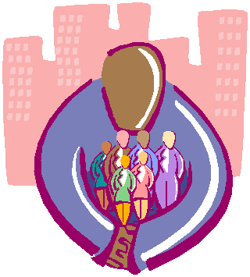
What is conflict resolution?
Copyright © Texas Education Agency, 2014. All rights reserved.
Notes:
There are many ways to resolve conflict. For conflict to be resolved, some form of change has to be accepted by both parties. This involves give and take. Conflict resolution can only occur if both parties are willing to work together.
Differences are sure to arise between people. When these differences are resolved in constructive ways, relationships can actually be made stronger. When destructive methods are used, relationships may be damaged or destroyed. The conflict either will not be resolved, or one party will definitely come out feeling bad. Learning to recognize constructive and destructive behaviors can help people focus on positive ways to resolve differences.
Can you recall the last conflict you had with an individual?
Did you resolve it? How was it resolved?

Slide 14
What are some positive constructive methods to resolve conflict?
Copyright © Texas Education Agency, 2014. All rights reserved.
Notes:
Ask the students this question and discuss their answers.

Slide 15
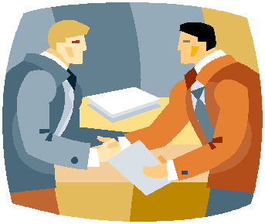
Constructive Conflict Resolutions
Accommodation
Compromise
Concession
Consensus
Copyright © Texas Education Agency, 2014. All rights reserved.
Notes:
The following list describes four constructive ways to resolve conflicts:
Accommodation - Both individuals “agree to disagree.” They accept differences and agree not to let these differences grow into major problems.
Compromise - Both individuals give in and find an agreement they can both live with. The result is based on a combination of their views.
Concession - One individual agrees to give in to the other.
Consensus - Both individuals are able to see each other’s point of view and choose a solution good for both of them.

Slide 16
Steps in Conflict Resolution
Define the problem
Evaluate a solution
Compromise
Suggest a solution
Brainstorm
Seek mediation
Copyright © Texas Education Agency, 2014. All rights reserved.
Notes:
Define the problem - Each party takes a turn describing the problem from his or her point of view. Participants should show respect for each other.
Suggest a solution - Each party suggests a solution.
Evaluate a solution - The solutions are discussed. Each party explains the part of a suggestion that (1) they agree with, and (2) they cannot accept.
Compromise - If the parties are fairly close to agreeing, they may compromise or settle the dispute by each agreeing to give up something.
Brainstorm - If the parties cannot compromise, they brainstorm different ways to approach the problem and try again to reach a compromise.
Seek mediation - If no solution is reached, the parties invite a third party to listen and make suggestions.

Slide 17
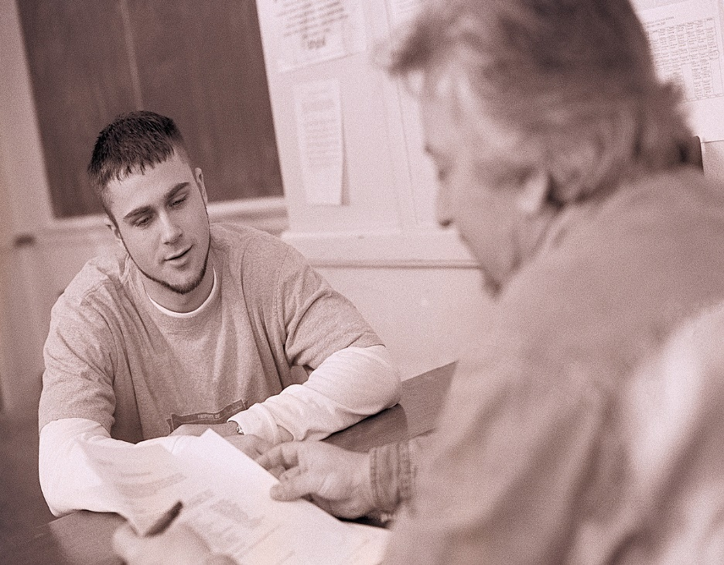
Conflict Resolutions
Respect each other
Listen to various points
Work towards mutual decisions
Copyright © Texas Education Agency, 2014. All rights reserved.
Notes:
Conflict resolution or management requires that everyone involved respects each other, listens to various views, and works toward mutual decisions. Some steps to reach an agreement are:
Each person stating his or her side while others listen respectfully with no interruptions
Using I-messages to verify understanding. For example: “I hear you say ________________.
Trying to see the other’s opinions or side
Brainstorming to find solutions
Participants volunteering what they can do to solve the conflict or problem
Listening, negotiating and working toward a mutual agreement or decision

Slide 18

Practicing Constructive Conflict Resolution
Be accepting of compromise
Be flexible and willing to bend
Be honest about your needs and wants
Cooperate by working together toward a solution
Do not change the subject
Face the conflict without fear (Do not avoid it.)
Put yourself in the other person’s shoes
Copyright © Texas Education Agency, 2014. All rights reserved.
Notes:
Be accepting of compromise
Be flexible and willing to bend
Be honest about your needs and wants
Cooperate by working together toward a solution
Do not change the subject
Face the conflict without fear (Do not avoid it.)
Put yourself in the other person’s shoes
What are some other ways to practice constructive conflict resolution?

Slide 19
Practicing Constructive Conflict Resolution
(click on picture)
Copyright © Texas Education Agency, 2014. All rights reserved.
Notes:
10 Hot Tips - Managing Conflict
10 Hot Leadership Tips Series - Managing Conflict
http://youtu.be/mqkm788-Jk8

Slide 20
Conflict Resolution Strategies
Altering the group structure
Appealing to a higher belief or value
Avoidance
Communication
Compromise
Democratic vote
Copyright © Texas Education Agency, 2014. All rights reserved.
Notes:
Altering the Group Structure – In a classroom or group setting, altering the group structure may mean changing the physical space in order to separate two conflicting individuals, changing a student’s schedule or even changing a teacher’s job responsibilities. Like the strategy of avoidance, this strategy may sometimes just push the conflict out of sight temporarily, only to have it return with increased intensity.
Appealing to a Higher Belief or Value – When conflict seems irresolvable, sometimes focusing on an overarching goal or belief will help resolve conflict. For example, two siblings involved in a personal conflict may decide to put their differences aside in order to do what is best for the family. Developmental levels have a great deal to do with how effective this strategy may be with individuals. A very young child may not be able to use this strategy, whereas a parent may appeal to an older sibling for the greater good of all.
Avoidance – Avoidance is a conflict resolution strategy that is overused not only by students but by adults as well. It can be helpful, however, in some situations. For instance, if two students in a classroom are having real difficulties getting along, teaching them the technique of “just don’t go there” or helping them maintain a greater distance may help the overall classroom environment. Be aware that ignored conflict often mushrooms into deeper conflict, so this strategy should be used with caution when the situation seems to warrant it.
Communication – It may be obvious to say that communication is needed to prevent and resolve conflict. However, many conflicts occur because of poor communication. To be effective, a communicated message must be sent in a clear and concise manner. Individuals must determine the best way to communicate their intended messages, and then obtain feedback from the receivers to determine if it was received and interpreted in the manner intended.
Compromise – Compromise is a strategy that allows the conflicting individuals or group of individuals to meet halfway. In other words, each side gives up part of what he or she wants in order to resolve the issue. In a compromise, it is important that both parties give equally or resentment and further conflict will result.
Democratic vote – Imagine your CTSO is planning a fall festival, and each class is asked to host an activity in their classroom. In order to choose an activity, the teachers ask for suggestions and then allow the class to vote on its favorite. This is an example of resolving conflict through democratic vote. It is a “majority-rules” strategy, in which a vote is taken of all the students or members of the conflict. The vote can be written, hand-raised or verbal. The group with the most votes wins.

Slide 21
Conflict Resolution Strategies
Direct order
Expanding or developing new resources
“I Need You and You Need Me”
Outside intervention
Seeking additional information
Using conciliatory gestures
Copyright © Texas Education Agency, 2014. All rights reserved.
Notes:
Direct order – A direct order is a conflict resolution strategy that is often overused by parents, guardians, or teachers. With a direct order, there is no input sought from the conflicting individuals. Without input, most conflicts will not be completely resolved and will reappear. However, the direct order is useful when resolution is needed immediately, such as with a physical fight, and when the person making the order is accepted as an authority figure by conflicting individuals.
Expanding or developing new resources – Conflict often occurs when resources are scarce. When scarcity occurs, individuals begin to scramble to get their fair share. When they come up empty-handed, conflict occurs. This issue can be resolved by expanding the current resources or by developing new resources.
“I Need You and You Need Me” – This strategy helps individuals understand how two conflicting individuals or groups of individuals may have resources that, when shared, will help each side achieve its own goals and interests. This strategy helps individuals realize the value of others. For instance, a student who is strong in math can tutor a fellow classmate in return for help with English.
Outside intervention – Sometimes conflict becomes so intense that an outside perspective is needed. Outside intervention means involving a third party who can help negotiate, arbitrate or just offer wise counsel with regard to the conflict. When teachers are involved in conflict or conflict is occurring in the classroom, their school administrators or counselors may be good resources to contact. Teachers whom students trust may find themselves providing a third-party perspective.
Seeking additional information – Seeking additional information is a good way to keep from overreacting to misinformation. Misinformation and rumors are everywhere. Many individuals have become angry or upset over something that they thought was said or done. When the truth was known, the perceived event never occurred or occurred under conditions that were acceptable. Many individual conflicts can be resolved through this strategy. When individuals encounter the “He said, she said” conflict, they should immediately seek the facts.
Using conciliatory gestures – Often two conflicting students or student groups will come to an impasse. When communication ceases, conflict cannot be resolved. At this point in the conflict, a conciliatory gesture can be of tremendous value. A conciliatory gesture can be as simple as a smile or kind word, or it can be as complex as a concession. Conciliation is the process whereby one side of the conflict initiates a gesture of good faith in the hope that the other party will reciprocate with a similar type of gesture. The intent is to move both conflicting parties toward decreased tension and increased communication and, eventually, cooperation and conflict resolution.

Slide 22
What are some negative methods to resolve conflict?
Copyright © Texas Education Agency, 2014. All rights reserved.
Notes:
Ask the students this question and discuss their answers.

Slide 23

Destructive Conflict Resolution
Attempting to prove who is right
Bagging
Blowing up
Deceiving
Lying
Personal attacking
Copyright © Texas Education Agency, 2014. All rights reserved.
Notes:
When differences arise between people, negative reactions can damage or destroy relationships. The following list is a sample of some destructive behaviors that are often used in resolving conflicts.
Attempting to prove who is right makes the conflict worse. Personal feelings get involved and parties are unable to focus on resolving the issue.
Bagging occurs when a person saves up irritations, hurts and anger instead of confronting issues as they develop. Bagging causes anger and resentment to build. Individuals with “baggage” find it hard to focus on the immediate issue, which makes it hard to resolve.
Blowing up or getting angry damages the relationship. Blowing up may involve crying, screaming, shouting, stomping feet or other exhibitions of anger. Angry outbursts can result in hurt feelings and grudges. Often, thoughtless words are said that are not meant but are hard for the other person to forget.
Deceiving is much like lying. The person practicing deception tries to gain an advantage by misrepresenting the truth in his or her favor. Eventually, others begin to doubt that person’s honesty and the accuracy of any information.
Lying damages trust and causes relationships to suffer greatly. Lying sometimes seems like a quick way to get out of a conflict but conflicts can never really be resolved without honesty. Lying will eventually weaken and destroy the very foundation of relationships.
Personal attacking is another behavior that damages relationships. When a person ridicules or belittles someone else, the real issue is not addressed. Problem solving becomes difficult, and trust is destroyed.

Slide 24

Peer Mediation, Problem Solving and Negotiation
Peer mediation is a process to resolve disputes between two people or small groups of people by a person or people of the same age group to facilitate the resolution.
Copyright © Texas Education Agency, 2014. All rights reserved.
Notes:
Peer Mediation, Problem Solving, and Negotiation
Peer mediation is a process to resolve disputes between two people or small groups by a person or people of the same age group of people to facilitate the resolution. This process has proven effective for years in all age groups, particularly in younger groups. Benefits of using peer mediation among the young have been used throughout the United States. Changes include improved self-esteem and the building of listening and critical thinking skills. Peer mediators do not place blame but rather they look for solutions for all those involved. This type of problem-solving method uses many skills to bring parties “to the table” in a calm, voluntary and cooperative manner. Negotiations are a common method used in mediation and decision-making.
Have you ever been part of a mediation process? If so, what happened?

Slide 25
Peer Mediation
(click on picture)
Copyright © Texas Education Agency, 2014. All rights reserved.
Notes:
In the Mix: Peer Mediation -- A Process of Respect (Excerpt)
We visit a diverse small city school that has a variety of pro-active student centered programs in place. When a fight breaks out in the cafeteria, two boys choose to participate in peer mediation rather than face the administration.
http://youtu.be/4gQ0ZLdHlHM

Slide 26

Questions?
Copyright © Texas Education Agency, 2014. All rights reserved.

Slide 27
References and Resources
Images:
Microsoft Clip Art: Used with permission from Microsoft.
Textbook:
Sasse, C.R. (2004). Families today. New York: Glencoe/McGraw Hill.
Websites:
About.com
Communicate: Improve Your Relationships With Effective Communication Skills.
http://stress.about.com/od/relationships/ht/healthycomm.htm
About.com
How To Handle Unresolved Conflict in Your Family.
http://stress.about.com/od/relationships/qt/unresolved.htm
YouTube™:
In the Mix: Peer Mediation — A Process of Respect (Excerpt)
We visit a diverse small city school that has a variety of pro-active student centered programs in place. When a fight breaks out in the cafeteria, two boys choose to participate in peer mediation rather than face the administration.
http://youtu.be/4gQ0ZLdHlHM
10 Hot Tips – Managing Conflict
10 Hot Leadership Tips Series – Managing Conflict
http://youtu.be/mqkm788-Jk8
Copyright © Texas Education Agency, 2014. All rights reserved.

