Slide 1
Culinary Arts Careers
Connecting Skills, Techniques, and Employment

Slide 3
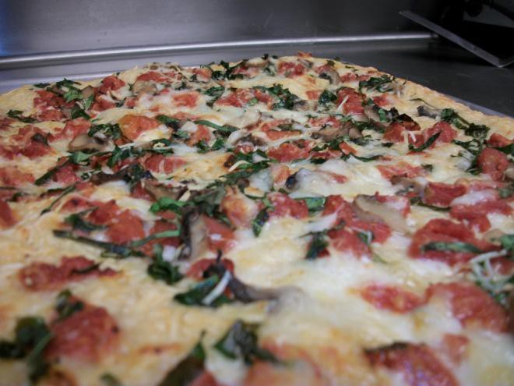
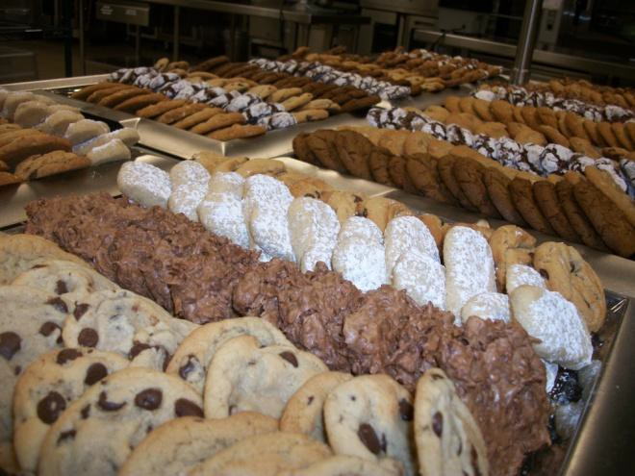
Great Beginnings…
Begins with the fundamentals and principles of the art of cooking and the science of baking and includes management and production skills and techniques. Students can pursue a national certification, a Texas culinary specialist certification, or any other appropriate industry certification.
Notes:
This course may be offered as a laboratory-based or internship course.
Click on hyperlink Chef and Head Cook to view video.
Achieve Texas
Chef and Head Cooks
http://www.achievetexas.org/_media/35-1011.00-09.mpg

Slide 4
Goals
  Something to work for
  Clear ideas, plans, or purposes
  Dreams
  Vision
  Short term
  Long term
Notes:
Begin by discussing goals with your students. Explain to them that goals are something they have to work for but should be clear ideas, plans, or purposes. It is their dreams – a vision they have of themselves in the future.
Goals start out as short term goals that can be achieved quickly like writing an essay for class, cleaning their room, or reading a book. You feel good when these things are accomplished.
Long term goals take planning and commitment and can be divided into a series of smaller goals. Achieving a high score on the SAT, being accepted into the college of their choice, graduating from college and beginning their dream career are examples.
Ask your student for more examples. Allow students to commence working on graphic organizer.

Slide 5
Long Term vs. Short Term Goals
Notes:
Distribute handout Setting Career Goals. Allow students time to reflect on the career goals they are interested in.

Slide 6

College and Career Initiative
  Education initiative designed to prepare students for a:
    Lifetime of success
    Secondary and postsecondary opportunities
    Career preparation and advancement
    Meaningful work
    Active citizenship
  Designed to help students (and parents) make:
    Wise education choices
    21st Century curricula combining
      rigorous academics and
      relevant career education
Notes:
Achieve Texas College and Career Initiative is an education initiative designed to prepare students for a lifetime of success. It allows students to achieve excellence by preparing them for secondary and postsecondary opportunities, career preparation and advancement, meaningful work, and active citizenship.
Achieve Texas is designed to help students (and their parents) make wise education choices. It is based on the belief that the curricula of the 21st century should combine rigorous academics with relevant career education. When schools integrate academic and technical education, students can see the “usefulness” of what they are learning. The system also facilitates a seamless transition from secondary to postsecondary opportunities.

Slide 7
Programs of Study
  Restaurants and Food/ Beverage Services
    Chef-Head Cook
    Food and Beverage Manager
  Lodging
    Lodging Manager
  Travel and Tourism
    Travel and Tourism Directors
  Recreation, Amusements and Attractions
    Competitive Sports Athlete
    Recreation Workers
Note - Programs of Study in your school may be different from the recommended sequence of coursework.
Notes:
The POS represent a recommended sequence of coursework based on a student’s interest and career goal. POS contain lots of helpful information, including the core courses and career-related electives in high school that will help prepare students for their career goals. The POS are based upon the Recommended High School Graduation Plan and can easily be adapted for the Distinguished Achievement High School Graduation Plan.
There are 4 Programs of Study and 6 Models for this Career Cluster.
All schools are different and may choose to follow other Programs of Study. Be sure to tell students what your school has to offer.

Slide 8
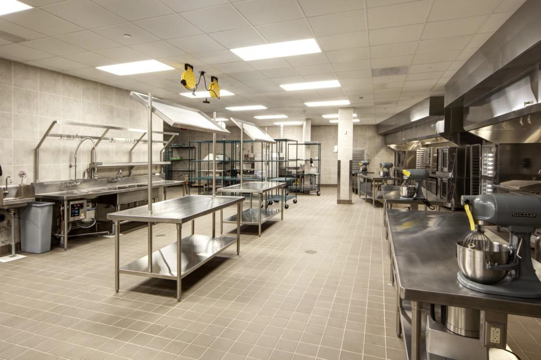
Restaurants and Food/Beverage Services
  Chef-Head Cook
  Food and Beverage Manager
Notes:
See Programs of Study Models for Chef-Head Cook and Food and Beverage Manager in the all Lesson Attachment tab to follow along with the slide presentation. The slides include information from the two models in alphabetical order.
Click on hyperlink Culinary Arts Service Careers to view short video.
Culinary Arts Service Careers at Francis Tuttle Technology Center
http://youtu.be/eovZpqJFiCQ

Slide 9
High School
Career Related Electives
  9th – Principles of Hospitality and Tourism
  10th – Lifetime Nutrition and Wellness or Restaurant Management
  11th – Culinary Arts, Entrepreneurship, or Hospitality Services
  12th – Practicum in Culinary Arts or Food Science or Problems and Solutions or Practicum in Hospitality and Tourism
Note - Sequence of courses in your school may be different from recommended sequence of coursework.
Notes:
These are recommended sequence of courses but _____________ (name of your school) offers _______________________.

Slide 10
On the Job Training
  Bus-person
  Cook Trainee
  Food Server
  Host
  Kitchen Helper
  Short-order Cook
Notes:
Discuss employment opportunities in your town or city. Remind students that many careers begin at the bottom.

Slide 11
Certificates
  Banquet Server
  Banquet Setup Employee
  Certified Food Manager
  Culinarian
  Culinary Specialist
  Food Manager
  Journey Baker
  Pastry Culinarian
  OSHA CareerSafe®
  ProStart®
  Restaurant Server
  Secondary Culinary Graduate
  ServSafe®
Notes:
Education never ends. Students should be aware that earning certifications will help their careers as they move up the ladder of success.

Slide 12
Certificates
Career Options:
  Banquet Setup Server
  Chef/Cook Assistant
  Fast Food Assistant Manager
  Food Preparation Worker
  Host
  Pastry Cook
  Prep Cook
  Restaurant Server
  Short-order Cook

Slide 13
Associate Degrees
  Baking/Pastry
  Culinary Arts
  Culinary Arts Specialization
  Food and Hospitality
  Services
  Hospitality Management
  Hotel/Restaurant Management
  Restaurant Management
Career Options:
  Baker/Pastry Chef
  Fast Food Manager
  Food and Beverage Manager
  Food Service Specialist
  Maitre’d
  Restaurant Assistant Manager
  Sous Chef
  Specialty Cook
Notes:
Associate Degrees are generally two year programs at a community college.

Slide 14
Bachelor Degrees
  Hospitality
  Administration
  Hospitality Management
  Hotel and Restaurant Management
  Restaurant, Hotel and Institutional Management
Notes:
Bachelor Degrees are generally four year programs that will assist the student as they continue in their careers.

Slide 15
Bachelor Degrees
Career Options:
  Caterer
  Catering and Banquet Director
  Culinary Arts Instructor
  Executive Chef
  Food and Beverage Director
  Food and Beverage Manager
  Independent Chef/Owner
  Kitchen Manager
  Restaurant/Food Service Owner
  Restaurant Manager

Slide 16
Graduate Degrees
  Hospitality
  Administration
  Hospitality Management
  Hotel and Restaurant Management
  Restaurant, Hotel, and Institutional Management
Notes:
Bachelor Degrees are generally four year programs that will assist the student as they continue in their careers.

Slide 17
Graduate Degrees
  Career Options:
  Catering/Banquet Manager
  Corporate Executive Chef
  Food and Beverage Administration
  Food and Beverage Controller
  Food and Beverage Director Operations Administrator
  Vice-President Operations

Slide 18
Interpersonal Skills Needed
  Arithmetic and mathematics
  Communication
    Verbal
    Nonverbal
  Electronic communication
  Listening and speaking
  Reading and writing
Notes:
The ability to communicate clearly and positively is one of the most important skills in work and life.
Verbal means using word in language and word choice.
Nonverbal means without words includes body language, facial expressions, posture, hand gestures and tone of voice.
Listening is an active process and you must pay attention when you listen to someone. Speaking occurs whenever you say something and includes the word you choose, your posture, and your tone of voice.
Reading is an important way to learn new information such as the employee handbook, guidelines, checklists, and information on a computer screen. Writing includes using a keyboard on a computer to enter information, reports, and ordering supplies.
Basic arithmetic and mathematics needed to use a calculator and computer.
Electronic communication includes computers, cell phones, two-way radios, pagers, and hand-held computers (tablets). Wireless devices and e-mail are also necessary to fulfill many requirements.

Slide 19
Careers
Restaurants and Food/Beverage Services
  Bakers
  Baristas
  Chefs and Head Cooks
  Cooks, Restaurant
  Cooks, Short Order
  Counter Attendants, Cafeteria, Food Concession, and Coffee Shop
  Food Preparation Workers
  Hosts and Hostesses, Restaurant, Lounge and Coffee Shop
  Waiters and Waitresses
Notes:
Career Cluster- Hospitality and Tourism Careers O*Net Online

Slide 20
Obtaining Employment
When seeking employment, have available:
  Career portfolio
    Resume
    Certifications
    Record of skills attained
    Letters of reference
  Completed job application
  Interview skills
Notes:
The career portfolio and interview skills may be taught in another lesson but you can introduce the information at this time.

Slide 21
Maintaining Employment
Once you have secured employment, be sure to:
  Arrive to work on time
  Work responsibly
  Work safely
  Respect the business
  Maintain a positive attitude
  Complete your assigned tasks
Notes:
Discuss with students other responsibilities they would need to keep their jobs.

Slide 22
Terminating Employment
If you have to quit your job, be sure to follow these steps:
  Give at least two weeks notice
  Submit a letter of resignation which may include:
    Reason for leaving
    Thanking employer for experience
    Offering to train new employee
Notes:
There may be several reasons to leave employment. Students may move away to college, have found another job with better pay, or have decided to return to school. Whatever the reasons may be, students should leave on good terms.

Slide 23
Continued Education
  Learning does not stop after completing a program
  Must keep up with current trends in the industry
  Continue updating your skills through
    Certificate programs
    Conferences
    Educational opportunities
    Meetings
    Seminars
    Webinars
Notes:
Stress to students the need for updating their skills to keep up with current trends.
What other ways can students update their skills?

Slide 24
Community Service
Volunteer at:
  Food for Friends
  Food Fundamentals
  Holiday Food Drive
  The Campus Kitchens
  The Edible Schoolyard
Notes:
Food for Friends - provide food and specifically peanut butter and jelly sandwiches to the hungry in our society.
Food Fundamentals - brings together information in food science, food safety, food economics and nutrition in the classroom.
Holiday Food Drive - Since the holiday season is a time when people are in particular need of food, the students will organize a school wide campaign to collect food for those in need.
The Campus Kitchens - operate student-led Campus Kitchens where student volunteers partner with on-campus dining services, local foodservice businesses, farmers and farmers’ markets and community food banks to recover unserved food, create and deliver nutritious meals to low-income children, families and the elderly.
The Edible Schoolyard - students prepare and eat delicious seasonal dishes from produce they have grown in the garden.
Ask your students for other suggestions in your area.
For more suggestions and lesson plans for the above listed projects, refer to:
National Service-Learning Clearinghouse
America's Most Comprehensive Service-Learning Resource
http://www.servicelearning.org/

Slide 25
Resources and References
Websites:
  An education initiative designed to prepare students for a lifetime of success http://www.achievetexas.org
  CTE – Learning that works for America
    Nationwide, Career Technical Education (CTE) programs are changing, evolving and innovating to better serve the country’s needs. http://www.careertech.org/
  O*NET OnLine
    Detailed descriptions of the world of work for use by job seekers, workforce development and HR professionals, students, researchers, and more! http://www.onetonline.org/
  Texas Work Prep Learning Management System. Texas Job Hunter’s Guide*Course. https://www.texasworkprep.com/texasworkprep.htm

