Slide 1
Child Abuse: The Hidden Epidemic

Slide 3
5 children die every day as a result of child abuse.

Slide 4
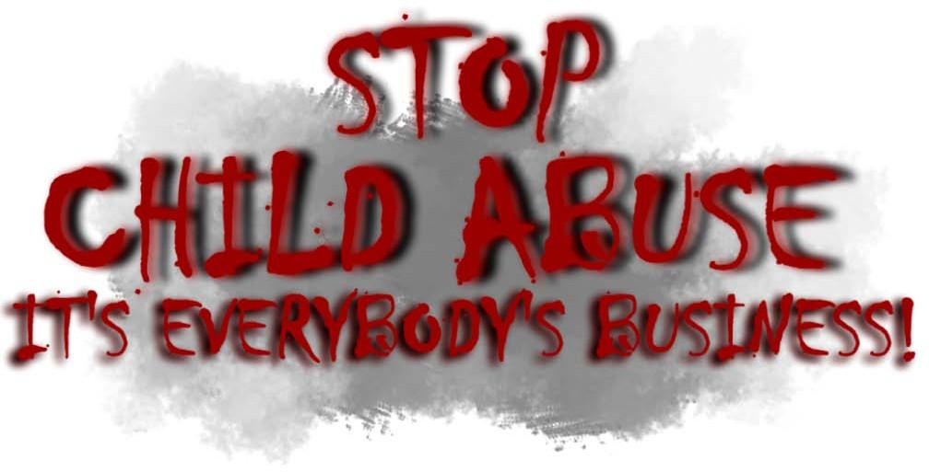
Instructional Objectives
  Analyze reasons for the high rate of child abuse.
  Describe the types of abuse and neglect
  Determine warning signs for each type of abuse and neglect.
  Become aware of the risk factors for child abuse and neglect.
  Analyze ways of breaking the cycle of abuse.

Slide 5
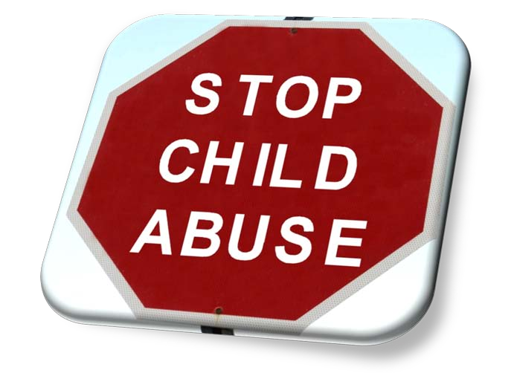
Definition of Abuse and Neglect
  Child abuse and neglect is defined as being any physical or mental injury, act of sexual abuse or exploitation, negligent treatment, or maltreatment of any child under the age of 18.

Slide 6
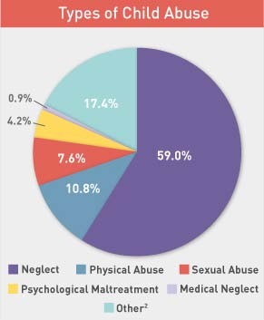
Types of Child Abuse and Occurrence
  Neglect – 59%
  Physical Abuse – 10.8%
  Sexual Abuse – 7.6%
  Emotional Abuse – 4.2%
  Medical Neglect – 0.9%
  Other – 17.4%

Slide 7
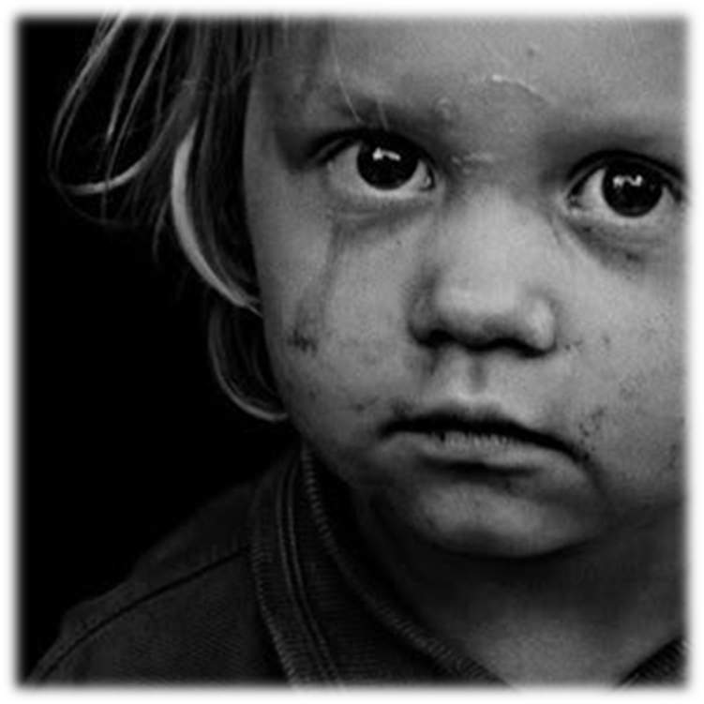
Child Neglect Most Common Type of Abuse
  Neglect is a pattern of failing to provide for a child’s basic needs, whether it be adequate food, clothing, hygiene or supervision.
Notes:
Neglect is a pattern of failing to provide for a child’s basic needs, whether it is adequate food, clothing, hygiene or supervision.

Slide 8
Warning Signs of Neglect in Children
  Clothes are ill-fitting or dirty
  Hygiene is consistently poor
  Untreated illnesses and physical injuries
  Frequently unsupervised
  Frequently late or missing from school
Notes:
Clothes are ill-fitting, dirty, or inappropriate for the weather. Hygiene is consistently poor (no bathed, matted and unwashed hair, noticeable body odor). Untreated illnesses and physical injuries. Is frequently unsupervised or left alone or allowed to play in unsafe situations and environments. Is frequently late or missing from school.

Slide 9
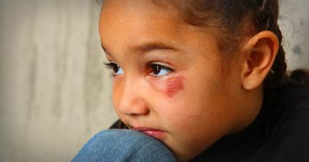

Physical Abuse
  Physical abuse involves physical harm
  Many physically abusive parents and caregivers insist that their actions are simply forms of discipline—ways to make children learn to behave
Notes:
Physical abuse involves physical harm or injury to the child resulting from punching, kicking, beating, biting, burning, or otherwise harming a child. It may be the result of a deliberate attempt to hurt the child, but not always. It can also result from severe discipline, such as using a belt on a child, or physical punishment that is inappropriate to the child’s age or physical condition. Many physically abusive parents and caregivers insist that their actions are simply forms of discipline—ways to make children learn to behave. But there is a big difference between using physical punishment to discipline and physical abuse. The point of disciplining children is to teach them right from wrong, not to make them live in fear.

Slide 10
Warning Signs of Physical Abuse in Children
  Frequent injuries
  Always watchful and “on alert,”
  Injuries appear to have a pattern
  Shies away from touch
  Wears inappropriate clothes
Notes:
Frequent injuries or unexplained bruises, welts, or cuts. o The child is always watchful and “on alert,” as if waiting for something bad to happen. o Injuries appear to have a pattern such as marks from a hand or belt. o Child shies away from touch, flinches at sudden movements, or seems afraid to go home. o Wears inappropriate clothing to cover up injuries, such as long-sleeved shirts on hot days.

Slide 11
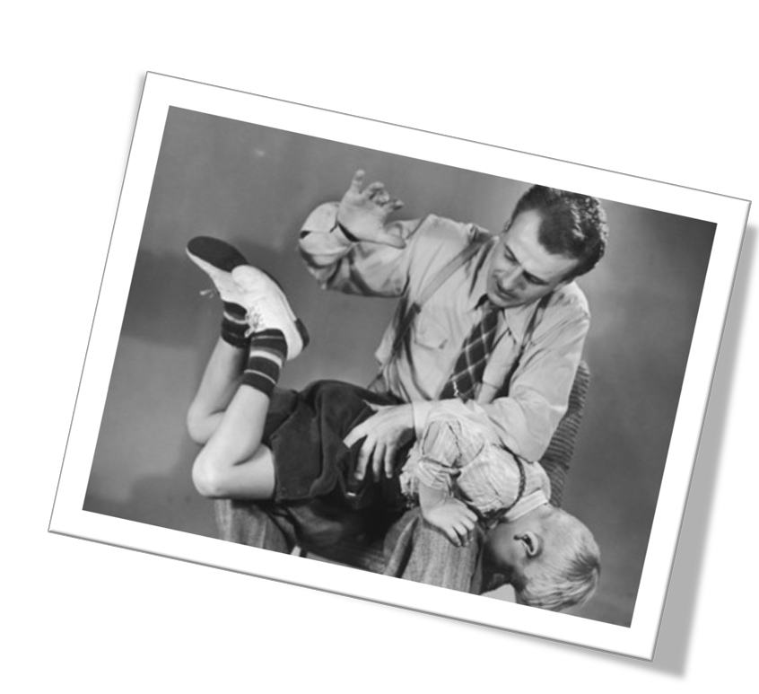
Physical Abuse vs. Discipline
  In physical abuse, unlike physical forms of discipline, the following elements are present:
    Unpredictability
    Lashing out in anger
    Using fear to control
Notes:
In physical abuse, unlike physical forms of discipline, the following elements are present: Unpredictability - The child never knows what is going to set the parent off. There are no clear boundaries or rules. The child is constantly walking on eggshells, never sure what behavior will trigger a physical assault. Lashing out in anger - Physically abusive parents act out of anger and the desire to assert control, not the motivation to lovingly teach the child. The angrier the parent, the more intense the abuse. Using fear to control behavior- Parents who are physically abusive may believe that their children need to fear them in order to behave, so they use physical abuse to “keep their child in line.” However, what children are really learning is how to avoid being hit, not how to behave or grow as individuals.

Slide 12
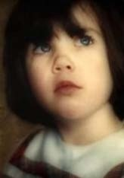
They may forget what you said, but they will never forget how you made them feel.

Slide 13
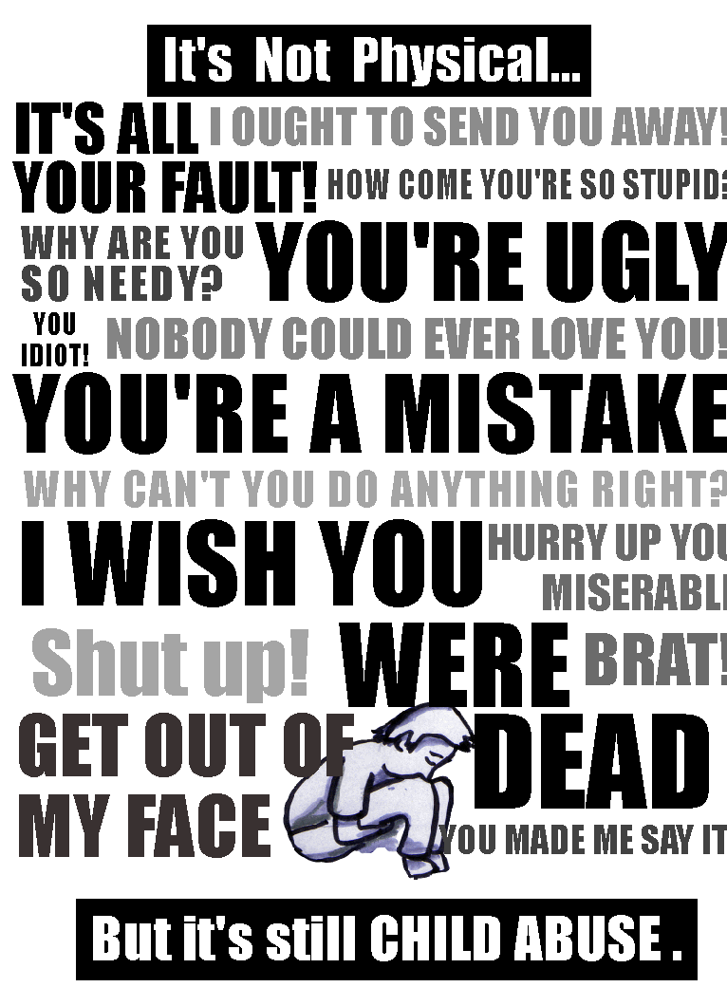
Emotional Abuse
  Emotional abuse can severely damage a child’s mental health or social development, leaving lifelong psychological scars.
Notes:
Emotional abuse can include shaming, terrorizing, humiliating, or rejecting a child.

Slide 14
Examples of Emotional Child Abuse include:
  Constant belittling
  Calling child inappropriate names
  Telling a child he or she is “no good"
  Frequent yelling
  Ignoring or rejecting a child as punishment
  Limited physical contact with the
  Exposing the child to violence or the abuse of others
Notes:
Constant belittling, shaming, and humiliating a child o Calling names and making negative comparisons to others o Telling a child he or she is “no good," "worthless," "bad," or "a mistake." o Frequent yelling, threatening, or bullying. o Ignoring or rejecting a child as punishment, giving him or her the silent treatment. o Limited physical contact with the child—no hugs, kisses, or other signs of affection. o Exposing the child to violence or the abuse of others, whether it be the abuse of a parent or a sibling.

Slide 15
Warning Signs of Emotional Abuse in Children
  Excessively withdrawn
  Shows extremes in behavior
  Appears detached from parent /caregiver
  Acts inappropriately adult or inappropriately infantile
Notes:
Excessively withdrawn, fearful, or anxious about doing something wrong o Shows extremes in behavior (extremely compliant or extremely demanding; extremely passive or extremely aggressive) o Doesn’t seem to be attached to the parent or caregiver o Acts inappropriately adult (taking care of other children) or inappropriately infantile (rocking, thumb-sucking, tantrums)

Slide 16
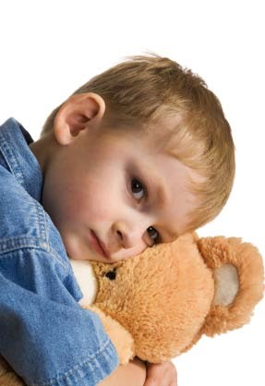
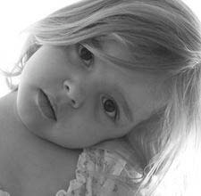
In most cases, the abuser is someone the parent or child knows, and is often trusted by the child and family.
Notes:
The biggest myth about child abuse is that the dangers to children come from strangers.

Slide 17

Sexual Abuse
  An act which forces, coerces, or threatens a child to engage in sexual activity.

Slide 18
Warning Signs of Sexual Abuse in Children
  Trouble walking or sitting
  Displays knowledge or interest in sexual acts inappropriate to his or her age, or even seductive behavior
  Makes strong efforts to avoid a specific person, without an obvious reason
  Doesn’t want to change clothes in front of others or participate in physical activities
  An STD or pregnancy, especially under the age of 14
  Runs away from home

Slide 19
Risk Factors for Child Abuse and Neglect
  Domestic violence
  Alcohol and drug abuse
  Untreated mental illness
  Lack of parenting skills
  Stress and lack of support
Notes:
While child abuse and neglect occurs in all types of families—even in those that look happy from the outside—children are at a much greater risk in certain situations. Domestic violence- Witnessing domestic violence is terrifying to children and emotionally abusive. Even if the mother does her best to protect her children and keeps them from being physically abused, the situation is still extremely damaging. If you or a loved one is in an abusive relationships, getting out is the best thing for protecting the children. Alcohol and drug abuse- Living with an alcoholic or addict is very difficult for children and can easily lead to abuse and neglect. Parents who are drunk or high are unable to care for their children, to make good parenting decisions, or control often-dangerous impulses. Substance abuse also commonly leads to physical abuse. Untreated mental illness- Parents who are suffering from depression, an anxiety disorder, bipolar disorder, or another mental illness have trouble taking care of themselves, much less their children. A mentally ill or traumatized parent may be distant and withdrawn from his or her children, or quick to anger without understanding why. Treatment for the caregiver means better care for the children. Lack of parenting skills- Some caregivers never learned the skills necessary for good parenting. Teen parents, for example, might have unrealistic expectations about how much care babies and small children need. Or parents who were themselves victims of child abuse may only know how to raise their children the way they were raised. In such cases, parenting classes, therapy, and caregiver support groups are great resources for learning better parenting skills. Stress and lack of support-Parenting can be a very time-intensive, difficult job, especially if you’re raising children without support from family, friends, or the community or you’re dealing with relationship problems or financial difficulties. Caring for a child with a disability, special needs, or difficult behaviors is also a challenge. It’s important to get the support you need, so you are emotionally and physically able to support your child.

Slide 20
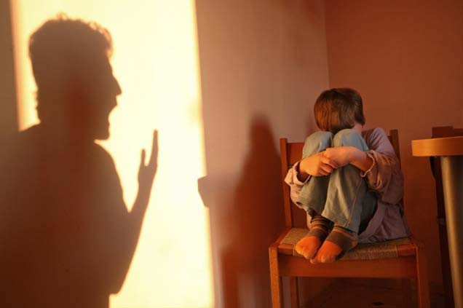
How do you know when you’ve crossed the line?
  Unable to control your anger
  Feeling emotionally disconnected from your child
  Meeting the daily needs of your child seems impossible
  Others have expressed concern

Slide 21
Breaking the cycle of Child Abuse
  Tips for changing your reactions:
    Learn what is and is not age appropriate
    Develop new parenting skills
    Take care of yourself
    Get professional help
    Learn strategies to get your emotions under control
Notes:
If you have a history of child abuse, having your own children can trigger strong memories and feelings that you may have repressed. This may happen when a child is born, or at later ages when you remember specific abuse to you. You may be shocked and overwhelmed by your anger, and feel like you can’t control it. But you can learn new ways to manage your emotions and break your old patterns. Remember, you are the most important person in your child’s world. It’s worth the effort to make a change, and you don’t have to go it alone. Help and support are available. Tips for changing your reactions Learn what age appropriate is and what is not. Having realistic expectations of what children can handle at certain ages will help you avoid frustration and anger at normal child behavior. For example, newborns are not going to sleep through the night without a peep, and toddlers are not going to be able to sit quietly for extended periods of time. Develop new parenting skills. While learning to control your emotions is critical, you also need a game plan of what you are going to do instead. Start by learning appropriate discipline techniques and how to set clear boundaries for your children. Parenting classes, books, and seminars are a way to get this information. You can also turn to other parents for tips and advice. Take care of yourself. If you are not getting enough rest and support or you’re feeling overwhelmed, you are much more likely to succumb to anger. Sleep deprivation, common in parents of young children, adds to moodiness and irritability—exactly what you are trying to avoid. Get professional help. Breaking the cycle of abuse can be very difficult if the patterns are strongly entrenched. If you can’t seem to stop yourself no matter how hard you try, it’s time to get help, be it therapy, parenting classes, or other interventions. Your children will thank you for it. Learn how you can get your emotions under control. The first step to getting your emotions under control is realizing that they are there. If you were abused as a child, you may have an especially difficult time getting in touch with your range of emotions. You may have had to deny or repress them as a child, and now they spill out without your control. For a step by step process on how you can develop your emotional intelligence, visit EQ Central.

Slide 22

The cycle can be broken.

Slide 23
References/Resources
  Websites
    www.helpguide.org
    www.preventchildabuse.org
    www.childhelp.org

