Slide 1
Children and Safety: Infancy to Toddler

Slide 3
Child Injury
Every hour, one child dies from an injury.
Every 4 seconds, a child is treated for an injury in an emergency department.
About 1 in 5 child deaths is due to injury.

Slide 4
Services and Agencies
U.S. Consumer Product Safety Commission (CPSC)
Juvenile Products Manufacturers Association (JPMA)

Slide 5
NAEYC
National Association for the Education of Young Children
NAEYC's mission is to serve and act on behalf of the needs, rights and well-being of all young children with primary focus on the provision of educational and developmental services and resources.

Slide 6
Child Safety First
Because a child is moving around more, he or she will come across more dangers as well. Dangerous situations can happen quickly, so keep a close eye on children.

Slide 7
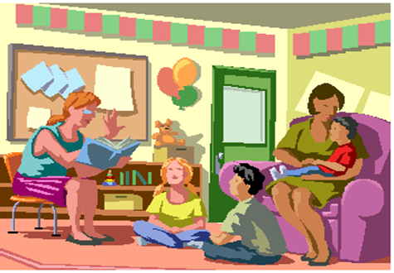
Child Care Options
Child Care Licensing Responsibilities
Regulates all child-care operations and child-placing agencies to protect the health, safety, and well-being of children in care, largely by reducing the risk of injury, abuse, and communicable disease.

Slide 8
Child Abuse
Texas Department of Family and Protective Services investigates reports of abuse and neglect of children.

Slide 9
Tips for Soothing Your Baby
It’s normal to feel frustrated or even angry at your baby’s crying.

Slide 10
Safety Crib Guidelines
With some careful planning, naptime and nighttime can be a pleasant experience for both you and your baby.

Slide 11
Play Yards: New Safety Rule to Take Effect
Play yards that meet the new safety standard must have:
Side rails that do not form a sharp V when the product is folded. This prevents a child from strangling in the side rail.
Sturdier mattress attachments to the play yard floor to prevent children from getting trapped or hurt.
Stronger corner brackets to prevent sharp- edged cracks and to prevent a side-rail collapse.

Slide 12
Baby Monitor Cords
Baby Monitor Safety Tips and Strangulation
Click on text above

Slide 13
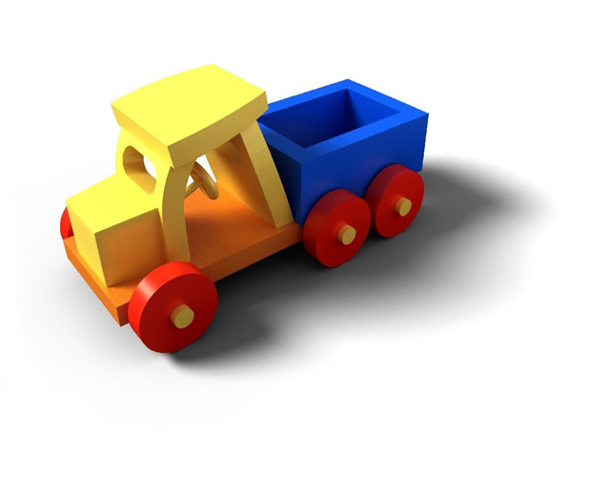
Toy Safety Guidelines
In 2009, an estimated 185,900 children ages 14 and under were treated in an emergency department for a toy-related injury.

Slide 14
Toy Safety Guidelines

Slide 15
Food Safety Guidelines
The food you serve your family can cause food poisoning if it is not safely handled, cooked, or stored.

Slide 16
Immunizations
Get the best protection for your child—make sure your child is immunized on schedule.
2013 Recommended Immunizations for Children from Birth Through 6 Years Old
Click on text above

Slide 17
Clothing Safety Guidelines
Young children can be seriously injured or killed if the upper outerwear they are wearing catches and snags on other objects.
The U.S. Consumer Product Safety Commission sets national flammability safety standards for children's sleepwear to protect children from burn injuries if they come in contact with ignition sources, such as a match or space heater.

Slide 18
Magnets
Small high-powered magnets swallowed by children are like a bullet hole in the body with no entry or exit wound, say doctors who have surgically removed magnets from children’s bodies.
Teen to Teen: Magnet Talk
Click on text above

Slide 19
Appropriate Health Care
Effective health care is an important aspect of achieving good health outcomes.

Slide 20
Falls
Use a soft landing surface on playgrounds (such as sand or wood chips, not dirt or grass).
Use protective gear, like a helmet, during sports and recreation.
Install protective rails on bunk beds and loft beds.

Slide 21
Shaken Baby Syndrome (SBS)
Know the Facts about SBS:
SBS is a leading cause of child abuse deaths in the United States.
Babies (newborn to 4 months) are at greatest risk of injury from shaking.
Inconsolable crying is a primary trigger for shaking a baby.
SBS

Slide 22
Furniture Tip-over Injuries
Secure Your Furniture
Click on text above

Slide 23
Furniture Tip-over Injuries

Slide 24
Fire/Burns
Use smoke alarms – where people sleep and on every level of the home – and test monthly.
Create and practice a family fire escape plan.

Slide 25
Suffocation
Make sure infants sleep alone; placed on their backs on a firm surface.
Be sure crib meets safety standards.
Avoid loose bedding or soft toys in crib.
Click for Sleep Positioners

Slide 26
Motor Vehicles
Always use seat belts, child safety seats and booster seats that are correct for a child’s age and weight.

Slide 27
Single-Load Laundry Packets
Do NOT let children handle laundry packets.
Keep them locked up and out of a child’s sight and reach.

Slide 28
What Can Be Done
States and communities can:
Align efforts with the National Action Plan for Child Injury Prevention.
Strengthen data collection on child injury.
Use strategies shown to reduce injuries.
Improve access to poison control centers, trauma center care, and preventive services

Slide 29
What Can Be Done
Health care systems can:
Use technology to improve the speed and quality of care.
Provide safety education for new parents.
Everyone can:
Take steps to prevent child injury where you live, work, and play.

Slide 30
References and Resources
Microsoft Clip Art: Used with permission from Microsoft.
Textbook:
Decker, C. (2011). Child development: Early stages through age 12. (5th ed.). Tinley Park: Goodheart-Willcox Company.
Websites:
2013 Recommended Immunizations for Children from Birth Through 6 Years Old
The recommended immunization schedule is designed to protect infants and children early in life, when they are most vulnerable and before they are exposed to potentially life-threatening diseases. http://www.cdc.gov/vaccines/parents/downloads/parent-ver-sch-0-6yrs.pdf
Center for Disease Control
Child Safety First is important because your child is moving around more; he will come across more dangers as well. Dangerous situations can happen quickly, so keep a close eye on your child. http://www.cdc.gov/ncbddd/childdevelopment/positiveparenting/toddlers.html

Slide 31
References and Resources
Consumer Federation of America
When It Comes to Protecting Our Nation’s Children, Regulations are Effective. The CPSIA empowers the CPSC to respond swiftly to emerging toy and product hazards, implement strong safety standards for these products, and immediately inform the American public through an online product database about safety hazards. http://www.consumerfed.org/news/627
Consumer Product Safety Commission
Publications and guidelines for baby sitters, soft bedding, baby monitors, infant cushions, strings, cords, and magnets.
http://www.cpsc.gov/Safety-Education/Safety-Guides/Topics/Child-Safety-Publications/
Crib Safety
http://cte.sfasu.edu/wp-content/uploads/2012/07/Crib-Sheet-Tips.pdf

Slide 32
References and Resources
National Association for the Education of Young Children
Founded in 1926, The National Association for the Education of Young Children (NAEYC) is the world’s largest organization working on behalf of young children with nearly 80,000 members, a national network of more than 300 state and local Affiliates, and a growing global alliance of like-minded organizations. http://www.naeyc.org/
Safe Kids
Here you will find a wealth of information from across Safe Kids Worldwide, covering everything from safety basics and fact sheets to activities you can adapt for your lesson plans. http://www.safekids.org/
What Is Child Abuse and Neglect?
Federal legislation lays the groundwork for States by identifying a minimum set of acts or behaviors that define child abuse and neglect. https://www.childwelfare.gov/pubs/factsheets/whatiscan.pdf

