Slide 1
Children’s Needs: The Foundation of Growth and Development

Slide 3
How do children develop?

Slide 4
Principles of Development
Notes:
Principles of development include:
Development occurs in a sequence of stages that can be predicted.
Development proceeds at different rates for different children.
Developmental skills build on earlier learning.
Different areas of development are interrelated.
Development continues throughout life.
Lead students to discuss the principles, one at a time, and to share reasons why it is important for parents to be aware of principles of development. Important reasons may include the following:
Knowing what to expect helps parents know how best to provide a safe environment for children at specific ages.
Knowing what to expect helps parents provide appropriate opportunities for children to grow and develop (such as toys that are appropriate to a child’s interests and abilities).
Understanding how children develop helps parents know what is realistic to expect of children at certain ages.

Slide 5
Sequence of Stages
Development occurs in a sequence of stages that can be predicted.
Notes:
Development occurs in a sequence of stages that can be predicted. Most of the developmental milestones occur in a sequential order and transpire within a specific time frames allowing assistance to be provided to children with special needs as considered necessary. How your child plays, learns, speaks and acts offers important clues about your child’s development.

Slide 6
Different Rates
Development proceeds at different rates for different children.
Notes:
Development proceeds at different rates for different children. Developmental milestones are things most children can do by a certain age. Check the milestones a child has reached by his or her 1st birthday. A parent can talk with their child’s doctor at every visit about the milestones their child has reached and what to expect next.

Slide 7
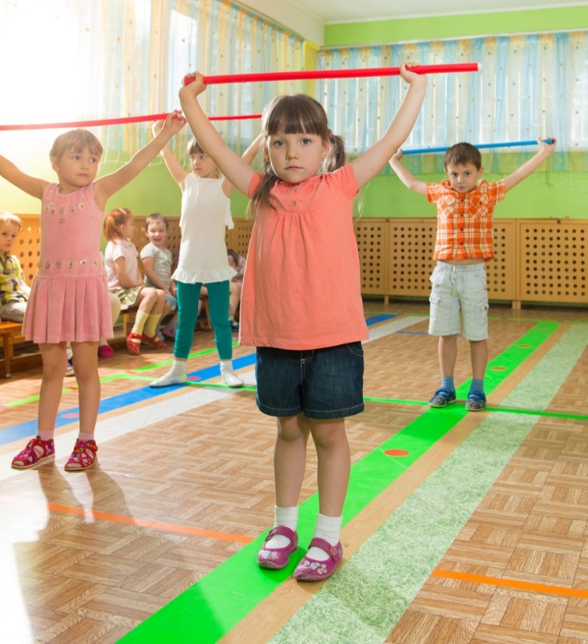
Build on Previous Learning
Developmental skills build on previous learning.
Notes:
Developmental skills build on previous learning. Children learn certain tasks best and most easily at particular points in their development. These tasks are called developmental tasks. Children do not move on to the next level until they master the tasks for the present level.

Slide 8
Areas of Development are Interrelated
Different areas of development are interrelated.
Notes:
Different areas of development are interrelated. The physical, mental, social and emotional aspects of growth and development interact with each other in complex ways. For example, as children’s motor skills improve, their physical skills improve, as children play with others and join physical activities, their social skills improve. With improved social skills, children can interact with others and exchange ideas and information. This improves their mental skills.

Slide 9
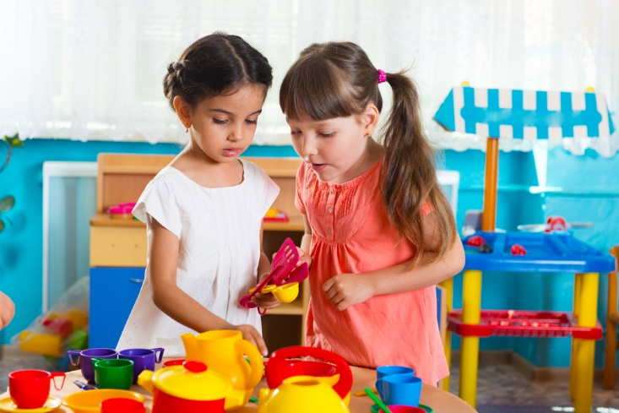
A Continual Process
Development continues throughout life.
Notes:
Development continues throughout life. The principle of growth and development is based on the fact that growth and development take place gradually and continuously. Are you fully developed in the areas of emotional, social, intellectual or physical growth?

Slide 10
Supporting Children’s Individual Needs
(click on picture)
Notes:
Supporting Children’s Individual Needs
Early childhood professionals face the continual challenge of planning for the entire classroom while meeting each child’s individual needs. In e-clip #6, Dr. Ann Gruenberg stresses the importance of observing children and assessing their strengths and needs to determine how best to support them, and teacher Niloufar Rezai reflects on strategies she used to identify and support a child’s learning needs, including working closely with the child’s family and giving them ideas for activities to do at home.
http://youtu.be/e62L1DeKVJA

Slide 11
Developmental Traits of Toddlers
Intellectual Skills | Physical Skills | Social-emotional Skills
Gives mechanical toy to caregiver to activate toy. | Builds towers consisting of two one-inch cubes | Demands personal attention
Identifies family members in photographs | Climbs up and down stairs | Enjoys solitary play
Mimics adult behaviors | Draws spontaneous scribbling | Likes to claim things as “mine”
Notes:
Aspects of Development
The stages of development describe behaviors that are common for children at a certain age. All children progress through patterns of development at their own rate, yet they share many similarities. Details of the intellectual, physical and social-emotional skills of a child from toddler to school-age are listed on the tables in the next few slides. The information in the table should not be viewed as an exact time-table but only as a general indicator of what might be expected of a child at a particular age.
Physical skills of a toddler can include:
Attempts to stand on balance beam
Builds tower of six cubes
Builds tower of two blocks
Hurls a ball
Kicks a large ball
Kicks backward and forward
May be able to take off clothes
May show preference for one hand
Pedals a tricycle
Intellectual skills can include:
At eighteen months, has an expressive vocabulary of ten to twenty words
By 24 months, has an expressive vocabulary of 20 to 50 words
Demonstrates knowledge of absence of familiar person (points to door, says “gone”)
Enjoys cause-effect relationships (banging on drum, splashing water or turning on the television set)
Has an expressive vocabulary of four to ten words; most nouns in vocabulary refer to animals, food and toys
Plays identification games using body parts (points to ears, nose, eyes or teeth upon request)
Points to and names objects in a book
Social-emotional skills can include:
Is easily hurt by criticism
Likes to control others and give them orders
Likes to exhibit affection to human and to objects
May reveal negativism and stubbornness
Reveals a trust in adults
Shows pride in personal accomplishment
Wants own way in everything
Will perform for an audience
As a parent of a specials needs child, it is important to understand how a child develops. Research shows clearly that children are more likely to succeed in learning when their families actively support them.
How would the information provided in the chart be beneficial to parents?

Slide 12
Two-Year-Old Child Development Stages and Milestones
(click on picture)
Notes:
Two-Year-Old Child Development Stages and Milestones/Help Me Grow MN
Do you know the typical development stages and milestones of a two-year-old? By two years of age, your child has new language and cognitive skills. Ensure they are developing properly by recognizing the signs and how to help if they are behind children their age.
http://youtu.be/y9Mm85UAWvM

Slide 13
Developmental Traits of Preschoolers
Intellectual Skills | Physical Skills | Social-emotional Skills
Child can answer routine questions | Attempts to balance on one foot | Continues to be self-centered
Combines two or more words (boy hit) | Catches a bean bag while standing | Likes to be accepted by others
Follows two-step directions | Runs without falling | Uses language to make friends and to alienate others
Notes:
Intellectual skills of a preschool child can include:
Comprehends pronouns: I, my, mine, me
Comprehends spatial concepts around, in front of, in back of, high and next to in object manipulation tasks
Distinguishes between one and many
Gives “just one” upon request
What are some additional intellectual skills of a preschooler?
Physical skills of a preschool child can include:
Builds a tower consisting of eight cubes
Completes simple puzzles
Pedals a tricycle
Unbuttons large buttons
Walks on tip toes
Washes and dries face and hands
What are some additional physical skills of a preschooler?
Social-emotional skills of a preschool child can include:
Begins to be choosy about companions, preferring one over another
Displays jealousy
Is learning to share and take turns
Likes to give affection to parents
What are some additional social-emotional skills of a preschooler?
What are the major developmental milestones for this age?
What would happen if a child did not reach each milestone at a particular age?

Slide 14
Four-Year-Old Child Development Stages and Milestones
(click on picture)
Notes:
Four-Year-Old Child Development Stages and Milestones | Help Me Grow MN
Do you know the typical development stages and milestones for a four-year-old child? By age four, your child should be beyond several cognitive, communication and social stages. Help your child develop and grow on schedule. Recognize the signs of a child who is not developing like they should.
http://youtu.be/o0TGczdbiV4

Slide 15
Developmental Traits of School-Age Children
Intellectual Skills | Physical Skills | Social-emotional Skills
A six-year-old child normally can follow a series of three commands in a row. | Fine motor skills may also vary widely. | Friendships at this age tend to be mainly with members of the same sex.
By age nine, a child should be able to focus attention for about an hour. | Height, weight and build vary among children of this age range. | It is important for the child to learn how to deal with failure or frustration without losing self-esteem.
Early school-age children should be able to use simple, but complete sentences that average five to seven words. | Their coordination (especially eye-hand), endurance, balance and physical abilities vary. | Peer acceptance becomes more important during the school-age years.
Notes:
Intellectual skills of a school-age child can include:
An ability to pay attention is important for success both at school and at home. A six-year-old should be able to focus on a task for at least 15 minutes. By age nine, a child should be able to focus attention for about an hour.
It is important for the child to learn how to deal with failure or frustration without losing self-esteem. There are many causes of school failure including: learning disabilities such a reading disability, stressors such as bulling and mental health issues such as anxiety or depression. If you suspect any of these causes, talk to your child’s teacher or health care provider.
What are some additional intellectual skills of a school-age child?
Physical skills of a school-age child can include:
A sense of body image begins developing around age six. Sedentary habits in school-aged children are linked to a risk of obesity and heart disease in adults. Children in this age group should get one hour of physical activity per day.
Fine motor skills can affect a child's ability to write neatly, dress appropriately, and perform certain chores, such as making beds or doing dishes.
School-age children usually have smooth and strong motor skills. However, their coordination (especially eye-hand), endurance, balance and physical abilities vary.
There will be big differences in height, weight, and build among children of this age range. It is important to remember that genetic background, as well as nutrition and exercise, may affect a child's growth.
What are some additional physical skills of a school-age child?
Social-emotional skills of a school-age child can include:
Younger school-age children often talk about members of the opposite sex as being "strange" or "awful." Children become less negative about the opposite sex as they get closer to adolescence.
Lying, cheating, and stealing are all examples of behaviors that school-age children may "try on" as they learn how to negotiate the expectations and rules placed on them by family, friends, school, and society. Parents should deal with these behaviors privately (so that the child's friends don't tease them). Parents should show forgiveness, and punish in a way that is related to the behavior.
What are some additional social-emotional skills of a school-age child?
What generalizations can be drawn about the stages of growth and development?

Slide 16
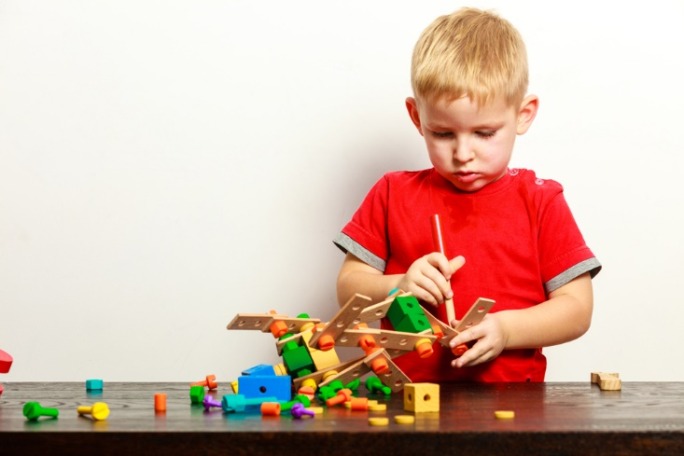
Play Activities, Toys and Equipment for Children
Notes:
Ask students to describe or show a favorite childhood toy (on an electronic mobile device) or tell about their memories of playing with the toy. Ask students if they felt their toy was developmental appropriate for them at the age when they received it. What kind of play activities are appropriate for children based upon their developmental characteristics? Lead students to identify safety concerns for play activities, toys and equipment associated with toddlers, preschoolers and school-age children.

Slide 17
Suggestions for Playing with Children
Notes:
Why is play so important? What are some suggested strategies parents and caregivers can use to encourage constructive play?

Slide 18
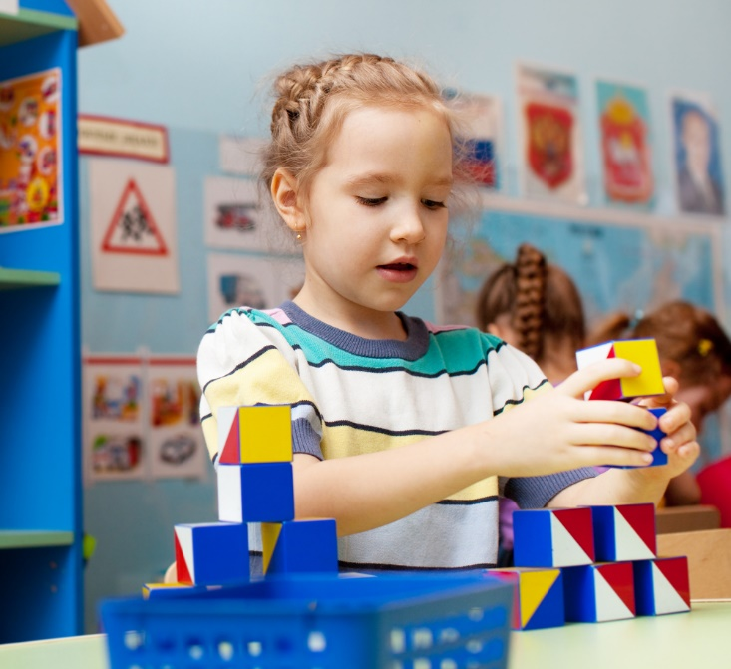
Activities, Toys and Equipment for Toddlers
Areas of Development
Creativity
Dramatic representation
Exploration
Fine motor skills
Gross motor skills
Language
Problem-solving
Notes:
Play activities, toys and equipment can develop children in many different areas. The next few slides will show the developmental factors during play time.
In the areas of development, what activities, toys and equipment can help toddlers?
Activities, toys and equipment can include:
Creativity:
Finger paints
Large crayons
Paper and pencils
Safety scissors
Simple musical instruments
Dramatic play:
Stuffed animals
Exploration:
Handmade materials
Large boxes for climbing in and out
Play appliances and utensils
Sandbox
Fine motor:
Large balls
Peg boards
Sandbox toys
Gross motor:
Outdoor play equipment
Push-pull toys
Rocking horse
Wagon
Language:
Tapes of stories

Slide 19
Preschool Children
In the areas of development, what activities, toys and equipment can help preschool children?
Notes:
Activities, toys and equipment can include:
Creativity:
Finger paints
Paste
Rhythm instruments
Safety scissors
Sketch pads
Form and Spacial Relationships (moving confidently through space)
Large tricycles
Monkey bars
Seesaws
Sets of measuring cups
Simple puzzles
Swings
Wagon
Language:
Radio
Story books
Television
Problem-solving
Blocks
Farm, village and other play sets
Housekeeping toys
Peg board
Small trucks, cars, planes and boats
Simple construction sets
Trains and car sets
Social and intellectual
Dolls for dressing and undressing
Dress-up outfits
Housekeeping toys
Large puzzles
Outdoor play equipment
Play houses
Puppets and theaters
Store-keeping toy
Toy telephone and toy clock

Slide 20
School-Age Children
In the areas of development, what activities, toys and equipment can help school-age children?
Creativity and problem-solving
Intellectual
Spacial relationships
Social skills
Notes:
Additional activities, toys and equipment can include:
Creativity and problem-solving
Costumes
Doll houses
Miniature people and vehicles
Play villages
Intellectual:
Computer
Craft kits
Electronic mobile devices
Handicrafts
Musical instruments
Puzzles
Science kits
Sports and hobbies
Tapes
Spacial Relationships (moving confidently through space)
Scooters
Skateboards
Skates
Sports activities
Social
Board games
Hobby kits
Kites
Organized sports
Skates
Tabletop sports games

Slide 21
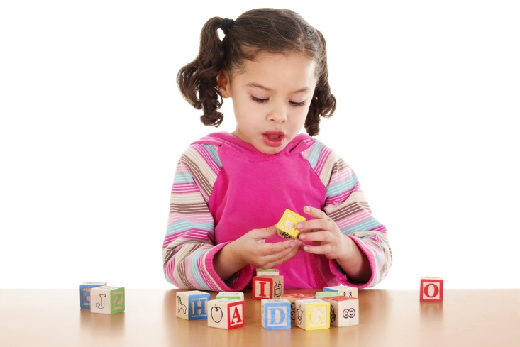
Providing Playing for Toddlers
Being prepared to change games
Helping toddlers develop language skills
Setting time aside for active play
Notes:
Toddlers are busy developing their large-motor skills and need space to walk and run. At this age, children love large dolls and stuffed animals, wooden or soft plastic vehicles, books, play telephones and housekeeping toys such as shopping baskets and brooms. Toddlers strive for independence as they learn skills they can do themselves.
The following are basic hints for playing with toddlers:
Being prepared to change games or activities when toddlers become restless or bored.
Helping toddlers develop language skills by talking and reading to them. Using simple terms, describe what you are doing or what you might see on a drive or walk.
Setting aside time for active play so toddlers can exercise their muscles and use up their store of energy.
Toddlers have not learned to share or take turns, so do not be disturbed if they try to take toys away from other children or try to hit other children. Be patient and correct their behavior in a gentle way.

Slide 22
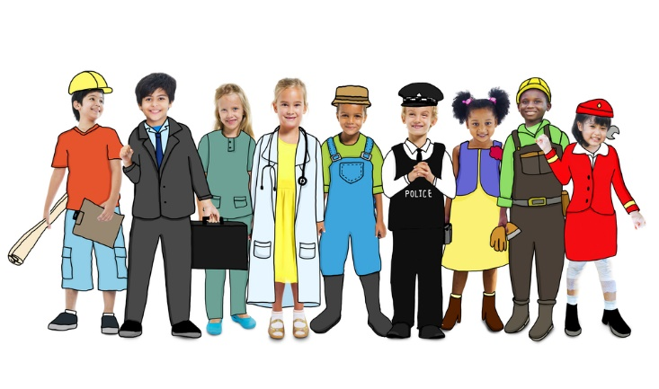
Providing Playing for Preschoolers
Providing materials for practicing mental skills
Providing musical instruments
Providing a variety of props
Notes:
Preschoolers really enjoy play. Considerable growth and change occur in preschool children in all areas of development. They are excellent builders and makers and spend much time creating. They are also inquisitive and may ask a lot of questions.
The following are some suggestions for playing with preschool children:
Children at this age need materials for practicing mental skills such as matching, sorting, naming and rearranging things such as books, puzzles and cards.
Preschool children also enjoy music and playing games
Preschoolers usually pretend or dramatize events with other children. They need a variety of props and experiences for simulating dramatic play, such as “dress up” clothes, housekeeping tools and objects that symbolize actions in various roles (such as mothers, fathers, babies, doctors or firefighters).
Providing space and equipment to challenge their gross motor skills
Providing a variety of play activities, toys and equipment to challenge gross motor skills. Preschool children need vehicles for riding and pedaling, balls for catching and throwing, as well as space for running, hopping, dancing, tumbling and rolling. They also need equipment for activities such as climbing, swinging, sliding, digging and building.
Providing opportunities for preschool children to develop fine motor skills. Children at this age like objects to stack, push, pull, build, fit together and activate. They also like to practice cutting, drawing and painting with different materials and tools.

Slide 23
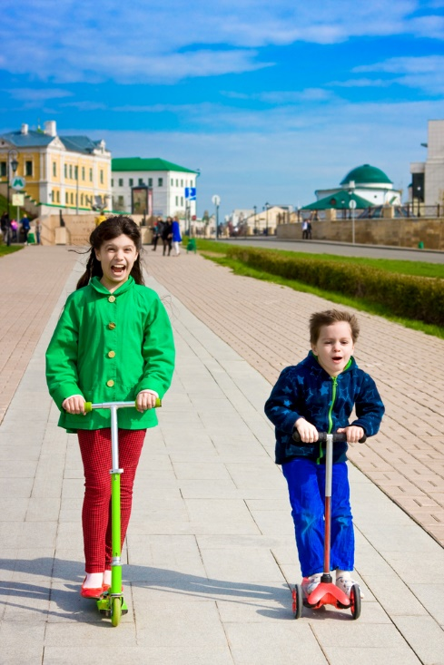
Providing Play for School-Age Children
Allowing choices whenever possible
Arranging activities to help refine fine motor skills
Encouraging children to dramatize stories, books and events
Notes:
Children between the ages of six and eight are growing and developing physical skills rapidly although the rate of growth has slowed down compared to the preschool years. School-age children like to stay busy. They like to make things, compete with each other (and against themselves) and they like to work using real tools. Children this age are usually very energetic and enjoy strenuous physical activity. They may try to test their abilities and take risks. Although they may seem very capable, school-age children need to be closely supervised. Peer groups are very important to school-age children. At this age, they usually choose to play with children of their own sex.
The following are some suggestions for playing with school-age children:
Allowing choices whenever possible. Children need to be able to choose from a variety of enjoyable activities.
Arranging activities which help refine fine motor skills, such as stringing beads, working smaller puzzle pieces, drawing and constructing crafts.
Encouraging children to dramatize stories, books and events.
Making the environment physically safe. It means setting and enforcing safety rules, both indoors and outdoors.
Providing opportunities for children to integrate their “school” skills (such as reading, math and science) into their play activities.
Providing opportunities for children to visit places such as the zoo, a museum or a park.
Providing space and equipment for challenging large motor skills.

Slide 24
Understanding Special Needs
Heredity and environment:
Hereditary factors include the genetic history and make-up of a person
Environmental factors affect the fetus after conception or the child after birth
Notes:
Heredity and environment influence the special needs in individuals. Hereditary factors include the genetic history and make-up of a person. Environmental factors affect the fetus after conception or the child after birth.
Many environmental factors can create special needs in children. These factors may include:
Accidents
Alcohol
Child abuse
Drugs
Illness
Poor nutrition
How can an illness create a special need? For example, repeated middle ear infections, if untreated, can cause hearing loss. Such hearing loss can result in slow language development. Poor nutrition, especially a lack of protein, can cause permanent brain damage. Accidents with cars, poisonous substances and unsafe surroundings often cause disabilities in children. Child abuse can lead to physical and emotional disabilities.
Often the exact cause of a child’s disability is unknown. Experts are learning more about the development of children with special needs. Some disabilities can provide helpful information with parents and others about the prevention of disabling conditions in children.

Slide 25
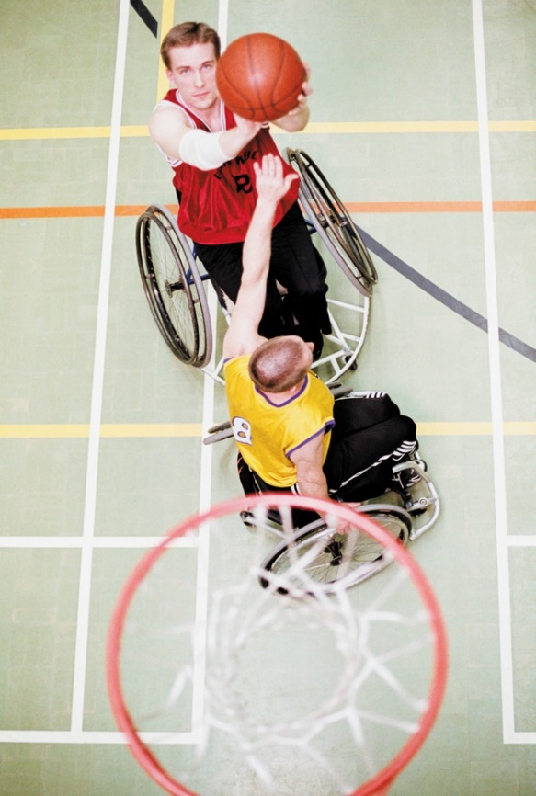
The Nature of Special Needs
A disability is any condition that prevents, delays or interferes with a child’s normal achievement and development. A disability may be classified as one of the following:
Developmental
Learning
Physical
Sensory
Notes:
A disability is any condition that prevents, delays or interferes with a child’s normal achievement and development. Developmental disabilities impair a child’s cognitive functioning. Learning disabilities result in reasoning and perceptual problems. Physical disabilities include deformities and diseases of the spine, bone, muscles and joints, as well as other health problems. Sensory disabilities include hearing and vision problems.
Other disabilities may be related to speech and language disorders. Behavioral problems include social and emotional adjustments. Giftedness refers to children with a greater than average ability to learn, reason and create. Often this category is called “gifted and talented.” Children with special needs are classified on the basis of the area of greater need. Each child has unique needs and cannot be described by these categories except in general terms.

Slide 26
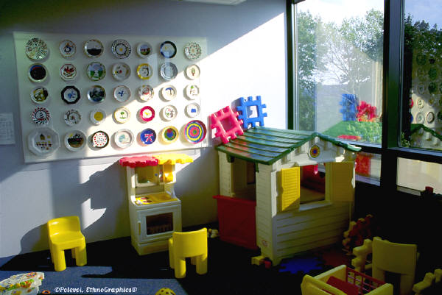
Roles of Special Needs Professionals
Appreciation of individual differences
Arranging the environment
Assessment
Encouraging cooperation
Encouraging independence
Encouraging positive interactions
Mainstreaming/Inclusion
Schedule planning
Notes:
As a professional of special needs children, you have many important roles to fulfill such as:
Appreciation of individual differences – Each child has special qualities which make him or her different from every other child. Caregivers should develop positive attitudes about individual differences in children. Such attitudes help caregivers serve as role models for children in their care. Caregivers should be aware of their own biases and feelings about children with disabilities or gifted children.
Arranging the environment – Rooms should be arranged so that children can move around freely and have easy access to all areas used. There should be a large open area for group activities and large muscle play. Several small areas should be planned for learning centers, small group activities or private, quiet activities. Avoid rearranging rooms, especially when children have physical or visual disabilities.
Assessment – Assessment involves a detailed evaluation of a child’s growth and development. Professionals determine the child’s areas of strengths and weaknesses and may be able to diagnose certain disabilities. Several professionals may participate in the assessment depending on the child’s needs. Caregivers can assist children with special needs by giving them individualized care. Such care should be based on a professional assessment and recommendation.
Encouraging cooperation – Promote positive interactions by providing materials and learning experiences which encourage cooperation. Such materials as blocks, dramatic play props and table games encourage children to play together. Plan learning experiences that give children a chance to interact positively.
Encouraging independence – Independent living is a major lifetime goal of children with disabilities. Caregivers may be tempted to perform tasks for children with disabilities but should avoid these temptations. Children with disabilities should be allowed to perform everyday tasks that they can do for themselves. This accomplishment builds self-confidence and gives a sense of independence to these children. Children can learn to care for their own needs through new and repeated experiences.
Encouraging positive interactions – There are many benefits when all children, with and without special needs, are educated and cared for together. Positive group interactions do not happen automatically. Caregivers must work to encourage positive group interactions. Plan and follow a well-balanced daily schedule to allow time to for positive interactions.
Mainstreaming/Inclusion – Mainstreaming is the process of placing individuals with disabilities into the general education or community environment. The term is now not recommended because of its association with the perceived “dumping” of students into general educational classes without the support they need (Kasser & Lytle, 2004).
Mainstreaming and Inclusion, the two terms are related, but are quite different. In mainstreaming, as in partial inclusion, an individual with a disability’s home classroom is a special education classroom. However, students who are mainstreamed will spend most of their day learning side by side with their general education peers. In mainstreaming the students are usually expected to keep up with the rest of their peers without significant supplementary aids and support services. This supports and values having individuals with disabilities interact with student without any disabilities. Inclusion is a philosophy that states all individuals, regardless of ability, should participate within the same environment with necessary support and individualized attention. Inclusion is more than simply placing individuals together, it’s a belief that all individuals belong and are valued (Kasser & Lytle, 2005). Children need caring adults to provide love security, safety and a positive environment. They need good surroundings to stimulate and support their development.
Schedule planning – The daily schedule may need to be more structured than usual for children with special needs. Much unstructured playtime may be difficult for such children. During a scheduled free choice time, limit the number of choices given. Spend a few minutes directing the child in a specific activity.
A well-balanced schedule should include carefully planned transition activities. Check on the child’s status in terms of task completion. If needed, delay the transition or remind the child in advance that an activity period is ending.
What is mainstreaming? Why is the term inclusion often used?
What strategies may a caregiver use for creating a positive mainstreamed environment?
What are four guidelines for caregivers working with children with disabilities?

Slide 27
Strategies for Working with Disabled Children
The following strategies are suggestions for working with learning-disabled children:
behavior modification
multi-sensory training
task analysis
Notes:
The following strategies are suggestions for working with learning-disabled children:
behavior modification
multi-sensory training
task analysis
Task analysis involves breaking down a job into small steps. For example, teaching how to brush teeth may be broken down into holding a tube of toothpaste, unscrewing the cap, putting toothpaste on the brush, and other small steps involved.
Multi-sensory training helps children learn through use of several senses at one time. An example might be guiding children outdoors to watch, listen, look and hunt for various items which are described by the caregiver.
Behavior modification is a method of changing a person’s behavior through carefully planned consequences for specific behaviors. For example, behavior modification is often used to teach self-help skills such as learning to use the restroom or cleaning up after oneself. For each appropriate behavior of the child, the caregiver responds with praise, a reward or some type of positive reinforcement.

Slide 28
Children Who Have Special Needs
Remember that children develop at different rates and that the range of “normal” development is broad.
Early detection of developmental problems is important.
The sooner problems are detected, the sooner a child can begin receiving help.
Notes:
Parents and caregivers play an important role in identifying and caring for children with special needs. Through training and experience, parents and caregivers understand normal patterns of child growth and development. They understand the sequence and age level for developing skills. When a parent or caregiver sees a major delay or problem in a child’s development, the child is referred to a specialist, teacher or other professional for assessment.
Remember that children develop at different rates and that the range of “normal” development is broad. However, early detection of developmental problems is important. The sooner problems are detected, the sooner a child can begin receiving help.

Slide 29
Ten Things Your Child Needs Every Day
(click on picture)
Notes:
To activate prior learning, as a class, brainstorm ten things they think a child needs everyday. Compare their findings with the information on the video.
Ten Things Your Child Needs Every Day
Children are experts at telling their parents what they want. They demand new toys, new video games and new cell phones. Sadly, children can rarely tell their parents what they need...really need, in order to feel safe, valued and deeply connected.
http://youtu.be/PzcmfXsYUXc

Slide 30
Review!
Explain and provide examples of two principles of development.
What are some examples of the intellectual, physical and social-emotional skills of a toddler?
What are some examples of the intellectual, physical and social-emotional skills of a preschool child?
What are some examples of the intellectual, physical and social-emotional skills of a school-age child?
Why is play so important?

Slide 32
References and Resources
Images:
Microsoft Clip Art: Used with permission from Microsoft™. (Slides 24, 25, 26 and 27)
Photos obtained through a license with Shutterstock.com™. (Slides 1, 3, 4, 5, 6, 7, 8, 9, 10, 12, 14, 16, 17, 20, 21, 22, 23, 28, and 30)
Textbooks:
Decker, C. (2011). Child development early stages through age 12. (7th ed.). Tinley Park: Goodheart-Willcox Company, Inc.
Decker, C. (2004). Children: the early years. (5th ed.). Tinley Park: Goodheart-Willcox Company, Inc.
Websites:
Building the Legacy: IDEA 2004 The Individuals with Disabilities Education Act (IDEA) is a law ensuring services to children with disabilities throughout the nation. IDEA governs how states and public agencies provide early intervention, special education and related services to more than 6.5 million eligible infants, toddlers, children and youth with disabilities. http://idea.ed.gov
National Institutes of Health School-age child development describes the expected physical, emotional and mental abilities of children ages six to twelve. http://www.nlm.nih.gov/medlineplus/ency/article/002017.htm
U.S. Department of Justice A Guide to Disability Rights Laws. http://www.ada.gov/cguide.pdf
U.S. Department of Justice Commonly asked questions concerning child care centers and the Americans with Disabilities Act. http://www.ada.gov/childqanda.htm

Slide 33
References and Resources
YouTube™:
Four-Year-Old Child Development Stages and Milestones | Help Me Grow MN Do you know the typical development stages and milestones for a four-year-old child? By age four, your child should be beyond several cognitive, communication and social stages. Help your child develop and grow on schedule. Recognize the signs of a child who is not developing like they should. http://youtu.be/o0TGczdbiV4
Two-Year-Old Child Development Stages and Milestones/Help Me Grow MN Do you know the typical development stages and milestones of a two-year-old? By two years of age, your child has new language and cognitive skills. Ensure they are developing properly by recognizing the signs and how to help if they are behind children their age. http://youtu.be/y9Mm85UAWvM
Supporting Children’s Individual Needs Early childhood professionals face the continual challenge of planning for the entire classroom while meeting each child’s individual needs. In e-clip #6, Dr. Ann Gruenberg stresses the importance of observing children and assessing their strengths and needs to determine how best to support them, and teacher Niloufar Rezai reflects on strategies she used to identify and support a child’s learning needs, including working closely with the child’s family and giving them ideas for activities to do at home. http://youtu.be/e62L1DeKVJA
Ten Things Your Child Needs Every Day Children are experts at telling their parents what they want. They demand new toys, new video games and new cell phones. Sadly, children can rarely tell their parents what they need…really need, in order to feel safe, valued and deeply connected. http://youtu.be/PzcmfXsYUXc

