Slide 1
Client Retention: Services,
Techniques and Resources
  Practicum in Human Services

Slide 3

Human Services Career Pathways
Notes:
Practicum in Human Services provides occupational specific training and focuses on the development of:
Consumer Services
Early Childhood Development and Services
Counseling and Mental Health Services
Family and Community Services
Personal Care Services
The importance of providing effective client services, resources and techniques can be applied to all Human Services Career Pathways.

Slide 4

Human Services Employees
  Employees who are focused on client needs have these characteristics:
    Address clients by name
    Are well-groomed
    Make eye contact
    Have good posture
    Respond quickly to requests/problems
    Smile
Notes:
If clients have a great experience at a business, they are more likely to return and become repeat customers.
They will also talk about this experience with their family and friends, thus increasing the business’s customer base.

Slide 5

Client’s Name
  Use the client’s name whenever possible
  Clients feel important and welcome
  Clients are more likely to return
Notes:
Using a client's name acknowledges their identity and boosts their self-esteem.

Slide 6
Well-Groomed
  Image is important
  Employees seen by the public should have:
    A clean uniform
    A good appearance
    Good grooming
Notes:
Many businesses have uniform guidelines or dress codes that employees must follow.

Slide 7

Eye Contact and Interactions
  A powerful act of communication
  Indicates a willingness to serve
  Shows interest
Notes:
Making eye contact with the clients lets them know that you are giving them your total attention.
In-person interactions provide an avenue to resolve major problems more effectively. It also helps generate long-term relationships with clients. When having an in-person interaction with a client, good communication skills are a must!
Focus on the client and the problem
Use an appropriate tone of voice
Use positive facial expressions
Be aware of the verbiage being used by you and the client
Be keen on your non-verbal body language
Live chat - With the help of a live chat software, customers can see who they are talking to and ensure they are talking to the right person. Alternatively, businesses can increase sales using a live video chat, by improving on their customer support service, hence, creating satisfied customers.

Slide 8

Respond Quickly
  Attitude should be positive
  Demonstrate willingness to help
  Response should be competent
  Show concern
Notes:
Be sure to respond quickly when a guest has a question. Communicate clearly and concisely.

Slide 9

Smile
  Demonstrates:
  An eagerness to help
  Care and warmth
  Friendliness
  Respect
  Also shows you enjoy your job!
Notes:
All employees should have a smile as part of their uniform.

Slide 10

Posture
  Should be relaxed, but alert
  Head up
  Face should look interested
  Project a positive attitude
Notes:
Good posture is important to all employees.

Slide 11

Methods to Promote Best Products, Plans or
Services For Clients
  Advertise the business, services and products
  Business conveniently located
  Having a good marketing plan in place
  Having products to meet the needs of your client base
  Sales promotions
Notes:
Some advertisements include:
Billboards - large outdoor boards for displaying advertisements
Commercials - a television or radio advertisement
Internet - the global communication network that allows almost all computers worldwide to connect and exchange information
Print advertising - advertising in newspapers or magazines, rather than on television, radio or the internet
Reader boards - a visual display board that conveys information about a wide variety of subjects, including advertising for products or services, travel, news or event information
The location is important in determining how successful your business will be. How do you think that effects a business?
The part of the business plan outlining the marketing strategy for a product or service.
Having products to meet the needs of your client base
Includes all activities involved in development of product(s)
Keep target market in mind
Look for changes in wants and needs of target market
Make changes if necessary
Sales promotions are intended to increase sales and the client base. Promotions can include:
Coupons
Free product samples
Loyalty programs
Sweepstakes
Two-for-one offers
Can you think of other sales promotions that have enticed you to a sale?

Slide 12
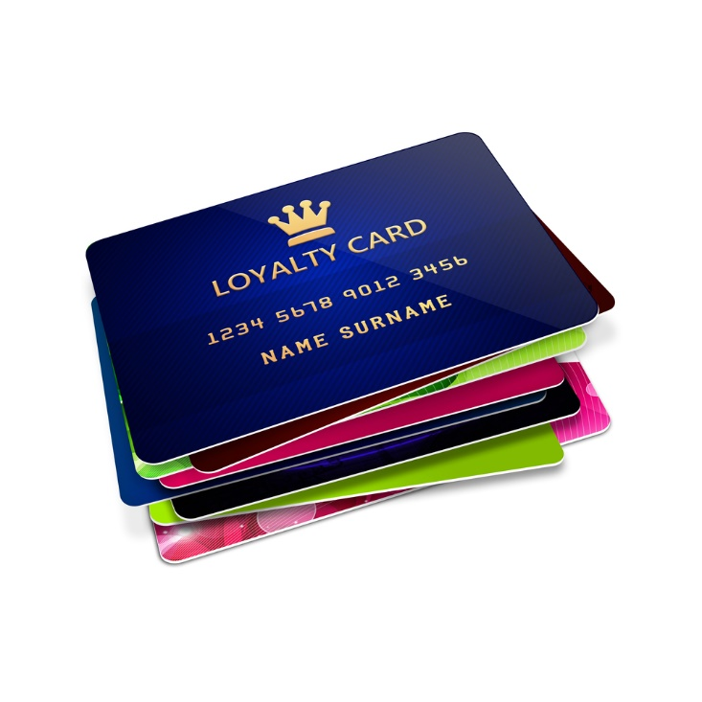

Customer Generation and Loyalty Program
Notes:
Customer Generation and Loyalty Program
Learn how we help business not only secure their current customers, but also keep them coming back without many marketing and outreach services.
https://youtu.be/p06-N0WOWEY

Slide 13

Growing Customer Service Trends for 2015
Notes:
According to Fonolo, the growing customer service trends for 2015 include the following:
Customer service with the use of a mobile device should be a priority for any business. Mobile defines how consumers communicate and engage with brands.
Self-service will become an important component of customer service. According to Fonolo, 83% of online customers require some degree of customer support to complete a purchase. In fact, 67% of customers use web self-service knowledge to find answers to their questions.
Human support will still be a main avenue for customer support. According to Gartner (It is the world's leading information technology research and advisory company. They deliver the technology-related insight necessary for clients to make the right decisions, every day), by 2017, one third of all customer service interactions will still require the support of a human intermediary.
Excellent customer service will be a number one priority for consumers.
Virtual agents (voice ordering app) will be used more such as a digital self-service. It is so important to achieving customer engagement.
Fonolo
Ten Growing Customer Service Trends for 2015
https://fonolo.com/top-10-contact-center-trends-for-2015

Slide 14

10 Growing Customer Service Trends for 2015
Notes:
According to Fonolo, the last five growing customer service trends for 2015 include the following:
It will be just as important to engage employees as it is to engage customers. In 2015, the trend leans towards creating an environment of participation and involvement to generate an engaged workforce, aiming to positively impact customer satisfaction.
Customers will expect more from companies. The customer of 2020 will expect companies to proactively address their current and future needs.
Customer journey mapping will be a key tool. Companies hope to provide the ultimate customer experience by reaching out to customers via social media, company’s website, in person, contact center (e-mail) and through a mobile device. According to Fonolo, the benefits of mapping the customer journey are limitless:
Gain a better understanding of the customer experience
Ensure the customer journey is the same, regardless of the channel
Improve customer satisfaction scores
Eliminate confusion
Remove inefficiencies
Reduce costs
Video-based chat is making an impact. According to Gartner, more than 100 of the 500 largest global businesses will introduce video-based chat by 2018.
The adoption of virtual queuing. What is virtual queuing? It means holding a caller’s place in line – “virtually” – so that they can remain in the queue without actually having to stay on the phone. Most commonly, this is done by collecting the caller’s phone number and then calling them back when an agent is free. You are turning a negative situation into a positive situation.
The use of technology will create a more enjoyable, personal experience for the customer.
Fonolo
Ten Growing Customer Service Trends for 2015
https://fonolo.com/blog/2015/01/whitepaper-top-10-contact-center-trends-for-2015

Slide 15

Sharing Information with Clients
  Having good communication skills
  Being able to show competency in the area you are working
  Being knowledgeable on the products, company policies and procedures
Notes:
Sharing information is a critical factor in delivering the best possible service to clients. As an employee, you need to:
Have good communication skills
Be able to show competency in the area you are working
Be knowledgeable on the products, company policies and procedures
When you are serving others, being friendly is key to making someone feel comfortable. Remember, the customer is always right so never argue or take up opposition with a customer’s view. Be helpful. Find out what they need and make it happen.
Successful customer relations will get you noticed by the boss and prompt promotions, so make sure you are taking the time to develop customer relations skills. A smile and a simple “Hello” are always good first steps to start a conversation and a friendship.

Slide 16

Strategies for Successful Relations with Clients
  Know your role
  Hire the right customers
  Build a solid reputation
  Approach all communication with a Zen mind
  Listen for what isn’t there
  Do what you said you were going to do
  Admit when you mess up
  Stay positive and cooperative
Notes:
Jeff Gardner published “8 strategies for Successful Relations with Clients” in Business, Clients and Communication in 2008.
Know your role – get as much information as you can to help and get other experts to assist when you are not sure.
Hire the right customers – don’t take on a project you cannot be successful – stay true to your strengths.
Build a solid reputation and choose to do a few things well.
Approach all communication with a Zen mind – approach every task with a beginners mind with no preconceived notions.
Listen for what isn’t there -check your ego at the door, ask lots of questions and clarify, clarify!
Do what you said you were going to do – different situations require different actions. Remember to approach things with an open mind, there is no one right answer that applies to all situations.
Admit it when you mess up- and then do everything possible to make it right.
Parting shot – If you do your due diligence up front and stay positive and cooperative you can be successful!

Slide 17
Review
  Name three characteristics that employees who are focused on client needs possess.
  Why is it important to respond to client’s needs, questions or problems quickly?
  Name three methods of advertising.
  Describe how sales promotions can benefit a business.
  Compare and contrast two growing customer service trends for 2015.
Notes:
Have students answer independently in short paragraphs on paper or allow for classroom discussion.

Slide 18


Slide 19
Resources and References
  Images:
    All photos obtained through a license with Shutterstock.com™.
  Websites:
    Blendspace™
    Create your own lesson today and start engaging your students with web resources.
    https://www.blendspace.com
    Fonolo
    Ten Growing Customer Service Trends for 2015
    https://fonolo.com/blog/2015/01/whitepaper-top-10-contact-center-trends-for-2015
    Houston Chronicle
    How Do I Define Good Client Service?
    http://smallbusiness.chron.com/define-good-client-service-2081.html

Slide 20
Resources and References
    Small Business Administration (SBA)
    Customer Service online course.
    https://www.sba.gov/tools/sba-learning-center/training/customer-service
    Smashing Magazine
    How to Deliver Exceptional Client Service.
    http://www.smashingmagazine.com/2012/01/25/how-to-deliver-exceptional-client-service
    Smashing Magazine
    Eight strategies for successful client relations by Jeff Gardner.
    http://www.smashingmagazine.com/2008/10/09/strategies-for-successful-client-relations

Slide 21
Resources and References
  YouTube™:
    Customer Generation and Loyalty Program
    Learn how we help business not only secure their current customers, but also keep them coming back without many marketing and outreach services.
    https://youtu.be/p06-N0WOWEY
    Three Minute Teaching w/Tech Tip — Create Powerful Lessons in Minutes with Blendspace™
    Tutorial on how to start a Blendspace™ presentation.
    https://youtu.be/fsONWnbYGnM

