Slide 1
Components of a Strong Family Unit

Slide 3
What is the life cycle?
Notes:
Ask the students this question. You may assign a scribe to write the answers on the board. Discuss the results.
How does the life cycle affect the family unit?

Slide 4
The Family Life Cycle
  Beginning stage
  Childbearing stage
  Parenting stage
  Launching stage
  Mid-years stage
  Aging stage
Beginning stage
Parenting stage
Launching stage
Mid-years stage
Aging stage
Childbearing stage
Notes:
The stages of the Family Life Cycle can be described as:
Beginning Stage
Childbearing Stage
Parenting Stage
Launching Stage
Mid-Years Stage
Aging Stage
The stages do not occur in exactly the same way in all families. Some families can be in two stages at one time. For example, the same family could be living with an adolescent and launching an older child. Remember, the family life stages are fluid, without rigid boundaries, and that they can encompass the emotional, intellectual, physical, and spiritual aspects of life.
What are the technological considerations related to the family life cycle?
What stage do you think people use the most technology? Why?
Does technology have an impact on the family life cycle?

Slide 5

Family Structures
  Adoptive family
  Extended kinship
  Foster family
  Single parent
  Step-family
  Two-parent
Notes:
Today, there are many different family structures. There is no one best structure as long as the family members are happy and fulfilled individuals.
The six common structures in society today are the:
adoptive family
extended kinship
foster family
single parent
Step-family
two-parent
The two-parent family is made up of a married couple and their biological children. One or both parents may work outside the home. This is also called a nuclear family. Activities and events center around the family. In 2009, 83 percent of children living in families maintained by two married parents had at least one parent who worked year round, full time. In contrast, 54 percent of children living in families maintained by a single father and 44 percent of children living in families maintained by a single mother had a parent who worked year round, full time.
The single-parent family occurs as the result of divorce, separation, death of a spouse, or having children outside of marriage. In 2010, 66 percent of children ages 0–17 lived with two married parents, down from 77 percent in 1980.
In 2010, 23 percent of children lived with only their mother, 3 percent lived with only their father, and 4 percent lived with neither of their parents. Being a single parent, the sole head of the household, can be stressful. Single parents must provide for the same needs and wants as all parents.
The stepfamily occurs when either or both spouses have been married before and have one or more children from the previous marriage. Relationships in stepfamilies can be rewarding and challenging. When families have been combined, it may bring financial tensions to the family. Space, time, and energy resources must be allocated with thought and consideration. Each family has to be dedicated and positive in making the new family system work.
The extended kinship family occurs when several generations of a family live together. It can be a mixture of grandparents, parents, children, aunts, uncles, and cousins in the same household. In many foreign countries, extended kinship families are very common. There are advantages of this type of family, including interaction between family members of all age groups. This can be an opportunity to educate and appreciate each other. Sometimes aging parents are the focus of this type of family. Middle-age has taken on a new image in recent years, partly due to finances. Some sociologists have labeled today’s middle-aged couples as the “sandwich generation.” The couple is often “sandwiched” between caring for their own children and their aging parents.
Foster parents try to make their home loving, caring, and inviting to foster children. They are reimbursed only for the child’s expenses. The challenges lie in the type of child that may be in their homes. Some children are often abused, neglected, angry, frightened, and resentful of their situation. Adjustments must be made for both parties involved.
The adoptive family chooses to adopt and raise a child. The child is legally theirs, and adoption can be just as fulfilling as having a biological child. Most couples prefer to adopt a newborn; however, children of all ages can be adopted.
How would you compare a stepfamily and extended kinship family?
Can you identify the type of family you are currently living in?

Slide 6
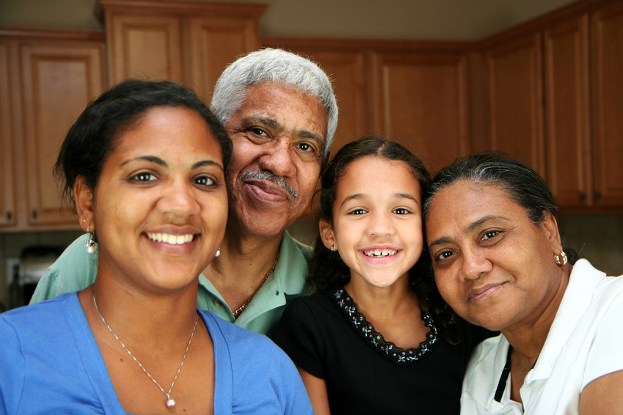
What are some traits of a healthy family unit?
Notes:
Ask the students this question. You may assign a scribe to write the answers on the board. Discuss the results.

Slide 7
Traits of a Healthy Family
  Affirms and supports
  Communicates
  Listens
  Respects
  Trusts and forgives
Notes:
Discuss how each one of these is important to the family. Ask students if there are other traits to add to the list.

Slide 8

Healthy Families
  Admit/seek help for problems
  Have a sense of humor
  Have family rituals and traditions
  Share responsibilities
  Teach right from wrong
Notes:
Review how traditions build family bonds and creates memories.

Slide 9

Roles in Life
Notes:
What roles do you have? Ask the students this question. You may assign a scribe to write the answers on the board. Discuss the results.
Possible answers can include:
Brother/sister
Club member
Cousin
Employee
Nephew/niece
Son/daughter
Student
Team member
Uncle/aunt
Volunteer
How do your different roles affect your family unit?

Slide 10
Roles in Life
  Life gives us a lot to balance:
    Different personalities
    Family
    Various roles
    Work or school
Notes:
We have learned that people play many roles in their lives. Some are by choice and some are not.

Slide 11
Roles
  The responsibilities we assume and how we portray them individually and in the family
    Acquired roles
    Character roles
    Given roles
Notes:
Acquired roles: The roles you assume because of choice. Husband, wife, co-worker or Vice President.
Character roles: The roles you demonstrate because you have been labeled as such. Athlete, brain, little mother, baby, scapegoat or victim.
Given roles: The roles we are given because of a birth in the family. Mother, father, sister, brother, grandparent, aunt or cousin.
Some roles happen by chance (given roles) and others by choice (acquired roles). The roles we choose for ourselves can be changed.
If we are not happy with our acquired roles, we can simply make the change such as:
Find a new job
Decide to get married or stay single

Slide 12
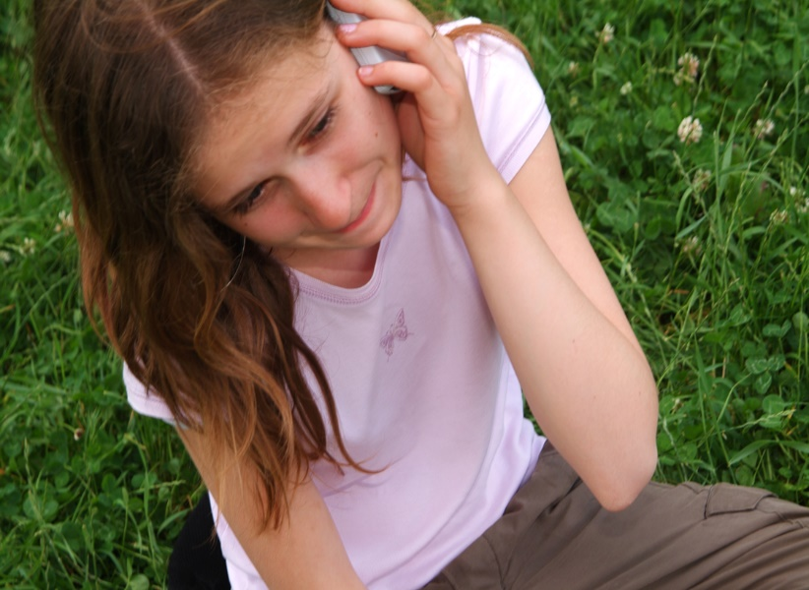
Character Roles
  Can be a true character trait or a myth
  Can be changed, but it requires communication and understanding by all parties
  Can put extra expectation on a person
  Can raise or lower one’s self-esteem
Notes:
These are the roles that we are “labeled” because of other’s views of us.
Example: The youngest child of the family is labeled “The Baby”. This child assumes the “baby” role and begins to act this way.
Other family members may feel that this child is spoiled or treated special because they are the baby of the family.
Do you have a label in your family?

Slide 13
Meeting the Needs of the Family
Notes:
What are the needs of a strong family unit?
Possible answers can include:
Consideration
Companionship
Financial skills
Good communication
Love
Resourceful
Respect
Sense of humor

Slide 14
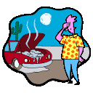
Family Bonds
  All families go through difficult and trying times. That’s why it’s so important to love and support each other at all times.
Notes:
When pressures of life, finances or work affect a family member, other family members can help out.
Students can brainstorm ways to support family members.

Slide 15
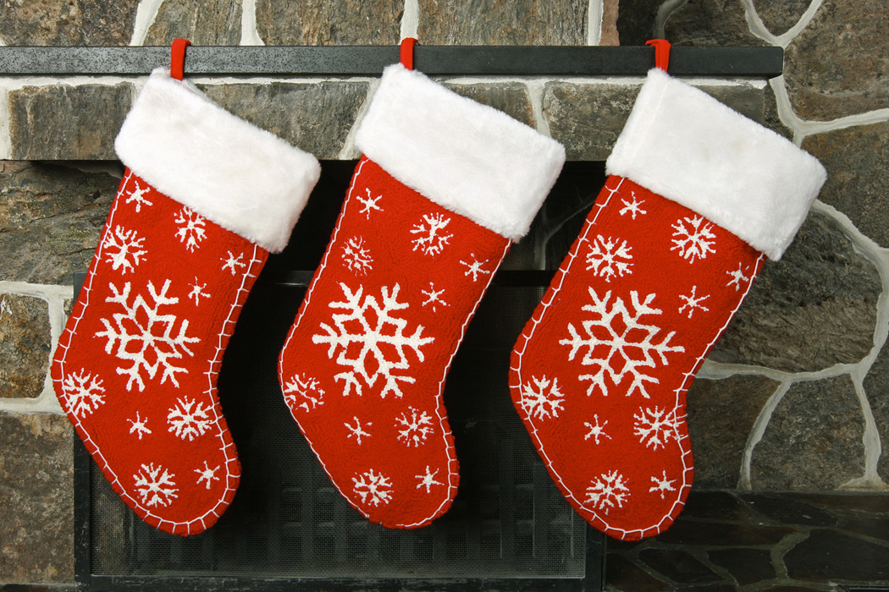
Family Traditions
  How does food transcend generations?
  How do family traditions strengthen the family unit?
  What are family traditions?
Notes:
What are family traditions? How do family traditions strengthen the family unit? Discuss family traditions with the students. Students need to understand that traditions allow for family bonding and the making of memories. Make sure that students understand that spending time together, reflecting on past memories and making new memories, bonds a family as an effective family unit. By raising hands, students will tell the class about the traditions in their individual families and cultures.
As an option, show and discuss the PBS videos (or others) on traditions.
This video shows a clip from the program Faces of America.
Faces of America
Episode: Family traditions and customs. Stephen Colbert talks about traditions and customs he's kept alive in his own family over the generations.
http://video.pbs.org/video/2247082872
Teacher note: The following video is about 56 minutes long. It shares the importance of family traditions. You may opt to assign viewing the video as an enrichment activity.
The video program: Lidia Celebrates America, Episode: Episode 1: Holiday Tables and Traditions. An Italian Christmas Eve. A Mexican-American Christmas Day in San Antonio, Texas. A Chinese New Year. A Passover Seder. Four holidays, four very different tables and traditions. Join celebrity chef and culinary author Lidia Bastianich as she travels across America in a celebration of culture through food in the new PBS prime-time special, Lidia Celebrates America: Holiday Tables and Traditions
http://video.pbs.org/video/2175964061

Slide 16
Meeting Needs Physically
  Other
    Picking up the responsibilities wherever needed
  Financially
    Do chores without allowance
    Restrain from asking for extra things
    Take a part-time job
  Meeting Needs Physically
    Chores
    Cooking
    Helping around the house
Notes:
Doing things for others to help alleviate stress.

Slide 17

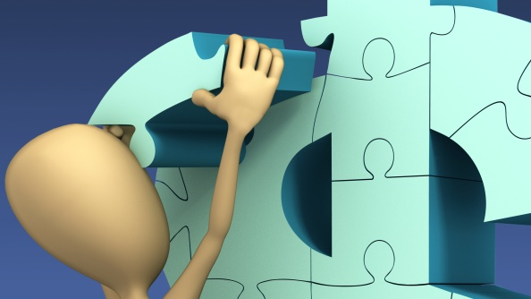

Managing Your Money
  Determine your needs and wants
  Establish your priorities
  Use a systematic process
  A decision-making process can help you make the best financial approach
  Become your own personal “accountant”
  Keep accurate and current records of money
Notes:
Organizing tasks and responsibilities can help you manage your individual and family resources such as finances, food, clothing, shelter, health care, recreation, transportation, time, and human capital.

Slide 18
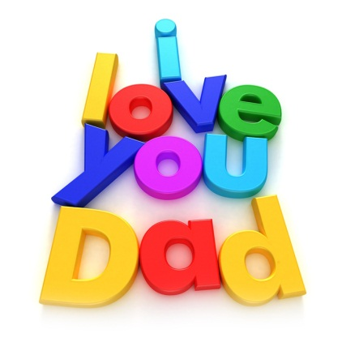
Meeting Emotional Needs
  Give verbal support or praise
  Listen
  Offer a hug
Notes:
What are other methods of offering emotional support to family members?

Slide 19
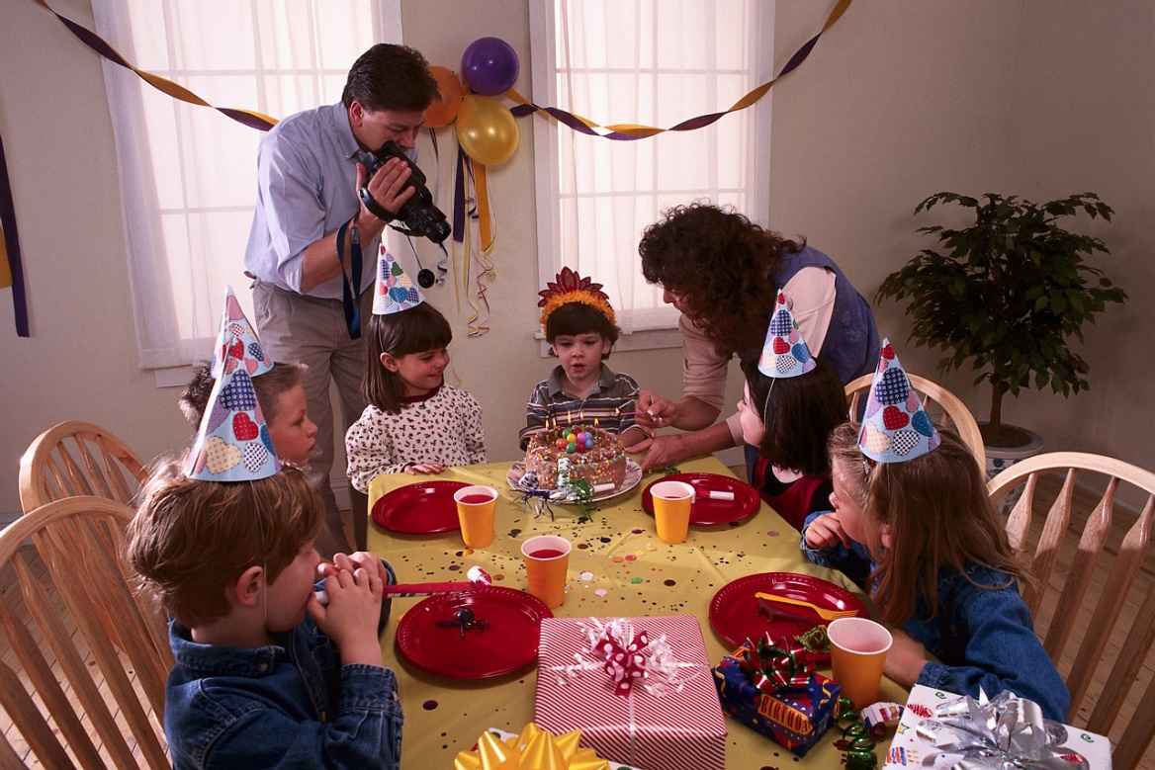
Dinner Makes A Difference
(click on picture)
Notes:
Teacher note: This video is about 10 minutes long. She discusses the importance and benefits of eating together as a family unit.
Ask the following questions after viewing the video:
Do you eat together at the table as a family? If so, how often?
Why do you think it is important to eat together as a family?
What are your most favorite memories as eating together with your family?
Dinner makes a difference: Laurie David at TEDxManhattan
Producer of Al Gore’s “An Inconvenient Truth,” Laurie David has authored best-selling books, executive produced television specials and documentaries and has been called the Bono of climate change by Vanity Fair. Now she’s bringing it all home to her kitchen table.
http://youtu.be/GzB0BDstCI0

Slide 20
Life Stages
  There are various events or situations in life that can greatly affect us. These are a natural and expected part of each person’s life.
Notes:
Life Passage - A predictable developmental stage in a person’s life. Example: Teen years, 20’s, 30’s, 40’s and so forth.
What events or situations typically occur in the teen years? 20’s? 30’s? 40’s? 50’s? 60’s and older?
How do these events or situations impact the family unit?

Slide 21
Life Changes
  Marker event - A significant event that marks real change in one’s life. For example: Graduation, marriage, birth of a child or winning the lottery.
Notes:
Marker events can affect a life positively or negatively. But the one thing about life, is that it is constantly changing. Some of those markers are shared and common to particular societies. Some of the common markers include:
Adoption
Baptism or Bar Mitzvah
Begin school
Birth
Birth of children
College
Death of loved ones
Divorce
Empty nest
First job
Graduation
Job changes
Join the armed services
Loss of job
Major health issues
Marriage
Retirement
You may opt to have the students indicate with a show of hands, how many have personally experienced the marker events.
How did the marker event(s) he or she experienced, impact the family unit?

Slide 22
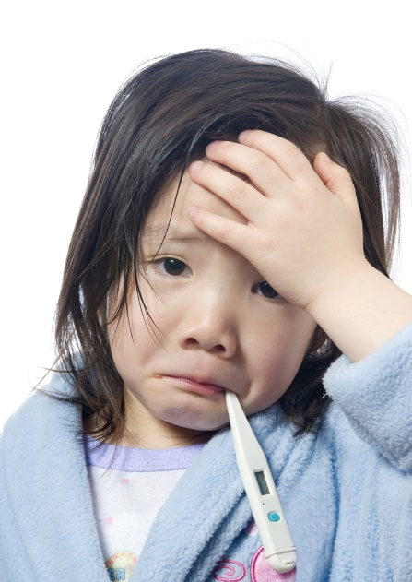
Influences on Family Dynamics
  Crisis in the family
  Dynamics of previous generations
  Family values
  Level and type of influence from extended family or others
  Nature of attachments
  Nature of the household “mix”
  Special needs or chronically sick child and/or adult
Notes:
Conduct a discussion about how each item listed can influence the dynamics of a family.
Crisis events which affect family members:
abuse
alcohol or other drug use
an affair
death
divorce
family violence
homelessness
mental health difficulties
poverty
trauma
unemployment
How do family values, beliefs, culture and ethnicity influence the family dynamics?
How does the nature of attachments in a family, such as being secure or insecure, influence the overall family dynamics?
How do the dynamics of previous generations (parents and grandparents families) influence the family dynamics?

Slide 23
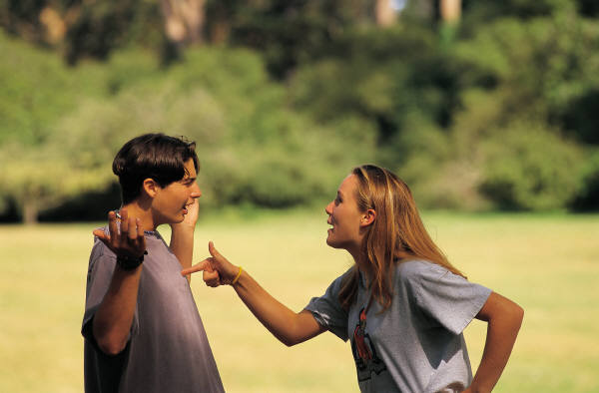
What are some traits of a dysfunctional family?
(click on picture)
Notes:
Ask the students this question. You may assign a scribe to write the answers on the board. Discuss the results. Some answers might include:
Abuse
Alcohol or other drug use
Child neglect
Family violence
High levels of tension or arguing
Lack of communication
Texas State University
Dysfunctional Family Patterns
http://www.counseling.txstate.edu/resources/shoverview/bro/dysfunc.html

Slide 24
Traits of a Dysfunctional Family
  Communicates indirectly
  Doesn’t express feelings openly
  Doesn’t laugh or play together
  Has unrealistic expectations
  Says it’s NOT okay to talk about problems
Notes:
Discuss each trait and have students give examples of how these could create a dysfunctional family.

Slide 25
A Dysfunctional Family
  May also use violence or abuse to try to solve problems.

Slide 26
Violence and Abuse
  Violence and abuse can include:
    Emotional – attacks on self-esteem, extreme pressure and neglect
    Physical – slapping, beating, torture and withholding food and water
    Sexual – forcing you to touch or do things with a body that you don’t like
    Verbal – yelling, cursing, sarcastic put-downs and verbal assaults
Notes:
Go into depth about abuse not being acceptable. A dysfunctional family needs to seek help and counseling. Discuss ways families can get the help and counseling they need.
What programs are available to assist individuals experiencing violence and abuse?

Slide 27
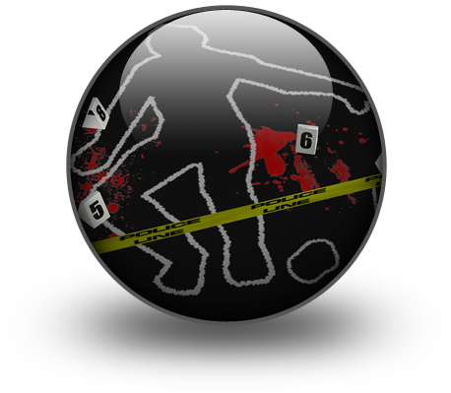
Violence
  Physical: pushing, hitting, slapping, punching or kicking
  Property: physically throwing things or punching doors or walls
  Psychological: threats, intimidation, controlling behavior, jealousy or verbal abuse
Notes:
Violence can include:
Child abuse
Elder abuse
Every ethnic, religious, educational and economic background
Spouse/partner abuse
Is bullying (in all its forms) a form of abuse? Why or why not?
What are some reasons for violence?
Anger
Frustration
Insecure
Low self-esteem
Stress
Resentment
Suspicion
Tension
What is youth violence? Youth violence refers to harmful behaviors that can start early and continue into young adulthood. The young person can be a victim, an offender or a witness to the violence. Youth violence includes various behaviors. Some violent acts—such as bullying, slapping or hitting—can cause more emotional harm than physical harm. Others, such as robbery and assault (with or without weapons) can lead to serious injury or even death.
Youth Violence Statistics
Source: Character Counts, Where Peace Lives, Bureau of Justice Statistics
http://www.statisticbrain.com/youth-violence-statistics/
9
What are some reasons for violence?
Reasons for violence:
Anger
Frustration
Stress
Resentment
Suspicion
Tension
Insecure
Low self-esteem
What is youth violence? Youth violence refers to harmful behaviors that can start early and continue into young adulthood. The young person can be a victim, an offender, or a witness to the violence. Youth violence includes various behaviors. Some violent acts—such as bullying, slapping, or hitting—can cause more emotional harm than physical harm. Others, such as robbery and assault (with or without weapons) can lead to serious injury or even death.
Youth Violence Statistics
Source: Character Counts, Where Peace Lives, Bureau of Justice Statistics
http://www.statisticbrain.com/youth-violence-statistics/

Slide 28
Resources Available During a Crisis
  Adult Protective and Child Protective Services Division of Texas
  Community resources
  Educators
  Family relationships
  Friends
  Legal system protections
Notes:
Coping with a crisis:
Look to each other for support
Recognize the existence of a crisis
Resume efforts to achieve personal and family goals
Seek alternative solutions
The following are resources available during a crisis:
Community efforts
Community resources including shelters, hotlines, intervention or support groups
Educational opportunities
Legal system protections
Personal commitments
Professional responsibilities
Additional information on this publication can be found at:
http://www.childwelfare.gov/pubs/usermanuals/educator/educator.pdf
Child Protective Services Division of Texas is another organization available to assist families in crisis. The Child Protective Services Division investigates reports of abuse and neglect of children.
It also aids in the following:
Placing children in adoptive homes
Placing children in foster care
Providing services to children and families in their own homes
Providing services to help youth in foster care make the transition to adulthood
For additional information and legal definitions of abuse and neglect, visit:
http://www.dfps.state.tx.us/Child_Protection/About_Child_Protective_Services/

Slide 29



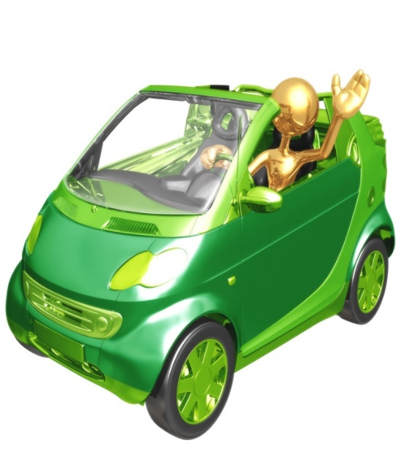

Technology in the Home
Notes:
Have students name each of these technology devices. Ask them how this is a benefit to the family and how it is a drawback. Which is it more? Would you suggest buying it?
Items listed:
Top left to right…cell phone, flat screen T.V., and laptop.
Bottom row: electric smart car, microwave oven, and ATM machine.

Slide 30

Using Technology to Meet Needs
  Calling or texting
  Keeping the lines of communication open
  Sending an e-mail or e-card to let someone know that you are thinking of them
  Using the Internet to research sources of assistance
Notes:
What forms of technology do you use to keep the lines of communication open with your family?

Slide 31
Improved Communication
  Blogging
  Cell phones
  E-mail
  Fax machines
  Instant messaging
  Internet
  Social networks
  Text messages
  Vehicles with Bluetooth
Notes:
How many cell phones do you have in your family?
Do you have a fax machine?
Do you send out e-mails or do you prefer other methods of social networking?
How many text messages do you or does your family send/or receive a day?
How has social networks improved communication between people?
How many of you have a wireless stereo headset? What are the advantages and disadvantages of using this type of device?
Which group in the family life cycle would benefit greatly with this type of technology? Why?

Slide 32
Questions?

Slide 33
References and Resources
  Images:
    Microsoft Clip Art: Used with permission from Microsoft.
  Textbook:
    Strengthening Family and Self. The Goodheart-Wilcox Company, Inc., Copyright 2004
  Websites:
    Bureau of Labor Statistics
    What Effects do Macroeconomic Conditions Have on Families’ Time Together?
    http://www.bls.gov/ore/pdf/ec120030.pdf
    Forum on Child and Family Statistics
    The Federal Interagency Forum on Child and Family Statistics, or the Forum is a working group of federal agencies that collect, analyze, and report data on issues related to children and families. The Forum has partners from 22 federal agencies as well as partners in private research organizations.
    http://www.childstats.gov/index.asp

Slide 34
References and Resources
  Websites:
    Maternal and Child Health
    The Federal Title V Maternal and Child Health program has provided a foundation for ensuring the health of the nation’s mothers, women, children and youth, including children and youth with special health care needs, and their families.
    http://mchb.hrsa.gov/
    Public Broadcasting Service (PBS)
    Website with links to television, articles and information on various curricular subjects of public interest.
    http://www.pbs.org or http://www.pbs.org/parents/cominghome/article-homecomings.html
    StoryBird
    StoryBird is a visual storytelling community and a global hub of readers, writers and artists of all ages.
    http://storybird.com/teachers/

Slide 35
References and Resources
  Websites:
    Texas State University
    Dysfunctional Family Patterns
    http://www.counseling.txstate.edu/resources/shoverview/bro/dysfunc.html
  Video:
    Faces of America
    Episode: Family traditions and customs. Stephen Colbert talks about traditions and customs he’s kept alive in his own family over the generations.
    http://video.pbs.org/video/2247082872

