Slide 1
Count It Out!
Change Makes Cents
Notes:
Culinary Arts, Practicum in Culinary Arts, Restaurant Management

Slide 3
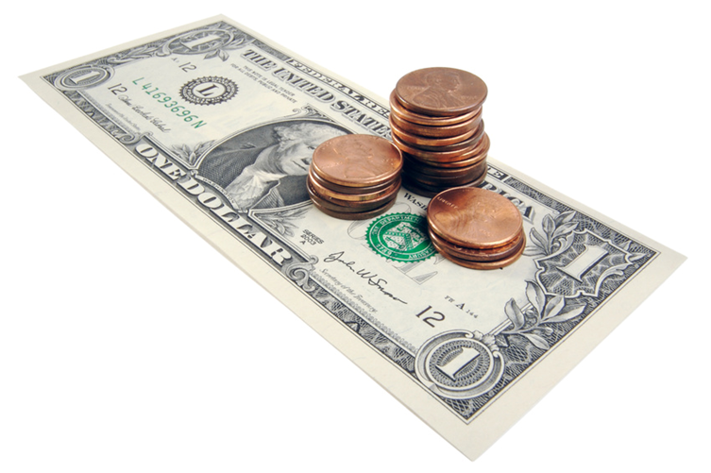
Making Change
  Cashier
Notes:
Change - paper money or coins

Slide 4
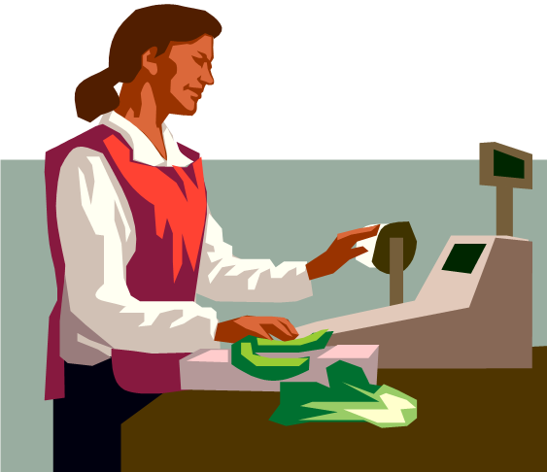
Cashier
  Calculates cost of good and services
  Greets customers/guests
  Provides information to customers
  Receives payment
  Thanks customers/guests
  Uses equipment:
    Card machine
    Register
    Scanner
Notes:
A cashier in the food industry will handle payments for the meals.
Some busy, informal or small food businesses have a cashier.

Slide 5
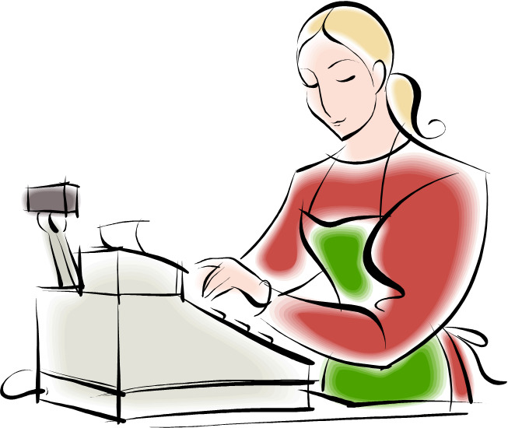
Skills Needed
  Listening Attentively
  Math
  Service Oriented
  Social Perceptiveness
  Verbal Communication
Notes:
Listening attentively - Giving full attention to what other people are saying, taking time to understand the points being made, asking questions as appropriate and not interrupting at inappropriate times
Math - Using mathematics to solve problems
Service Oriented - Actively looking for ways to help people
Social Perceptiveness - Being aware of others' reactions and understanding why they react as they do
Verbal Communication - Talking to others to convey information effectively
Source: Career One Stop
Cashier Occupation Profile

Slide 6


Handling Cash
  Know and understand cash system
  Count back change
  Know how customers will be paying
    Cash, check, credit, debit
Notes:
It is important for a cashier to understand the cash system.
Know the policies for using credit or debit cards, and personal check writing procedures for your business.
Click on image to view video:
Career One Stop - Cashiers
Receive and disburse money in establishments other than financial institutions. May use electronic scanners, cash registers, or related equipment. May process credit or debit card transactions and validate checks.
http://youtu.be/TG9l3U0Gq6o?list=UU8opl10LrVIBL_JlcHFKWRg

Slide 7
Other Responsibilities
  Answer customer questions about goods or services
  Calculate costs of goods or services
  Clean work areas
  Explain technical product or service information to customers
  Maintain records of sales or other business transactions
  Monitor sales activities
  Reconcile records of sales or other financial transactions
  Sell products or services
  Stock products or parts
  Supervise sales or support personnel
  Train sales personnel
Notes:
Other responsibilities for a cashier may include any of the items listed depending on the size and type of business.
Would you be willing to do these tasks?
Source: Career One Stop
Cashier Occupation Profile

Slide 8

Questions?

Slide 9
References and Resources
  Article:
    How to Count Back Money
    If you are responsible for making change or giving cash to someone it is very important to know how to count back change.
    http://www.ehow.com/how_5715904_count-back-money.html
  Images:
    Microsoft Office Clip Art: Used with permission from Microsoft.
  Website:
    Career One Stop - Cashier
    Offers a wide range of career, employment and education data as Web Services, allowing third parties to obtain quality-controlled data sets and seamlessly integrate them into their own websites.
    http://www.careerinfonet.org/occ_rep.asp?nodeid=2&optstatus=000110111&next=occ_rep&jobfam=41&soccode=412011&stfips=&level=&id=1&ES=Y&EST=cashier

Slide 10
References and Resources
  YouTube™:
    Career One Stop - Cashiers
    Receive and disburse money in establishments other than financial institutions. May use electronic scanners, cash registers, or related equipment. May process credit or debit card transactions and validate checks.
    http://youtu.be/TG9l3U0Gq6o?list=UU8opl10LrVIBL_JlcHFKWRg

