Slide 1
Effective Verbal Communication

Slide 3
Verbal Communication
Exchange of information
Information communicated through words
A verbal or written message
A process by which information is exchanged between individuals though a common system of symbols, signs, or behavior

Slide 4
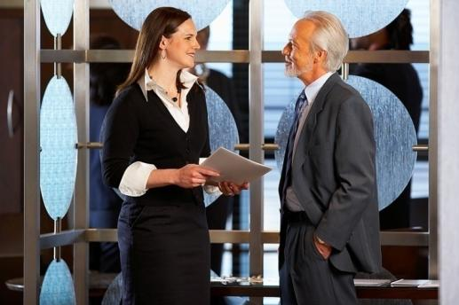
Why Communication?
Establish and maintain relationships
Persuade and change attitudes or behavior
Develop an understanding of other people
Solve problems

Slide 5
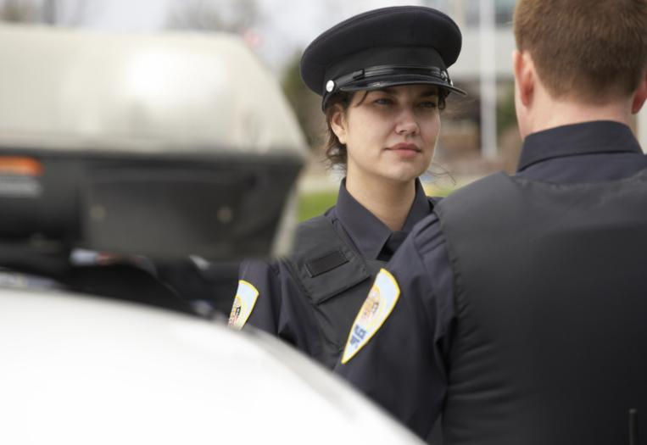
Uses of Verbal Communication in LPSCS Careers?
Interactions with:
Public
Clients
Co-workers
Supervisors
Inmates
LPSCS Reports

Slide 6
Elements of Effective Communication
Speaker/Writer – creator of message
Message – transmitted information
Receiver – individual who analyzes and interprets the message
Feedback – verbal or nonverbal response the receiver sends to the speaker/writer
Clear and Concise message
Use understandable terms
Modify or define legal terms
Use proper grammar and pronunciation
Avoid slang and meaningless words
Moderate speed of speech
Correct spelling, punctuation, and grammar for written communication

Slide 7
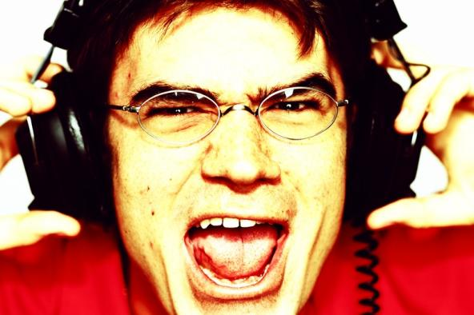
Elements of Effective Communication Cont.
Message must be heard and received
Hearing or vision loss
Non-English speaker
Under the influence of an intoxicant
Consider alternate methods
Writing message out
Interpreter
Repeating message
Avoid interruptions or distractions
Phone
Weather
Noise from TV
Noise from radio

Slide 8
Barriers to Effective Communication
Hearing Loss
Use body language
Use short sentences
Face the receiver
Ensure hearing aids work properly
Get receiver’s attention before speaking
Do not chew gum or cover mouth
Impaired Vision
Describe what is happening
Announce arrival
Use touch
Use good light
Keep objects stationary
Announce departure

Slide 9
Barriers to Effective Communication
Trouble Speaking
Use yes or no questions
Allow time to answer
Repeat answer for clarification
Encourage alternate methods of communication if necessary
Defense Mechanisms
Compensation for another goal to achieve success
Denial
Displacement of anger
Projection
Rationalization

Slide 10
Effective Communication
Verbal messages must be clear, complete, concise, courteous, and cohesive
Nonverbal communication (body language) may change the message

Slide 11
Effective Listening
Involves both hearing and interpreting messages
Requires focusing on body language and the message being sent
May be passive or active
Notes:
Active listening is very important in the LPSCS profession to gather information (for example, when interviewing a witness to a crime)

