Slide 1
Creating A Lifestyle Budget

Slide 3

Budget
  A plan for spending money
  In this lesson you will: Create a Personal Budget Based on Your Selected Lifestyle
Notes:
Why is it necessary to have a plan for spending money? Have students brainstorm the need for a plan to spend money.
Today we will create a budget based upon the lifestyle you have chosen.

Slide 4

Components of a Budget
Notes:
There are several components of a budget that are important to know. Some of the components of a budget are the rent/mortgage payment, utilities, savings, transportation and groceries.

Slide 5
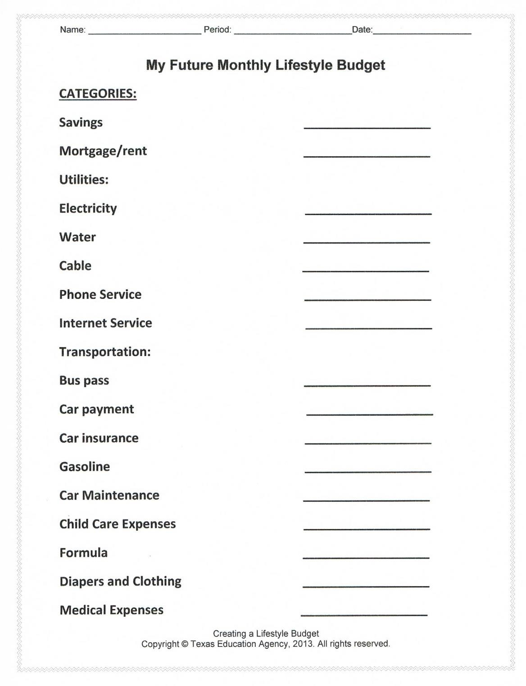
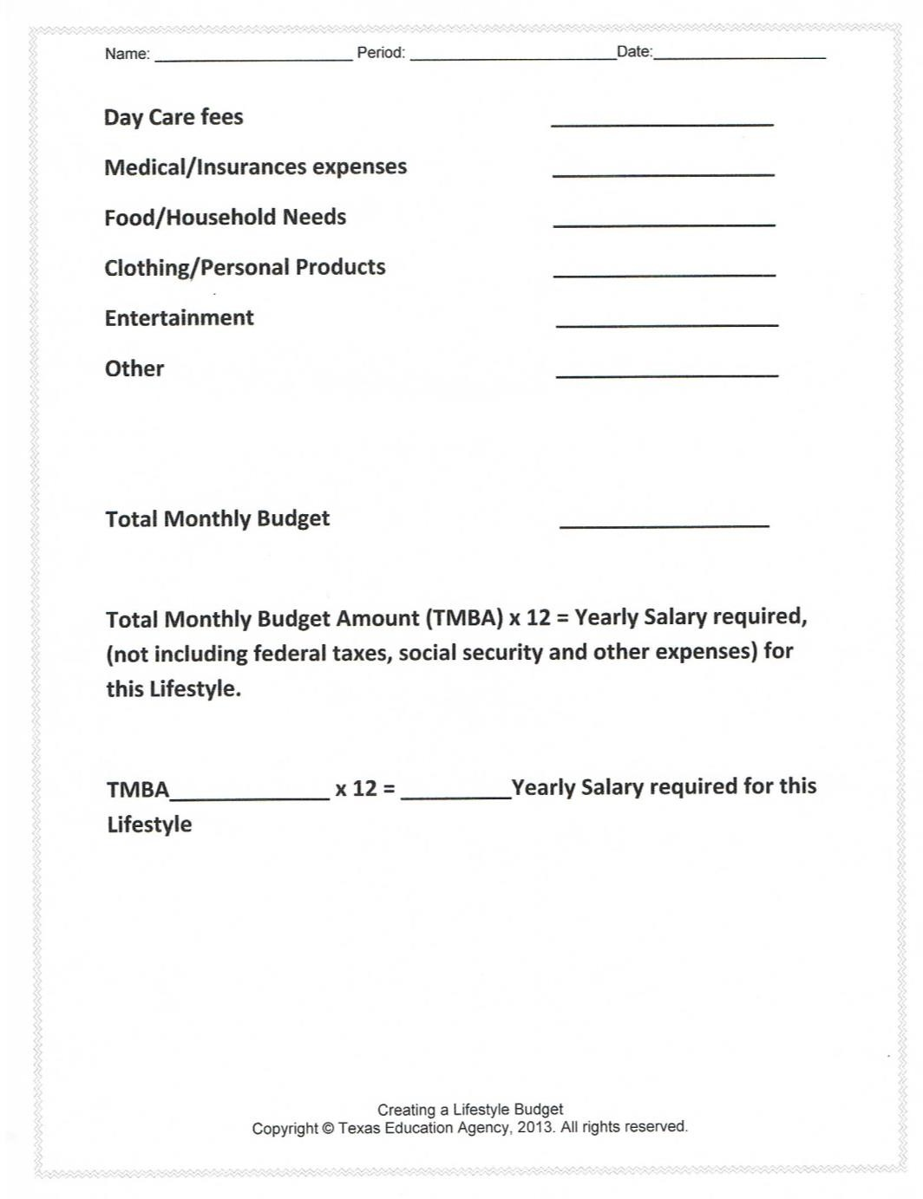
Notes:
Here is an example of a budget that you may want to plan out.
There are numerous ways to spend your money. Here are a few examples of categories you may need to include in your budget planning.

Slide 6

Savings
  Why save?
  Emergencies
  Specific goals (vacation, tuition)
  Retirement
  ????
Notes:
Money put away into savings are important because it gives you a security blanket to fall onto when the unexpected happens. The general rule of thumb is to save about 3-6months salary in case you lose your job, or you are unable to work.
Other than for emergencies, savings can also be used for specific goals, such as vacations, tuitions, birthdays, celebrations and retirement. Can you think of any other reasons to save money?

Slide 7

Mortgage/rent
  What is the difference between a mortgage payment and a rent payment?
  What is a down payment?
Notes:
What is the difference between a mortgage payment and a rent payment? Ask for volunteers to look up the differences. The major difference between a mortgage and a rent payment is money that is spent on rent is not applied to investment into a property like a mortgage payment. Eventually, one can own a home that mortgage is being paid toward. However, individuals who pay a rent payment will never own the property. What are the pros and cons of each? Have students brainstorm the answers in groups or pairs. What is a down payment? A down payment is an initial payment made toward a large purchase.

Slide 8


Utilities:
  Electricity
  Water
  Cable
  Phone Service
  Internet Service
  Can you think of others?
Notes:
Utilities are extra expenses associated with owning or renting a home that are separate from the mortgage or rent payment. Sometimes apartment complexes include some utilities, such as water, in the rent payment. What are some other utilities that are not listed?

Slide 9



Transportation:
  Bus pass
  Car payment
    Car insurance
    Gasoline
    Car maintenance
    Yearly registration
    Inspection Sticker
Notes:
Whether you use public transportation, or a personal vehicle, you will incur transportation costs. While a personal vehicle may seem like the cheaper option over the long term, it has many costs some people may be unaware of, such as car insurance, gasoline, car maintenance, registration and inspections.

Slide 10
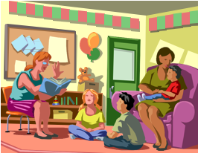
Child Care Expenses
  Formula
  Diapers and Clothing
  Medical expenses
  Day Care fees
  Private vs. Public education
Notes:
Children demand or need a large part of a person’s household budget because as they grow, they have many expenses. Some of the expenses include new clothes, food, regular doctor’s visits, day care and more. What other expenses do children have?

Slide 11

Medical/Insurance Expenses
  Prescriptions
  Medical/Dental Expenses
  Medical/Dental Insurance (often provided by employers)
Notes:
The rising costs of medical care is becoming a burden to some Americans. This means that Americans have more reasons to budget expenses to accommodate the costs of medications, doctor office co-pays, insurance premiums and more.

Slide 12
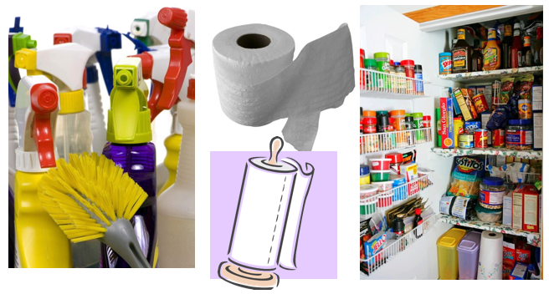
Groceries/Household Needs
Notes:
In addition to the many expenses a person must allocate funds for, groceries and household items need to be accounted for as well. Everyone will need to do household cleaning, although it may not be a desired chore. And, of course, we all eat food; therefore groceries need to be figured into the budget. What could result if a family did not budget for meals?

Slide 13

Clothing/Personal Products
Notes:
Clothing should be budgeted for also, even though you may not shop for clothing every month. Toiletries and other personal care products should be budgeted for each month too.

Slide 14

Entertainment
  Movies
  Concert tickets
  Dining Out
Notes:
Be sure to allow for an entertainment budget also. This would include items such as going to concerts, athletic events, movies or dining out. Why might it be hard to stick to an entertainment budget? What are the benefits of creating an entertainment budget?

Slide 15


Other Categories
  Child support
  Student Loans
  Pets
  Gym membership
  Charity/Donations
  Can you think of others?
Notes:
All budgets should be unique to the individual’s household. What might you include that we have not discussed today?

Slide 16
Questions?

Slide 17
Your Turn
Notes:
Now it is your turn to complete a personal budget.

Slide 18
Notes:
Complete the budget based upon the amount of money you plan to spend in each category.

Slide 19
References/Resources
  Images:
    Microsoft Office Clip Art: Used with permission from Microsoft.

