Slide 1
Crisis and the Family

Slide 3
What is a Crisis?
Notes:
Assign a student scribe to write the answers to this question on the board.
How does a crisis affect the family? An individual? The community?

Slide 4
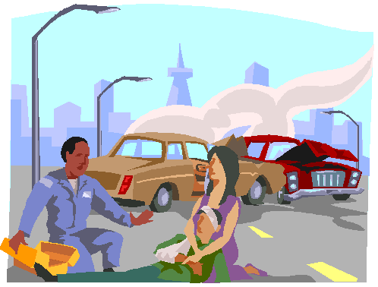
What is a Crisis?
  Devastation
  Disaster
  Crucial time or event that changes a person’s life
  End to happiness and achievement
  Incentive to achieve new and different goals
Notes:
Have you experienced a crisis? We all have at one time or another.

Slide 5

Causes
  Social pressure
  Job stress
  Family problems
  Defensive mechanisms
(click on link)
Notes:
What are some social pressures that can lead to a crisis? Are there social pressures in high school? At the work place?
How can job stress cause a crisis in an individual or family?
“In some areas of psychology (especially in psychodynamic theory), psychologists talk about defense mechanisms, or manners in which we behave or think in certain ways to better protect or defend ourselves” said Dr. John M. Grohol, Psy.D.
How do these defense mechanisms relate to a family crisis?
15 Common Defensive Mechanisms
Defense mechanisms are one way of looking at how people distance themselves from a full awareness of unpleasant thoughts, feelings and behaviors.
http://psychcentral.com/lib/15-common-defense-mechanisms/0001251

Slide 6
Dealing with Family Crisis
  A family crisis usually has three distinct phases:
    the event that precipitates the crisis
    the period of disorganization
    the reorganizing or recovery phase after the family reaches a low point
  15 Ways to Help Your Child through Crisis
  (click on link)
Notes:
After the crisis hits bottom, recovery can begin. A family’s crisis-meeting capabilities (resources and coping behaviors) represents its ability to prevent a stressor from creating severe disruption.
Special problems such as divorce, family violence or illness or death in the family can strongly impact children. During very difficult family changes, children may have developmental regressions. Such behavior is not a selfish way to get attention. It may be a sign that the child is under great stress and needs help from parents and caregivers in order to cope with the stress. Understanding how various factors may influence children helps the parents and caregivers know how best to relate to them.
KidsPeace.org
15 Ways to Help Your Child through Crisis
http://www.kidspeace.org/uploadedFiles/15_Ways_parenting_008_0010_flier.pdf
After the crisis hits bottom, recovery can begin. A family’s crisis-meeting capabilities (resources and coping behaviors) represents its ability to prevent a stressor from creating severe disruption.
Special problems such as divorce, family violence or illness or death in the family can strongly impact children. During very difficult family changes, children may have developmental regressions. Such behavior is not a selfish way to get attention. It may be a sign that the child is under great stress and needs help from parents and caregivers in order to cope with the stress. Understanding how various factors may influence children helps the parents and caregivers know how best to relate to them.
KidsPeace.org
15 Ways to Help Your Child through Crisis
http://www.kidspeace.org/uploadedFiles/15_Ways_parenting_008_0010_flier.pdf

Slide 7

Factors Associated with Meeting a Crisis Creatively
  A positive outlook
  Spiritual values
  Support groups
  Adaptability
  Informal social support
Notes:
Factors associated with meeting a crisis creatively include:
a positive outlook
spiritual values
support groups
adaptability
informal social support
A family crisis is a turning point that requires family members to change their patterns of thinking and acting.
Stressor events do not have to lead to crisis situations; the key is how individuals and families respond to the situation.
Do your friends give you informal social support during a crisis you might be experiencing? Is it helpful?

Slide 8

Some Strategies Which May be Ineffective or Harmful in Solving Family Problems
  Denying or avoiding problems
  Not expressing one’s frustrations
  Keeping one’s feelings inside
Notes:
Some ineffective and harmful strategies to solving family problems are:
denying or avoiding problems
not expressing one’s frustrations
keeping one’s feelings inside
What are some other strategies which may be harmful or ineffective in solving family problems?

Slide 9
Types of Crisis
  Loss of job
  Relocation
  Addictions: drugs/alcohol
  Compulsive gambling
  Suicide
  Criminal attack
  Violent behavior in families
  Missing children
  Community and national crises
  Separation or divorce
Notes:
Other crises might include:
Abuse of spouse and children
Change of family dynamics; blended family members
Death in the family
Demotion of job or position
Deployment of spouse or family member
Loss of home due to foreclosure/fire/eviction
Medical or mental health problems
Separation or divorce of parents
Teen pregnancy
Vehicle accident
Violent death or injury
How do these events affect families, individuals or a student in the classroom?

Slide 10
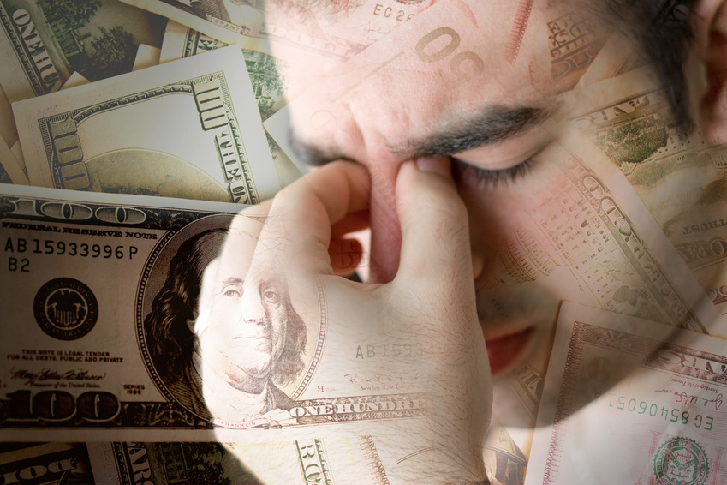
Loss of Job
  Financial decisions related to unemployment
    Assessing obligations
    Making a budget
    Talking to creditors for payment plan
Notes:
A family crisis is a turning point that requires family members to change their patterns of thinking and acting. How might a loss of a job require a family to make changes?

Slide 11

Relocation
  Feelings of vulnerability
  Uncertainty of the future
  Hesitation leaving familiar surroundings
  Moving is difficult for children – let them help with finding and decorating a new home
Notes:
With the increased mobility that is possible today, immediate families have a greater chance of having to be separated than they once did. Family separation that is not marital-related can cause strain on a family. Separation may be necessary when a parent has to travel to another city for employment or when a parent has to leave to care for an ill relative. Children need to understand that when a parent leaves, he or she will return.
How can family separation that is not marital-related affect children?
How can/does being homeless affect the family unit?

Slide 12
Addictions: Drugs/Alcohol
Notes:
According to the Centers for Disease Control and Prevention, men are more likely than women to drink excessively. Excessive drinking is associated with significant increases in short-term risks to health and safety, and the risk increases as the amount of drinking increases. Men are also more likely than women to take other risks (such as drive fast or without a safety belt), when combined with excessive drinking, further increasing their risk of injury or death.
Underage drinking brings major health problems and consequences to the family. Discuss the Facts Sheets – Underage Drinking at the Centers for Disease Control and Prevention. Allow for questions and discussion.
Centers for Disease Control and Prevention
Facts Sheets – Underage Drinking
http://www.cdc.gov/alcohol/fact-sheets/underage-drinking.htm
Throughout history, cultures have used psychoactive drugs for various purposes such as recreation, rituals, ceremonies and medicine. A major concern for today’s medical professionals is substance abuse and its effect on society.
Predisposing factors include:
working in health care (high risk due to availability of drugs) with the highest addiction rate belonging to anesthesiologists
family history of substance abuse
emotional problems
ineffective coping mechanisms
history of childhood physical or sexual abuse
“addictive” personality
An individual using drugs suffers physically, emotionally, socially and intellectually. Children and teens blame themselves if a parent is using drugs. Teens will avoid bringing friends home and try to hide family problems from others. Children will start doing poorly in school and start complaining about physical health to get attention they aren’t getting at home.
What are other ways families are affected by drug and alcohol use?
Family members get caught up in deceit to cover the problem. Some families choose to intervene. What is an intervention? An intervention is forcing a person to look at his or her behavior without the mask of denial. Do interventions work? Why or why not?

Slide 13
Statistics on Drunk Driving
  Mother's Against Drunk Driving Statistics
  (click on link)
Notes:
Mothers Against Drunk Driving
Mother’s Against Drunk Driving Statistics
http://www.madd.org/statistics/
What effects would this have on the family?

Slide 14

411 On Teen Drinking
(click on picture)
Notes:
MADD and National Presenting Sponsor State Farm® are introducing the newest tool to prevent underage drinking, a booklet called The 411 on Teen Drinking. This booklet is part of MADD’s Power of You(th)program, which empowers teens to resist peer pressure and influence other teens to not drink before age 21 and never get in the car with someone who’s been drinking.
Sign up and receive MADD's research-based teen booklet and learn the best way to take a stand against underage drinking.

Slide 15
Gambling
  Potential losses are high for the whole family
  Gambler goes through family savings
  Threatens family relationships and jeopardizes educational and career opportunities
Notes:
Gamblers can become bankrupt and turn to government assistance or crime to pay back debts.
Gamblers go through four stages:
1. Winning
2. Losing
3. Desperation
4. Hopelessness

Slide 16
Suicide
  Four patterns:
    Impulsiveness
    Exhibiting many signs of depression
    Suffering from illness or suddenly learning about an illness
    Extreme depression over lost loved ones or other perceived mental or emotional losses
Notes:
If a family member or friend has hinted about suicide or openly talked about it, do not ignore the situation. Express concern directly to the person. Suggest the person see a professional.

Slide 17
Criminal Activity
  Anyone is vulnerable
  Take precautions
  Can take place anywhere
  Practice situational awareness
Notes:
Acts of violence and crime have increased dramatically from one or two generations ago. Many acts of violence and crime can be related to the increased use of drugs and alcohol. Criminal attacks can occur in your home, school, businesses, job or car. Many of these acts of violence and crime affect children.
What is situational awareness? It is knowing your surroundings at all times. Why is it important to report suspicious activity at school? In the community?

Slide 18
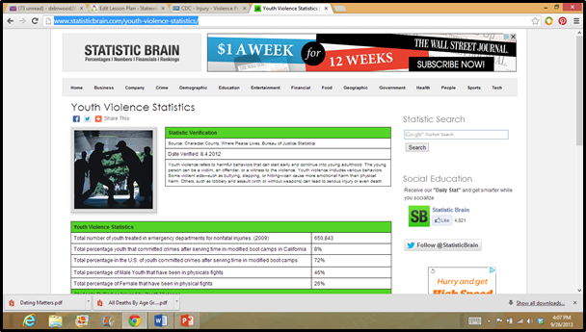
Violence
  Forms of Violence
    Psychological: threats, intimidation, controlling behavior, jealousy or verbal abuse
    Property: physically throwing things or punching doors or walls
    Physical: pushing, hitting, slapping, punching or kicking
  Youth Violence
(click on picture)
Notes:
Violence can include:
Spouse/partner abuse
Elder abuse
Child abuse
Every ethnic, religious, educational and economic background
Is bullying (in all its forms) a form of abuse? Why or why not?
What are some reasons for violence?
Reasons for violence:
Anger
Frustration
Stress
Resentment
Suspicion
Tension
Insecure
Low self-esteem
What is youth violence? Youth violence refers to harmful behaviors that can start early and continue into young adulthood. The young person can be a victim, an offender or a witness to the violence. Youth violence includes various behaviors. Some violent acts—such as bullying, slapping or hitting—can cause more emotional harm than physical harm. Others, such as robbery and assault (with or without weapons) can lead to serious injury or even death.
Youth Violence Statistics
Source: Character Counts, Where Peace Lives, Bureau of Justice Statistics
http://www.statisticbrain.com/youth-violence-statistics/
9
What are some reasons for violence?
Reasons for violence:
Anger
Frustration
Stress
Resentment
Suspicion
Tension
Insecure
Low self-esteem
What is youth violence? Youth violence refers to harmful behaviors that can start early and continue into young adulthood. The young person can be a victim, an offender, or a witness to the violence. Youth violence includes various behaviors. Some violent acts—such as bullying, slapping, or hitting—can cause more emotional harm than physical harm. Others, such as robbery and assault (with or without weapons) can lead to serious injury or even death.
Youth Violence Statistics
Source: Character Counts, Where Peace Lives, Bureau of Justice Statistics
http://www.statisticbrain.com/youth-violence-statistics/

Slide 19

Does Your Relationship Need a Makeover?
  Love is Respect
  (click on link)
Notes:
Does Your Relationship Need a Makeover?
Check out this PSA play in movie theaters in California and Texas....loveisrespect
http://youtu.be/V2Kv-7DB7NA
How often does date violence occur?
According to the Texas Advocacy Project, these are the statistics on teen dating violence:
Relationship violence is the number one cause of injury to women between the ages of 15-44
• 70% of severe injuries and deaths occur when the victim is trying to leave or has already left the relationship
• 70% of pregnant teenagers are abused by their partners
• 63% of boys ages 11-20 arrested for murder were arrested for murdering the man who was assaulting their mother
• 38% of date rape victims are young women between the ages of 14 and 17
• 24% of female homicide victims are between 15 and 24 years old
Texas Advocacy Project
Legal solutions to end violence.
http://www.texasadvocacyproject.org/faq.php?faqid=54

Slide 20
Missing/Runaway Children
  1.5 million children are reported each year
  Children leave home because of abuse
  Communication breakdown
  Divorce/remarriage of parents
  Abductions take place by parents in divorces
  Children are lured by acquaintances or people they do not regard as strangers
Notes:
1.5 million children are reported each year as missing or runaways.
Some children leave home because of abuse. It is a nationwide problem.
Some children leave home because of a breakdown of family communication. This may involve disagreements between parents and teens on issues such as curfews, drug use, friends and school performance. Divorce/remarriage can cause children to leave home. Abductions take place by parents in divorces. Children are lured by acquaintances or people they do not regard as strangers. These acquaintances may have contacted them through youth groups, sports, recreational organizations, or the Internet.
Texas Runaway Hotline
1-888-580-HELP (1-888-580-4357)
Texas Youth (and Parents) Hotline
1-800-210-2278
Texas Suicide Prevention
Please call 1-800-273-TALK (8255)
to find more help, search for Programs in Your County or call 2-1-1

Slide 21

Community and National Crisis
  Local terrorist incident
  Natural disaster – earthquake, flood, severe weather or fire
  Preparedness – being ready for crises that could occur (situational awareness)
Notes:
Why is it important to take fire drills, lock-downs and other emergency drills seriously at school?

Slide 22
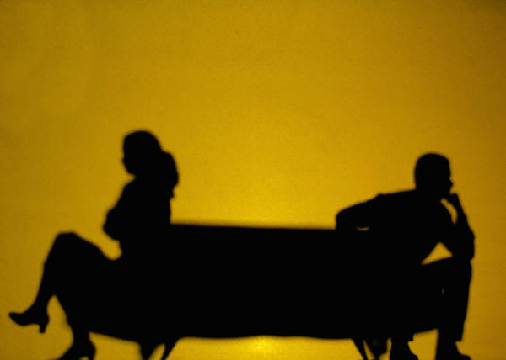
Separation or Divorce
  Tell children the truth
  Reassure the children that it is not their fault
  Parents should reinforce their love for their children
  Professional counseling may be helpful
Notes:
The effects of separation and divorce vary depending on the family situation and the ages of the children involved. To deal with the separation or divorce, children always should be told the truth about what is happening and what can be expected. Children often feel that the separation or divorce is their fault and that they could have done something to prevent it.
What can parents do to make separation and divorce easier for children?
How can remarriage affect children?

Slide 23
Special Needs Individuals
  Adult Protective Services (APS) is responsible for investigating abuse, neglect and exploitation of clients receiving services in state operated and/or contracted settings that serve adults and children with mental illness or intellectual and developmental disabilities.
Notes:
Some families have family member’s which require special needs. Would this be considered a crisis in a family? Why or why not?
Investigations are conducted in the following settings:
State supported living centers
State hospitals
State centers
Community centers
Local authorities serving individuals with mental health or intellectual and developmental disabilities
Intermediate Care Facilities for Individuals with an Intellectual Disability or Related Conditions (ICFs/IDD), formerly known as ICF-MR
Home and Community-based waiver providers (HCS)
Texas Home Living waiver providers (TxHmL)

Slide 24
Laws and Public Policies Related to the Family
  Texas Family Code
    Rights and Duties of a Parent (Sec. 151.001)
      A parent has:
        (1) the right to have physical possession, to direct the moral and religious training, and to designate the residence of the child
        (2) the duty of care, control, protection, and reasonable discipline of the child
        (3) the duty to support the child, including providing the child with clothing, food, shelter, medical and dental care, and education
Notes:
Ask students if they were aware that Texas has a Family Code as one of its statutes in the State Constitution.
Discuss with students that parents have a right and a duty to provide for their children. Does this also include protecting children from a crisis situation?
Refer to handout Texas Family Code (see All Lesson Attachments tab) for more information.

Slide 25
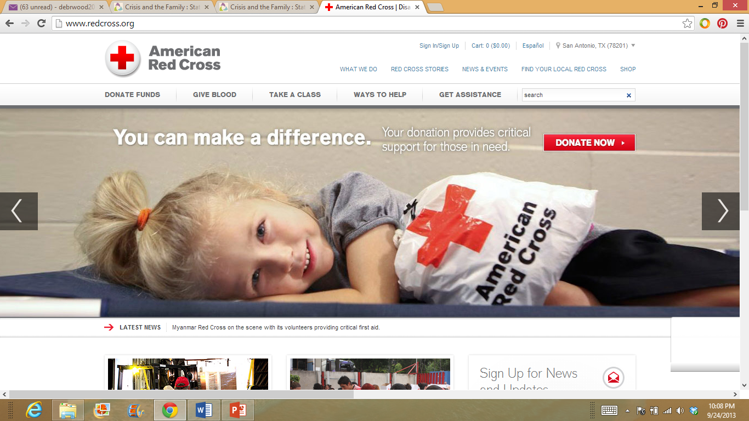
Resources Available During a Crisis
  Educators
  Legal system protections
  Adult Protective and Child Protective
  Services Division of Texas
  Family relationships
  Friends
  Community resources
(click on picture)
Notes:
Coping with a crisis:
Recognize the existence of a crisis
Seek alternative solutions
Look to each other for support
Resume efforts to achieve personal and family goals
The following are resources available during a crisis:
Community efforts
Educational opportunities
Legal system protections
Personal commitments
Professional responsibilities
Community resources including shelters, hotlines, intervention or support groups
Additional information on this publication can be found at:
http://www.childwelfare.gov/pubs/usermanuals/educator/educator.pdf
Child Protective Services Division of Texas is another organization available to assist families in crisis. The Child Protective Services Division investigates reports of abuse and neglect of children.
It also aids in the following:
Placing children in adoptive homes
Placing children in foster care
Providing services to children and families in their own homes
Providing services to help youth in foster care make the transition to adulthood
For additional information and legal definitions of abuse and neglect, visit:
http://www.dfps.state.tx.us/Child_Protection/About_Child_Protective_Services/
American Red Cross
Plan and prepare information.
http://www.redcross.org/prepare

Slide 26

Questions?

Slide 27
References and Resources
  Images:
    Microsoft Clip Art: Used with permission from Microsoft.
  Textbooks:
    Parnell Frances Baynor. (2001). Skills for personal and family living. (pp. 195-206). Tinley Park: The Goodheart-Willcox Publishing Company.
    Sasse Connie. (2004). Families today. (4th ed., pp. 285-304). New York: McGraw Hill Glencoe.
  Websites:
    American Red Cross
    Plan and prepare information.
    http://www.redcross.org/prepare
    Centers for Disease Control and Prevention
    Facts Sheets – Underage Drinking
    http://www.cdc.gov/alcohol/fact-sheets/underage-drinking.htm

Slide 28
References and Resources
  Websites:
    Child Protective Services Division of Texas
    For additional information on abuse and neglect, visit:
    http://www.dfps.state.tx.us/Child_Protection/About_Child_Protective_Services/
    KidsPeace.org
    15 Ways to Help Your Child through Crisis
    http://www.kidspeace.org/uploadedFiles/15_Ways_parenting_008_0010_flier.pdf
    Mothers Against Drunk Driving (MADD)
    “The mission of Mothers Against Drunk Driving is to stop drunk driving, support the victims of this violent crime and prevent underage drinking.”
    http://www.madd.org/
    Statistic Brain
    Youth Violence Statistics
    http://www.statisticbrain.com/youth-violence-statistics/

Slide 29
References and Resources
  Websites:
    Suicide Hotlines
    Source: Texas Suicide and Crisis Hotline
    Crisis hotline available for individuals needing someone to talk to during times of crisis. Provides comforting words.
    http://suicidehotlines.com/texas.html
    Texas Advocacy Project
    Legal solutions to end violence.
    http://www.texasadvocacyproject.org/faq.php?faqid=54
    Youth Violence Statistics
    Source: Character Counts, Where Peace Lives, Bureau of Justice Statistics
    http://www.statisticbrain.com/youth-violence-statistics/
    15 Common Defensive Mechanisms
    Defense mechanisms are one way of looking at how people distance themselves from a full awareness of unpleasant thoughts, feelings and behaviors.
    http://psychcentral.com/lib/15-common-defense-mechanisms/0001251

Slide 30
References and Resources
  YouTube™:
    Does Your Relationship Need a Makeover?
    Check out this PSA play in movie theaters in California and Texas….loveisrespect
    http://youtu.be/V2Kv-7DB7NA

