Slide 1
Crunching Numbers:
Budgeting and Forecasting
Traveling and Tourism Management

Slide 3

Budgeting and Forecasting
Notes:
Budget is a guideline for spending money.
Forecasting is a prediction or estimation of a future event for a given time period

Slide 4
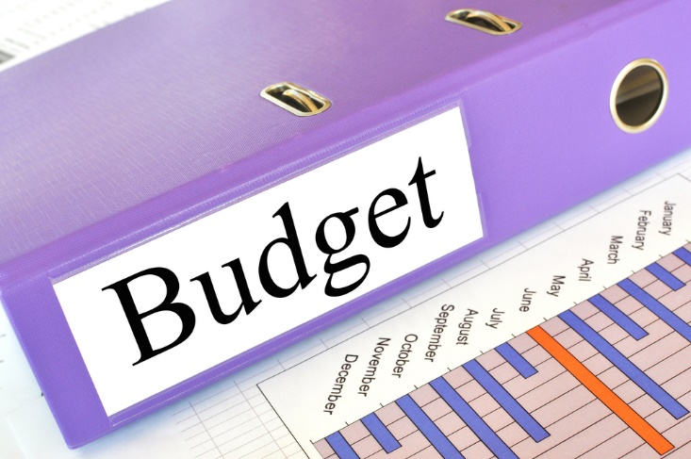
Budgets
Help businesses monitor spending
Key to maximizing profits
Lists anticipated sales and projected costs
Notes:
Management prepares the budget monthly or for longer periods depending on the organization.
Budgets are sometimes made by looking at the previous years’ spending while considering the forecast of revenue.

Slide 5
Types of Budgets
Long-range
Monthly
Scheduling large expenditures
Used to operate the business daily. Especially important for seasonal businesses.
Annual
Estimated spending for one year, often divided by department
Notes:
Annual budgets are a prediction and estimation of the spending for a business for one year, usually the current year.
Then it often is divided by department and each department is expected to stay within their number for that year.
Long-range budget that will cover two to five years or more
This type of budget is good for scheduling large personnel growth and capital expenditures such as building expansion, property, and large equipment.
A monthly budget is the natural extension of the annual budget and is used to operate the business daily.
Monthly budgets are especially important for seasonal businesses such as a cruise line.
Great care will need to be taken with each month’s budget to effectively reach the target budgets.
Looking at forecasts, revenue and budgets is the sound way to estimate the amount of company profits.

Slide 6

Revenue Manager
Brings value to guests
Devises and implements pricing strategies
    Approves:
      discounts to a variety of groups (AAA or AARP)
      exclusive rates to select guests
      flexible rates
Forecasts future sales
Meets revenue goals
Notes:
The revenue manager must devise and implement many different pricing strategies and room rates.
Room rates will vary based on demand.
The revenue manager approves discounts to a variety of national groups such as AAA or AARP and also approves exclusive rates to select important guests.
The revenue manager is responsible for meeting the revenue goals set by the owners or general manager and do so while bringing value to guests.
Another responsibility is to forecast room sales into the future so appropriate planning can be done by all departments.

Slide 7
Revenue Management
Average Rate
5 Factors of Influence
Demand
Room or Seat Price
Inventory / Supply
Occupancy Rate
Notes:
AR (average rate) – a measurement used by the revenue manager to forecast the measurement of all of the rooms’ rates or flight rates together.
The revenue manager will measure, track and try to increase the overall AR rather than manage individual prices for each and every person.
They will use the AR in conjunction with demand as a means to increase sales/revenue.
It is calculated by taking the total room or seat revenue and dividing by the total number of rooms or seats sold. It is important to note that it can be a trip rate, category rate or total rate and depends on the level of forecasting.
Demand – the amount of goods or services (rooms) consumers want to buy at a specific price (room rate).
Demand is ever changing. Regardless of the type of hotel, a room rate or price will be high when demand is high.
Discounts are offered when demand is low in order to try and create demand.
The revenue manager’s job is to know the demand and price accordingly to maximize revenue.
Occupancy rate is a measurement used in pricing. It is determined by dividing the total rooms or seats occupied by the number of rooms or seats available.
Room or Seat Price – the single rate or price for a specific type of room or seat.
A rate is relative to the demand and supply on a given trip.
This is called the law of supply and demand.
Supply – the total amount of goods or services (rooms on a cruise or seats on a flight) available for sale – also called inventory and that number is fixed and perishable.

Slide 8
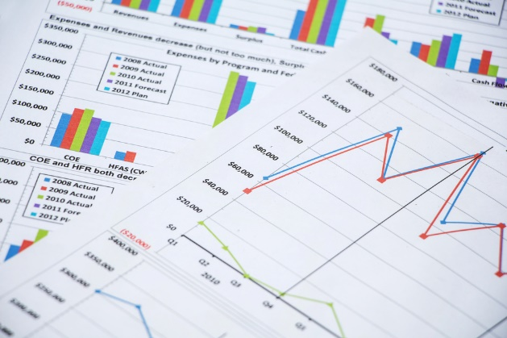
Revenue Forecasting
Includes:
Rooms or seats available to sell
Estimated average rate
Estimated occupancy rate
Estimated rooms or seats to be sold
Profit = Revenue - Costs
Notes:
Budgets and forecasts are essential elements of managing a business because the demand affects more than just revenue or sales volume.
It affects the number of staff to have on hand, how many supplies to order, how many flight attendants or housekeeping staff to hire and how much food and beverage staff and supplies are needed.

Slide 9
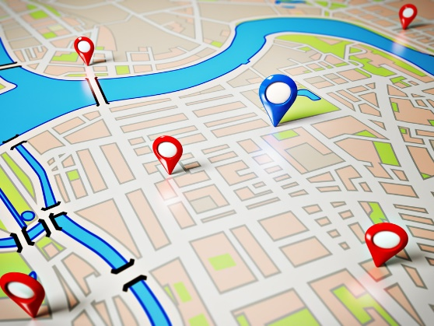
Other Factors
Competition
Economy
Location
Weather
Notes:
Other factors that influence profits are competition, economy, location and the weather.
What examples can you think of for each one?

Slide 10


Slide 11
Let’s Revue
What is a budget?
What is forecasting?
What are the three types of budgets?
What can a revenue manager do?
What factors influence revenue?
What does revenue forecasting include?
What other factors can influence revenue?
Notes:
Answers to the questions are found within the slide presentation or may vary with class discussion.

Slide 12
References and Resources
Images:
  Microsoft Office Clip Art: Used with permission from Microsoft. (Slide 1)
  Shutterstock™ images. Photos obtained with subscription. (Slides 3, 4, 6, 8, 9, 10)
  Textbooks:
  Hayes, D. K., & Ninemeier, J. D. (2004). Hotel operations management. Upper Saddle River, NJ: Pearson/Prentice Hall.
  Reynolds, J. S. (2010). Hospitality services: Food & lodging. Tinley Park, IL: The Goodheart-Willcox Company.

