Slide 1
Culinary Kitchen Math Calculations

Slide 3
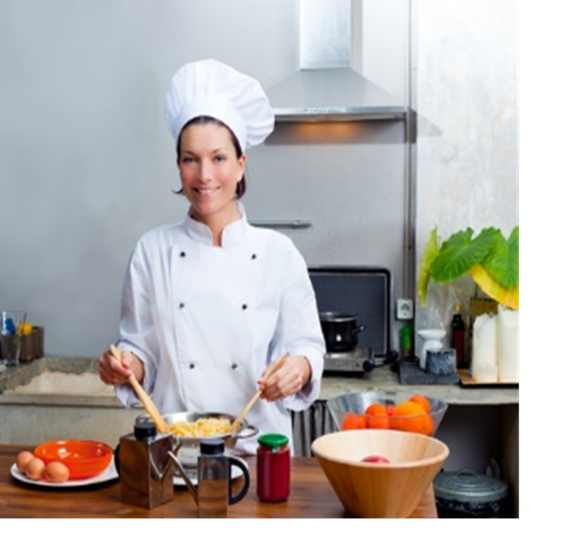
Math in the Culinary Kitchen?
  Yes!
  Math in the culinary kitchen includes:
  Examples:
    Converting recipes
    Measuring ingredients
Notes:
Brainstorm with the students as to how math calculations can be used in the culinary kitchen every day.
Other examples may include:
billing
converting recipes
costing recipe ingredients
measuring
portion sizes
profits
salaries

Slide 4
Calculations
  Math Skills
  Food Costs
  Percentages
  Weights and Measures
Notes:
You will add, subtract, multiply and divide numbers in foodservice industry.

Slide 5
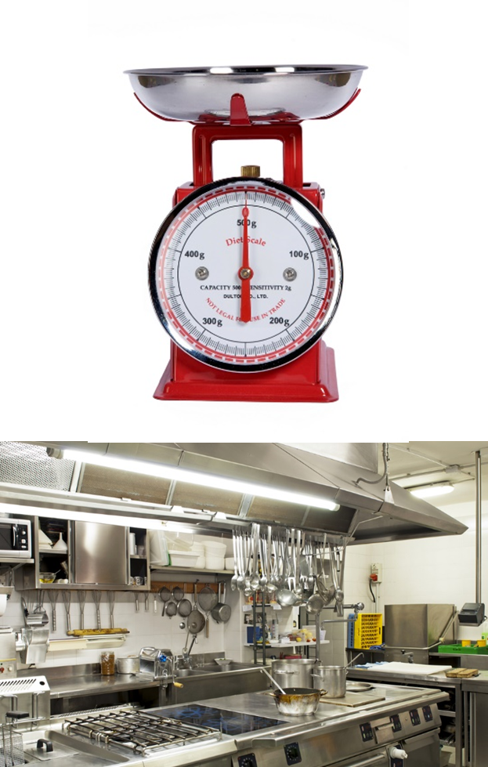
Math Skills
  Are used to:
    Adjust cooking times and temperatures
    Establish portion sizes
    Estimate profits for business
    Increase or decrease recipe yields
    Order supplies
    Weigh ingredients
Notes:
Math skills are a part of every foodservice job.

Slide 6
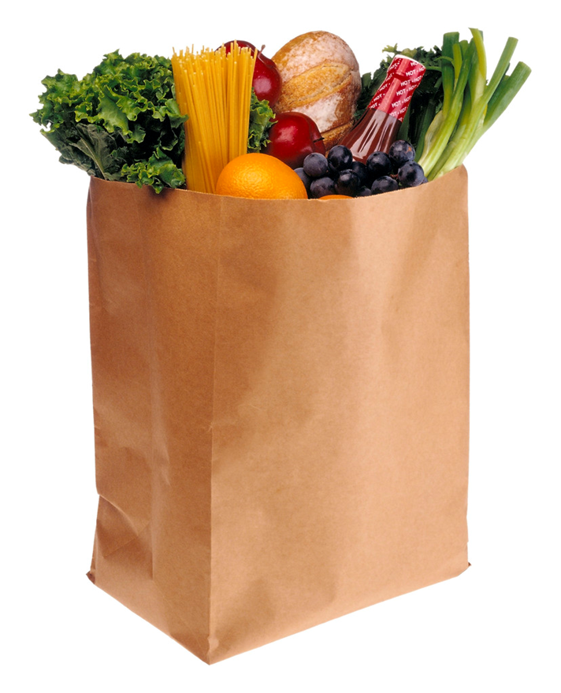
Food Costing
  The cost of the foods and beverages that go directly into production of menu items
  To calculate food cost:
  Cost of Goods Sold ÷ Sales = Food Cost %
Notes:
The following formula is the only accurate way to obtain an actual food cost:
Cost of Goods Sold - defined as the cost of the food items sold during a given period. Opening and closing inventory data is needed to determine the COGS.
Opening Inventory (represented in dollar amount) + Purchases = Total Food Available - Closing Inventory = COGS

Slide 7

Percentages
  A rate or proportion of 100
  Formulas are often expressed in baker’s percentages
  Used in recipes
  Used to calculate taxes
Notes:
Baker’s percentages allow you to compare the weight of each ingredient.
Click on image to view YouTube(tm) video:
Percent word problem example 5
Find the number that is expressed as a given percentage.
http://www.khanacademy.org/math/cc-seventh-grade-math/cc-7th-fractions-decimals/cc-7th-percent-word-problems/v/solving-percent-problems-3
Practice the percentages with your students by practicing the problems in the next section:
Discount, tax, and tip word problems
http://www.khanacademy.org/math/cc-seventh-grade-math/cc-7th-fractions-decimals/cc-7th-percent-word-problems/e/discount_tax_and_tip_word_problems
Mastery of this basic math concept is crucial to calculating quickly in the kitchen.

Slide 8
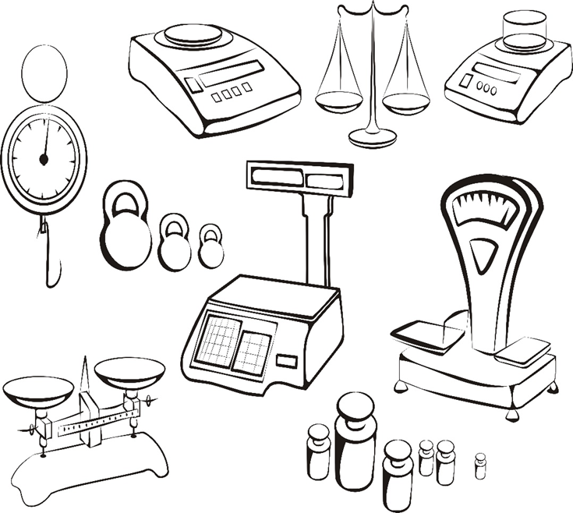
Weights and Measurements
  Ingredients must be accurately weighed and measured
  Ensures the food will be of high quality
  Also ensures the recipe will be same each time
Notes:
Simple fractions are also used in the food industry and may need to be multiplied or divided in recipes.

Slide 9
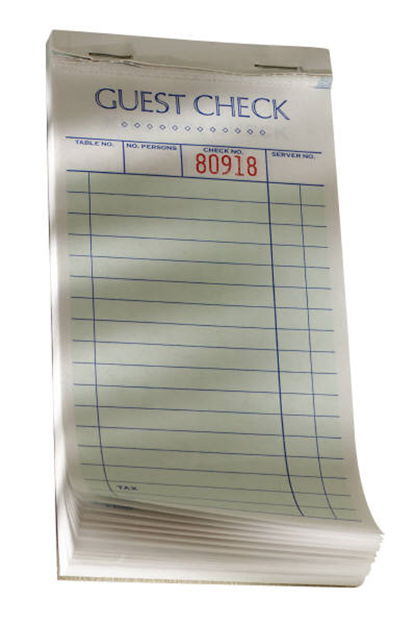
Math Skills
  Are also needed to calculate:
    Change for customers
    Customers’ bills
    Sales tax
    Work hours and pay rate
    Tips and gratuity
Notes:
Let’s not forget the front-of-the house and how we use math skills in that area.

Slide 10

Who uses Math Skills in Culinary Arts?
  Bakers
  Chefs
  Cooks
  Managers
  Servers
Notes:
Bakers, chefs and cooks use math skills to adjust recipe yields, weigh ingredients and adjust cooking times and temperatures for different foods.
Managers use math skills to take care of the business side of the food service industry such as payroll, ordering supplies, estimating profits and more.
Servers use math skills to calculate the customer’s bill, sales tax, make change and keep track of their tips and gratuity.
All foodservice employees use math skills to keep track of their work hours and pay rates.

Slide 11
Let’s Practice!
  A chicken spaghetti recipe for 48 costs $138.82 to prepare. How much is each individual portion?
  Formula
    Total Recipe Cost ÷ Number of Portions = Cost Per Portion
  Your recipe for blueberry pancakes serves 24. You need to serve the entire middle school faculty for the teacher workday breakfast. There are 62 teachers on campus and they each will eat two pancakes. What is the conversion factor for your recipe?
  Formula
    New Yield ÷ Old Yield = Conversion Factor
Notes:
Work the problems out AS A CLASS.
Chicken spaghetti
$138.82 ÷ 48 = $2.89 per portion
Pancakes
62 x 2 = 124
124 ÷ 24 = 5.17 conversion factor

Slide 12


Slide 13
References and Resources
  Images:
    Microsoft Office Clip Art: Used with permission from Microsoft™. (slides 1, 5, 6, 8, 10)
    Shutterstock™ images: Photos obtained with a subscription. (slides 3, 5, 8, 9, 10)
  Textbook:
    Labsneksy, Sarah R. Applied Math for Food Service. (1998). Upper Saddle, New Jersey: Prentice Hall.
    Culinary essentials. (2010) Woodland Hills, CA: Glencoe-McGraw Hill.
    Foundations of restaurant management & culinary arts. (2011). Boston: Prentice Hall.
  Videos:
    Percent word problem example 5
    Find the number that is expressed as a given percentage.
    http://www.khanacademy.org/math/cc-seventh-grade-math/cc-7th-fractions-decimals/cc-7th-percent-word-problems/v/solving-percent-problems-3
    Discount, tax, and tip word problems
    http://www.khanacademy.org/math/cc-seventh-grade-math/cc-7th-fractions-decimals/cc-7th-percent-word-problems/e/discount_tax_and_tip_word_problems

