Slide 1
Successful Culinary Lab Management Guidelines

Slide 3
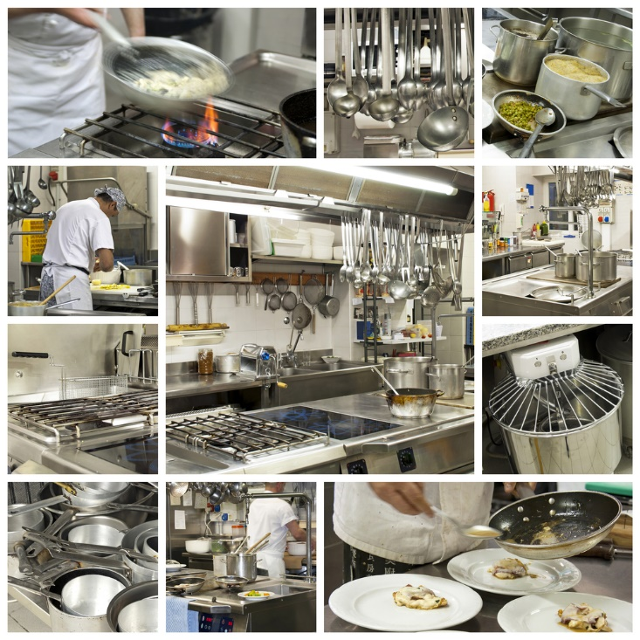
Culinary Lab Management
Notes:
Working in a culinary lab can be intimidating with the large commercial equipment and new skills to learn.
This lesson will introduce you to some of the tools and equipment you will use

Slide 4
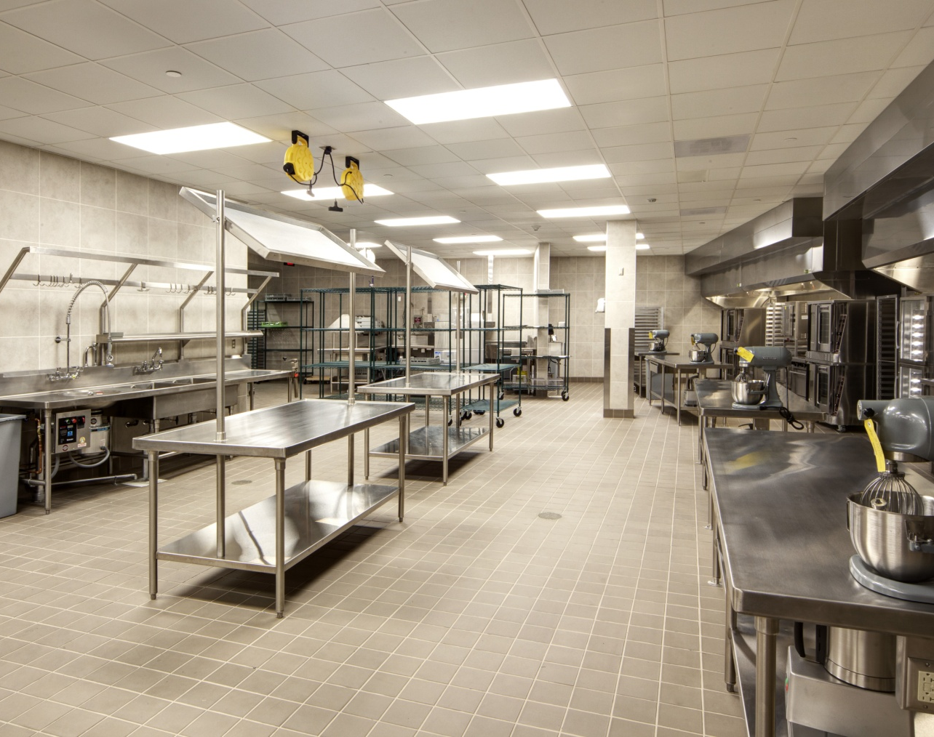
Commercial Equipment
Cooking Equipment
Holding Equipment
Refrigeration
Notes:
The capacity, durability, size and speed of commercial equipment can be overwhelming for someone who is not familiar with the equipment.
It is important to know the proper operating procedures, safety features and temperature settings of these large appliances to avoid injuries and ensure a properly cooked product.

Slide 5
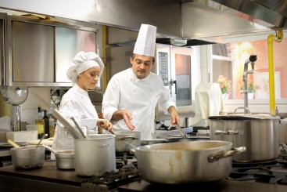
Cooking Equipment
Broilers, grills and fryers
Kettles and steamers
Ovens
Ranges
Notes:
All of these appliances may vary in the location of the heat source to the food as some use dry heat while other may use moist heat.

Slide 6
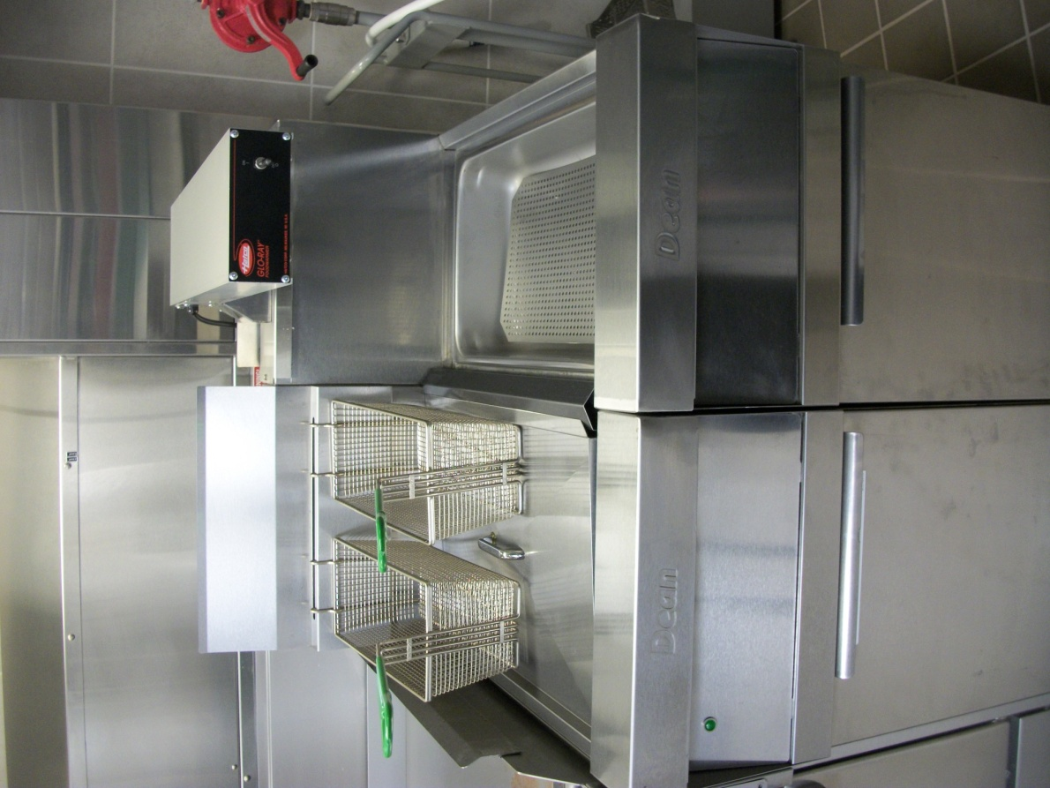
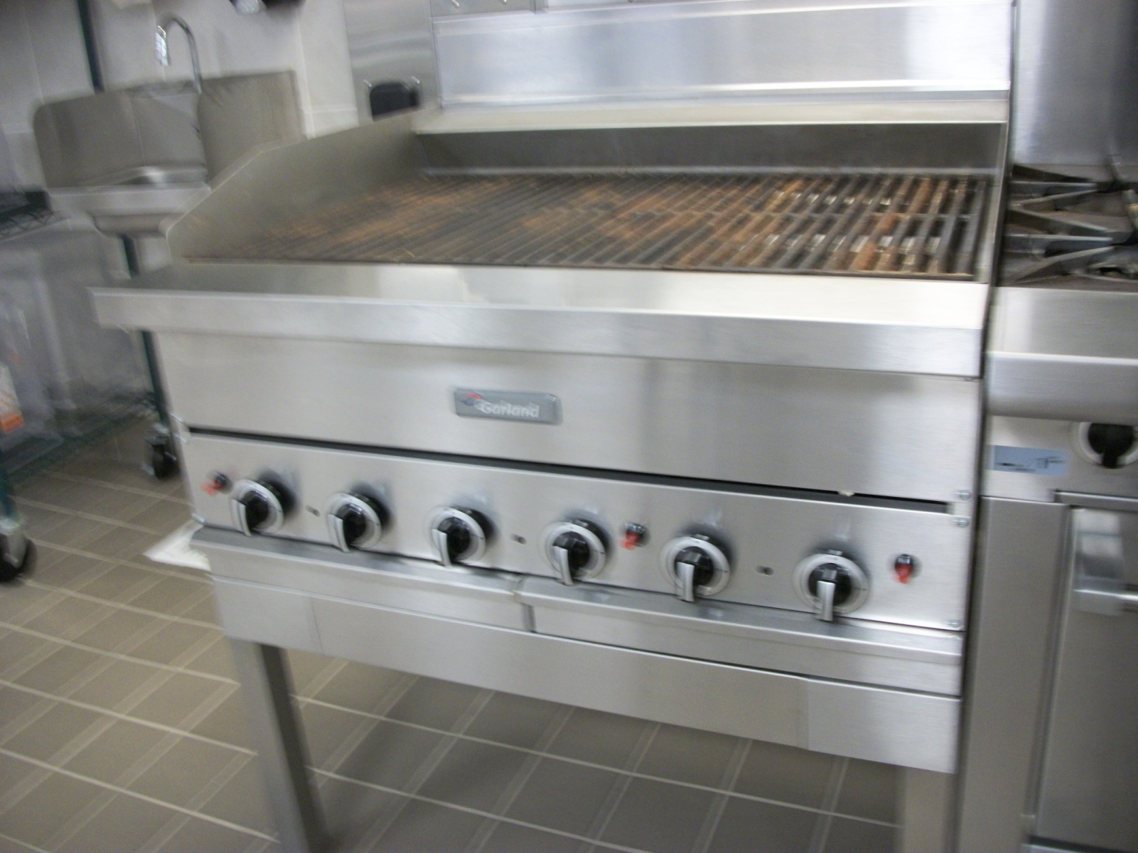
Broilers, Grills and Fryers
Broilers and grills
Broiler
Grill
Salamander
Fryers
Deep
Pressure
Notes:
Broilers, grills and salamanders use radiant heat to produce flavorful foods with nice carmelization.
Deep fryers heat hot fat to produce fried foods.
Pressure fryers fry food rapidly even at low temperatures.

Slide 7
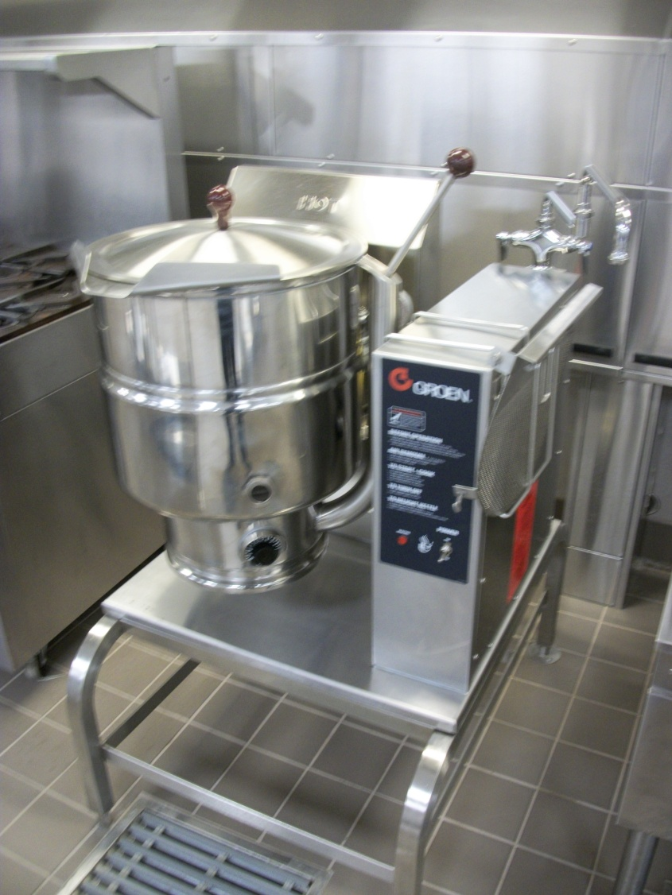
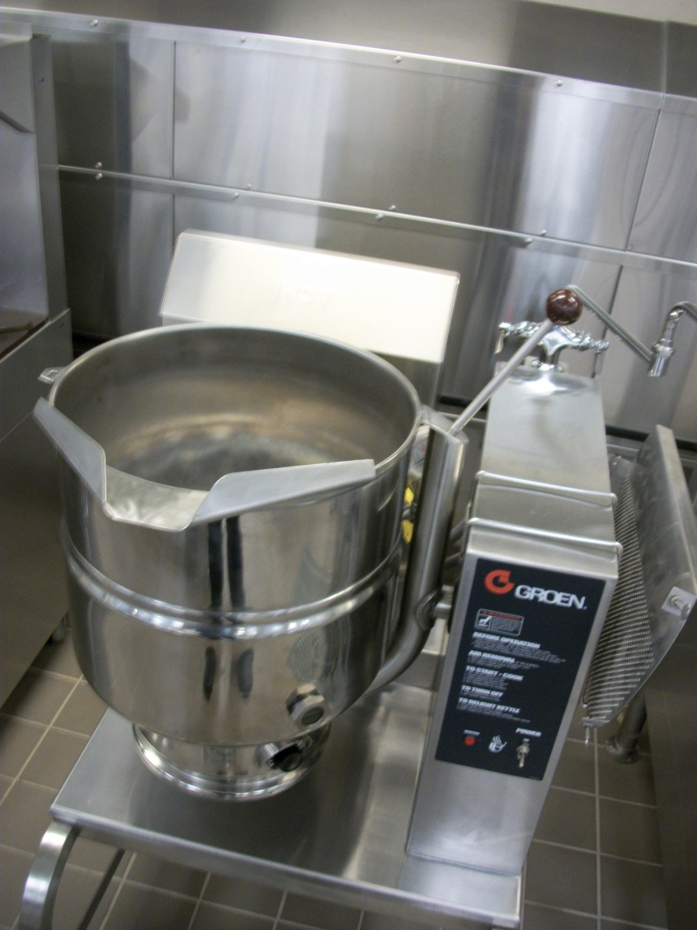
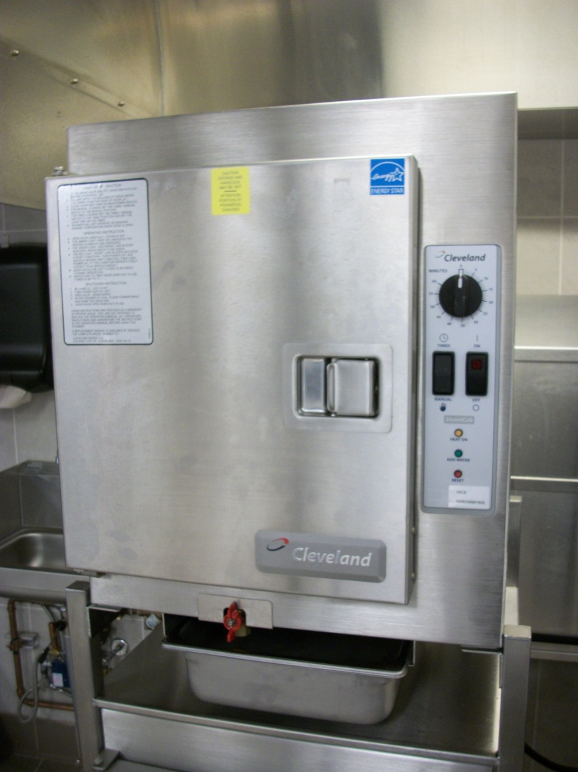
Kettles and Steamers
Kettles
Steam-jacketed
Tilt braiser
Steamers
Convection
Pressure
Notes:
Kettles are large pots with a self-contained heat source.
Steamers use water that is heated to the vaporizing point to apply heat to food for a moist method of cooking.

Slide 8
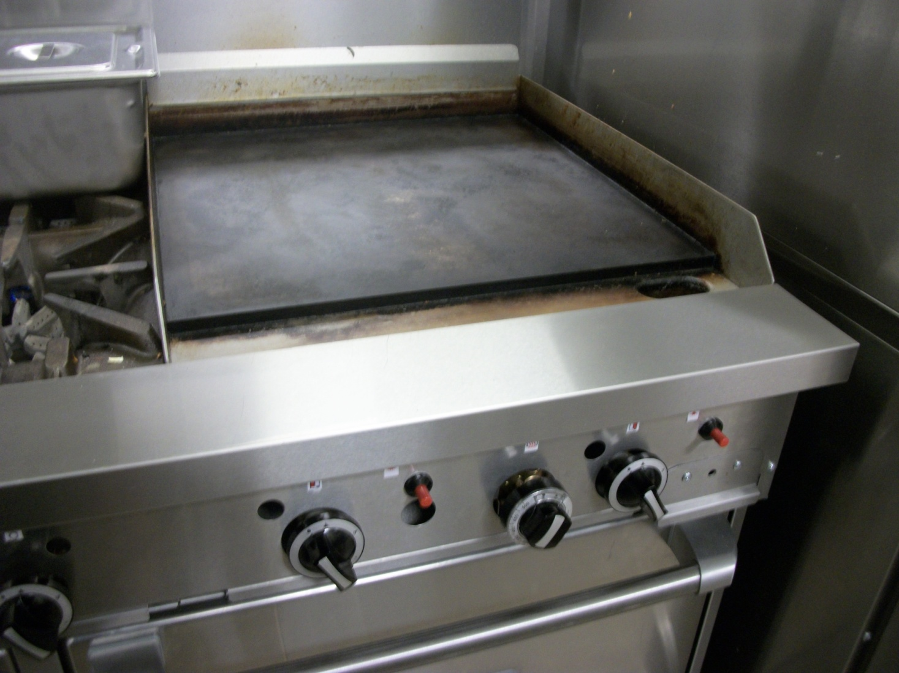
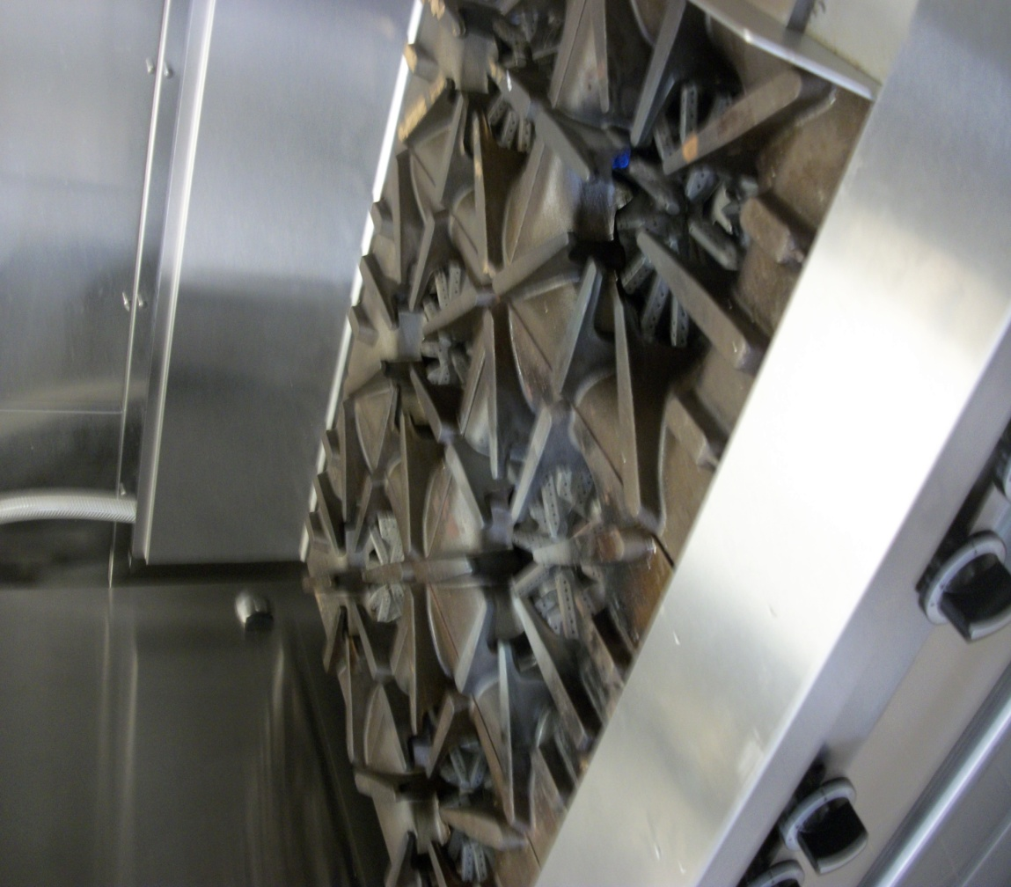
Ranges
Flattop range
Griddle
Induction range
Open-burner range
Notes:
Range refers to a cooktop or a stove.
There are several types of ranges available.

Slide 9
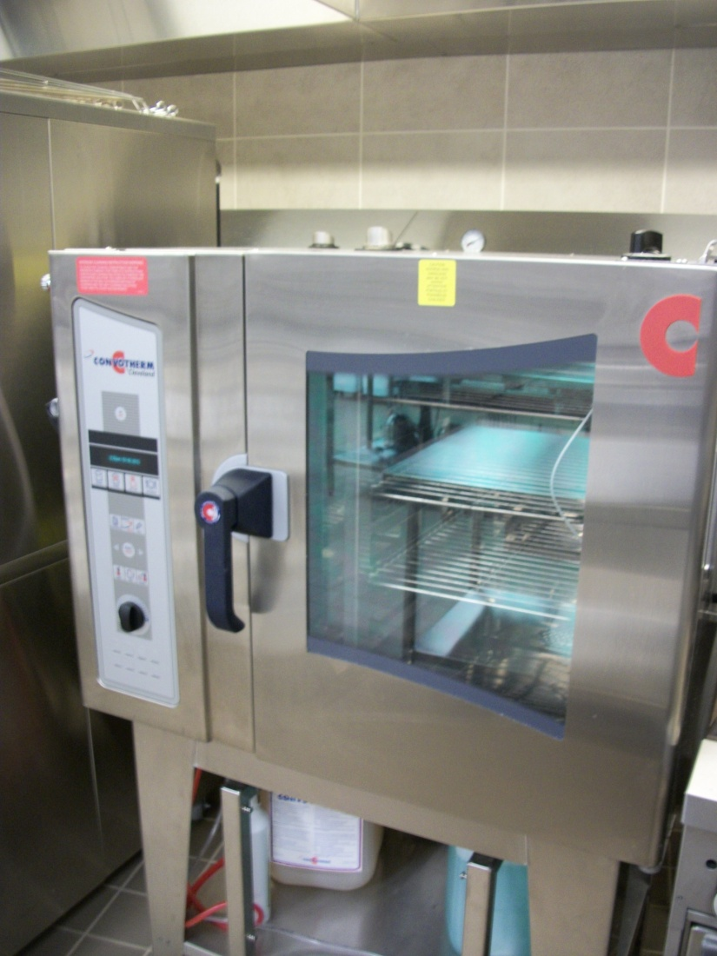
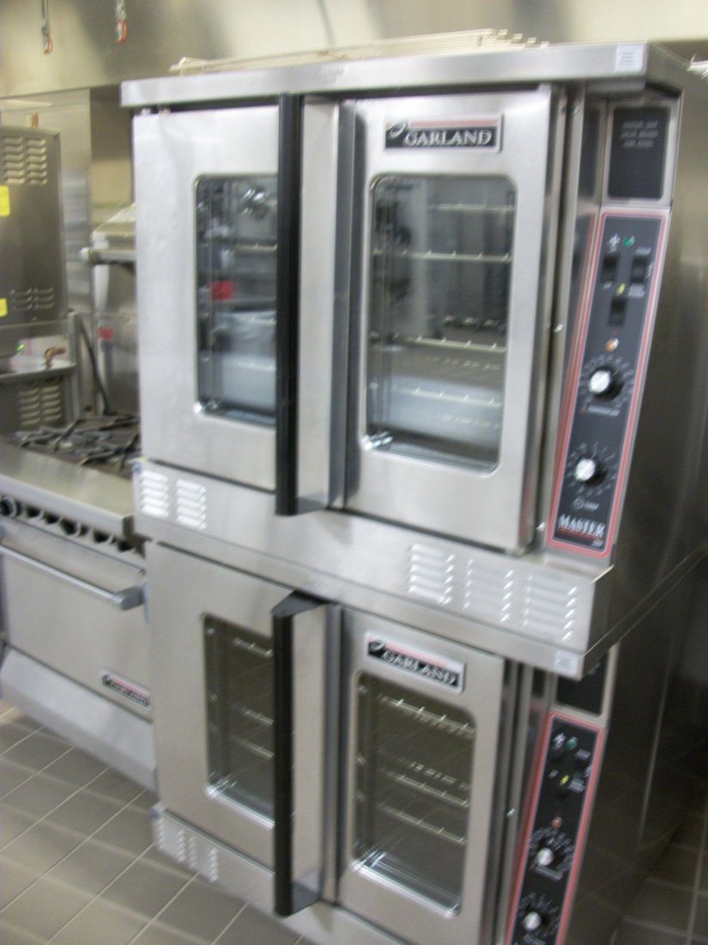
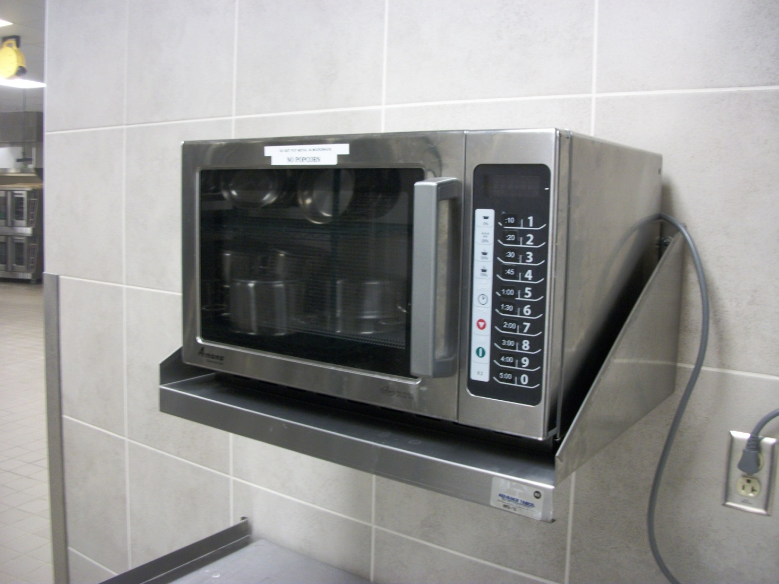
Ovens
Combination
Convection
Conventional
Cook-hold
Microwave
Notes:
An oven is an enclosed compartment in which heat is applied to bake, roast or thaw food.

Slide 10
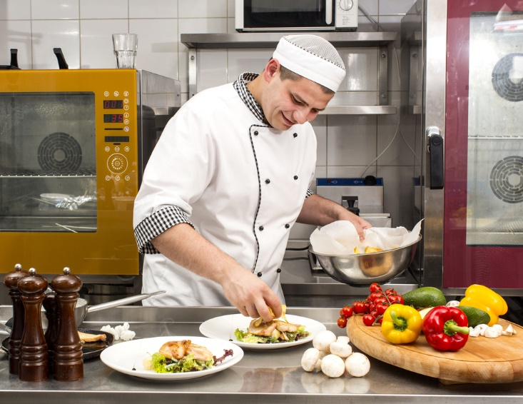
Holding Equipment
Steam tables
Warming cabinets
Notes:
It is essential that once food is cooked, it is held at a temperature that keeps it safe, healthy and appealing.

Slide 11
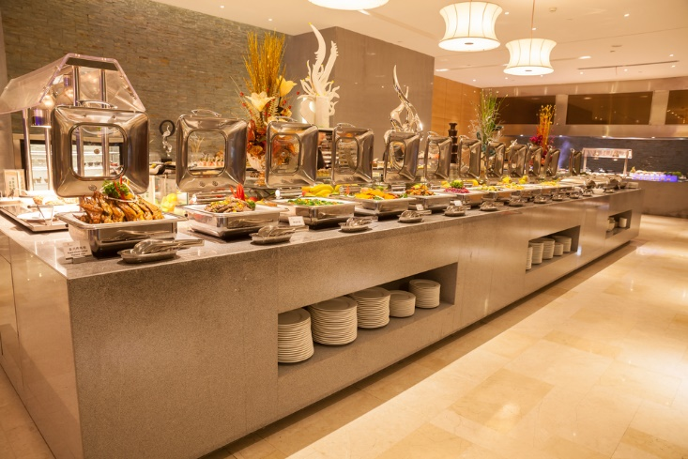
Steam Tables and Warming Cabinets
Steam tables:
Hotel pans and metal inserts are kept hot by surrounding them with hot water and steam
Placed where food is plated for service
Sometimes referred to by the French term bain marie
Warming Cabinets:
An enclosed, heated cabinet designed to hold food
Notes:
Steam tables and warming cabinets hold cooked food ready for service.

Slide 12
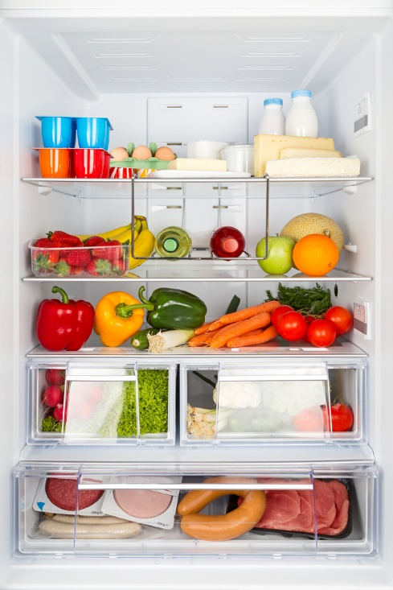
Refrigeration
Freezers
Refrigerators
Reach-in refrigerator
Walk-in refrigerator
Notes:
Refrigeration is one of the most important appliances in the commercial kitchen.

Slide 13
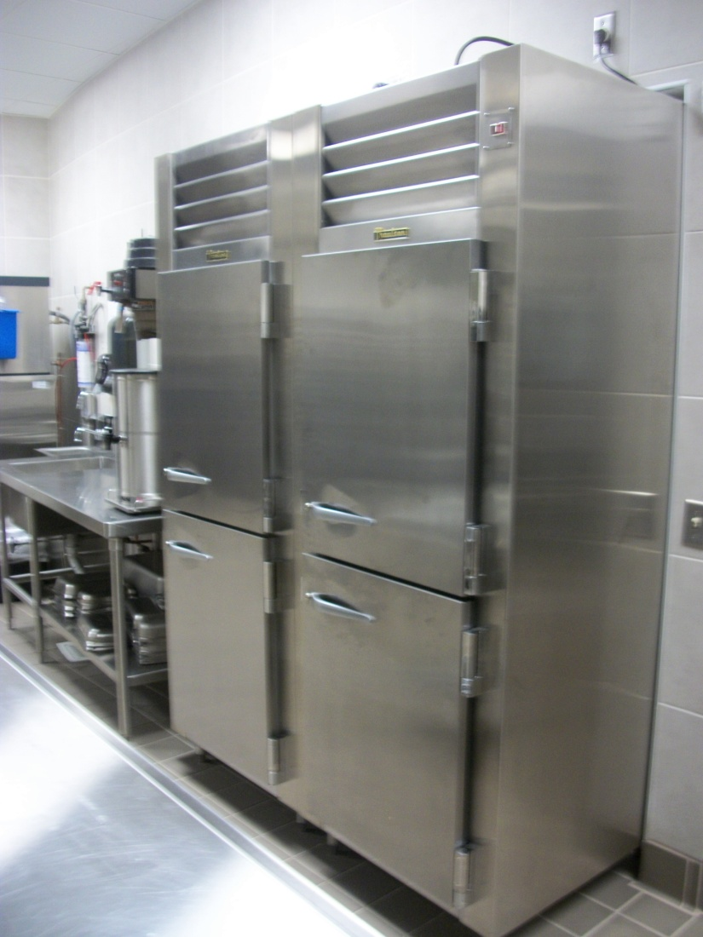
Freezers
Hold food at 0°F (-18°C) for long-term storage
May be reach-in or walk-in
Notes:
It is essential to keep food products at proper temperatures.

Slide 14
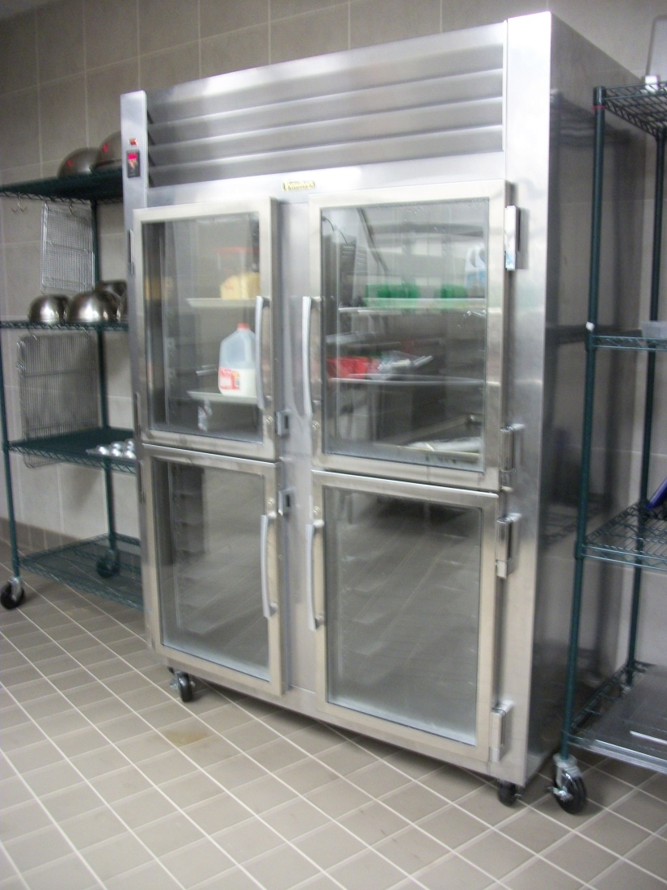
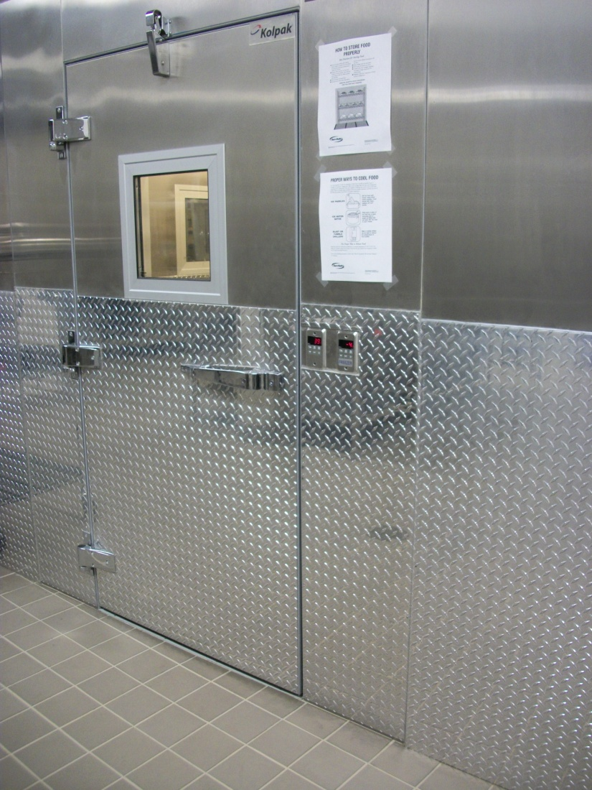
Reach-In and Walk-In Refrigerators
Stores foods below 41°F (5°C)
Reach-in:
Smaller units placed at cooking stations
Walk-in:
Are the size of a room and tall enough to walk in to
Notes:
Refrigerators keep food out of the temperature danger zone until ready to be cooked or served.

Slide 15
Culinary Procedure: Knife Skills
Notes:
There are many culinary procedures to learn but we will focus on knife skills in this lesson.

Slide 16
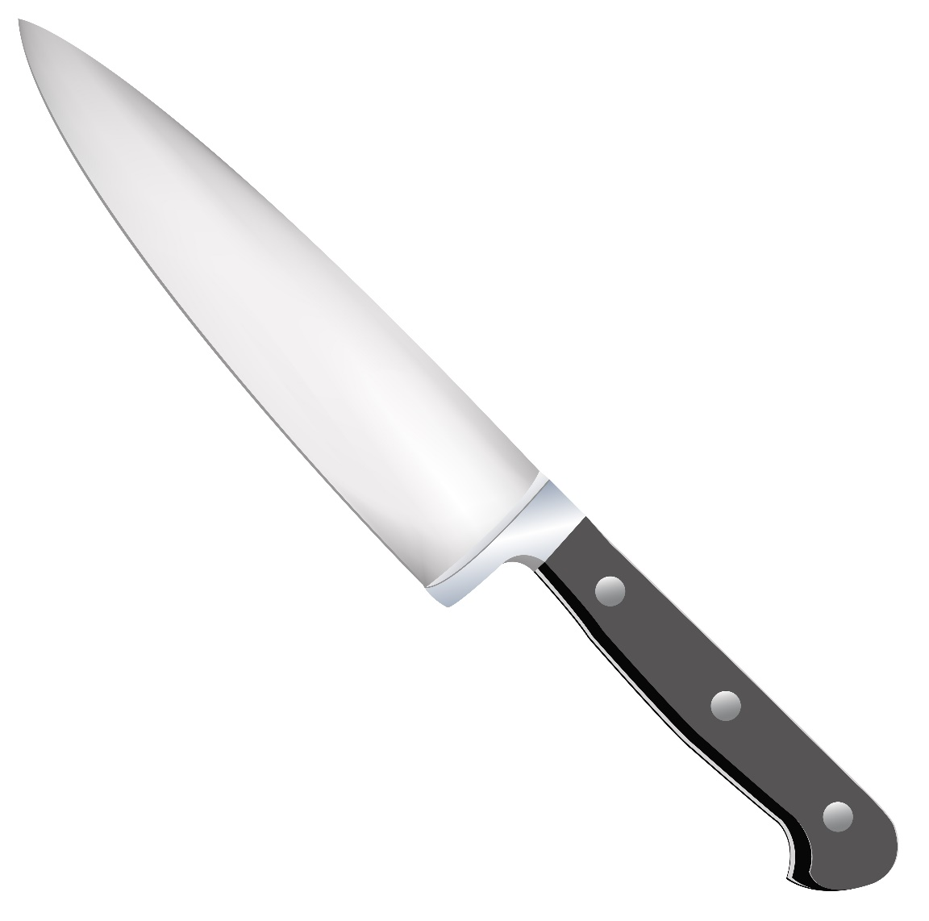
Parts of a Knife
Tip
Cutting edge
Spine
Bolster
Heal
Tang
Rivets
Handle
Notes:
Knives are one of the most important tools for chefs.
A sharp, well-constructed knife makes the task easier and quicker for the chef.

Slide 17
Types of Knives
Boning
Butcher
Chef’s (French)
Cleaver
Fillet
Paring
Santoku
Serrated
Tourné
Utility
Notes:
There are many types of knives that can be used in a commercial kitchen.
Investing in a good quality knife set to develop a young chef’s skills is a valuable asset.
Note: Display the types of knives you have available in your lab and explain how they are used.

Slide 18
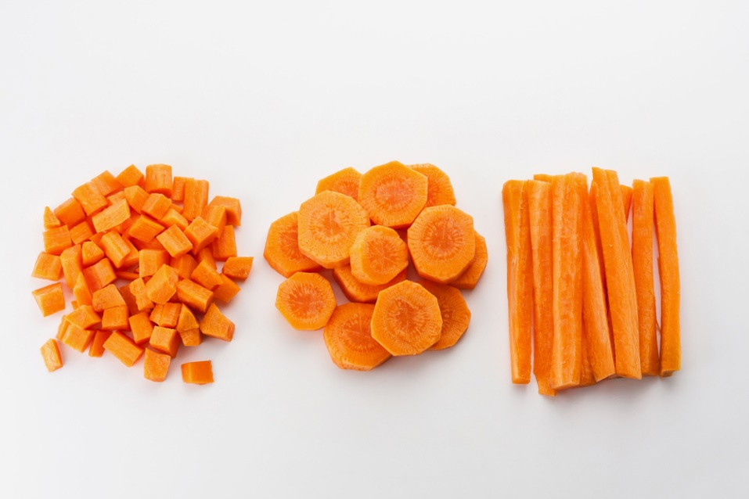
Basic Knife Cuts
Slicing
Chiffonade
Diagonal
Roll cut
Rondelle
Dice
Small
Medium
Large
Mincing
Batonnet
Brunoise
Julienne
Notes:
Working in the foodservice industry, employees must be able to consistently produce shapes that are exactly the same.
We will practice this technique after the slide presentation.

Slide 19
Knife Skills for Chefs (click on link)
Notes:
Click on the hyperlink to view video:
Knife Skills for Chefs
Build your basic knife skills with these educational videos. View the following videos for examples on the proper use of quality knives and basic knife cuts.
http://www.acfchefs.org/ACF/Resources/Video_Library/Knife/ACF/Resources/Video/Knife/

Slide 20
Staff Meetings
Notes:
Staff meetings - a meeting attended by the members of staff of a company, school or business to discuss issues relating to the running of the company, school or business.

Slide 21
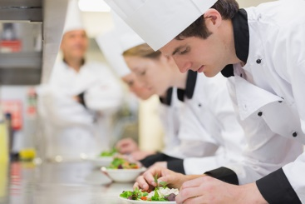
Training
May be scheduled or random to discuss:
Changes in the menu
Customer complaints
New employees
New policies
Suggestive selling techniques
Notes:
Staff meetings may be held for various reasons and may be held often or only as necessary depending on management.

Slide 22
Communication
Managers should:
Encourage communication
Listen carefully
Motivate the employees
Praise employees work
Notes:
In order for the foodservice operation to be run smoothly, managers must be able to be good leaders.

Slide 23
Objectives of a Staff Meeting
Creative
Discussion
Informational
Motivational
Notes:
In a creative session, (may be referred to as a brainstorming meeting), new ideas may be generated.
In a discussion meeting, participants offer input to solve a problem or address an issue.
The informational staff meeting’s primary purpose is to disseminate information to meeting participants.
A motivational meeting may be useful to address change or improve attitudes.

Slide 24
Restaurant Marketing - How to Manage Your Restaurant Staff (click on link)
Notes:
Click on hyperlink to view video:
Restaurant Marketing - How to Manage Your Restaurant Staff
It is certainly important to have happy and satisfied customers in your restaurant, and staff that is happy and content will help to achieve this goal. Good communications skills are one thing that will help to keep your staff happy.
https://youtu.be/ApqhfgzYbw4

Slide 25
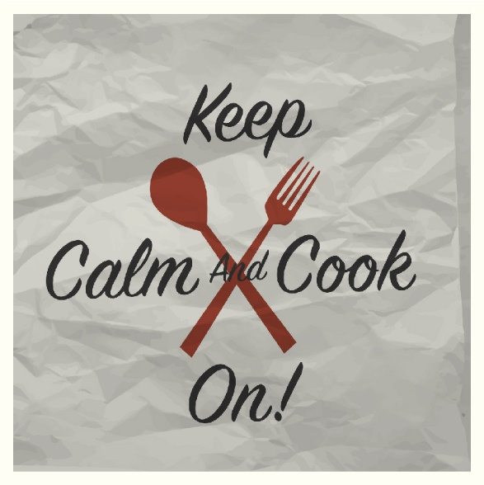
Notes:
What does this quote mean to you?

Slide 26
Let’s Review!
Is commercial equipment intimidating?
Can you identify all of the commercial equipment in the lab?
What should the temperature of the refrigerator be set at? The freezer?
What are the parts of a knife?
Can you name at least five types of knives?
Why are staff meetings needed?
Notes:
Answers to the questions are found within the slide presentation or may vary with class discussion.

Slide 27
Questions?

Slide 28
References and Resources
Images:
Hollestein Career and Technology Center, Eagle Mountain-Saginaw ISD, Fort Worth, Texas, Chef Damion Brown (Slides 4, 6, 7, 8, 9, 13, 14)
Shutterstock™ images. Photos obtained with subscription. (Slides 3, 5, 10, 11, 12, 15, 16, 18, 20, 21, 22, 23, 25, 27)
Textbooks:
Culinary essentials. (2010). Woodland Hills, CA: Glencoe/McGraw-Hill.
Draz, J., & Koetke, C. (2014). The culinary professional. Tinley Park, IL: Goodheart-Willcox Company.
Foundations of restaurant management & culinary arts. (2011). Boston, MA: Prentice Hall.

Slide 29
References and Resources
YouTube™:
Restaurant Marketing - How to Manage Your Restaurant Staff
It is certainly important to have happy and satisfied customers in your restaurant, and staff that is happy and content will help to achieve this goal. Good communications skills are one thing that will help to keep your staff happy.
https://youtu.be/ApqhfgzYbw4
Video:
Knife Skills for Chefs
Build your basic knife skills with these educational videos. View the following videos for examples on the proper use of quality knives and basic knife cuts.
http://www.acfchefs.org/ACF/Resources/Video_Library/Knife/ACF/Resources/Video/Knife
Website:
What Is the Objective of a Staff Meeting?
It's important to convey the meeting's objectives in advance so that participants know what to expect and how to prepare.
http://smallbusiness.chron.com/objective-staff-meeting-31381.html

