Slide 1
Culinary Nutrition
Culinary Arts

Slide 3

Nutrition
Notes:
The process of eating the right kind of food so you can grow properly and be healthy.

Slide 4

Nutrition in foodservice
  Chefs must be able to:
    Accommodate diners’ dietary request
    Create menu items for dietary restrictions
    Stay current with nutrition information
    Work with nutrition experts
Notes:
Nutrition is affecting the foodservice industry more and more.

Slide 5
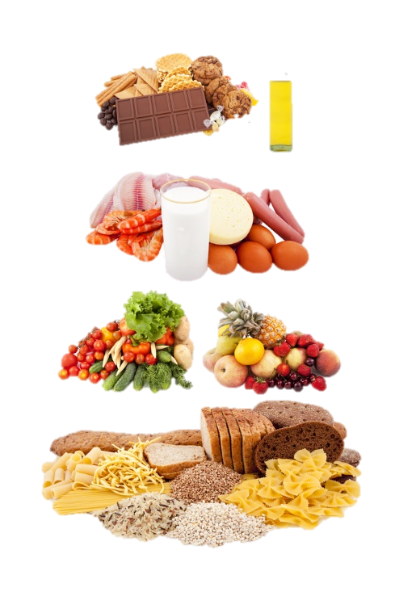
Nutrition basics
Notes:
Chefs can apply nutrition knowledge to:
food preparation
food purchasing
menu planning

Slide 6

Nutrient Groups
  Carbohydrates
  Lipids
  Minerals
  Protein
  Vitamins
  Water
Notes:
Nutrient - a substance that provides nourishment essential for the maintenance of life and for growth.
There are six nutrient groups.

Slide 7
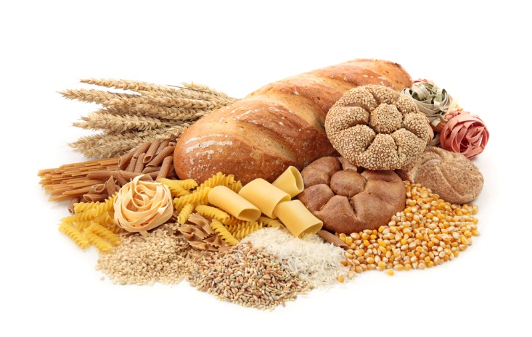
Carbohydrates
  Body’s chief energy source
  Contributes four calories of energy per gram
  Two types:
    Complex
      Starch
      Fiber
        Soluble
        insoluble
    Simple
      Sugars
Notes:
Carbohydrates - any one of various substances found in certain foods (such as bread, rice, and potatoes) that provide your body with heat and energy and are made of carbon, hydrogen and oxygen.
Plants are the main source of carbohydrates.
Complex carbohydrates:
Starch consists of long chains of glucose molecules that are broken down during digestion and provide energy at a slower rate.
Common foods include:
bread
grains
legumes
pasta
potatoes
Fiber consists of long chains of glucose but do not breakdown during digestion so fiber is not digested. It passes through the body and is excreted.
soluble fiber absorbs large amounts of liquid during digestion
foods include fruits, legumes, oats and vegetables
insoluble fiber does not absorb as much liquid
foods include the structural parts of various fruits and vegetables and whole grains
Simple carbohydrates consist of a single sugar unit or two sugar units combined.
They include:
fructose
galactose
glucose
lactose (glucose + galactose)
maltose (glucose + glucose)
sucrose (glucose + fructose)

Slide 8
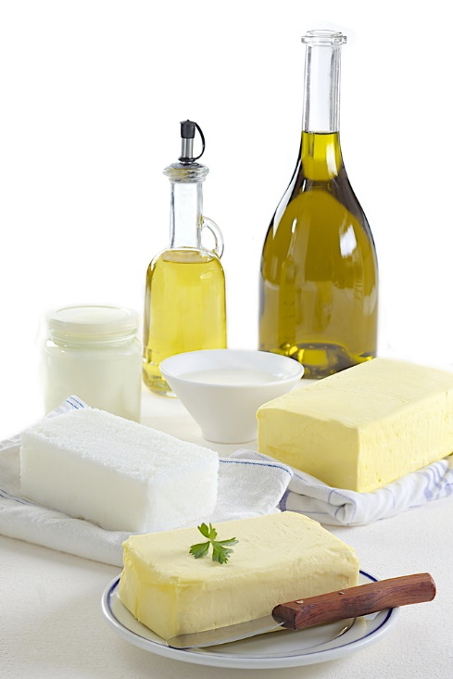
Lipids
  Contain nine calories of energy per gram
  Found in animal-based foods
    Saturated fat – solid at room temperature
    Unsaturated fat – liquid at room temperature
  Needed for normal growth and development
  Provide a concentrated source of energy
  Trans fat is created when unsaturated oil is chemically changed (hydrogenation)
Notes:
Lipids are any one of various substances that contain fat and that are important parts of living cells.
Saturated fats contain only a single bond.
foods include dairy products, eggs, fatty meats and poultry skin
Unsaturated fats contain one or more double bonds depending on the specific oil.
This includes avocados, nuts, olive oil, safflower oil, seeds, soybean oil and sunflower oil.
Hydrogenation occurs when the chemical process changes liquid oil to a solid fat.

Slide 9
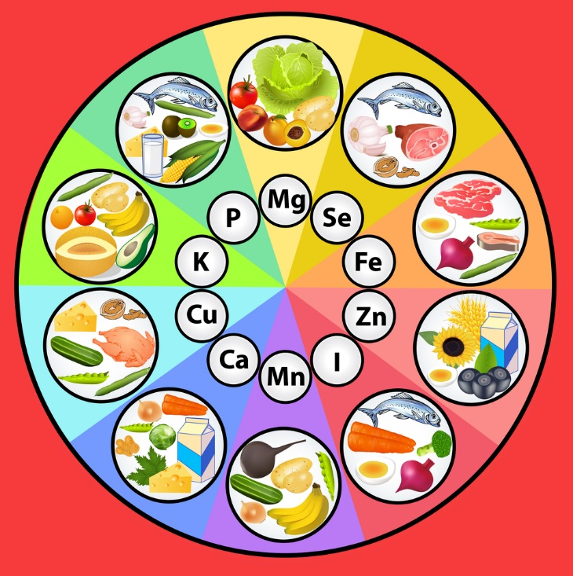
Minerals
  Divided into:
    Major – 100 milligrams or more needed per day
    Trace – less than 100 milligrams needed per day
  Necessary for important functions such as:
    Bone formation
    Energy metabolism
    Proper functioning of the nervous system
    Water balance
Notes:
Minerals are needed for many body processes and become part of the body’s bones, fluids and tissues.
Major minerals include:
Calcium
Chloride
Magnesium
Phosphorus
Potassium
Sodium
Sulfur
Trace Minerals include:
Chromium
Copper
Fluoride
Iodine
Iron
Manganese
Molybdenum
Selenium
Zinc

Slide 10
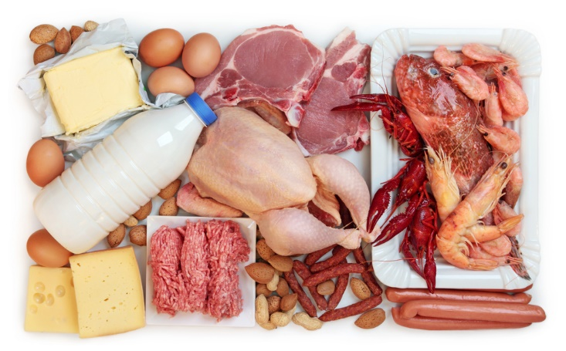
Proteins
  Building blocks of the human body
  Food sources can be either:
    Animal – complete protein
    Plant based – incomplete protein
  Needed for:
    Growth
    Maintenance
    Repair of body tissues
Notes:
Proteins - a substance that has amino acids, compounds and carbon, hydrogen, oxygen, nitrogen and sometimes sulfur and is found in many foods.
Complete proteins contain all nine indispensable amino acids in the correct proportions needed to support life.
food sources include cheese, eggs, milk, meats, poultry and seafood
Incomplete proteins are missing one or more of the indispensable amino acids.
food sources include grains, legumes and nuts

Slide 11
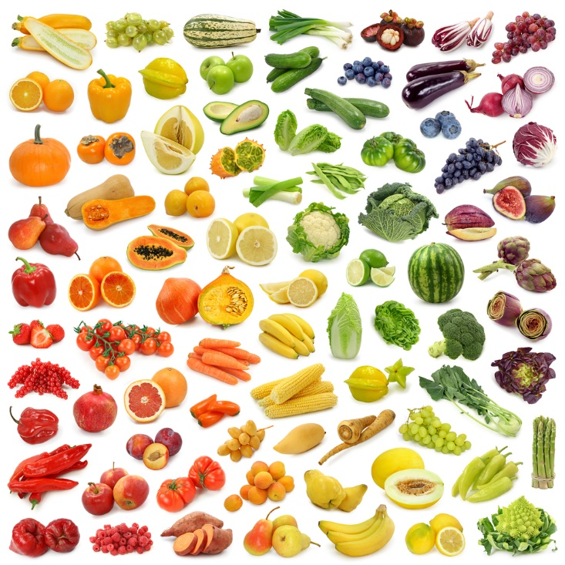
Vitamins
  Aid in the formation of healthy bones and teeth
  Are part of the blood-clotting process
  Ensure proper vision
  Support the immune system
  Vitamins are either:
    Fat-soluble vitamins ingested when various fats are eaten
    Water-soluble vitamins dissolve in water
Notes:
Vitamins are needed to support many of the systems within the body.
Fat-soluble vitamins include:
Vitamin A
Vitamin D
Vitamin E
Vitamin K
Water-soluble vitamins include:
B12
Biotin
Folate
Niacin (vitamin B3)
Pantothenic acid
Riboflavin (vitamin B2)
Thiamin (vitamin B1)
Vitamin C (Ascorbic Acid)

Slide 12
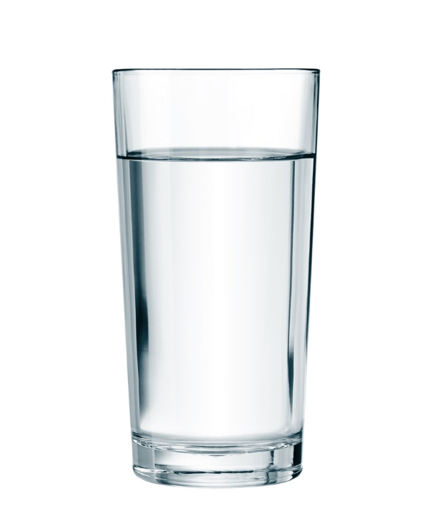
Water
  50 to 60 percent of weight of the human body
  Essential part of digestion
  Lubricates joints
  Transports nutrients and waste
Notes:
Water is the single greatest component of the human body.
Humans can survive only a short while without water.
Almost all foods contain some amount of water.

Slide 13

Dietary habits
Notes:
According to the Dietary Guidelines Brochure for 2010, Americans should:
Build a healthy plate
Cut back on foods high in solid fats, added sugars, and salt
Eat the right amount of calories for you
Be physically active your way

Slide 14

Exercise
  The Dietary Guidelines for 2010 recommends to:
    Increase physical activity
    Reduce sedentary behavior
  Encourage physical activity in:
    Childcare and childhood settings
    Schools
    Walk-to-school programs
Notes:
The Dietary Guidelines for Americans are updated every five years by the Department of Agriculture (USDA) and the Department of Health and Human Services (HHS).
They provide authoritative advice for Americans ages 2 and older about consuming fewer calories, making informed food choices and being physically active to attain and maintain a healthy weight, reduce risk of chronic disease and promote overall health.
The 2015 Dietary Guidelines are scheduled to be published in the fall of 2015.

Slide 15

Emotional factors
  Job requirements include:
    Long hours of physically demanding work
    Work schedule of evenings, holidays and weekends
  Pressures can be caused by:
    Change
    Confrontation
    Deadlines
Notes:
Stress is a state of mental tension and worry caused by problems in your life, work and so forth.

Slide 16

Managing stress
  Positive ways include:
    Exercise
    Hobbies
    Meditation
    Reading
    Talking to a friend
Notes:
Long-term unmanaged stress may lead to health problem such as depression, high blood pressure and insomnia.

Slide 17
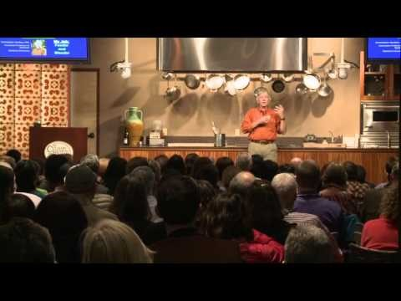
  Healthy Kitchens, Healthy Lives™ Conference
  (click on link)
Notes:
Click on hyperlink to view video:
Healthy Kitchens, Healthy Lives™ Conference
Healthy Kitchens, Healthy Lives is a four-day conference held at The Culinary Institute of America at Greystone in the Napa Valley. The conference brings together experts from Harvard School of Public Health, the Samueli Institute, and other leading organizations, to present state-of-the-science on diet and nutrition. These experts are joined by chefs from the CIA to lead teaching sessions for healthcare professionals who want to learn about techniques for cooking delicious healthy foods.
https://youtu.be/qGmmCNe4qLo

Slide 18
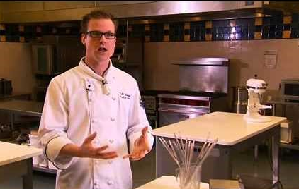
  Nutrition: Breaking Boundaries
  (click on link)
Notes:
Click on hyperlink to view video from Johnson and Wales University:
Nutrition: Breaking Boundaries
JWU's groundbreaking Culinary Nutrition program is changing the science of food - and it's the first of its kind to receive ACEND accreditation. Ready to launch your dietitian, product research, spa chef or medical nutrition career?
https://youtu.be/xqb_YyrNHPk?list=PLSpZmcyjE5lYAW6yYcNE1KiJxG_SVIJLg

Slide 19
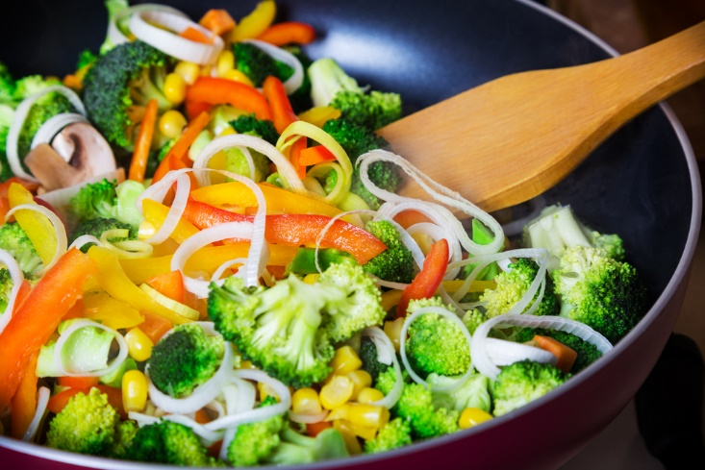
Cooking methods
Notes:
Cooking is the process of preparing food for eating by applying heat.

Slide 20

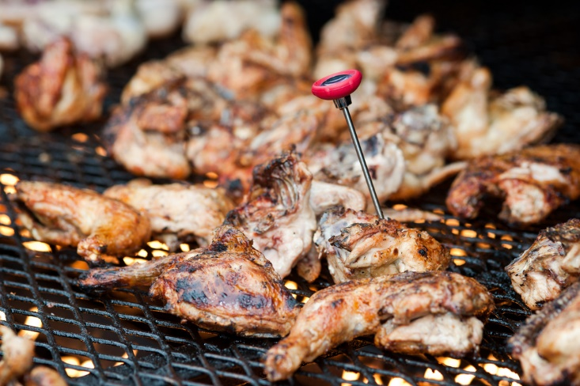
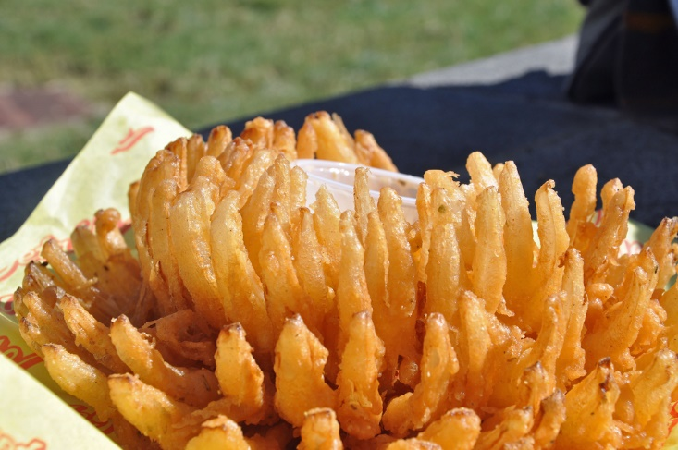
Dry Cookery Methods
  Transfer heat to food by:
    Conduction
    Hot air convection
    Radiation
  Include:
    Baking
    Broiling
    Deep frying
    Grilling
    Roasting
    Sautéing
Notes:
Dry-heat cooking methods are often used with tender products.
Baking – done in the oven with a certain amount of added moisture and most often covered.
Broiling – uses radiation from heat source located above the oven to sear or brown the food.
Deep-frying – cooks food in enough hot fat to fully cover the item.
Grilling – uses radiation from a heat source located below the food.
Roasting – a method that cooks a food by surrounding it with hot-air.
Sautéing - cooking an item quickly in a small amount of hot fat over high heat.

Slide 21

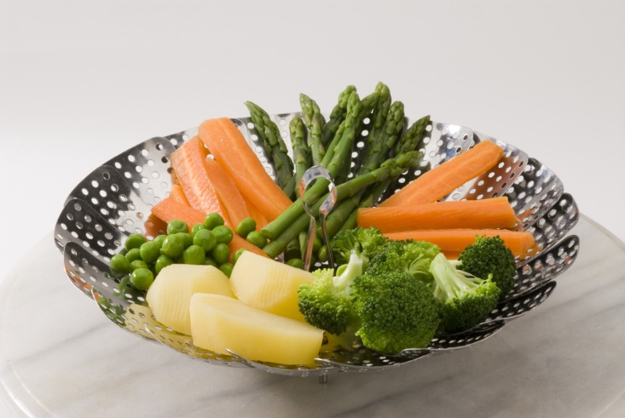
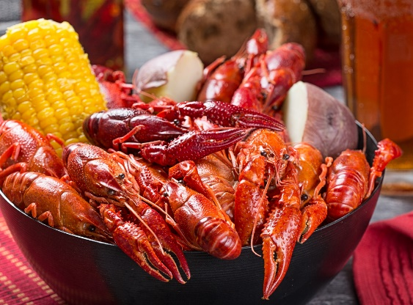
Moist cookery methods
  Use liquid or steam in the cooking process
  Best used for tougher meats and fibrous vegetables
  Include:
    Boiling
    Poaching
    Simmering
    Steaming
Notes:
Moist cooking - uses liquid instead of oil to create the heat energy that is needed to cook the food.
Boiling – cooking in liquid at the highest possible temperature.
Poaching – cooking food in a liquid at a low temperature.
Simmering – cooks food in a liquid just below boiling.
Steaming – cooks food by surrounding it with steam vapor.

Slide 22


Combination
  Applies both dry and moist heat techniques to the same food
  Includes:
    Braising
    Stewing
Notes:
Braising – combines browning and simmering and tenderizes tough cuts of meat or poultry.
Stewing – combines braising or simmering to ingredients cut into small pieces and allows them to float freely during cooking.

Slide 23
Let’s Review!
  Why do chefs need to know about nutrition?
  How many nutrient groups are there? Can you name them?
  What is the body’s chief energy source?
  What are trans fats? Are they healthy for you?
  There are many minerals and vitamins – how many can you name?
  How much of the body is water?
  How is working in the foodservice industry stressful?
  Identify the different dry and moist cooking methods.
Notes:
Answers to the questions are found within the slide presentation or may vary with class discussion.

Slide 24

Notes:
What does this quote mean to you?

Slide 25

Questions?

Slide 26
References and Resources
  Images:
    Shutterstock™ images. Photos obtained with subscription. (Slides 1, 3, 4, 5, 6, 7, 8, 9, 10, 11, 12, 13, 14, 15, 16, 19, 20, 21, 22, 24, 25)
  Textbooks:
    Culinary essentials. (2010). Woodland Hills, CA: Glencoe/McGraw-Hill.
    Draz, J., & Koetke, C. (2014). The culinary professional. Tinley Park, IL: Goodheart-Willcox Company.
    Foundations of restaurant management & culinary arts. (2011). Boston, MA: Prentice Hall.
  Website:
    SDA WIC Work Resource System
    Appendix C: Nutrient Chart – Function, Deficiency and Toxicity Symptoms, and Major Food Sources
    http://www.nal.usda.gov/wicworks/Topics/FG/AppendixC_NutrientChart.pdf

Slide 27
References and Resources
  YouTube™:
    Healthy Kitchens, Healthy Lives™ Conference
    Healthy Kitchens, Healthy Lives is a four-day conference held at The Culinary Institute of America at Greystone in the Napa Valley. The conference brings together experts from Harvard School of Public Health, the Samueli Institute, and other leading organizations, to present state-of-the-science on diet and nutrition. These experts are joined by chefs from the CIA to lead teaching sessions for healthcare professionals who want to learn about techniques for cooking delicious healthy foods.
    https://youtu.be/qGmmCNe4qLo
    Nutrition: Breaking Boundaries
    JWU's groundbreaking Culinary Nutrition program is changing the science of food - and it's the first of its kind to receive ACEND accreditation. Ready to launch your dietitian, product research, spa chef or medical nutrition career?
    https://youtu.be/xqb_YyrNHPk?list=PLSpZmcyjE5lYAW6yYcNE1KiJxG_SVIJLg

