Slide 1
Cultural Diversity in the Workplace
Travel and Tourism Management

Slide 3
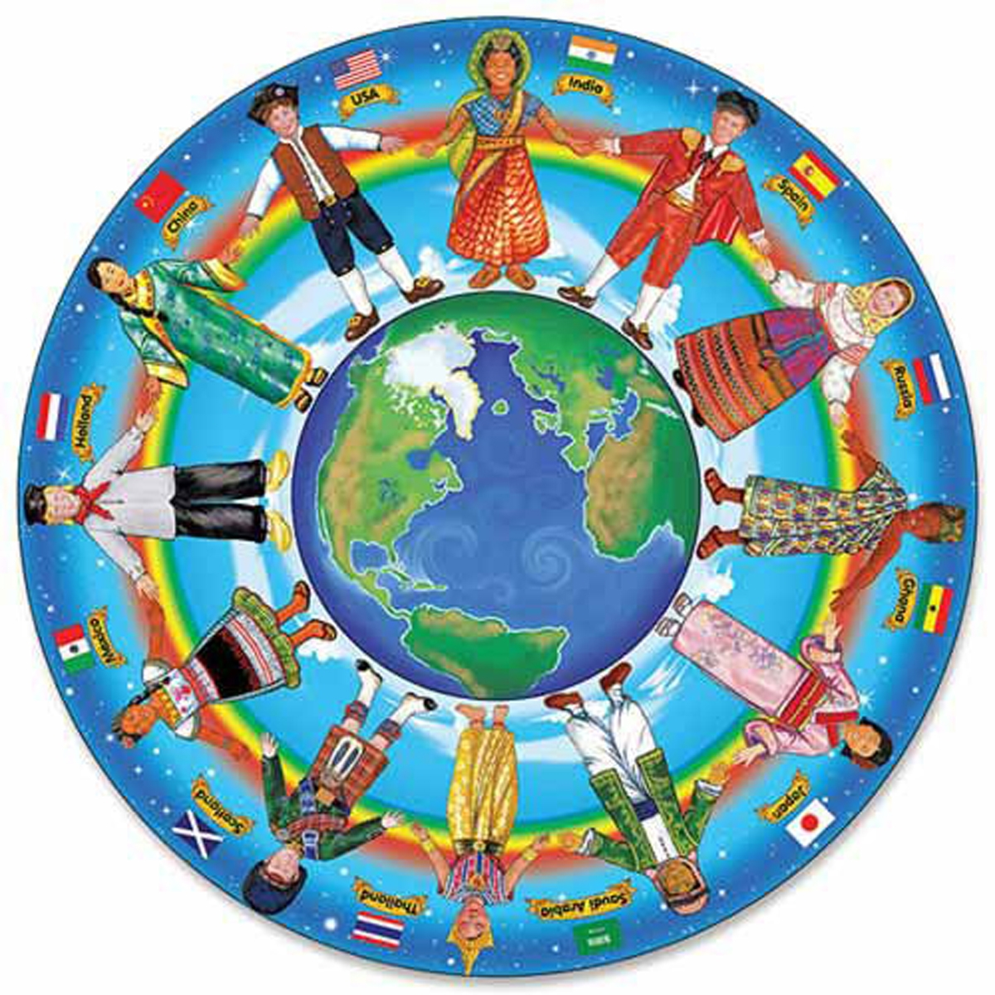
Culture
Notes:
Culture is the behaviors, beliefs, opinions and feelings of a particular social, ethnic or age group.
What is your cultural background?

Slide 4

Cultural Diversity
Notes:
Cultural diversity refers to differences among people because of their racial or ethnic backgrounds, language, dress and traditions.

Slide 5

Travelers
  Ages
  Culture
  Disabilities
  Religion
  Special help
Notes:
People who travel come from all over the world.
They represent all ages, cultures and religions.
Many may have disabilities or require special help.

Slide 6

Employees
  Come from different countries with varied:
    Abilities
    Interests
    Languages
    Levels of education
    Religions
Notes:
Employees in the travel and tourism industry come from many different countries and vary in abilities, interests, languages, education and religions.
They also vary in age from young people to older adults.

Slide 7

Workplace
  Working together as a team includes:
    Ability to work with others
    Commitment to the team
    Cooperation
Notes:
To be successful on the job, teamwork is essential.
The ability to work with others includes being pleasant, understanding and respectful.
Commitment to the team means that you will fulfill your obligations and do your part of the work.
Cooperating with other workers to get the job is vital in the travel and tourism industry.
Being to get along with everyone will make the job easier.

Slide 8
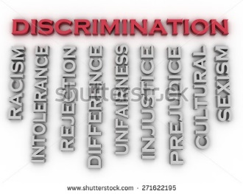
Issues
  Communication
  Discrimination
  Prejudice
  Sexual harassment
Notes:
Some issues may arise from a diverse workforce such as:
Communication – a language barrier may exist
Discrimination – the unjust or prejudicial treatment of different people or things, especially on the grounds of race, age or gender
Prejudice – an unfair feeling of dislike for a person or group because of race, sex, religion or gender
Sexual harassment – unwelcome sexual advances, requests for sexual favors and other verbal or physical harassment of a sexual nature
The human resources office has training programs that will help with these issues.

Slide 9
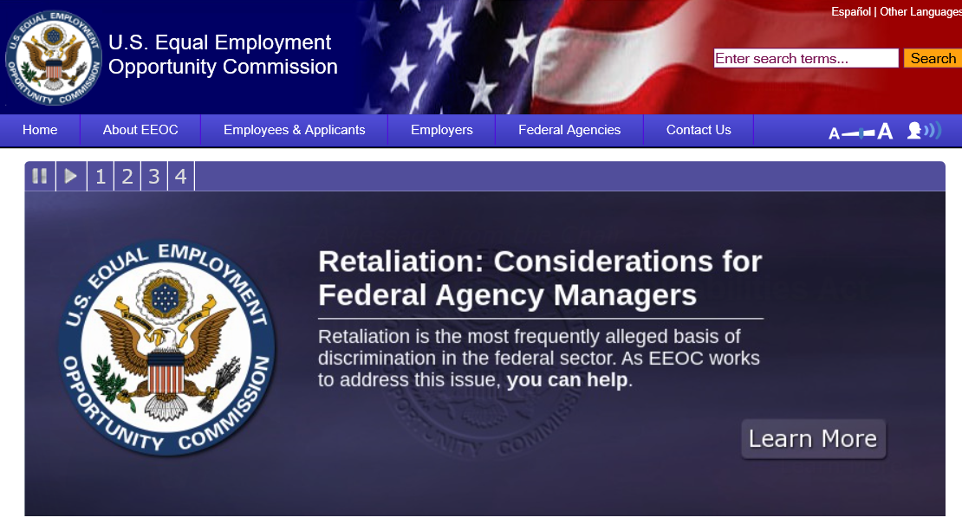
Equal Opportunity Employment Commission
(click on link)
Notes:
The EEOC federal agency can assist with those issues if problems are not resolved.
U.S. Equal Employment Opportunity Commission
Responsible for enforcing federal laws that make it illegal to discriminate against a job applicant or an employee because of the person's race, color, religion, sex (including pregnancy), national origin, age (40 or older), disability or genetic information. It is also illegal to discriminate against a person because the person complained about discrimination, filed a charge of discrimination, or participated in an employment discrimination investigation or lawsuit.
http://www.eeoc.gov/

Slide 10

Breaking Ground for Justice and Opportunity; EEOC
(click on link)
Notes:
Click on hyperlink to view video:
Breaking Ground for Justice and Opportunity; EEOC
The U.S. Equal Employment Opportunity Commission (EEOC) is responsible for enforcing federal laws that make it illegal to discriminate against a job applicant or an employee because of the person's race, color, religion, sex (including pregnancy), national origin, age (40 or older), disability or genetic information. It is also illegal to discriminate against a person because the person complained about discrimination, filed a charge of discrimination, or participated in an employment discrimination investigation or lawsuit.
Most employers with at least 15 employees are covered by EEOC laws (20 employees in age discrimination cases). Most labor unions and employment agencies are also covered.
The laws apply to all types of work situations, including hiring, firing, promotions, harassment, training, wages, and benefits.
https://youtu.be/ejLMGs30Aag

Slide 11

Notes:
What does this quote mean to you?

Slide 12
Let’s Review!
  Define culture.
  What is cultural diversity?
  What types of people travel?
  Where do employees in the travel and tourism industry come from?
  What is teamwork?
  What types of issues can arise from a diverse workforce?
  What does EEOC stand for?
  What does the federal agency do?
Notes:
Answers to the questions are found within the slide presentation or may vary with class discussion.

Slide 13

Questions?

Slide 14
References and Resources
  Images:
    Shutterstock™ images. Photos obtained with subscription.
  Textbooks:
    Mancini, M. (2013). Access: Introduction to travel and tourism. Clifton Park, NY. Cengage Learning.
    Reynolds, J. S. & Chase, D. M. (2014). Hospitality services. Tinley-Park, Illinois: The Goodheart-Willcox Company.
  Websites:
    U.S. Equal Employment Opportunity Commission
    Responsible for enforcing federal laws that make it illegal to discriminate against a job applicant or an employee because of the person's race, color, religion, sex (including pregnancy), national origin, age (40 or older), disability or genetic information. It is also illegal to discriminate against a person because the person complained about discrimination, filed a charge of discrimination, or participated in an employment discrimination investigation or lawsuit.
    http://www.eeoc.gov/

Slide 15
References and Resources
  YouTube™:
    Breaking Ground for Justice and Opportunity; EEOC
    The U.S. Equal Employment Opportunity Commission (EEOC) is responsible for enforcing federal laws that make it illegal to discriminate against a job applicant or an employee because of the person's race, color, religion, sex (including pregnancy), national origin, age (40 or older), disability or genetic information. It is also illegal to discriminate against a person because the person complained about discrimination, filed a charge of discrimination, or participated in an employment discrimination investigation or lawsuit.
    https://youtu.be/ejLMGs30Aag

