Slide 1
Gluten-Free
Current trends in the food industry
Notes:
One of the new grocery store items on the shelves these days are gluten-free products. We are going to find out more about gluten, what it does, and what we can do to help people with gluten intolerance and celiac disease.

Slide 3
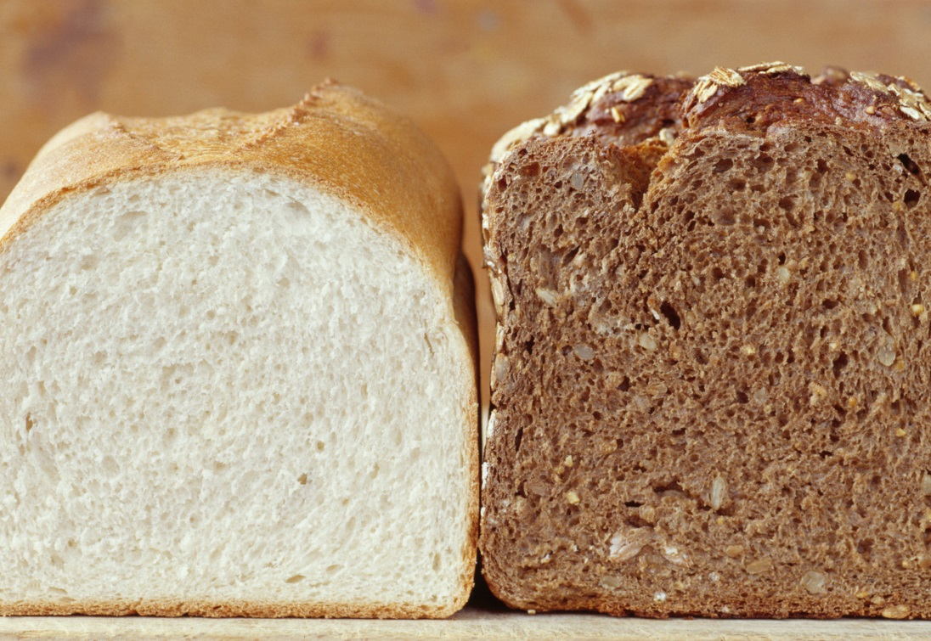
What is Gluten?
  A protein found in wheat, barley and rye and all foods made with these grains

Slide 4
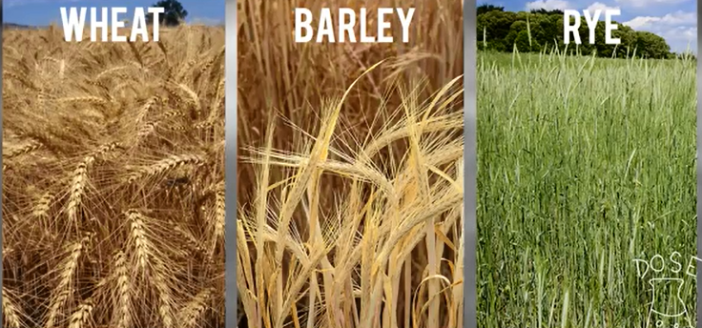
Gluten
(click on link)
Notes:
Click on hyperlink to view YouTube™ video:
Gluten
Gluten is a sticky protein composite found in cereal grains. Hank gives us some insight into the importance of gluten in history, as well as its impact on health in our own time.
http://youtu.be/p6CK_QlagWA
*Image taken from video

Slide 5
Common Foods with Wheat
  Beer
  Bread
  Cakes
  Cereals
  Cookies
  Couscous
  Crackers
  Dressings
  Flour Tortillas
  Gravy
  Muffins
  Oats
  Pasta
  Pastries
  Sauces
Notes:
Avoiding wheat can be especially hard because this means you should avoid all wheat-based flours and ingredients.
These include:
Durum wheat
Graham flour
Kamut
Semolina
Spelt
Triticale
Wheat bran
Wheat germ
White flour
Whole wheat flour

Slide 6
Foods also containing Gluten
  Breadcrumbs
  Bouillon cubes
  Broth in soups
  Candies (some)
  Croutons
  Fried foods
  Hot dogs (some)
  Imitation fish
  Lunch meats (some)
  Malt
  Matzo
  Modified food starch
  Salad dressings
  Seasoned chips and other seasoned snack foods
  Seasoned pasta mixes
  Seasoned rice
  Self-basting turkey
  Soy sauce
Notes:
That’s a long list! Can you imagine NOT eating some of these foods?

Slide 7
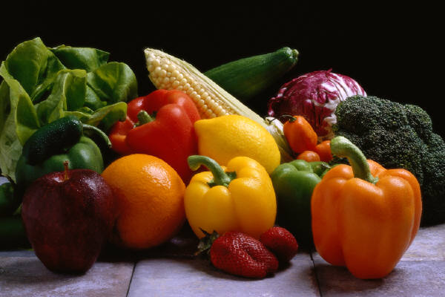
Gluten-Free Foods
  Beans
  Dairy
  Fruits
  Nuts
  Vegetables
  Quinoa
  Rice
  Gluten-free versions of foods
Notes:
There are also gluten-free versions of many of the foods above available in most grocery stores. You just have to look for them!

Slide 8
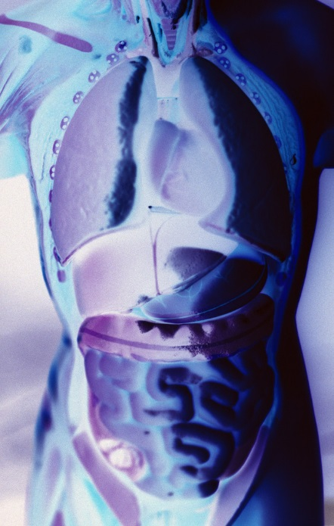
Celiac Disease
  Symptoms
  Treatment
Notes:
Does anyone know what Celiac disease is?

Slide 9
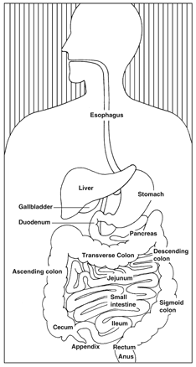
Celiac Disease
  Digestive disorder
  Small intestine could be damaged
  Abdominal pain
  Nutrient loss
National Institute of Diabetes and Digestive and Kidney Diseases, National Institutes of Health
Notes:
Celiac disease is a digestive disorder.
When someone with celiac disease eats food containing gluten, their body reacts by damaging the small intestine.
Uncomfortable symptoms such as abdominal pain often occur. The damage to the small intestine also interferes with the body's ability to make use of the nutrients in food.
About 1% of the total population has celiac disease. It is more common in people with type 1 diabetes. An estimated 10% of people with type 1 diabetes also have celiac disease.
The only way to manage celiac disease is to completely avoid all foods that have gluten. Following a gluten-free diet will prevent permanent damage to your body and will help you feel better.

Slide 10
Symptoms - Children
  Abdominal bloating and pain
  Chronic diarrhea
  Vomiting
  Constipation
  Pale, foul-smelling, or fatty stool
  Weight loss
  Fatigue
  Irritability and behavioral issues
  Dental enamel defects of the permanent teeth
  Delayed growth and puberty
  Short stature
  Failure to thrive
  Attention Deficit Hyperactivity Disorder (ADHD)
Notes:
Digestive symptoms are more common in infants and children.
This is a list of the most common symptoms in children.

Slide 11
Symptoms - Adults
  Unexplained iron-deficiency anemia
  Fatigue
  Bone or joint pain
  Arthritis
  Bone loss or osteoporosis
  Depression or anxiety
  Tingling numbness in the hands and feet
  Seizures or migraines
  Missed menstrual periods
  Infertility or recurrent miscarriage
  Canker sores inside the mouth
  An itchy skin rash called dermatitis herpetiformis
Notes:
Adults are less likely to have digestive symptoms, with only one-third experiencing diarrhea.
Adults are more likely to have the symptoms listed.

Slide 12
Gluten Intolerance
  Also called Gluten Sensitivity
  Experience same symptoms
  Test negative for Celiac disease
  Avoid food with gluten to ease symptoms

Slide 13
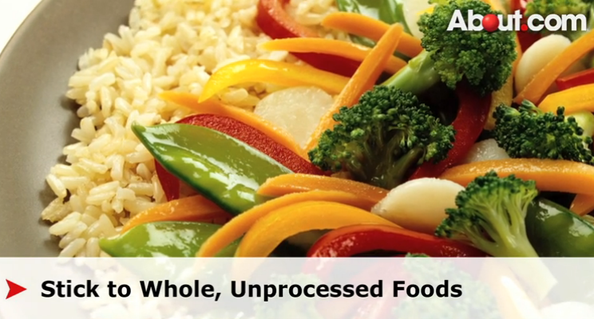
Treatment
  Gluten-free diet
  Visit with a dietitian
  Avoid foods containing gluten
  How to Start Eating Gluten-Free
  (click on link)
Notes:
How to Start Eating Gluten-Free
Wondering how to start eating a gluten-free diet? This video from About.com provides six helpful tips about what to avoid and what to keep or add in to your gluten-free lifestyle.
http://video.about.com/celiacdisease/How-to-Start-Eating-Gluten-Free.htm
*Image taken from video

Slide 14

Questions?

Slide 15
References and Resources
  Images:
    Microsoft Office Clip Art: Used with permission from Microsoft.
  Textbook(s):
    Culinary essentials. (2010). Woodland Hills, CA: Glencoe/McGraw Hill.
    Foundations of restaurant management & culinary arts: Level one. (2011) Boston, MA: Prentice Hill.
  Website(s):
    American Diabetes Association®
    We lead the fight against the deadly consequences of diabetes and fight for those affected by diabetes.
    http://www.diabetes.org/food-and-fitness/food/planning-meals/gluten-free-diets
    Celiac Disease Foundation
    A non-profit, public benefit corporation driving diagnosis of celiac disease, dermatitis herpetiformis, and other gluten related disorders through advocacy, education and advancing research.
    http://celiac.org/

Slide 16
References and Resources
  YouTube™:
    Gluten
    Gluten is a sticky protein composite found in cereal grains. Hank gives us some insight into the importance of gluten in history, as well as its impact on health in our own time. http://youtu.be/p6CK_QlagWA
  Video:
    How to Start Eating Gluten-Free
    Wondering how to start eating a gluten-free diet? This video from About.com provides six helpful tips about what to avoid and what to keep or add in to your gluten-free lifestyle.
    http://video.about.com/celiacdisease/How-to-Start-Eating-Gluten-Free.htm

