Slide 1
Customer Service
The Cornerstone of Restaurant Operations

Slide 3
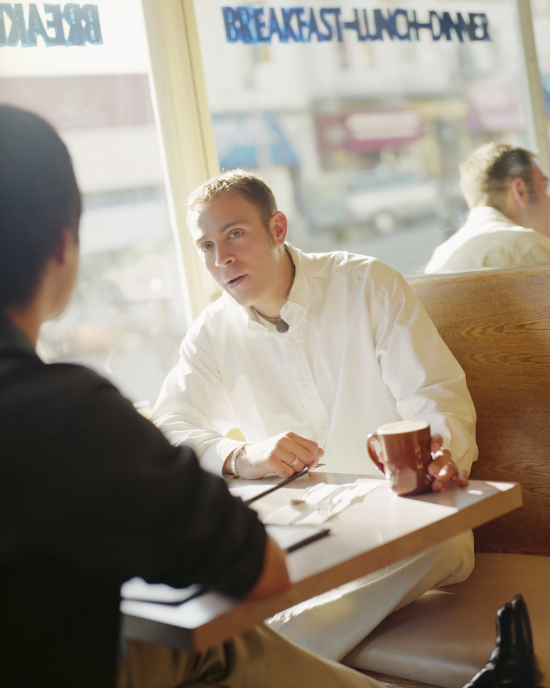
Service
  Goals
  Attitude
  Appearance
  Benefits
Notes:
Service is what restaurant employees provide.
This lesson will review the goals, appearance, attitude and benefits of quality service.

Slide 4
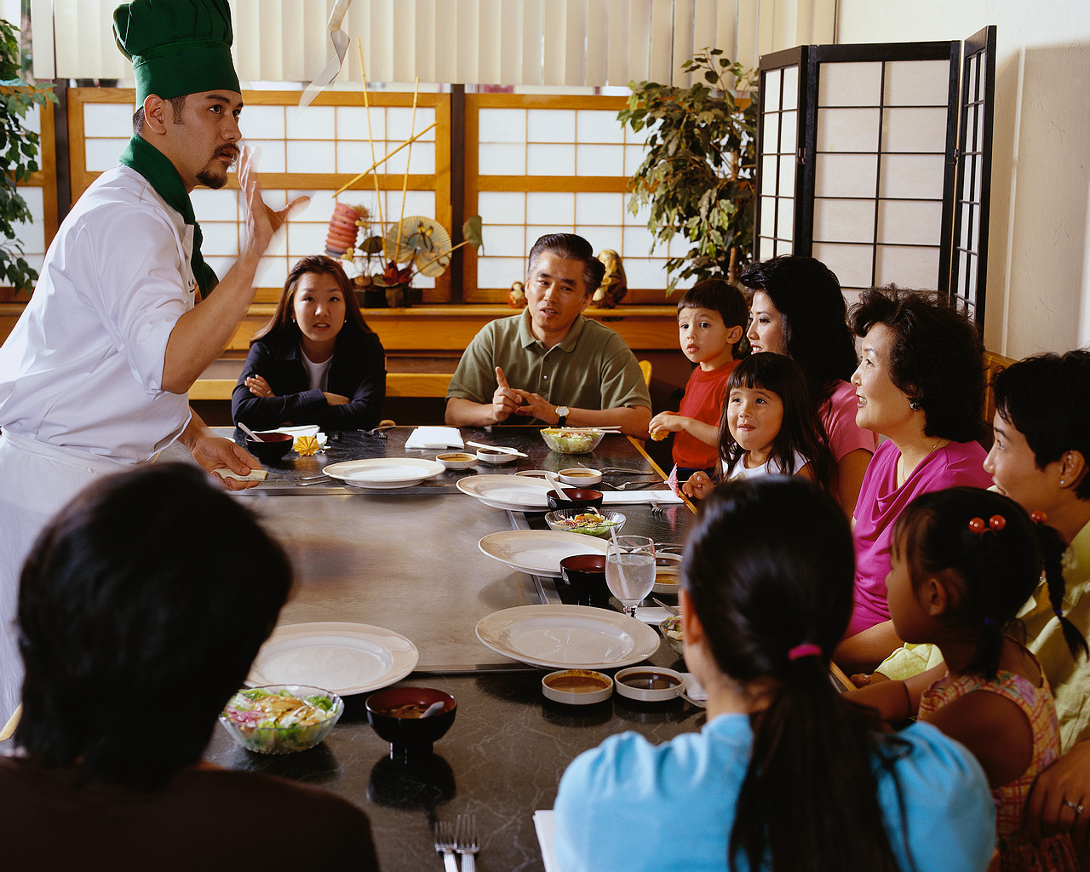
Goals
  Make the customer feel welcome
  Set the stage for a pleasant dining experience
  Greet customers immediately upon arrival
  Display courtesy, respect and friendliness
Notes:
The primary goal of a quality restaurant is to always make the customer feel special.
How do you feel when you dine out?

Slide 5
Appearance
  Uniform
  Hygiene
    Hair
    Hands and nails
  Jewelry
Notes:
The appearance of restaurant employees impacts the restaurant business.
Employees should:
wear a clean uniform to work
practice good personal hygiene
hair should be pulled back or put up
hands should be clean and nails short
jewelry should be minimal

Slide 6

Attitude
  Be someone who is:
    Positive
    Willing to please the customer
    Takes pride in their work
    Friendly and cheerful
    Shows courtesy to customers
Notes:
A positive attitude is critical to the restaurant and repeat business.

Slide 7

Benefits
  Improved customer satisfaction
  Greater customer loyalty
  Reduced marketing costs
  Enhanced business reputation
  Positive work environment
  Increased profits
Notes:
Many benefits are gained when providing quality customer service.
Do you agree with these?

Slide 8
Happy Customer
  A Happy Customer is a Repeat Customer
  (click on link)
Notes:
Click on hyperlink to view video:
A Happy Customer is a Repeat Customer
Customer Service: Skills for Success
http://www.youtube.com/watch?v=7rJTAp6G57A&feature=share&list=PL3F79BA3148626C28&index=9

Slide 9

Payment Options
  Types of Payment
  End of the Meal

Slide 10
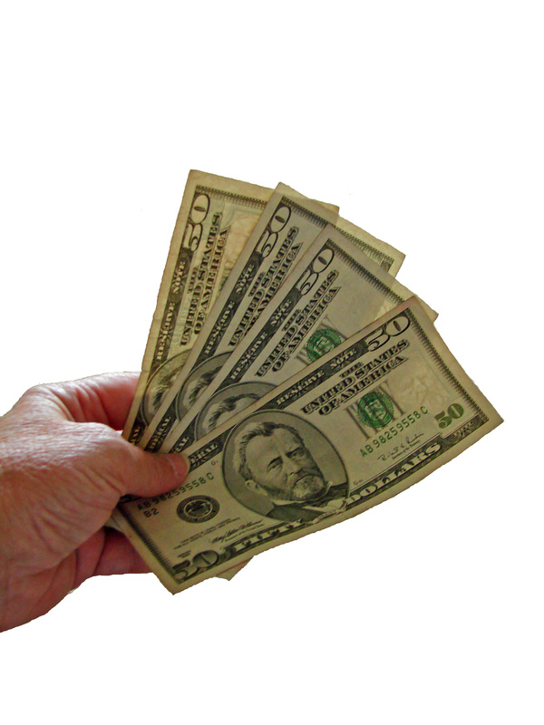
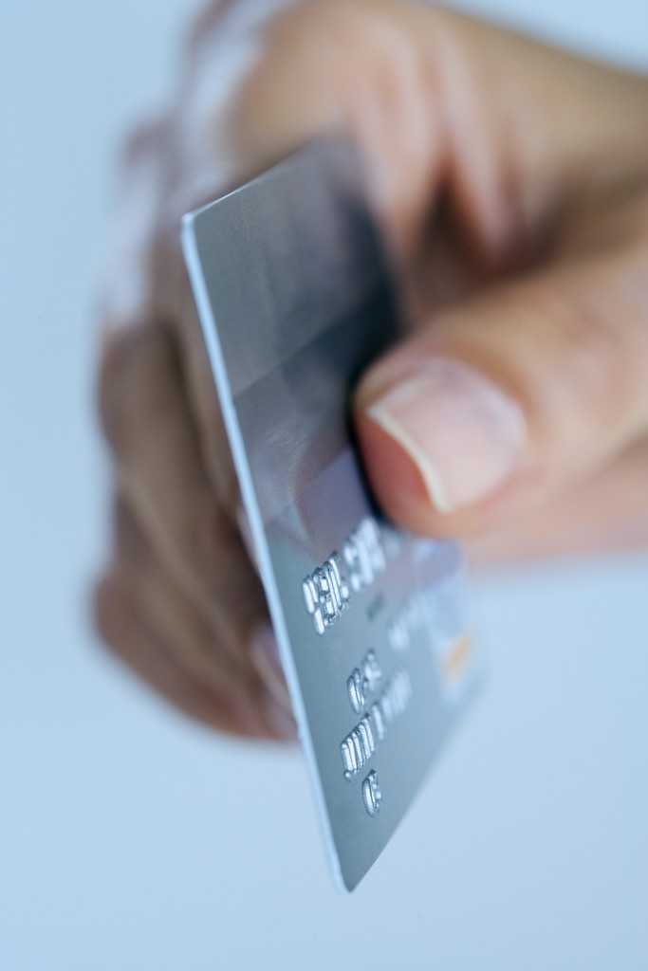
Types of Payment
  Cash
  Credit card
Notes:
If the customer pays in cash, be sure that the correct payment is received.
Never ask customers if they want change. Always return the change to them.
Credit cards are easier to carry than cash so many customers will use a credit card to pay for their meal.
Be sure to check:
the expiration date
the customer’s signature
That the customer signs the credit slip
Return the credit card to the customer immediately.

Slide 11

End of the Meal
  Thank your customers
  Invite to return
  Ask for feedback
Notes:
During the meal, be sure to check back with the customers to see if they need anything.
Be sure to thank your customers and invite them to return at the end of the meal. Ask them if they have any comments about the food or service they can write or share with your manager.

Slide 12

Questions?

Slide 13
References and Resources
  Images:
    Microsoft Office Clip Art: Used with permission from Microsoft.
  Textbooks:
    Culinary essentials. (2010). Woodland Hills, CA: Glencoe/McGraw Hill.
    Foundations of restaurant management & culinary arts: Level one. (2011). Boston, MA: Prentice Hall.
    Remarkable service: a guide to winning and keeping customers for servers, managers, and restaurant owners. (2009). Hoboken, NJ: John Wiley & Sons.
  YouTube™:
    A Happy Customer is a Repeat Customer
    Customer Service: Skills for Success
    http://www.youtube.com/watch?v=7rJTAp6G57A&feature=share&list=PL3F79BA3148626C28&index=9

