Slide 1
Decisions: Managing Your Money
  Principles of Human Services

Slide 3

Why is it important to make wise decisions pertaining to money matters?
Notes:
It is important because money can be a limited resource. It is wise to carefully think about your needs and wants. Decide how you can best use your financial resources to achieve your needs and wants.
The FCCLA Planning Process is a tool to help you develop a financial plan.

Slide 4
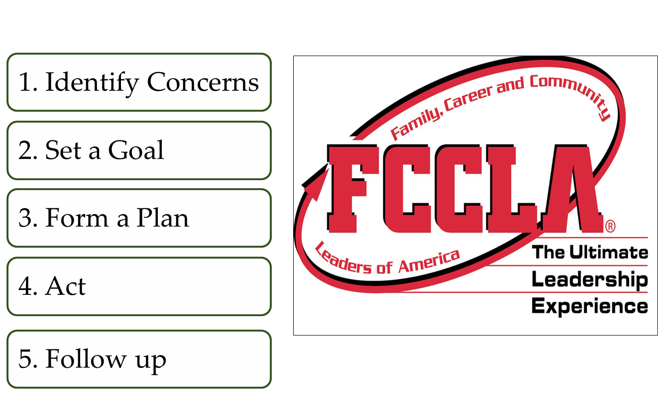
FCCLA Planning Process
Notes:
The Planning Process is a decision-making tool that supports the organization’s overall philosophy about youth-centered leadership and personal growth. It can be used to determine group action in a chapter or class or to plan individual projects.
IDENTIFY CONCERNS
■ Brainstorm to generate ideas, or state the activity or problem you want to address if already determined.
■ Evaluate your list and narrow it down to a workable idea or project that interests and concerns the majority or all of your members.
SET A GOAL
■ Get a clear mental picture of what you want to accomplish, and write your ideas down as your goal.
■ Make sure your goal is one that can be achieved and evaluated.
■ Consider resources available to you.
FORM A PLAN
■ Decide what needs to be done to reach your goal.
■ Figure out the who, what, where, when, and how.
■ List the abilities, skills, and knowledge required on your part.
■ List other available resources, such as people, places, publications and funds.
■ Make a workable timetable to keep track of your progress.
■ List possible barriers you might face, and develop plans if necessary.
■ Decide ways to recognize your accomplishments along the way.
ACT
■ Carry out your group or individual plan.
■ Use family and community members, advisers, committees, task forces and advisory groups when needed.
FOLLOW UP
■ Determine if your goal was met.
■ List ways you would improve your project or plan for future reference.
■ Share and publicize your efforts with others, including the media if appropriate.
■ Recognize members and thank people involved with your project.
Lead a class discussion on decision-making. Point out that the process of careful decision-making is important if individual’s goals are to be reached within available resources. Explain that the decision-making process involves carefully comparing benefits and costs of alternatives before making a decision. Discuss each step and help students understand each step.
When should you implement the decision-making process?
Why are alternatives important in decision-making?
How does evaluating a decision help you make decisions in the future?

Slide 5

Influential Impact of Making Good Financial Decisions
  Now
  Immediate future
  Throughout your lifetime
Notes:
Making good financial decisions will help you:
Now as you:
Make decisions about how to spend and save money
Manage income from allowances or part-time jobs
Plan for large purchases
Plan and save for education or training beyond high school
Immediate future as you:
Function as effective consumers and citizens in the U.S. economy
Have greater access to credit
Maintain your own budgets and financial records
Make larger purchases
Make the transition to independent adulthood
Throughout your lifetime:
As a family
As an individual
As economic circumstances change

Slide 6

Resources Are Limited
  Financial planning can help consumers and their families with their economic choices.
  Failing to plan is planning to fail!
Notes:
Resources can be human and non-human such as:
Human resources
Attitude
Energy
Experience
Knowledge
Personal qualities (cooperative, honest and hardworking)
Skills
Talents
Thinking skills (decision-making skills)
Non-human resources
Community facilities and services
Economic institutions
Financial
Material
Natural resources
Political institutions
Social organizations
Time
How do human resources differ from non-human resources?
What are examples of resources that are limited?
What are examples of resources that are readily available to all?
How can thinking skills, such as decision-making, be used as financial management resources?
Why is it important to know about all possible resources available to you in financial management?

Slide 7
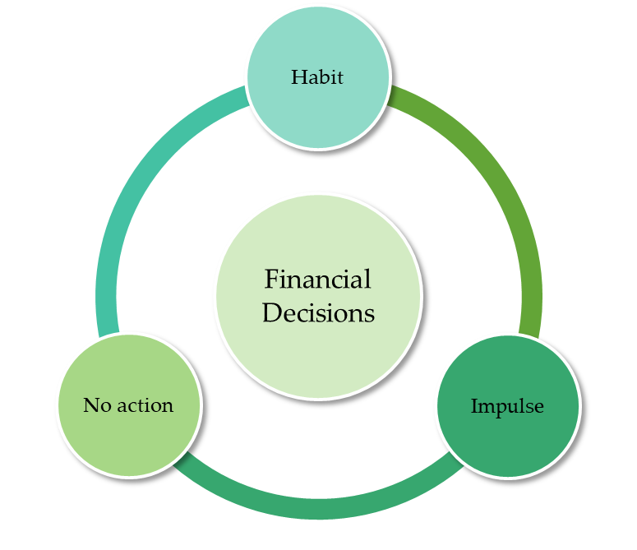
Making Financial Decisions
  When it comes to making financial decisions, you want to be wise and thorough. The key to financial well-being is spending less than you earn.
Notes:
How people make financial decisions
Habit: Do you buy the same soft drink every day? Do you sit at the same table for lunch every day? We have good habits and bad habits. If you have a bad habit of not checking your balance in your checking account, how could this hinder your financial success?
Impulse: Have you ever bought something on sale even though you knew it did not look good on you? Have you ever bought anything on an impulse? Do you have items in your closet with the sales tags still attached? Was purchasing these items a sound financial decision?
No action: Not being able to buy what you need and want because of inadequate financial planning.
Your financial decisions carry a lifetime of consequences. Learn how to manage your money and have financial peace of mind. What does it mean to “live within your means”? Think about your priorities, and plan carefully. Determine your needs, and make sure they are met before you satisfy your wants. A systematic or decision-making process can help you manage your money wisely.

Slide 8

Why is it important to follow a budget?
Notes:
Allow time for classroom discussion.

Slide 9

Budgets
  Help you to:
  Control where your money goes
  Keep from overspending
  Reduce wasteful spending
  Work toward short- and long- term goals
Notes:
Do you have a budget?

Slide 10

Budgeting Tips
  It is never too early to plan for your future.
Notes:
Budgeting tips can include:
Write down your plan of action and keep in a binder
Be specific about the plan but keep it simple
Be ready for the unexpected by being flexible. Remember to be disciplined.
Allow time for classroom discussion.
Do you think these budgeting tips could improve your money management skills?
How often should you evaluate your budget plan?
What changes in life would result in changes in the budget plan?

Slide 11

Consumer Rights and Responsibilities
  Consumer laws
  The importance of warranties and return policies
  Writing a complaint letter
Notes:
Consumer Rights and Responsibilities
You should know your rights and responsibilities as a consumer. You should investigate the following areas of concern:
Consumer laws
The Federal Trade Commission (FTC) is the nation’s consumer protection agency. The FTC’s Bureau of Consumer Protection works for the consumer to prevent fraud, deception and unfair business practices in the marketplace. The Bureau:
enhances consumer confidence by enforcing federal laws that protect consumers
empowers consumers with free information to help them exercise their rights and spot and avoid fraud and deception
wants to hear from consumers who want to get information or file a complaint about fraud or identity theft
The importance of warranties and return policies
Generally, a warranty is a promise, as a manufacturer or seller, to stand behind your product. It is a statement about the integrity of your product and about your commitment to correct problems when your product fails.
Writing a complaint letter
The Federal Trade Commission (FTC) website offers practical information on a variety of consumer topics. The Federal Trade Commission, the nation’s consumer protection agency, collects complaints about companies, business practices, identity theft and episodes of violence in the media.

Slide 12
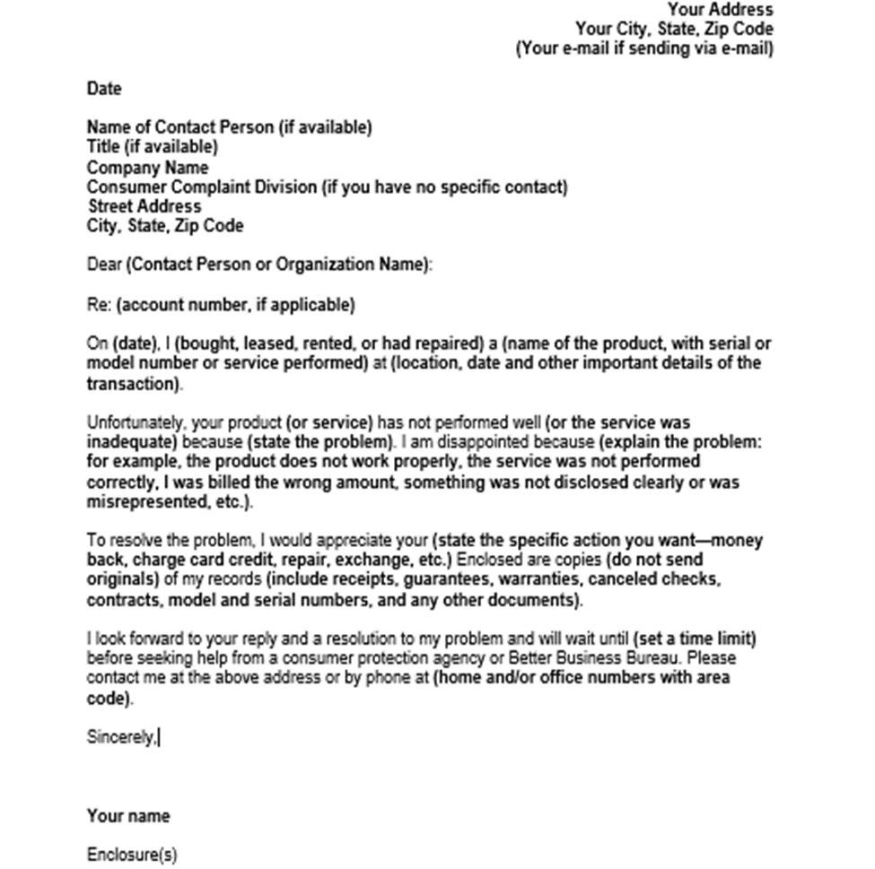
Consumer Complaint Letter
Notes:
Writing a complaint letter
Summarize the information you should include on a consumer complaint letter.
Distribute the graphic organizer “Writing a Complaint Letter” handout to the students. Students will complete the handout as you review the information.

Slide 13

Tips for Writing a Complaint Letter
Notes:
Click on hyperlink to view the website:
Write Express
How to write a complaint letter
http://www.writeexpress.com/How-to-write-a-complaint-letter.html
It is better to type your letter. It looks neater and more professional. Keep all these tips in mind. Your effective letter of complaint may produce positive results.

Slide 14


Federal Trade Commission
Notes:
Click on hyperlink to view YouTube™ video:
Federal Trade Commission (FTC)
How to File a Complaint with the Federal Trade Commission – Revised
https://youtu.be/3LvMO5UMCl8
Your complaints can help the FTC detect patterns of wrong-doing and lead to investigations and prosecutions. The FTC enters all complaints it receives into Consumer Sentinel, a secure online database that is used by thousands of civil and criminal law enforcement authorities worldwide. The FTC does not resolve individual consumer complaints.

Slide 15

Effective Consumer Buying
  Be informed
  Make wise shopping decisions
  Plan purchases
Notes:
Be informed
Understand the marketplace; know about the sources of goods and services
Make the most of information available to you
Recognize selling strategies and use them to your advantage
Make wise shopping decisions
Compare products and services, considering prices, quality, performance, guarantee/warranty and return policy
Resist pressure
Deal with reputable and reliable sources
Plan purchases
Resist impulse purchases
Consider needs and wants, keeping in mind your goals and priorities
Determine when is the best time to buy
Lead students to elaborate on the three effective methods of consumer buying and explain why they are good practices.
Have students provide an example of a purchase that turned out to be a disappointment later. Lead students to share and discuss their examples.
What were reasons for purchases that had disappointing results?
Who is to blame when decisions turn out badly? (Review the basics of decision-making.)
What practices might have prevented the problems?
What effective consumer buying practices are related to the right to be informed?
What effective consumer buying practices are related to the right to choose?

Slide 16

What are consumer recalls?
Notes:
Recall is to ask people to return (a product with a defect or problem). The United States Consumer Product Safety Commission provides individuals with current information pertaining to recalls, safety education, regulations, laws and standards and business and manufacturing.
Have you ever had to return an item because of a recall?

Slide 17
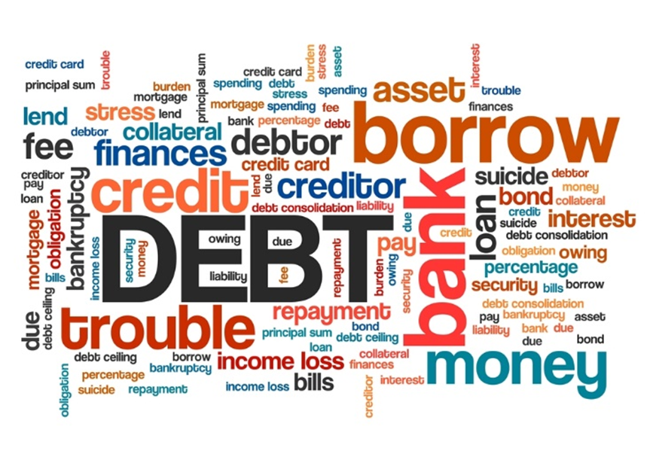
Impact of Technology on Consumers
  What should you know about using debit and credit cards?
Notes:
What is a debit card?
Debit cards are a way to pay for things. You get a debit card from your bank or credit union when you open a checking account. Sometimes a debit card is free to use. Sometimes you will pay a fee to use the card. Debit cards look like credit cards, but they do not work the same way. Credit cards use money that you borrow. Debit cards use money that is already in your checking account.
Why would I use a debit card?
Debit cards let you buy things without carrying cash.
Debit cards let you get cash quickly.
Debit cards take money out of your checking account immediately.
You also can get cash back when you use a debit card to buy something at a store.
You borrow money (with your credit card or loan).
You buy the thing you want.
You can use your debit card at an automated teller machine, or ATM, to get money from your checking account.
You can use your debit card in most stores to pay for something.
You just swipe the card and enter your PIN number on a key pad.
You pay back that loan later – with interest.
Credit cards and loans have different interest rates. Look for the APR. APR means annual percentage rate. APR is how much interest you pay during a whole year. A lower interest rate means you pay less money. A higher interest rate means you pay more money. For example, a loan with a two percent interest rate costs less than a loan with an 18% interest rate.
Banks and credit unions offer credit cards. They usually offer credit cards to people with a good credit history. Some stores offer credit cards. You can use a store credit card only in that store. Sometimes these cards are easier to get if you do not have a good credit history. Sometimes a store credit card is a good way to build your credit history.

Slide 18
Online Checking and Management
  Services offered by financial institutions:
    Auto, personal, mortgage and business loans
    Bill-pay services
    Debit and credit cards
    Investing in money market accounts
    Investment services, such as savings accounts and certificates of deposits
    Mobile apps
    Saving
    Various other services such as money transfers and cashier’s checks
Notes:
Once you have a job and start receiving weekly, bi-weekly or monthly paychecks, you have to decide how you are going to manage that money. You do not want to carry around large amounts of cash. That is not safe for you or your money. You don’t want to send large amounts of cash through the mail to pay bills. Using the services of a bank is a great way to keep your money safe and manage your money by tracking your deposits and spending.
Depository institutions provide similar services. They differ in terms of the government regulations under which they operate. They take in people’s money and loan it to other people at a higher rate of interest than the interest they pay back to the depositor. The interest earned by these institutions becomes the profit of the institutions and a means by which they pay their employees and expand their businesses.
What do mobile apps generally allow you to do?
Most apps offered by financial institutions are free for customers. While the functionalities differ, at a minimum, all of the apps at some of the largest financial institutions allow customers to:
Check balances
Locate ATMs
Transfer money between the owner’s accounts at the same bank
View the transaction history
Additionally, most of the apps allow customers to pay bills.
Do you use financial mobile apps on your electronic devices? How often?

Slide 19
Review
  What is the FCCLA Planning Process?
  Why is it important to follow a budget?
  What are the components in a letter of complaint?
  What are three effective consumer buying strategies to implement?
  What is the impact of technology on consumers?

Slide 20


Slide 21
References and Resources
  Images:
    Federal Trade Commission (Slide 12)
    FCCLA Planning Process (Slide 4)
    Photos obtained through a license with Shutterstock.com™. (Slides 1, 3, 5, 6, 8, 9, 10, 11, 13, 15 and 16)
  Textbooks:
    Campbell, S. R. (2010). Foundations of personal finance. Tinley Park, IL: Goodheart-Willcox.
    Madura, Jeff, K. Casey Michael, and Sherry Roberts J. (2010). Annotated teacher’s edition to personal financial literacy. Saddle River, NJ: Pearson Education.
    Ryder, V., & Harter, M. B. (2010). Contemporary living. Tinley Park, IL: Goodheart-Willcox.

Slide 22
References and Resources
  Websites:
    BankingQuestions.com
    Savings account versus checking account.
    http://www.bankingquestions.com/savingsaccounts/q_savecheck.html
    Consumer.gov
    What to know and do.
    http://www.consumer.gov

Slide 23
References and Resources
  Federal Trade Commission (FTC)
    The FTC’s Bureau of Consumer Protection works to help the consumer prevent fraud, deception and unfair business practices in the marketplace.
    http://www.ftc.gov
  Money Basics
    Information and interactive tools concerning checking, savings and investment options.
    http://www.gcflearnfree.org/moneybasics

Slide 24
References and Resources
  Recalls.gov
    To provide better service in alerting the American people to unsafe, hazardous or defective products, six federal agencies with vastly different jurisdictions have joined together to create www.recalls.gov — a “one stop shop” for U.S. Government recalls.
    http://www.recalls.gov
  Write Express
    How to write a complaint letter
    http://www.writeexpress.com/How-to-write-a-complaint-letter.html
  Video:
    Federal Trade Commission (FTC)
    How to File a Complaint with the Federal Trade Commission – Revised
    https://youtu.be/3LvMO5UMCl8

