Slide 1
Developing Effective Instructional Multimedia Presentations:
The Good, Bad and Ugly

Slide 3
Applying Technology
The use of technology benefits students by:
Exposing students to real world relevance
Providing the tools to create classroom web pages
Providing students with the opportunity to produce digital multimedia for presentations and projects
Providing realistic learning
Notes:
Teaching is changing in many ways. Technology is one area where the changes occur almost daily. Strategies or equipment that is new today could well be obsolete in a few weeks. It is the responsibility of the teacher to evaluate applications to determine their effectiveness for the ages and abilities of students and the knowledge and skills they support.
Technology can improve education in many ways by:
Developing digital learning games
Exposing students to real world relevance
Making class web pages and web classrooms
Presenting E-books
Providing digital data storage
Providing digital multimedia for creating presentations and projects
Providing more realistic learning with digital simulations and models and virtual activities
Implementing video-making technology

Slide 4
What is a multimedia presentation?
Notes:
We have all seen and probably created a PowerPoint™ presentation. Slide presentations are effective ways to share information, but there are so many other innovative ways to share information.
Can anyone give me an example of multimedia presentation tools?
Answers might include:
Prezi™
Snapguide
Glogster™
Blendspace (formerly called Edcanvas)
Vine
How are they effective in conveying information?

Slide 5
Multimedia Is…
What is Multimedia?
(click on link)
Notes:
What is Multimedia?
Stop Motion in MMD211 Creative Thinking Class.
http://youtu.be/Xs8mhLDKnJg

Slide 6
Cognitive Development
Bloom’s Taxonomy
Creating
Understanding
Remembering
Applying
Analyzing
Evaluating
Notes:
Bloom’s taxonomy was developed in the 1950’s and is still used today to categorize ways of learning and thinking in a hierarchical structure. During the 1990's, a former student of Bloom's, Lorin Anderson, led a new assembly which met for the purpose of updating the taxonomy, hoping to add relevance for 21st century students and teachers. Bloom’s Taxonomy lends itself to multimedia presentations to enhance cognitive development.
Remembering: Retrieving, recognizing and recalling relevant knowledge from long-term memory.
Understanding: Constructing meaning from oral, written and graphic messages through interpreting, exemplifying, classifying, summarizing, inferring, comparing and explaining.
Applying: Carrying out or using a procedure through executing or implementing.
Analyzing: Breaking material into constituent parts, determining how the parts relate to one another and to an overall structure or purpose through differentiating, organizing and attributing.
Evaluating: Making judgments based on criteria and standards through checking and critiquing.
Creating: Putting elements together to form a coherent or functional whole; reorganizing elements into a new pattern or structure through generating, planning or producing.
Using the pyramid, describe how a multimedia presentation could touch on all the components.

Slide 7
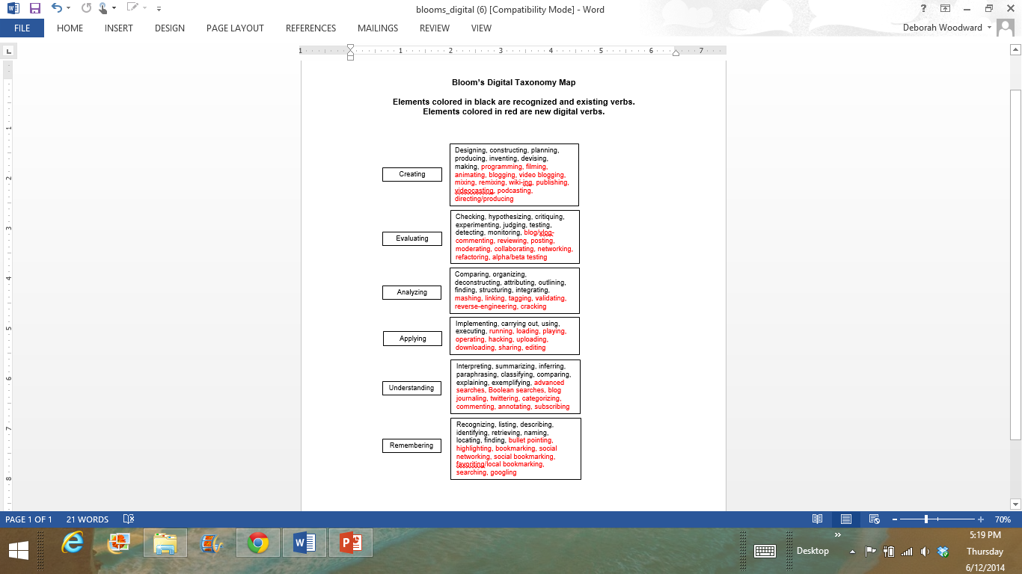
Bloom’s Digital Taxonomy Map
Notes:
What words from Bloom’s Digital Taxonomy map could apply to a multimedia presentation?
Andrew Church
Bloom’s Digital Taxonomy Map
http://edorigami.wikispaces.com/Bloom%27s+Digital+Taxonomy

Slide 8

Applications for Education
As a teaching tool
Assist students that have been absent
Lesson/Content review
To share information with colleagues and/or parents
Notes:
A multimedia presentation might be a good provision to use to organize groups of educational materials for each unit that you teach. It is a good reviewing tool and could be used for students that are absent.
As you work in a department with other teachers, you might have an opportunity to co-teach or collaborate with them. Multimedia presentations are a good venue for that purpose.
You could also share your presentations with parents as a reinforcement to their children’s education.

Slide 9
Teacher Communication
A multimedia presentation provides a venue for communication.
Classroom instructions should be:
developmentally appropriate
at the correct level of understanding
encouraging for language and mental development
considerate of different types of intelligences and learning styles
Notes:
A significant point about communication in the classroom is for students to differentiate between personal communication and professional communication. It is very important for students to communicate with correct grammar, punctuation and spelling as they are a part of the education profession. They should also avoid using inappropriate words and phrases around children and other students. This class is an excellent place for them to apply what they have been learning in English classes.
When teachers talk with students, the conversation needs be developmentally appropriate and at the correct level of understanding for each student in the class.
Classroom interactions between students and teachers and student to student should encourage language and mental development.
Teachers should consider different types of intelligences and learning styles when communicating in the classroom.
Teachers and students continue to be challenged by the integration of different languages and cultures and the effect they have on classroom dynamics, understanding and learning.

Slide 10

Creating Appropriate Multimedia Presentations
How will you analyze the effectiveness of the presentation?
Are you going to include multimedia presentations in all your lesson plans?
Notes:
After you have completed your lesson, analyze the effectiveness of the presentation. Did the students comprehend the information? Were your student expectations met with the use of the presentation? Would the selection of another type of multimedia presentation have made the lesson more effective?
If you decide to use multimedia presentations throughout the year, your students need to understand the benefits of using the presentations.

Slide 11
Instructional Uses of Multimedia Presentations
Determine and extract key ideas and information
Introduce new information
Outline topics or chapters
Comprehend information
Analyze interrelationships between ideas
Used as a test alternate
Notes:
Multimedia presentations are an excellent instructional tool. Some presentations are more suitable for certain content and types of information than others. As a teacher, you need to determine which type of presentation to use with your lesson.

Slide 12
Types of Presentations
Informative
Instructional
Attention-gaining
Persuasive
Decision-making
Notes:
The first step in preparing a presentation is to define the purpose of your presentation.
Informative - Keep an informative presentation brief and to the point. Stick to the facts and avoid complicated information. Choose one of the following organizational structures for an informative presentation:
Time – Explain when things should happen. Use words or phrases such as first, second and third to explain order.
Place – Explain where things should happen.
Cause and effect – Explain how things should happen.
Logical order - Place items in the order of importance.
Instructional – As an educator, you are going to create instructional multimedia presentations to share with students or colleagues. Your purpose in an instructional presentation is to give specific directions or orders. Your presentation will probably be a bit longer because it has to cover your topic thoroughly. In an instructional presentation, your listeners should come away with new knowledge or a new skill. Remember to apply Bloom’s Taxonomy in an instructional presentation.
Attention-gaining – The main purpose of this type of presentation is to make people think about a certain problem or situation. This presentation includes:
sharing a personal story
providing vivid examples or illustrations
discussing a need to solve a problem
calling on the audience to help solve the problem
What kind of presentation could lend itself to this type of presentation?
Persuasive - the purpose in a persuasive presentation is to convince your audience to accept your proposal, ideas or beliefs. A convincing persuasive presentation offers a solution to a controversy, disagreement or problem.
Decision-making - Your purpose in a decision-making presentation is to move your audience to take your suggested action. You can do this by:
Gaining attention with a personal story that illustrates the problem
Showing the need to solve the problem and illustrating it with an example that is common to most individuals
Describing your solution to bring a satisfactory resolution to the problem
Comparing/contrasting the two worlds with the problem solved and unsolved
Calling the audience to action to help solve the problem and provide them a way to be part of the solution

Slide 13
Presentation Tools
Prezi™
Snapguide
Glogster™
Blendspace (formerly called Edcanvas)
Vine
Will:
Enhance lessons
Challenge students
Utilize technology
Encourage creativity
Prepare for 21st century learning skills
Promote rigor
Notes:
Tired of PowerPoint™? Try these FREE presentation tools to present research, information, how-to, and much more.
Presentation tools will:
Enhance lessons
Challenge students
Utilize technology
Encourage creativity
Prepare for 21st century learning skills
Promote rigor
Since many of you have probably created a PowerPoint™ presentation, we are going to exclude it as one of your options. You will be researching multimedia presentation tools later in the lesson. I want you to expand your knowledge by researching and creating a new multimedia presentation tool.

Slide 14

Criteria for an Effective Multimedia Presentation
Audio
Citations
Conventions
Focus
Organization
Notes:
Audio - Background noise, if evident, is not distracting and sound effects are appropriate; volume of voice and music are balanced so each can be easily heard; and volume is consistent.
Citations - The producer(s) and other key individuals responsible for this work are identified along with the date of creation. All media/information used as part of this work is original or the copyright owner has granted permission for its use and proper citations are used, including identifying any TEA contract or grant used to fund the work. Student work and participation in products are appropriately cited.
Conventions - No syntax or grammatical errors are evident. Was the text free of errors in grammar, spelling and usage? Had the presenter edited carefully, or were there sloppy errors?
Focus - The resource states its main focus and fulfills that focus in a concise and well-organized manner.
Organization - Are the slides presented in an order that makes logical sense and supports the focus of the presentation? Is the overall plan of the presentation obvious and constant? Is the information on each slide presented in a common-sense manner, with clear titles, headings, paragraphs and bulleted or numbered lists?

Slide 15
Criteria of an Effective Multimedia Presentation
Presentation skills
State-wide relevance
Style
Support and elaboration
Video (if applicable)
Notes:
Presentation skills - Length and pace of presentation are appropriate to the audience; narration is clear, well-rehearsed, and engaging; and any audio and video elements are balanced and appropriate.
Statewide relevance - The resource has statewide applicability, interest and/or educational relevance. The resource may include material about a locality but also has appeal. As an educator in Texas, your multimedia presentations should be aligned with the Texas TEKS.
Style – The purpose of your presentation will determine the style. Will it be informative, instructional, attention-gaining, persuasive or decision-making?
Support and elaboration - Information is accurate and audience appropriate, important and/or relevant information is imparted, experts and examples are referenced when appropriate and any potential bias is identified.
Video (if applicable) - The video is clear and consistent, transitions are smooth and lighting is consistent.

Slide 16
Tips in Preparing Your Presentation
Aim for no more than one slide for every five minutes of speaking
Place no more than five bullet points on a slide
Limit each bullet point to five words, if possible
Notes:
Result: the audience will receive the message from you, rather than read it off the screen.

Slide 17
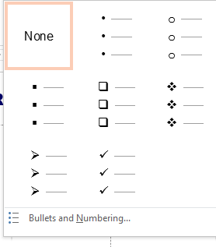
Rules for Using a Bulleted List
I enjoy all of the following:
Reading
Writing
Solitude
Notes:
Option A (Use this option whenever possible as it’s much cleaner than Option B.)
A clause introduces the list; therefore it ends with a colon, and the list has either no punctuation (if made of words or phrases) or appropriate punctuation (if made of sentences). The items in the list are capitalized.
I enjoy all of the following:
Reading
Writing
Solitude
The following questions should be considered when deciding whether or not to sing:
Can you carry a tune?
Will your singing harm yourself or others?
Will your singing make the dogs howl?

Slide 18
Rules for Using a Bulleted List
It is not always possible to bring the introduction of a list to a full grammatical stop.
I will never
coach a softball team;
scuba dive;
eat insects, even chocolate-covered ones; or
date Tom Cruise.
Notes:
Option B
It is not always possible to bring the introduction of a list to a full grammatical stop. If the items in the list complete the clause of the introduction, then do not use a colon and do not capitalize the items in the list, but do use appropriate end punctuation (usually a semi-colon) after each item. (Your computer will try to make you capitalize; don’t give in.)
I will never
coach a softball team;
scuba dive;
eat insects, even chocolate-covered ones; or
date Tom Cruise.

Slide 19
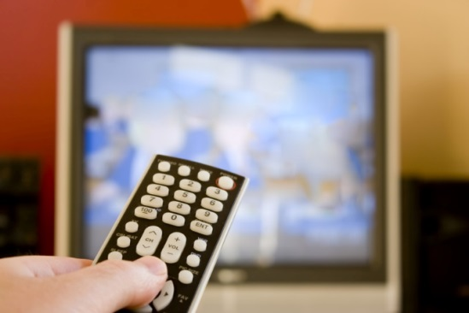
Additional Tips
Use fonts large enough to read
Use royalty free graphics
Follow a logical sequence
Be creative with color to draw the audience’s attention
Notes:
Ask the students for input on what makes a good presentation. You may assign a scribe to write the points on the board.

Slide 20
What makes a presentation ineffective?
Notes:
Ask the students for input on what makes a bad presentation. You may assign a scribe to write the points on the board.

Slide 21
Bad and Good Examples of Presentations
(click on link)
Notes:
Presentation Bad/Good Examples
A short video of Bad and Good Examples of Presentations.
http://youtu.be/S5c1susCPAE

Slide 22
Delivery: Practice Makes Perfect

Slide 23

Questions?

Slide 24
References and Resources
Images:
Microsoft Clip Art: Used with permission from Microsoft.
Textbooks:
Curriculum Center for FCS. Ready, set, teach! Curriculum Guide. 2003.
Curriculum Center for FCS. Reaching to teach. 2005.
Websites:
Andrew Church
Bloom’s Digital Taxonomy Map
http://edorigami.wikispaces.com/Bloom%27s+Digital+Taxonomy
Texas Association of Future Educators (TAFE)
Advisor Handbook – Competitive Events
http://www.tafeonline.org/?page=CompetitiveEvents

Slide 25
References and Resources
YouTube™:
What is Multimedia?
Stop Motion in MMD211 Creative Thinking Class.
http://youtu.be/Xs8mhLDKnJg
Presentation Bad/Good Examples
A short simple video of Bad and Good examples of Presentations.
http://youtu.be/S5c1susCPAE

