Slide 1
Dining Experiences in Hospitality

Slide 3
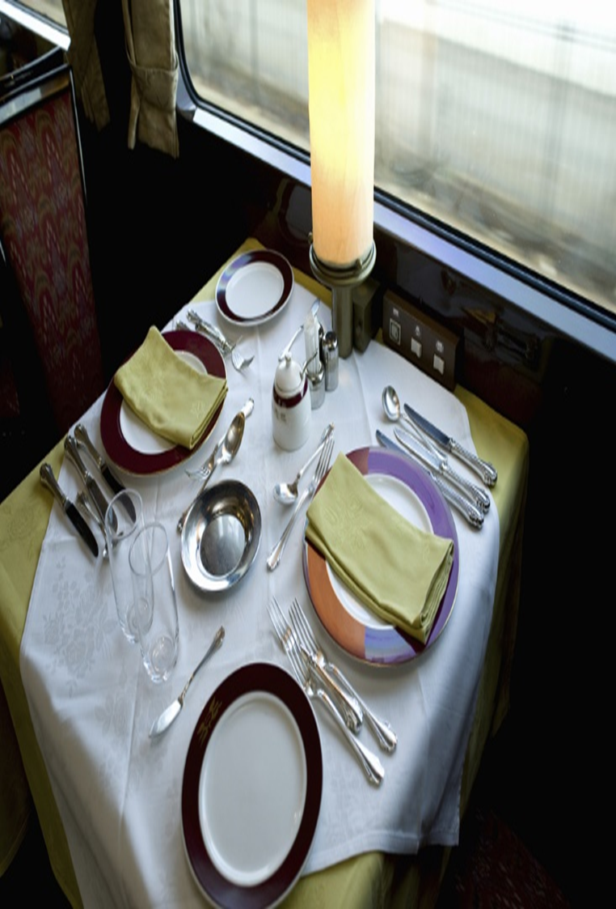
Dining Experiences
Elements
Notes:
Elements are a part or aspect of something abstract, especially one that is essential or characteristic.

Slide 4
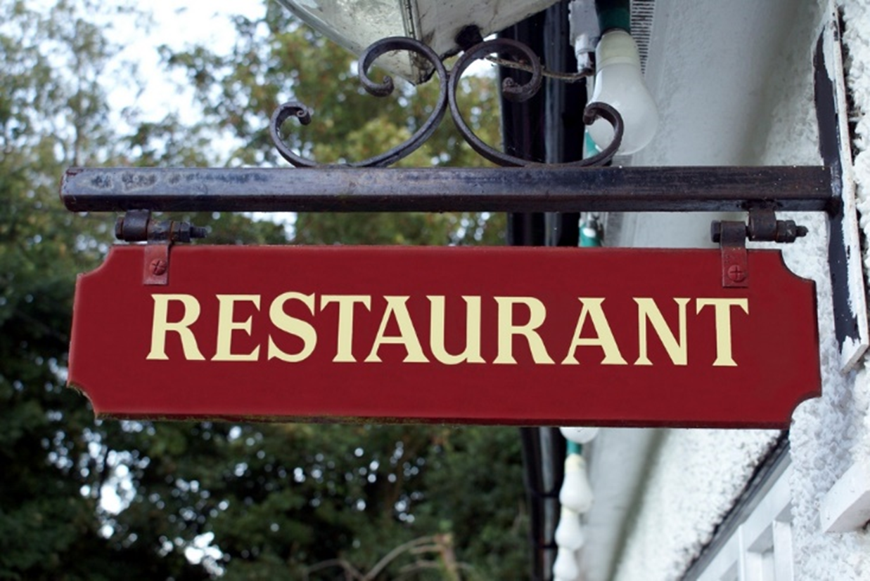
Elements
Ambiance
Décor
Location
Service style
Target market
Theme
Notes:
Elements in the restaurant may be the whole idea or a concept.

Slide 5
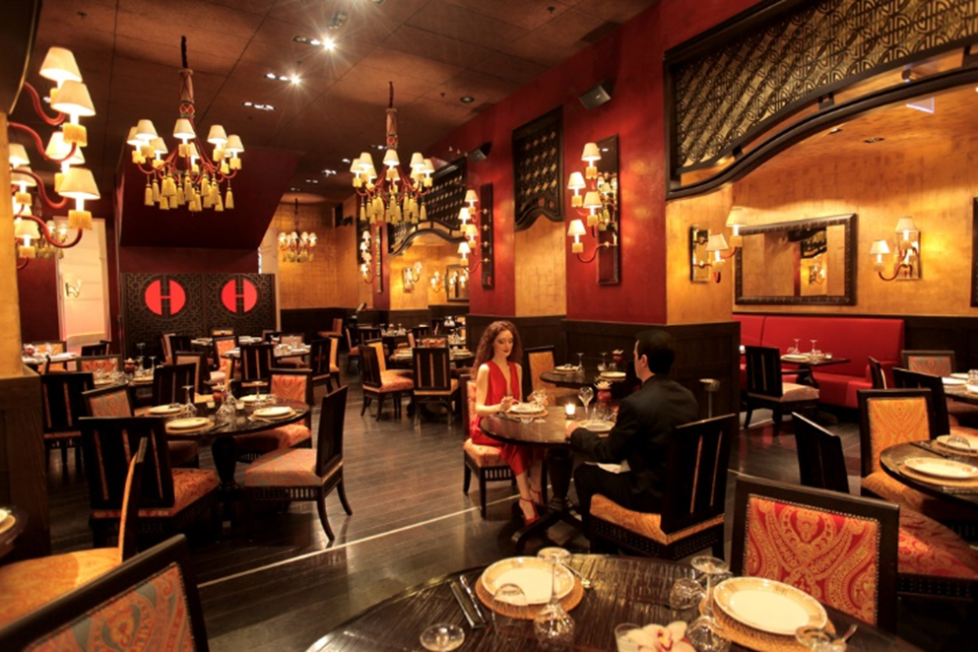
Ambiance
The feeling or mood associated with a particular place
Examples include:
Casual
Elegant
Fun
Homelike
Romantic
Sportslike
Notes:
Ambiance may also be called atmosphere.
It is created by the décor, lighting, menu, music and table setting.

Slide 6
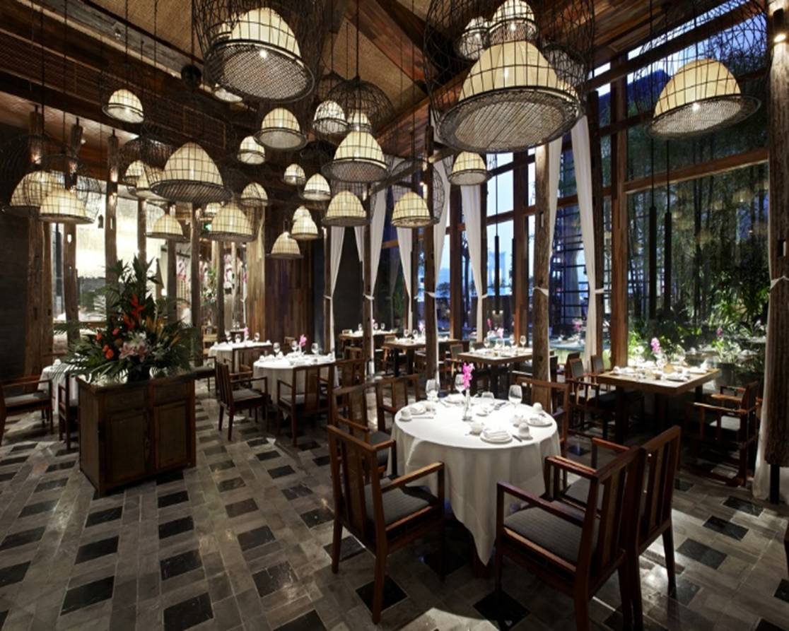
Décor
The furnishings and decorations of a room
Examples include:
Centerpieces
Flower arrangements
Furniture
Lightning
Tablecloths
Notes:
The décor may be part of the theme.

Slide 7
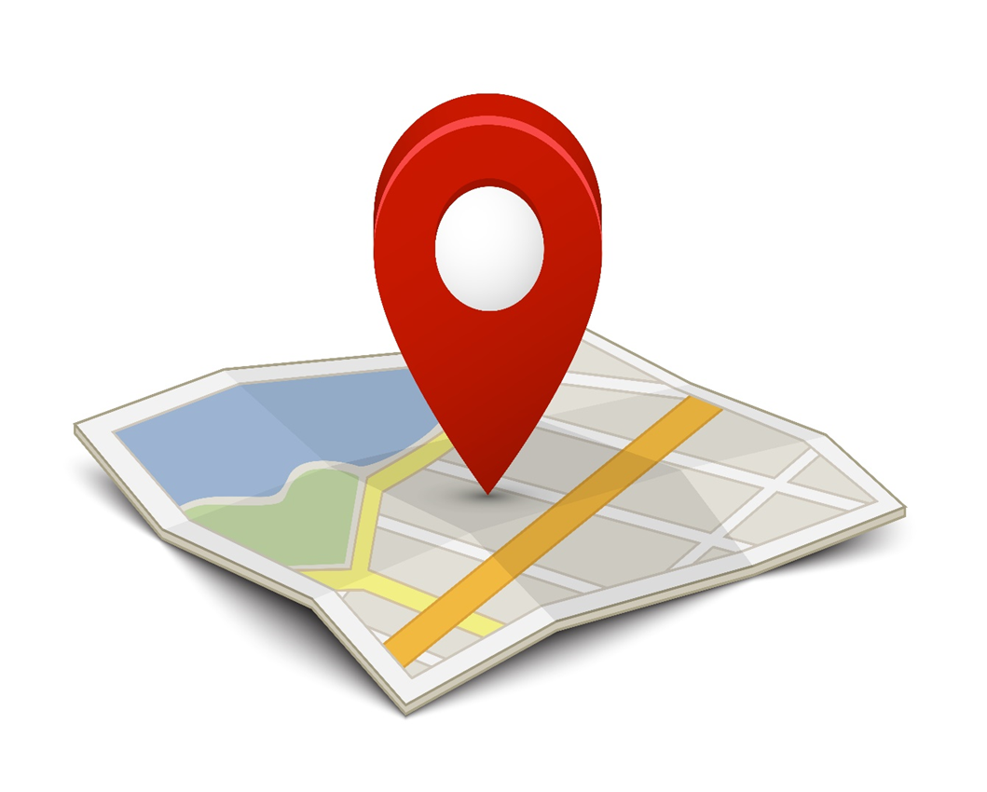
Location
A key factor in the dining experience
Examples include:
Boardwalk
Downtown
Mall
Stand alone
Suburban
Notes:
Location is a particular place where the dining venue is located.

Slide 8
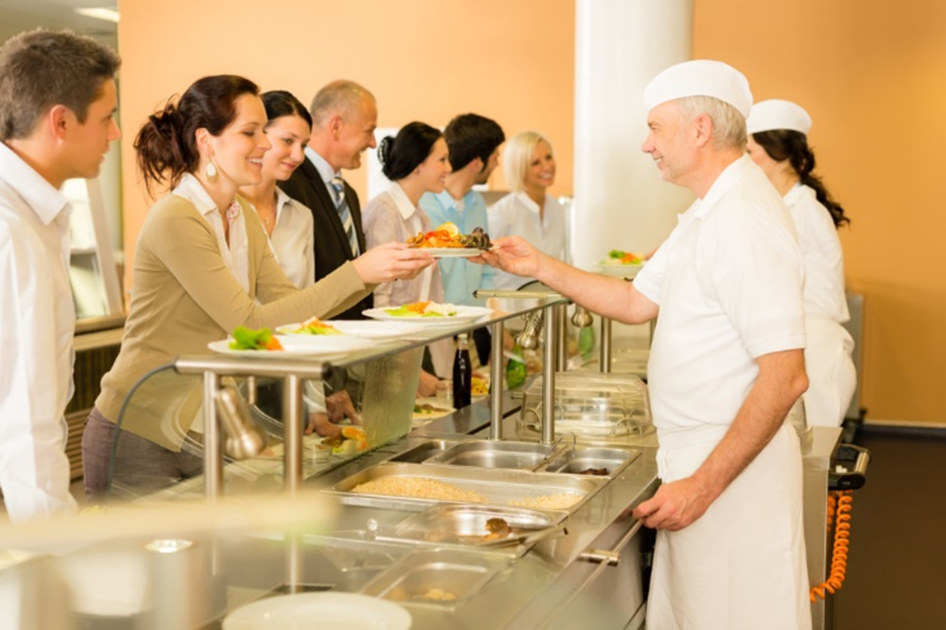
Service Style
Buffet
Cafeteria
Drive-through
Over-the-counter
Seated
American service
French service
Russian service
Notes:
Buffet -a restaurant that has meals consisting of several dishes from which guests serve themselves
Cafeteria -a restaurant or dining room in a school or a business in which customers serve themselves or are served from a counter and pay before eating
Drive-through – customers stay seated in their cars for the whole process of ordering, paying and being served
Over-the-counter – customers place their orders at a counter that has cash registers and the meal is received at the counter.
Seated – the customer is seated at a table and a server brings the food to the table
American service – food is plated in the kitchen
French service – the meal is partially prepared in the kitchen and the server finished the cooking, carving or flaming of the food in front of the customer
Russian service – the food is cooked and divided into portions in the kitchen and placed on silver trays to be served on each guest’s plate

Slide 9
Target Market
A particular group of consumers at which a product or service is aimed
Examples include:
Children
Couples on a date
Mature adults
Shoppers
Sports fans
Teenagers
Young adults
Notes:
A market consists of all the people who could potentially buy what you are selling.
A market segment is a subgroup of a larger market that has similar needs and wants for the product.

Slide 10
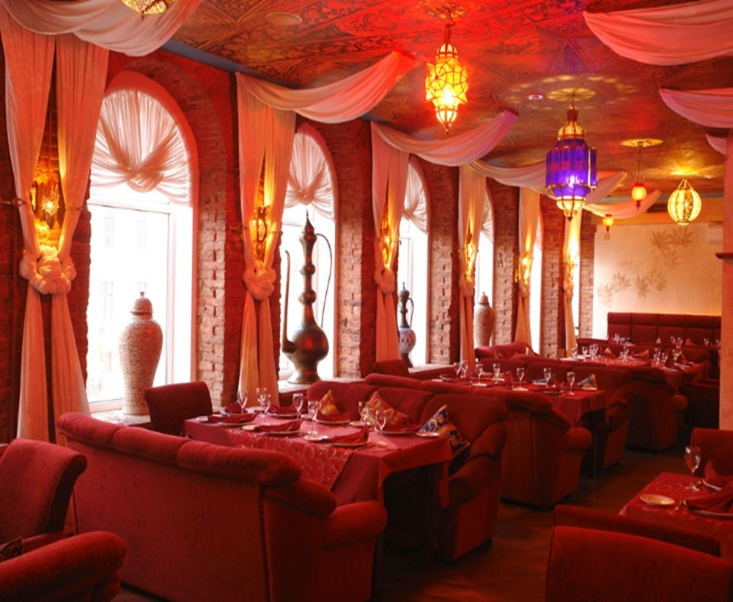
Theme
A specific idea around which something is organized
Carried out in the:
Décor
Menu
Type of food served
Uniforms employees wear
Notes:
Themes may include Asian, Barbecue, Chinese, Mexican and many others.
Can you name some more?

Slide 11
Inside Thomas Keller's restaurants
Thomas Keller is the only American chef to own two three-star Michelin restaurants and Tracy Smith got a behind the scenes look at how this sometimes-intimidating culinary connoisseur operates.
Notes:
Click on image to view YouTube™ video:
Inside Thomas Keller's restaurants
Thomas Keller is the only American chef to own two three-star Michelin restaurants and Tracy Smith got a behind the scenes look at how this sometimes-intimidating culinary connoisseur operates.
http://youtu.be/T0ZanmJQXFA

Slide 13
References and Resources
Images:
Shutterstock™ images. Photos obtained with subscription. (Slides 1, 3, 4, 5, 6, 7, 8, 9, 10, 12)
Textbooks:
Culinary essentials. (2010). Woodland Hills, CA: Glencoe/McGraw Hill.
Reynolds, J. S. (2010). Hospitality services: Food & lodging. Tinley Park, IL: Goodheart-Willcox Company.
YouTube™:
Inside Thomas Keller's restaurants
Thomas Keller is the only American chef to own two three-star Michelin restaurants and Tracy Smith got a behind the scenes look at how this sometimes-intimidating culinary connoisseur operates.
http://youtu.be/T0ZanmJQXFA

