Slide 1
Down Syndrome

Slide 3

Down syndrome
  A genetic disorder that causes delays in physical and intellectual development.
Notes:
Down syndrome is not linked to race, nationality, or socioeconomic levels. The Center for Disease Control estimates that each year about 6,000 babies in the United States are born with Down syndrome. In other words, about 1 of every 691babies born in the United States each year is born with Down syndrome. It is the most frequently occurring chromosomal disorder.

Slide 4

Causes of Down Syndrome
  Caused by extra genetic material from chromosome 21
Notes:
Chromosomes are the structures in cells that contain the genes. Each person normally has 23 pairs of chromosomes, 46 in all. An individual inherits one chromosome per pair from the mother’s egg and one from the father’s sperm. When an egg and sperm join together, they normally form a fertilized egg with 46 chromosomes.

Slide 5

Prenatal Testing
  Amniocentesis:
    procedure in which a small sample of amniotic fluid is drawn out of the uterus through a needle inserted in the abdomen
Notes:
Amniotic fluid is analyzed to detect genetic abnormalities in the fetus or to determine the sex of the fetus.

Slide 6

Prenatal Testing
  Chorionic Villus Sampling (CVS):
    prenatal test to detect birth defects that is performed at an early stage of pregnancy
Notes:
Involves retrieval and examination of tissue from the chorionic villi. The doctor inserts a special instrument into the mother’s vagina and cervix. With this instrument, a small amount of the tissue from the amino-chorionic membrane. This test will show any problems with the developing baby’s genes and chromosomes. Doctors can perform this test as early as the eighth week of pregnancy, but often wait until the tenth week of pregnancy.

Slide 7

Prenatal Testing
  Percutaneous Umbilical Blood Sampling (PUBS):
    a genetic test that examines blood from the umbilical cord to detect fetal abnormalities
Notes:
This test carries a high risk of complication and is usually reserved for high risk pregnancies.

Slide 8
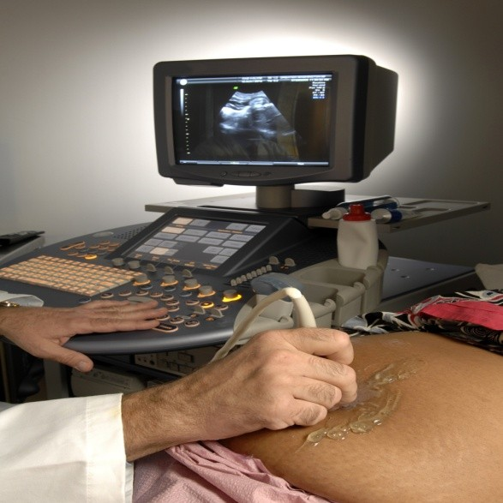
Prenatal Testing
  Alpha-fetoprotein Test (AFP)
    Alpha fetoprotein (AFP) is a protein normally produced by the liver and yolk sac of a developing baby during pregnancy in adults.
  Sonogram
    It is a picture taken of the baby during an ultrasound test.
Notes:
AFP levels decrease soon after birth. When the needle is inserted to draw blood, some people feel moderate pain, while others feel only a prick or stinging sensation. Afterward, there may be some throbbing. Your doctor may order this test to: Screen for problems in the baby during pregnancy Diagnose certain liver disorders Screen for and monitor some cancers During pregnancy, this AFP test can be done along with amniocentesis to help detect spinabifida or other birth defects in the developing baby. During pregnancy, abnormal levels of AFP (as part of a quadruple screen) may be due to genetic disorders, including Down syndrome. An ultrasound test provides a way to view the position and the development of the fetus. The test can also show if the mother is carrying multiple births. It can also reveal certain physical disabilities the baby might have. An ultrasound works by using a special device attached to a machine which bounces high-frequency sound waves of the mother’s internal structures. Parents often are able to keep the first “picture” sonogram of the baby.

Slide 9
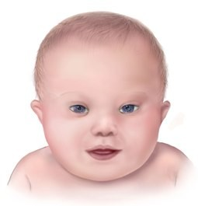
Physical Traits
  A flattened facial profile
  Eyes that slant upward
  A small mouth, making the tongue appear large
  Dental anomalies
  Small and arched palate
  Short nose
  Flat back of head
  Abnormal ears
Notes:
Discuss the physical features of a baby with Down syndrome.
Growth failure
Mental retardation
Many “loops” on finger tips
Palm crease
Special skin ridge patterns
Unilateral or bilaternal absence of one rib
Intestinal blockage
Umbilical hernia
Abnormal pelvis
Diminished muscle tone
Broad flat face
Slanting eyes
Epicanthic eyefold
Short and broad hands
Congenitial heart disease
Enlarged colon
Big toes widely spaced

Slide 10
Health Problems
  Congenital Heart defects
  Intestinal defects
  Vision problems
  Hearing loss
  Infections
  Thyroid problems
  Memory loss
Notes:
Some individuals with Down syndrome may have a number of these problems, while others may have none. The severity of these conditions varies greatly. The average life expectancy of individuals with Down syndrome is 55 years.

Slide 11

Age Matters
  The chance of having a child with Down syndrome increases with the mother’s age
Notes:
http://www.ndss.org/en/About-Down-Syndrome/Incidences-and-Maternal-Age/
Let’s look at the incidences and maternal age of the mother. What are the chances of having a Down syndrome baby at age 20? Age 35? Age 45? Why does the incidence rate increase as the mother gets older? Remember, this can also occur at an early age also. The National Down syndrome society helpline is 1.800.221.4602

Slide 12
References/Resources
  Websites:
    Facts about Down Syndrome
    Source: Kids Health Facts and information for parents about Down syndrome.
    http://kidshealth.org/parent/medical/genetic/down_syndrome.html
  Images:
    Microsoft Clip Art: Used with permission from Microsoft
    http://www.cdc.gov/ncbddd/birthdefects/DownSyndrome.html

