Slide 1
Eat Right, Exercise, and Stay Healthy!

Slide 3
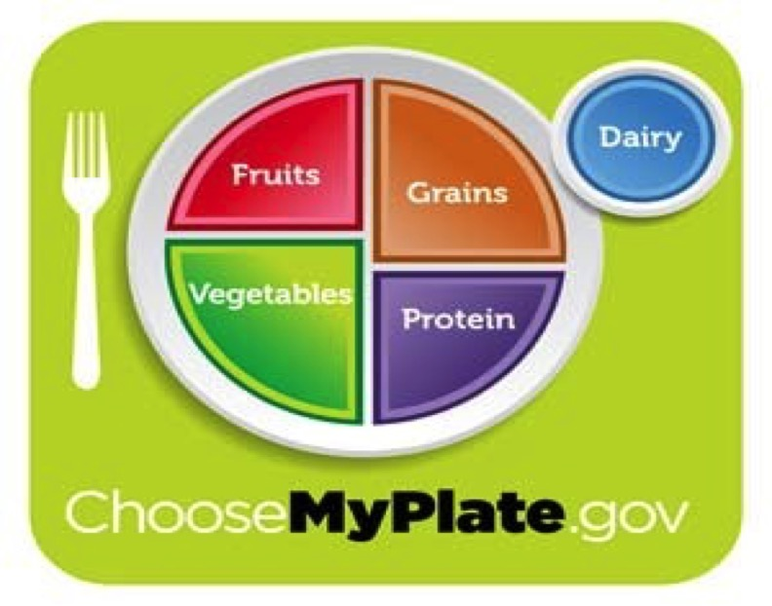
My Plate
Notes:
Name the five food groups: fruits, vegetables, grains, protein & dairy
www.choosemyplate.gov

Slide 4
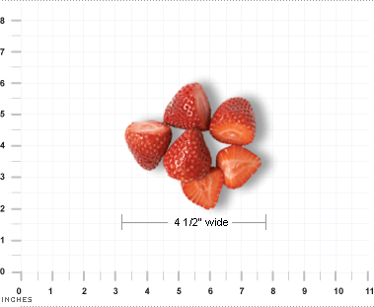

Fruits
  Fruits may be fresh, canned, frozen, or dried, and may be whole, cut-up, or pureed.
  1 cup of fruit or 100% fruit juice, or ½ cup of dried fruit
Notes:
Make half of your plate fruits and vegetables. Brainstorm types of fruits. Discuss nutritional value.

Slide 5
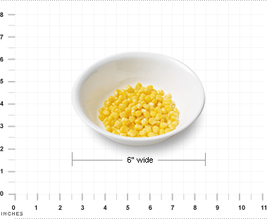

Vegetables
  Vegetables may be raw or cooked; fresh, frozen, canned, or dried/dehydrated; and may be whole, cut- up, or mashed.
  1 cup of raw or cooked vegetables or vegetable juice, or 2 cups of raw leafy greens
Notes:
Brainstorm types of vegetable prepared in their homes. Discuss nutritional value.

Slide 6
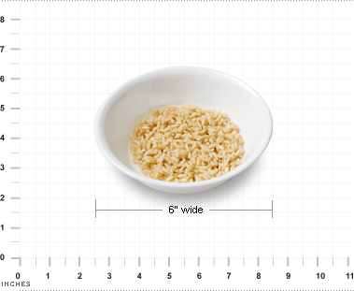
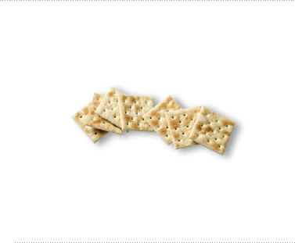
Grains
  Any food made from wheat, rice, oats, cornmeal, barley or another cereal grain is a grain product.
  Servings: 1 slice of bread, 1 cup of ready-to-eat cereal, or ½ cup of cooked rice, cooked pasta, or cooked cereal can be considered a serving.
Notes:
Define whole grain foods. Discuss types of grain products. Make sure at least half of the grains you consume daily are whole grain. Discuss nutritional value.

Slide 7
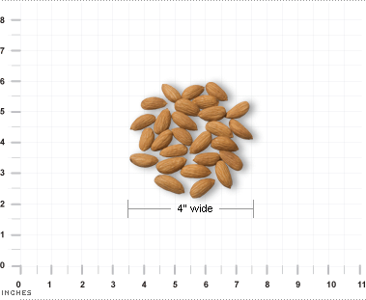

Protein
  All foods made from meat, poultry, seafood, beans and peas, eggs, processed soy products, nuts, and seeds.
  1 ounce of meat, poultry or fish, ¼ cup cooked beans, 1 egg, 1 tablespoon of peanut butter, or ½ ounce of nuts or seeds can be considered as 1 ounce equivalent.
Notes:
Most American get enough protein. Discuss the different types of protein. Discuss nutritional value.

Slide 8
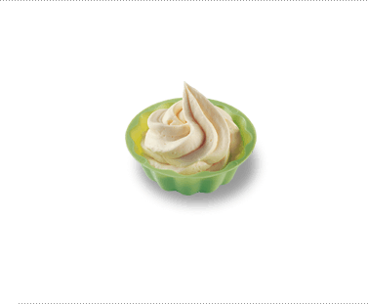
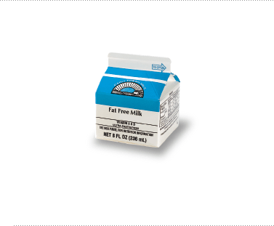
Dairy
  All fluid milk products and many foods made from milk are considered part of this food group.
  1 cup of milk or yogurt, 1 ½ ounces of natural cheese, or 2 ounces of processed cheese
Notes:
Brainstorm types of dairy products. Discuss nutritional value.

Slide 9
Eat Right, Exercise, and Stay Healthy!
Eating a variety of foods from My Plate and being physically active will help you maintain a healthy lifestyle!

Slide 10
References/Resources
  United States Department of Agriculture
    https://www.usda.gov/
    www.choosemyplate.gov

