Slide 1
Career Investigation
  Education and Training Career Cluster

Slide 3

Education and Training
Notes:
What careers fall into the Education and Training Career Pathway? Allow students to discuss the possibilities.

Slide 4

Quiz
  Is Education and Training the right career cluster for you? Take this quiz to find out. Answer “yes” or “no” to the following questions on the next few slides.
Notes:
Students may answer the questions on a scratch piece of paper for their own notes.

Slide 5

Quiz
  Do you enjoy school?

Slide 6

Quiz
  Do you have a favorite subject that you want to make a career?

Slide 7

Quiz
  Are you a good public speaker?

Slide 8

Quiz
  Do you like to help people with their problems?

Slide 9

Quiz
  Do you enjoy playing team sports?

Slide 10

Quiz
  Are you involved in school or community groups?

Slide 11

Quiz
  Are you good at interacting with young children, pre-teens or teenagers?

Slide 12

Quiz
  Are you optimistic, caring and confident?
Notes:
If you answered “yes” to five or more of the previous questions, Education and Training may be the right cluster for you.

Slide 13

Education and Training Career Pathways
  Administration and Administrative Support
  Professional Support Services
  Teaching and Training
Notes:
There are three pathways that fall under the Education and Training Career Cluster. The three pathways are Administration and Administrative Support, Professional Support Services and Teaching and Training.

Slide 14
A World of Possibilities
Education and Training Cluster
Teacher
Principal
Counseling
Librarian
Coaches
Fitness Instructors
Audio Visual and Multimedia Specialists
Notes:
There are several different careers within the Education and Training Cluster. Teaching is not the only career available in education, as some people may think. In fact, there are numerous jobs and careers related to teaching that help teachers do their job in the education field.
Ask the following: What are some other careers related to education that are not represented on the board? How do all of the careers fit together so that the education world works together cohesively?

Slide 15

Administration
  Master’s degree
  1 to 5 years work experience
  Average salary $86,970
  Job growth
    10 % (about average)
Notes:
A principal’s position requires a minimum of a master’s degree. According to the Bureau of Labor Statistics, the average salary in 2010 for principals was $86,970. The BLS said in 2010 there was an increase by 10 % in administrative careers.
Information from: http://www.bls.gov/ooh/management/elementary-middle-and-high-school-principals.htm

Slide 16

Administrative Support
  High school diploma or equivalent
  On the job training
  Average salary $34,660
  Job growth
    12 % (about average)
Notes:
Administrative staff require only a high school diploma and on the job training. The average salary for administrative staff, according to the BLS was $34,660 in 2010 and the job outlook was 12%.
Information from: http://www.bls.gov/ooh/office-and-administrative-support/secretaries-and-administrative-assistants.htm

Slide 17

Professional Support Services
  High school diploma or equivalent
  On the job training
  Average salary $23,220
  Job outlook
    15% (average growth)
Notes:
Support staff members usually have a high school diploma or equivalent. According to the Bureau of Labor Statistics, the average salary in 2010 for teacher assistants was $23,220. The BLS said in 2010 there were a 15% growth each year for teacher assistants.
Information from: http://www.bls.gov/ooh/education-training-and-library/teacher-assistants.htm

Slide 18

Teaching and Training
  College degree
    Bachelor’s degree minimum
  Additional certifications
  Average salary $51,380
  Job outlook
    17% (about average)
Notes:
The education and training necessary for careers within the education and training cluster vary greatly on the specific job tasks. For example, a teacher would require a minimum of a bachelor’s degree. Teachers may also require additional certifications such as a Gifted and Talented certification to work with GT students. According to the Bureau of Labor Statistics, the average salary in 2010 for teachers was $51,380. The BLS said in 2010 there was a 17% increase in the need for new teachers.
Information is from: http://www.bls.gov/ooh/Education-Training-and-Library/Kindergarten-and-elementary-school-teachers.htm

Slide 19

Careers in Education
  Department of Defense overseas school teacher
  Fitness trainer
  Instructional media designer
  Outdoor education instructor
  School psychologist
Notes:
Careers in education and training go far beyond the four walls of a classroom. Check out these five careers in education that prove teaching exists beyond the classroom:
Department of Defense Overseas School Teacher
Move to a foreign country and teach at a school for the military’s children
Fitness Trainer
Educate individuals how to become or maintain a healthy lifestyle
Instructional Media Designer
Create instructional resources for schools and teachers
Outdoor Education Instructor
Teach skills such as white-water canoeing, rock climbing and wilderness first-aid
School Psychologist
Work with students on a one-on-one basis to provide them with the help and support they need emotionally to focus on school work

Slide 20

Top Careers in Education
  Law Teacher, Postsecondary
Notes:
Law educators are expected to see a 35 percent increase in job openings from 2008 – 2018. Each year Texas is expected to see an average of 5,870 job openings for law teachers with a salary posting of $103,700. Interested individuals must seek a degree in law for this position.

Slide 21

Top Careers in Education
  Library Science Teacher, Postsecondary
Notes:
Librarians are expected to see a 35 percent increase in job openings from 2008 – 2018. Each year Texas is expected to see an average of 5,870 job openings with a salary posting of $59,446. Interested individuals must seek a master’s degree.

Slide 22

Top Careers in Education
  Special Education Teacher, Pre-K through Elementary
Notes:
Special education teachers in pre-k through elementary are expected to see a 50 percent increase in job openings from 2008 – 2018. Each year Texas is expected to see an average of 990 job openings with an average salary of $45,900. Interested individuals must seek a bachelor’s degree for this position.

Slide 23

Top Careers in Education
  Career and Technical Education Teacher, Secondary
Notes:
Career and Technology educators are expected to see a 30 percent increase in job openings from 2008 – 2018. Each year Texas is expected to see an average of 1,040 job openings with an average salary of $52,800. Interested individuals must seek a master’s degree.

Slide 24

An Introduction to Teacher Development
Notes:
An Introduction to Teacher Development
New models for preparing educators in training focus on practical tips and feedback.
http://youtu.be/wDdC8_e3Aog

Slide 25
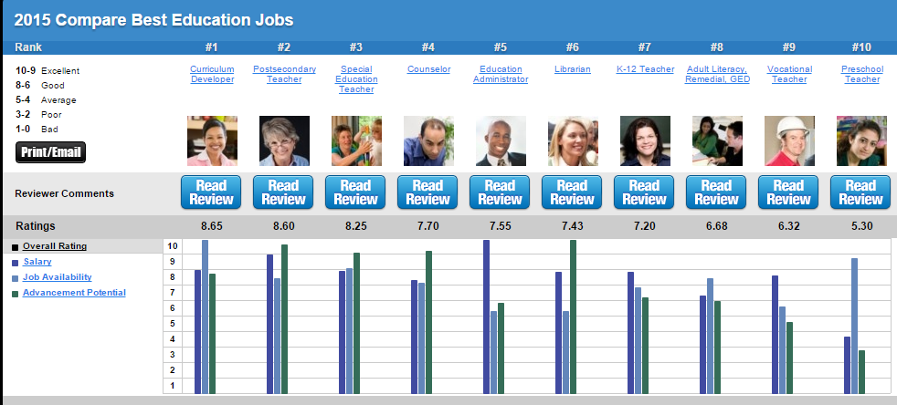
2015 Compare Best Education Jobs
Notes:
Teacher note: Click on picture and discuss overall rating, salary, job availability and advancement potential of each job listed. Allow time for questions and discussion.
Top Ten Reviews
2015 Compare Best Education Jobs
http://education-careers-review.toptenreviews.com/

Slide 26

Education Careers: What to Look For
  Advancement potential
  Basic skills required
  Educational requirements
  Informational criteria
  Interactions with others
  Job availability
  Physical/emotional requirements
  Salary
  Schedules available
Notes:
Before deciding on a career in education, research the follow areas as they pertain to education careers:
Advancement potential
Basic skills required
Educational requirements
Informational criteria
Interactions with others
Job availability
Physical/emotional requirements
Salary
Schedules available

Slide 27

Benefits of Education Careers
  High demand
    High needs areas: Math, science and special education
  Job security
    30 percent increase in positions from 2002 – 2012
  Room for advancement
Notes:
Source: Blanche Desjean-Perrotta, associate dean for teacher education in the College of Education and Human Development at the University of Texas at San Antonio.
The education field is one of the few career fields that will always have a high demand for individuals, thus creating job security for those within the field of education. The world will continue to need educators to teach the leaders of tomorrow. According to Blanche Desjean-Perrotta, associate dean for teacher education in the College of Education and Human Development at the University of Texas at San Antonio, education related careers are the second fastest growing job category in Texas.
The demand for new teacher positions is quickly growing as the population in Texas increases. Also contributing to the high demand for new teachers, is an increased teacher retirement rate.
Graduating students who are certified in a high-needs area, such as math, science or special education, will be able to find a large pool of vacancies throughout the state. Each year the Texas Education Agency (TEA) evaluates the need for each teacher position and determines whether it qualifies as a high needs area. This list is posted each year on the TEA’s website.
Education careers are not bound to the classroom walls – instead, there is plenty of room and opportunities for career advancement.

Slide 28
Review
  Compare and contrast the three pathways that are included in the Education and Training Career Cluster.
  What potential careers are included the Education and Training Career Pathway?
  Based on what you know about careers in education, explain the benefits of an education career.
  Pertaining to a career as an administrator, what questions would you ask in an interview with a principal?
  Identify five careers in education and training which go far beyond the four walls of a classroom.

Slide 29
References and Resources
  Images:
    Photos obtained through a license with Shutterstock.com™.
  Textbooks:
    Diaz, C., Pelletier, C. & Provenzo, Jr., E. (2006). Touch the future: teaching! Boston, MA: Pearson Education, Inc.
    Kauchak, D. & Eggen, P. (2014). Introduction to teaching: becoming a professional. (Fifth ed.). Saddle River, NJ: Pearson Education, Inc.
    Morrison, G. (2012). Early childhood education today. (Twelfth ed.). Upper Saddle River, NJ: Pearson Education, Inc.
  Websites:
    Texas CTE Resource Center
      College and Career Planning Guide for Students
      https://www.txcte.org/
    Bureau of Labor Statistics
      Data tools for Education and Training.
      http://www.bls.gov/home.htm

Slide 30
References and Resources
  Websites:
    National Center for O*NET Development
      O*NET OnLine resources.
      http://www.onetonline.org/help/online/
    Top Ten Reviews
      2015 Compare Best Education Jobs
      http://education-careers-review.toptenreviews.com/
  YouTube™:
    An Introduction to Teacher Development
      New models for preparing educators in training focus on practical tips and feedback.
      http://youtu.be/wDdC8_e3Aog

