Slide 1
Emergency Procedures at the Workplace
Practicum in Human Services

Slide 3
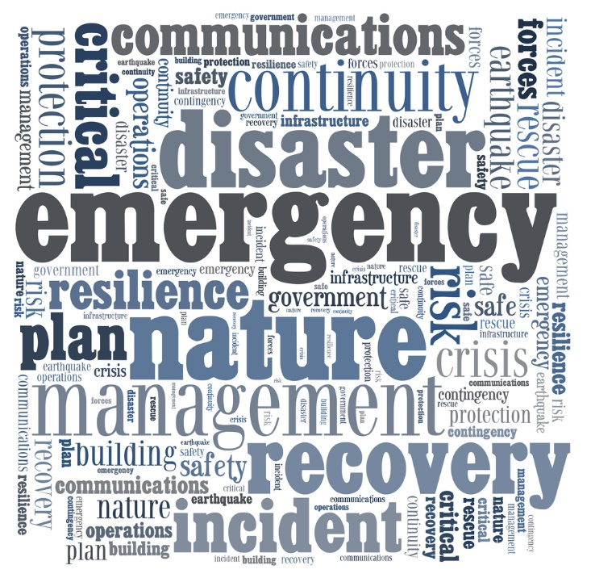
What constitutes an emergency or disaster?
Notes:
What constitutes an emergency or disaster at the workplace? A workplace emergency or disaster is an unforeseen situation that threatens your employees, customers, or the public; disrupts or shuts down your operations; or causes physical or environmental damage. Emergencies may be natural or man-made and may include the following:
Chemical emergency
Civil disturbances
Earthquake
Fire
Flood
Hurricane
Medical emergency
Power outage
Terrorism
Thunderstorm
Tornado
Tsunami
Volcano eruptions
Wildfire
Winter storm
Workplace violence resulting in bodily harm and trauma
Teacher note: You may opt to assign each student one word on the slide. Ask the students how their word relates to handling an emergency or disaster at the workplace.

Slide 4
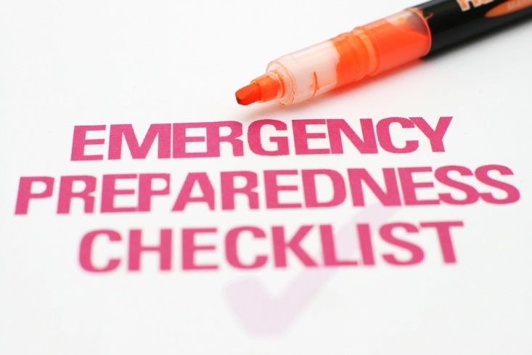
Why is it important to invest time in preparedness program?
Notes:
It is important to invest in a preparedness program. The following are good reasons:
Up to 40% of businesses affected by a natural or human-caused disaster never reopen. (Source: Insurance Information Institute)
Customers expect delivery of products or services on time. If there is a significant delay, customers may go to a competitor.
Larger businesses are asking their suppliers about preparedness. They want to be sure that their supply chain is not interrupted. Failure to implement a preparedness program risks losing business to competitors who can demonstrate they have a plan.
Insurance is only a partial solution. It does not cover all losses and it will not replace customers.
Many disasters — natural or human-caused — may overwhelm the resources of even the largest public agencies. Or they may not be able to reach every facility in time.
News travels fast and perceptions often differ from reality. Businesses need to reach out to customers and other stakeholders quickly.
According to Staples’ Business Safety Survey: Natural Disasters Top Concern, states that nearly (62 percent) of businesses said they have not reassessed their emergency safety plans.

Slide 5

Program Management
Typical goals of the preparedness program include:
Protect the safety of employees, visitors, contractors and others at risk from hazards at the facility. Plan for persons with disabilities and functional needs.
Maintain customer service by minimizing interruptions or disruptions of business operations
Protect facilities, physical assets and electronic information
Prevent environmental contamination
Notes:
The best way is to prepare to respond to an emergency before it happens. A preparedness policy that is consistent with the mission and vision of the business should be written and disseminated by management. The policy should define roles and responsibilities. It should authorize selected employees to develop the program and keep it current. The policy should also define the goals and objectives of the program. Typical goals of the preparedness program include:
Protect the safety of employees, visitors, contractors and others at risk from hazards at the facility. Plan for persons with disabilities and functional needs.
Maintain customer service by minimizing interruptions or disruptions of business operations
Protect facilities, physical assets and electronic information
Prevent environmental contamination

Slide 6

Preparedness Planning for Business
The five steps in developing a preparedness program are:
Program management
Planning
Implementation
Testing and exercises
Program improvement
Notes:
According to www.ready.gov, businesses can do much to prepare for the impact of the many hazards they face in today’s world including natural hazards like floods, hurricanes, tornadoes, earthquakes and widespread serious illness such as the H1N1 flu virus pandemic. Human-caused hazards include accidents, acts of violence by people and acts of terrorism. Examples of technology-related hazards are the failure or malfunction of systems, equipment or software.

Slide 7

Planning
The planning process should take an “all hazards” approach.
Blackouts
Hazardous materials incidents
Household chemical emergencies
Nuclear power plants
(click on image)
Notes:
The planning process should take an “all hazards” approach. There are many different threats or hazards. The probability that a specific hazard will impact your business is hard to determine. That’s why it’s important to consider many different threats and hazards and the likelihood they will occur.
www.ready.gov
Technological & Accidental Hazards.
http://www.ready.gov/technological-accidental-hazards
Teacher note: You may opt to click on the four types of hazards and discuss each one in detail.

Slide 8

Implementation
Implementation of the preparedness program includes identifying and assessing resources, writing plans, developing a system to manage incidents and training employees so they can execute plans.
Notes:
Implementation of the preparedness program includes identifying and assessing resources, writing plans, developing a system to manage incidents and training employees so they can execute plans.
Resource Management: Resources needed for responding to emergencies, continuing business operations and communicating during and after an incident should be identified and assessed.
Emergency Response Plan: Plans to protect people, property and the environment should be developed. Plans should include evacuation, sheltering in place and lockdown as well as plans for other types of threats identified during the risk assessment.
Crisis Communications Plan: A plan should be established to communicate with employees, customers, the news media and stakeholders.
Business Continuity Plan: A business continuity plan that includes recovery strategies to overcome the disruption of business should be developed.
Information Technology Plan: A plan to recover computer hardware, connectivity and electronic data to support critical business processes should be developed.
Employee Assistance and Support: The business preparedness plan should encourage employees and their families to develop family preparedness plans. Plans should also be developed to support the needs of employees following an incident.
Incident Management: An incident management system is needed to define responsibilities and coordinate activities before, during and following an incident.
Training: Persons with a defined role in the preparedness program should be trained to do their assigned tasks. All employees should be trained so they can take appropriate protective actions during an emergency.

Slide 9
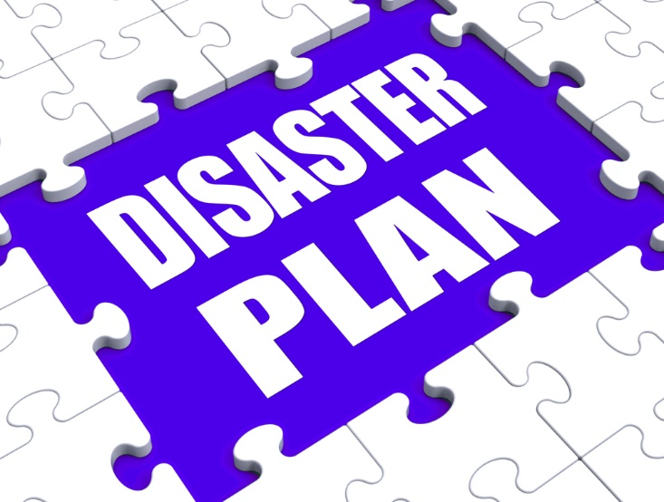
Testing and Exercises
Employers should conduct testing and exercises to evaluate the effectiveness of the preparedness program, make sure employees know what to do and find any missing parts.
Notes:
Employers should conduct testing and exercises to evaluate the effectiveness of the preparedness program, make sure employees know what to do and find any missing parts. There are many benefits to testing and exercises:
Train personnel; clarify roles and responsibilities
Reinforce knowledge of procedures, facilities, systems and equipment
Improve individual performance as well as organizational coordination and communications
Evaluate policies, plans, procedures and the knowledge and skills of team members
Reveal weaknesses and resource gaps
Comply with local laws, codes and regulations
Gain recognition for the emergency management and business continuity program

Slide 10

Program Improvement
There are opportunities for program improvement following an actual incident.
Notes:
There are opportunities for program improvement following an actual incident. A critique should be conducted to assess the response to the incident. Lessons learned from incidents that occur within the community, within the business’ industry or nationally can identify needs for preparedness program changes.

Slide 11
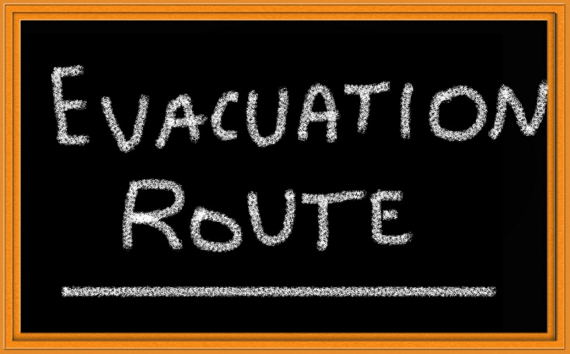
Emergency Guidelines
Be sure to locate:
Potential dangers
Emergency exits and routes
Hand washing stations
First aid kits
MSDS information
Notes:
Be aware of your surroundings and locate:
• any potential dangers
• where to exit in case of emergency
• the hand washing station
• first aid kits in case of a minor accident
• the materials safety data sheets (MSDS)

Slide 12

When Emergencies Arise
Emergencies happen all too often and early intervention can save a life.
CPR and first aid skills are important for everyone at the workplace to know.
(click on image)
Notes:
All individuals should have a basic understanding of first aid and cardiopulmonary resuscitation (CPR) skills. CPR is a technique involving heart and lungs that is used when breathing stops. Administering CPR can restore breathing and restart the heart if heart failure accompanies the loss of breathing. This valuable technique should be learned by all in case an emergency arises where professional help is not immediately available. Emergencies happen all too often, and early intervention can save a life.
Would you know what to do in an emergency?
Official 2012 Hands-Only CPR Instructional Video
Learn how to perform CPR in this 60-second video showing Hands-Only CPR in action
http://youtu.be/zSgmledxFe8

Slide 13

Handling Medical Emergencies
Employers and employees must be trained in first aid to handle medical emergencies such as:
Preventing severe blood loss
Helping an individual to maintain breathing
Diluting or removing poisons from an individual’s body
Preventing shock
Treating burns properly
Immobilizing head and back injuries
Notes:
Employers and employees must be trained in first aid to handle medical emergencies. First aid is used to save lives and prevent further injury. Examples of first aid procedures include the following:
Preventing severe blood loss
Helping an individual to maintain breathing
Diluting or removing poisons from an individual’s body
Preventing shock
Treating burns properly
Immobilizing head and back injuries

Slide 14
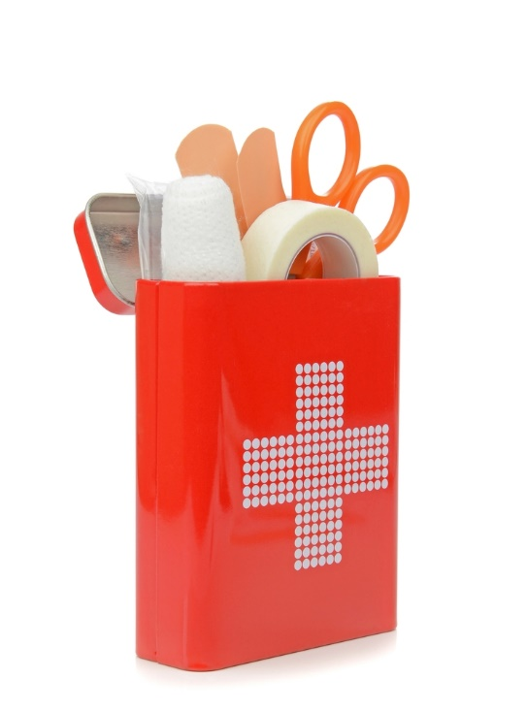
First Aid Kit
A good first aid kit should always be checked and periodically restocked
Notes:
A first aid kit is a collection of supplies and equipment for use in giving first aid and can be put together for the purpose by an individual or organization or purchased complete.
The American Red Cross recommends that a good first aid kit should be checked, restocked periodically and always contain the following items:
2 absorbent compress dressings (5 x 9 inches)
25 adhesive bandages (assorted sizes)
1 adhesive cloth tape (10 yards x 1 inch)
5 antibiotic ointment packets (approximately 1 gram)
5 antiseptic wipe packets
1 blanket (space blanket)
1 breathing barrier (with one-way valve)
First aid instruction booklet
2 hydrocortisone ointment packets (approximately 1 gram each)
1 instant cold compress
oral thermometer (non-mercury/non-glass)
2 packets of aspirin (81 mg each)
2 pair of non-latex gloves (size: large)
scissors
1 roller bandage (3 inches wide)
1 roller bandage (4 inches wide)
5 sterile gauze pads (3 x 3 inches)
5 sterile gauze pads (4 x 4 inches)
2 triangular bandages
tweezers
Do you have a first aid kit at your workplace? In your car?
American Red Cross
Anatomy of a First Aid Kit.
http://www.redcross.org/prepare/location/home-family/get-kit/anatomy

Slide 15
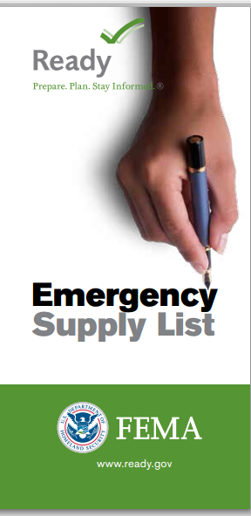
Emergency Supply List
Ready.gov asks individuals to do three key things:
get an emergency supply kit
make a family emergency plan
be informed about the different types of emergencies that could occur and their appropriate responses
(click on image)
Notes:
Teacher note: Click on image and review the items that need to be in an emergency supply kit.
Ready asks individuals to do three key things:
get an emergency supply kit
make a family emergency plan
be informed about the different types of emergencies that could occur and their appropriate responses
Individuals should also consider having at least two emergency supply kits, one full kit at home and smaller portable kits in their workplace, vehicle or other places they spend time.
Do you have an emergency supply kit at home? In your vehicle? At your workplace?
Federal Emergency Management Agency (FEMA)
All Americans should have some basic supplies on hand in order to survive for at least three days if an emergency occurs.
http://www.fema.gov/media-library-data/1390846764394-dc08e309debe561d866b05ac84daf1ee/checklist_2014.pdf

Slide 16
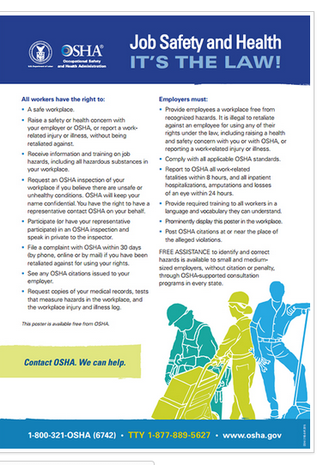
Occupational Safety and Health Act
Protects employee health and safety
Passed in 1970
Requires employers to make the workplace free of hazards
Notes:
This is one of the most important laws to protect employee health and safety. It requires employers to make the workplace free of hazards that might cause injury or death to employees.
The OSH Act also established the Occupational Safety and Health Administration (OSHA). It is the federal agency responsible for making sure that the laws of the OSH Act are followed. The OSHA Job Safety and Health: It's the Law poster, available for free from OSHA, informs workers of their rights under the Occupational Safety and Health Act. All covered employers are required to display the poster in their workplace. Employers do not need to replace previous versions of the poster. Employers must display the poster in a conspicuous place where workers can see it.
Occupational Health and Safety Administration With the Occupational Safety and Health Act of 1970, Congress created the Occupational Safety and Health Administration (OSHA) to assure safe and healthful working conditions for working men and women by setting and enforcing standards and by providing training, outreach, education and assistance.
http://www.osha.gov/index.html

Slide 17
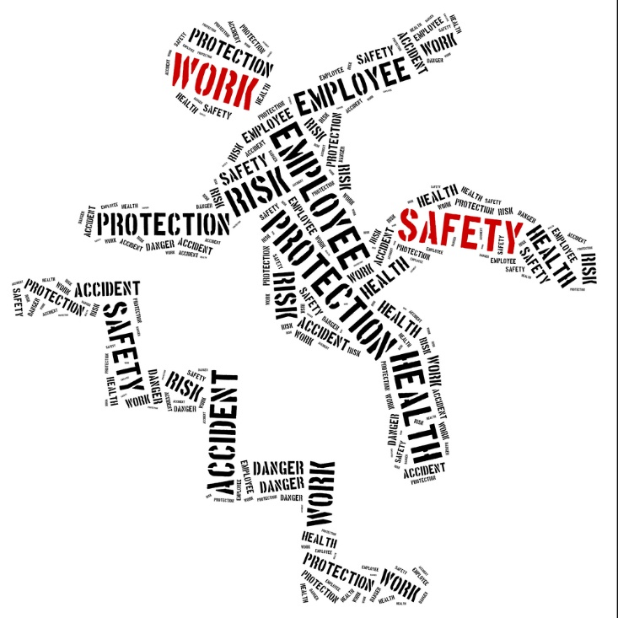
Exit Routes, Emergency Action Plans, Fire Prevention Plans and Fire Protection
(click on image)
Notes:
Exit Routes, Emergency Action Plans, Fire Prevention Plans and Fire Protection
Monthly Employee Training courtesy of Federal Safety Solutions, LLC
https://youtu.be/GYoUWKhKQdI

Slide 18
Review
What constitutes an emergency or disaster at the workplace?
Why is it important to invest time in a preparedness program?
Why is it important to seriously consider many different threats and hazards and the likelihood they will occur at the workplace?
Why is it important for employers to conduct testing and exercises to evaluate the effectiveness of the preparedness program?
Name seven items that need to be in an emergency supply kit.
Notes:
Have students answer independently in short paragraphs on paper or allow for classroom discussion.

Slide 19
References and Resources
Images:
All photos obtained through a license with Shutterstock.com™.
Websites:
American Red Cross
Is your business or organization prepared for emergency? If you’re like most of us, the answer is no, you’re not as prepared as you would like to be. It can be difficult to know where to begin – and where to go from there.
http://www.redcross.org/prepare/location/workplace
Federal Emergency Management Agency (FEMA)
FEMA’s mission is to support our citizens and first responders to ensure that as a nation we work together to build, sustain and improve our capability to prepare for, protect against, respond to, recover from and mitigate all hazards.
http://www.fema.gov
Occupational Health and Safety Administration With the Occupational Safety and Health Act of 1970, Congress created the Occupational Safety and Health Administration (OSHA) to assure safe and healthful working conditions for working men and women by setting and enforcing standards and by providing training, outreach, education and assistance.
http://www.osha.gov/index.html

Slide 20
References and Resources
Ready. Prepare. Plan. Be Informed
Like individuals and families, schools, daycare providers, workplaces, neighborhoods and apartment buildings should all have site-specific emergency plans.
http://www.ready.gov/workplace-plans
United States Department of Labor
How to Plan for Workplace Emergencies and Evacuations
https://www.osha.gov/Publications/osha3088.html
YouTube:
Exit Routes, Emergency Action Plans, Fire Prevention Plans and Fire Protection
Monthly Employee Training courtesy of Federal Safety Solutions, LLC
https://youtu.be/GYoUWKhKQdI
Official 2012 Hands-Only CPR Instructional Video
Learn how to perform CPR in this 60-second video showing Hands-Only CPR in action
http://youtu.be/zSgmledxFe8

